Slide 1

Developer Day 2019
Advanced Java

Slide 2





What on the back-end?
11

Slide 3
What to expect?
Modular with JPMS
Asynchronous programming with Future interface
Data driven strategy with ELK
Contract driven development with GraphQL
Support multiple APIs
Reduce boilerplate code
Notes:
Future vs CompletableFuture
Assynchronous progrogramming as a way to practice the reactive manifesto

Slide 4
(Reserved for each topic content)

Slide 5

Back-end business domain: library
http://85.214.44.228:8082/swagger-ui.html#/
Notes:
Add link to swagger

Slide 6
How to make V2?
Do not modify /master branch
Make a new branch(es) for your chosen exercise
How many exercises?
Apply JPMS
Analyze application behavior using ELK
Apply Future interface for calling external resources
Apply GraphQL
Support multiple API versions
Reducing boilerplate code
…
How many exercises have to be finished?
Your team decision
Notes:
How & who will check your exercise: your supporters

Slide 7
Checklist for V2(s)(TBD)

Slide 8
Some other Hypes
Open JDK
Jakarta EE
Microprofile
Notes:
Just for back-up for audience satisfaction
JPMS & microprofile

Slide 9

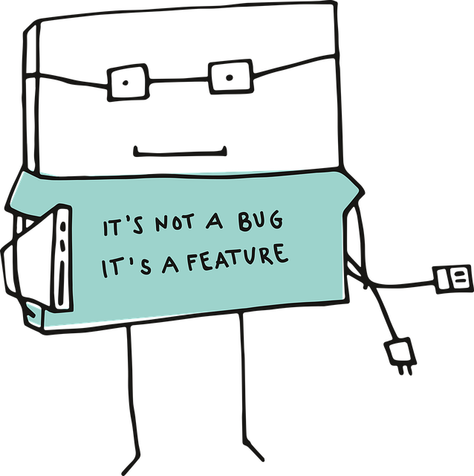
THANK YOU!

