Slide 1

JAVA PLATFORM MODULE SYSTEM (JPMS)

Slide 2
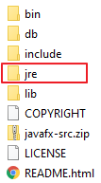
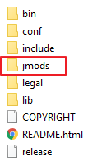
JPMS: Overview
JDK1 - JDK8
Programs are packages
Accessibility
JDK as a whole
>= JDK 9
Programs are modules
More accessibility: module-scope
Modular JDK

Slide 3
JPMS: Benefit
Reliable configuration
Strong Encapsulation
Maintainability & reusability
Scalability & performance
Module path vs classpath
Less coupling
Small runtime image
Classpath Hell
NoClassDefFoundError
Version conflict
Shadowing

Slide 4



JPMS: Current state
Tool support
Maven
Gradle
Eclipse
IntelliJ
What's holding us back?
Framework & library adoption
Multi Java Version
Spring, ...
Developer adoption

Slide 5
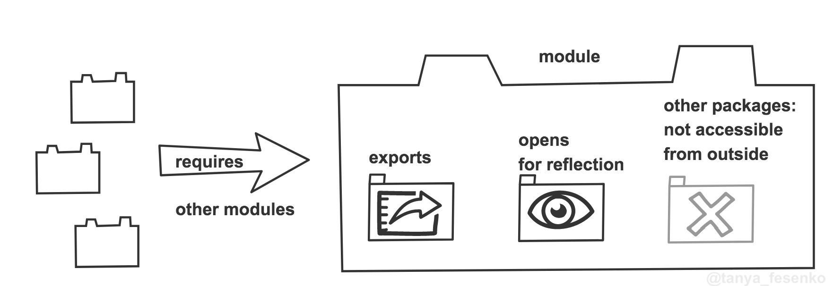
JPMS: Module overview

Slide 6
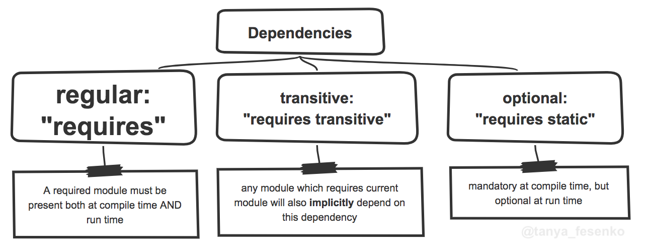
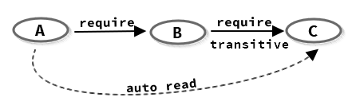
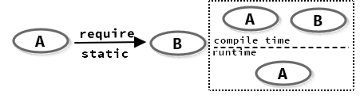
JPMS: Declaration

Slide 7
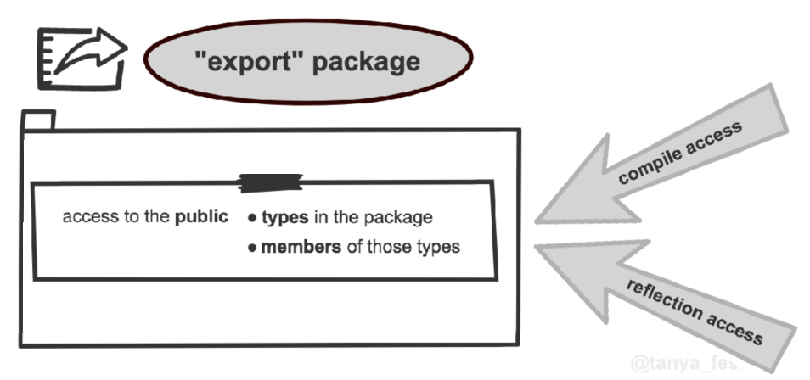
JPMS: Declaration

Slide 8
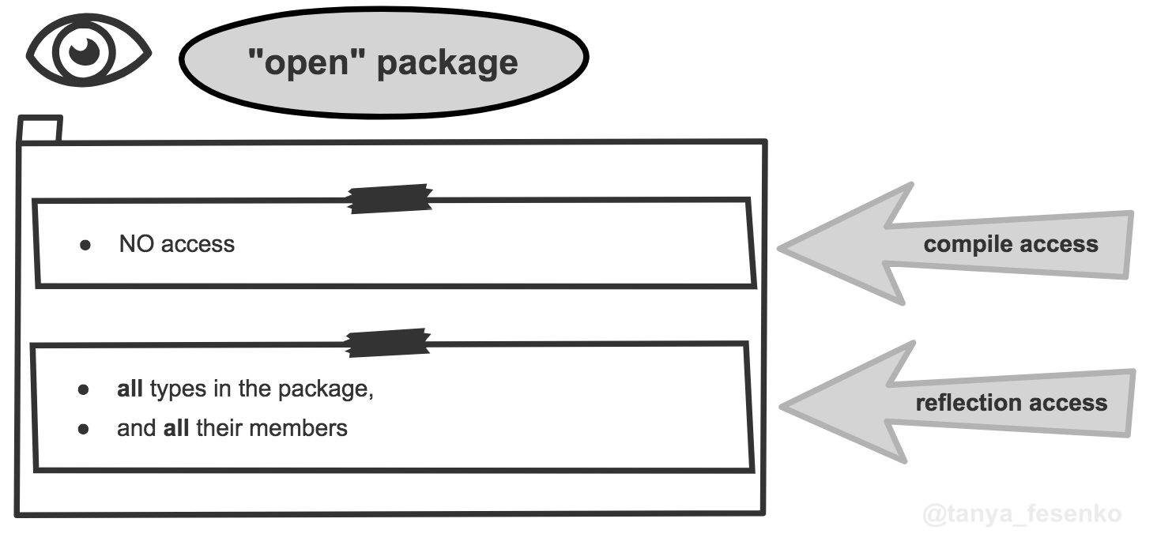
JPMS: Declaration

Slide 9
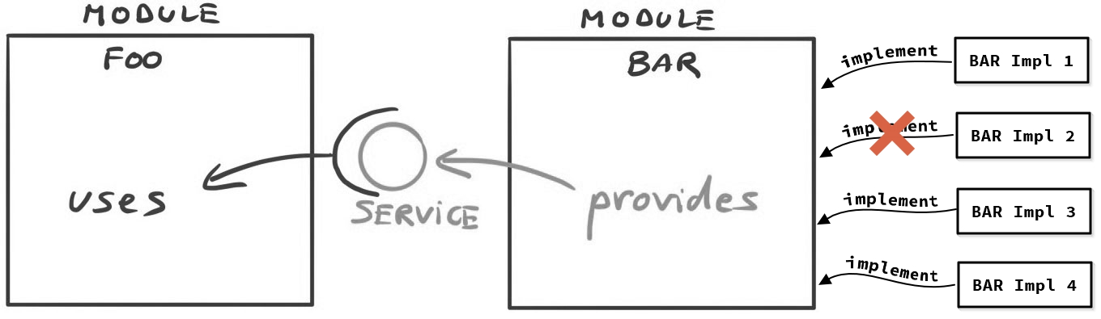
JPMS: Declaration

Slide 10
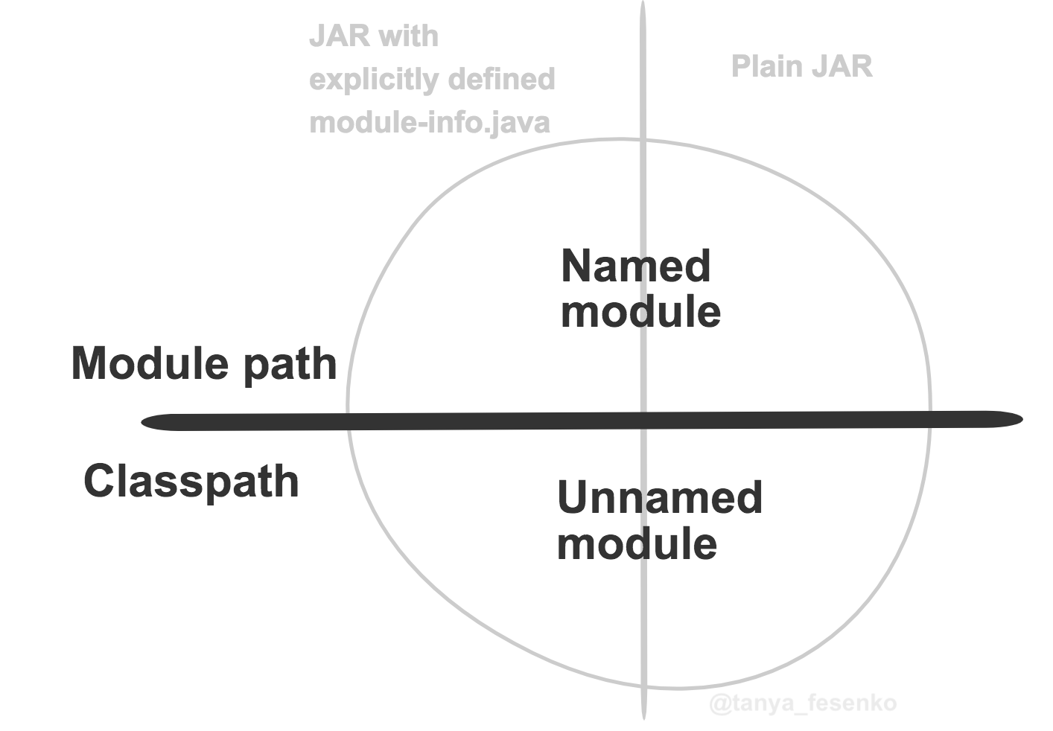
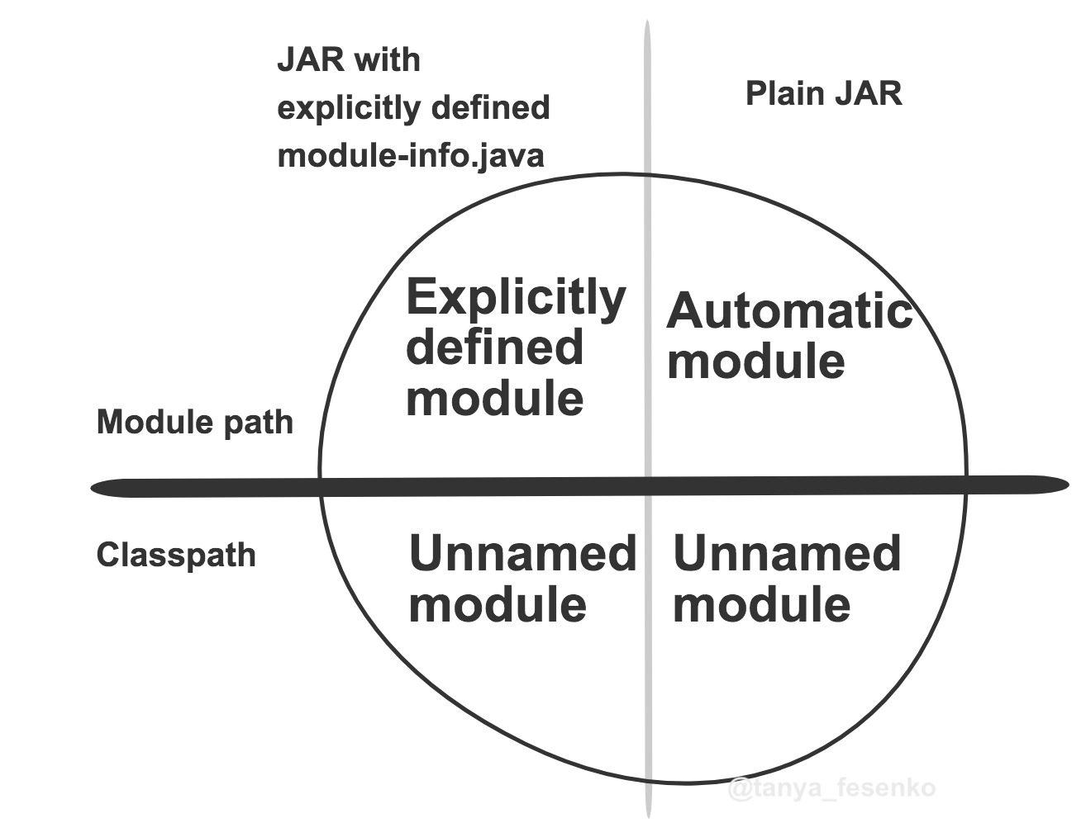
JPMS: Module Path

Slide 11
JPMS: Migration challenges
Encapsulated JDK internal APIs
Cyclic dependencies
Split package
Deprecated java.ee, removed methods & libraries
Limited support of jlink & build plugin to build runtime image

Slide 12
JPMS: Get started
Step 1: Upgrade your dependencies
Step 2: Determine module's boundary
Step 3: Prepare module structure & refactor code
Step 4: Add module descriptors bottom-up
Step 5: Resolve issues at boot time
Step 6: Test all paths to make sure the aplication work

