Slide 1

JAVA PLATFORM MODULE SYSTEM (JPMS)
Notes:
co-exist
Class path: where the jar files or .class files were located to be used by the runtime.
Module path: sequence of modules

Slide 2
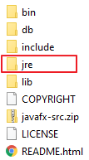
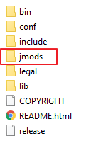
JPMS: Overview
JDK1 - JDK8
Programs are packages
Accessibility
JDK as a whole
>= JDK 9
Programs are modules
More accessibility: module-scope
Modular JDK
Notes:
A module is a new way of grouping code, data and some resources, adding a higher level of aggregation above packages. Every module describes which packages are exposed and which packages of other modules your application depends on. In modules, only explicitly exported public classes can be used from other modules.

Slide 3
JPMS: Benefit
Reliable configuration
Strong Encapsulation
Maintainability & reusability
Scalability & performance
Module path vs classpath
Less coupling
Small runtime image
Classpath Hell
NoClassDefFoundError
Version conflict
Shadowing
Notes:
- Reliable configuration—Modularity provides mechanisms for explicitly declaring dependencies between modules in a manner that’s recognized both at compile time and execution time. The system can walk through these dependencies to determine the subset of all modules required to support your app.
- Strong encapsulation—The packages in a module are accessible to other modules only if the module explicitly exports them. Even then, another module cannot use those packages unless it explicitly states that it requires the other module’s capabilities. This improves platform security because fewer classes are accessible to potential attackers. You may find that considering modularity helps you come up with cleaner, more logical designs.
- Scalable—Previously, the Java platform was a monolith consisting of a massive number of packages, making it challenging to develop, maintain and evolve. It couldn't be easily subsetted. The platform is now modularized into 95 modules (this number might change as Java evolves). You can create custom runtimes consisting of only modules you need for your apps or the devices you’re targeting. For example, if a device does not support GUIs, you could create a runtime that does not include the GUI modules, significantly reducing the runtime's size.
Improved performance—The JVM uses various optimization techniques to improve application performance. These techniques are more effective when it’s known in advance that required types are located only in specific modules.
- SRI: JDK is too big to scale down to small devices. JAR files, like rt.jar, are too big to be used on small devices and applications

Slide 4



JPMS: Current state
Tool support
Maven
Gradle
Eclipse
IntelliJ
What's holding us back?
Framework & library adoption
Multi Java Version
Spring, ...
Developer adoption

Slide 5
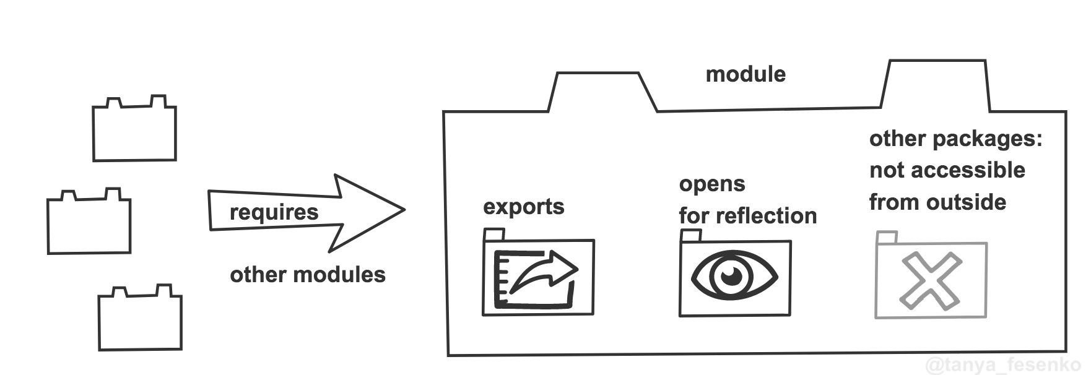
JPMS: Module overview
module-info.java

Slide 6
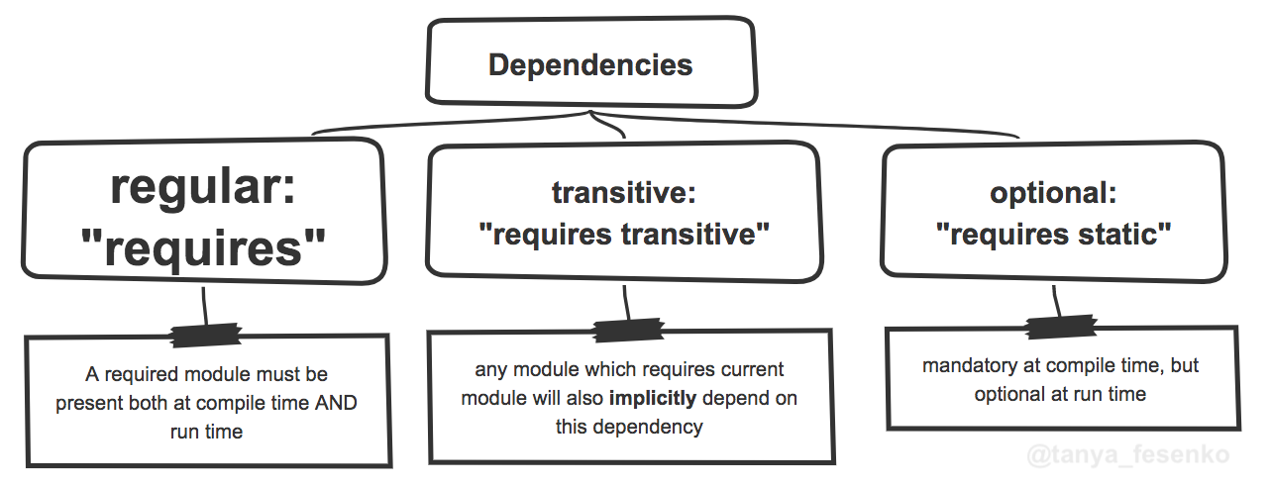
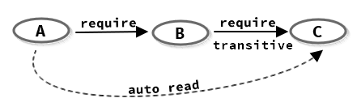
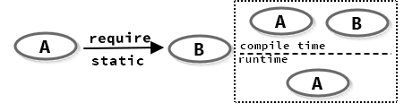
JPMS: Declaration

Slide 7
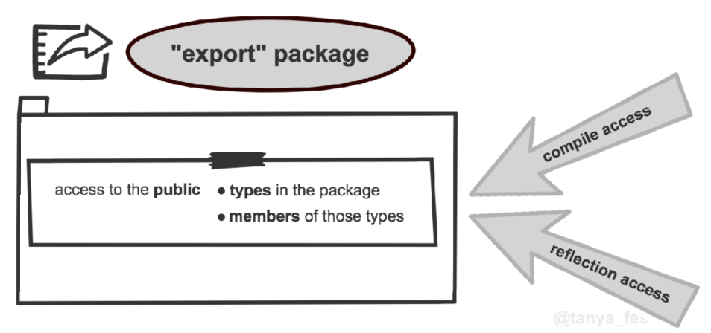
JPMS: Declaration

Slide 8
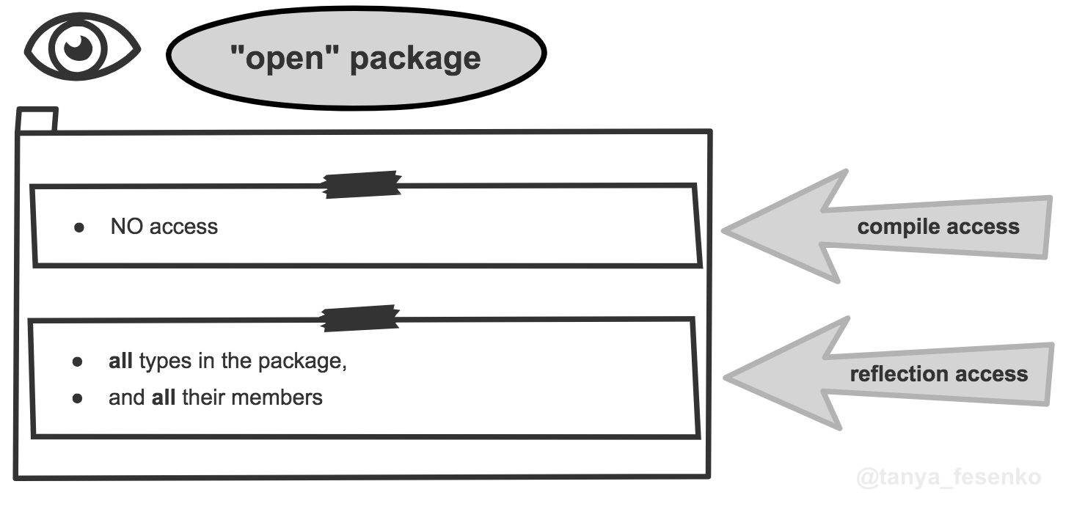
JPMS: Declaration

Slide 9
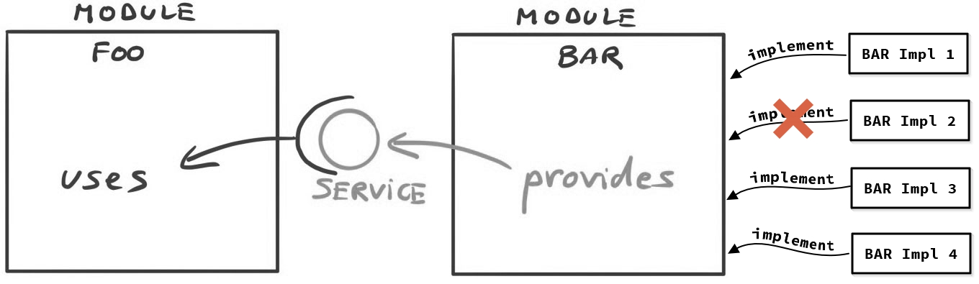
JPMS: Declaration

Slide 10
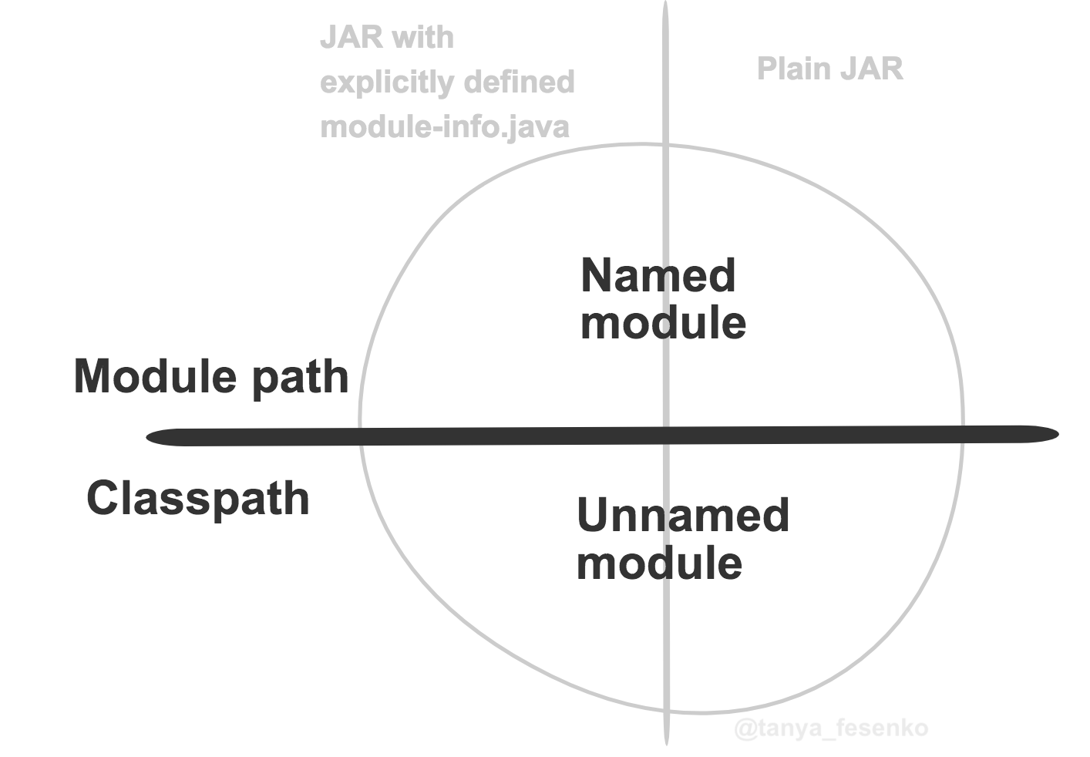
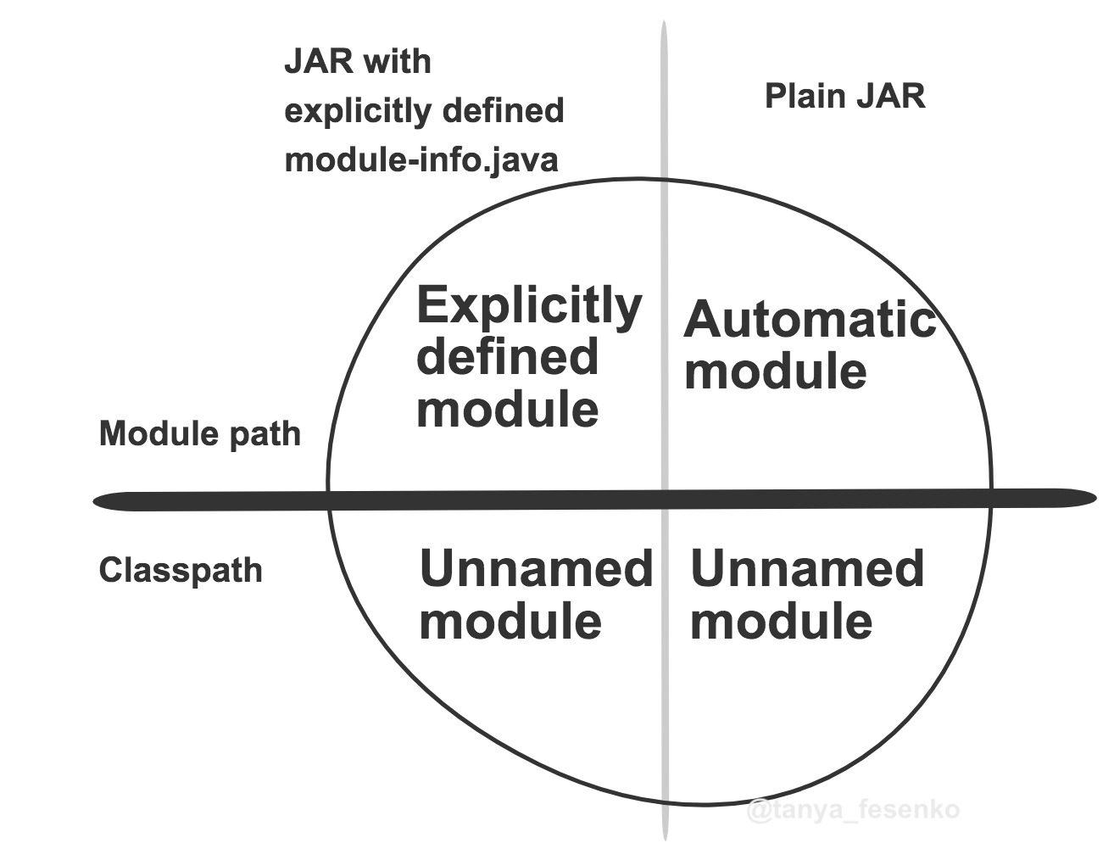
JPMS: Module Path
Notes:
- Named module: a module created with a module declaration file module-info.java in its folder.
- Unnamed module: a jar built without module-info.java declaration
Named modules does not allowed to read unnamed modules
- Automated modules: Module name derived from its jar name, or if it has a Manifest entry Automatic-Module-Name, the module name will be its value.
You are working on a Java module application, but one of your dependencies is not a module, and you don't have access to that code to convert it into an application module. A normal jar can be converted into a module by putting this library in the module-path instead of the classpath -> it immediately becomes an “automatic module.

Slide 11
JPMS: Migration challenges
Encapsulated JDK internal APIs
Cyclic dependencies
Split package
Limited support of jlink^{(*)} & build plugin to build runtime image
(*) jlink: jdk tool to generate runtime image

Slide 12
JPMS: Get started
Step 1: Upgrade your dependencies
Step 2: Determine module's boundary
Step 3: Prepare module structure & refactor code
Step 4: Add module descriptors bottom-up
Step 5: Resolve issues at boot time
Step 6: Test all paths to make sure the aplication work

