Slide 2
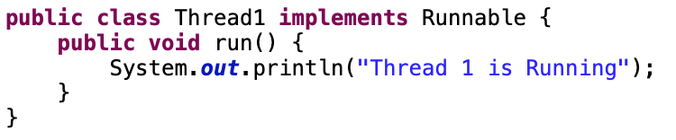
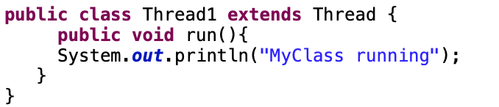
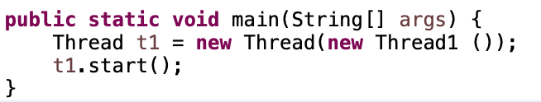
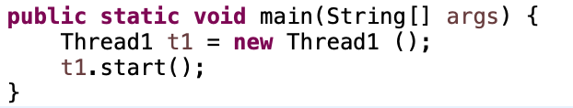
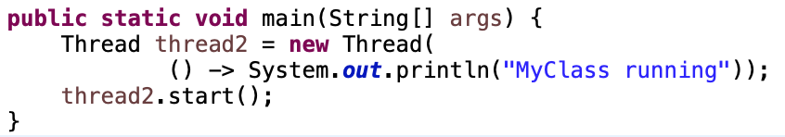
TRADITIONAL ASYNCHRONOUS BEST PRACTICE
Implement Runnable
Extend Thread
Java 8 with
Lambda Expression

Slide 3

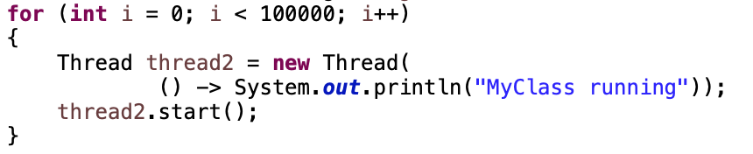
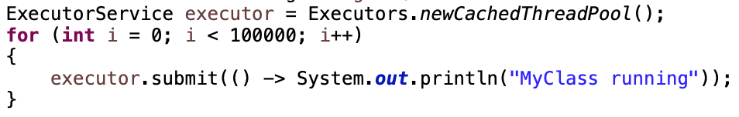
TRADITIONAL ASYNCHRONOUS BEST PRACTICE
EXECUTOR SERVICE
Thread Pool
Submit Tasks
ThreadPool 1
Task
1
Task
2
Task
3
…
Task 10000
ThreadPool 2
Java Executor Service
…
ThreadPool 10
Notes:
Advantage;
Thread Creation, Thread Management, Task submission and execution
shutdown()
shutdownNow()

Slide 4
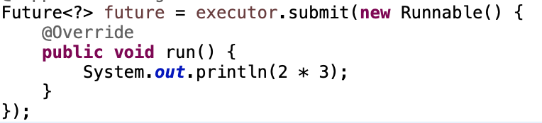
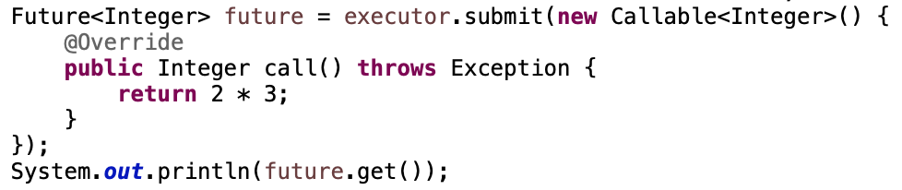
WHAT IS FUTURE INTERFACE?
MainThread
Separate Thread
MainThread
Separate Thread
Task
Task
Callable
Runnable
Return Value with get()

Slide 5
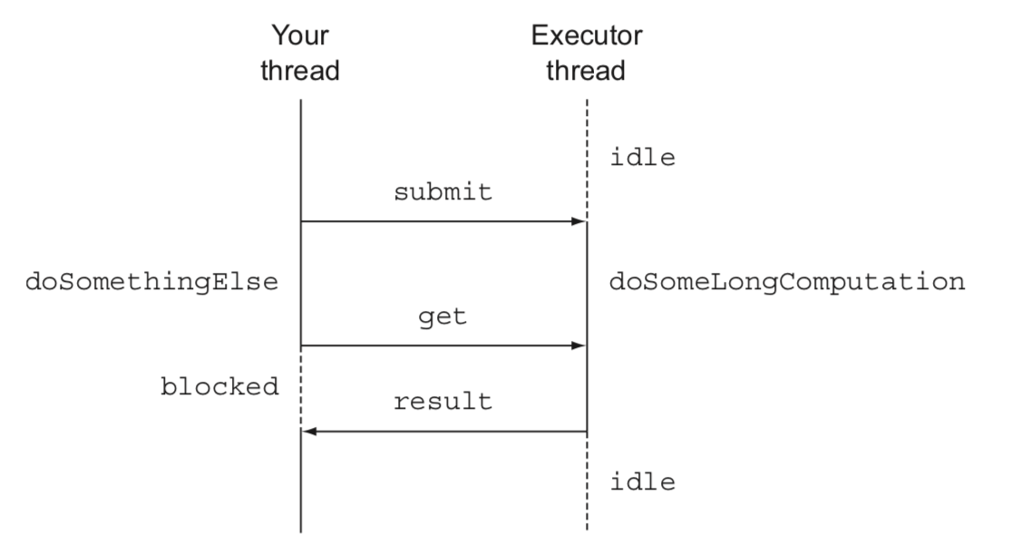
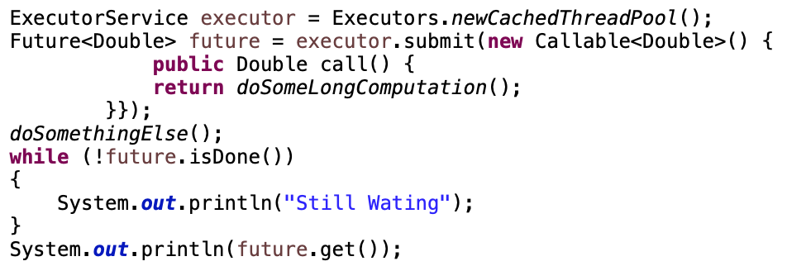
WHAT IS FUTURE INTERFACE?

Slide 6
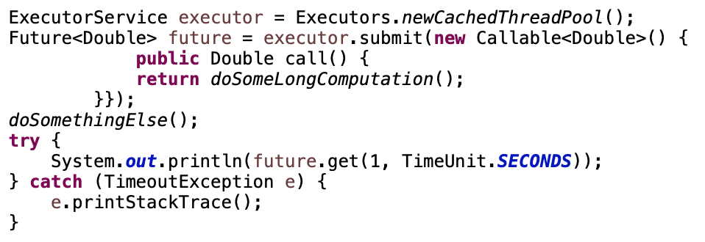
WHAT IS FUTURE INTERFACE?
isDone():
Check a task is finished
get(timeout, unit ) :
Get return value in limit of time
isTerminal
cancel()
isCancel()
invokeAll():
Start all tasks same time

Slide 7
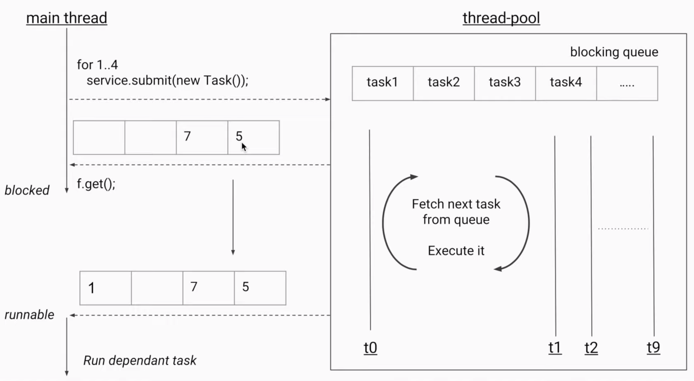
WHY DEVELOPER IGNORES FUTURE?
1. Blocking

Slide 8
WHY DEVELOPER IGNORES FUTURE?
1. Blocking
2. Manually completed -> Cannot
3. Multiple Futures chain -> Cannot
4. Multiple Futures combine -> Cannot
5. No Exception Handling -> Cannot

Slide 9
COMPLETABLE FUTURE

Slide 10
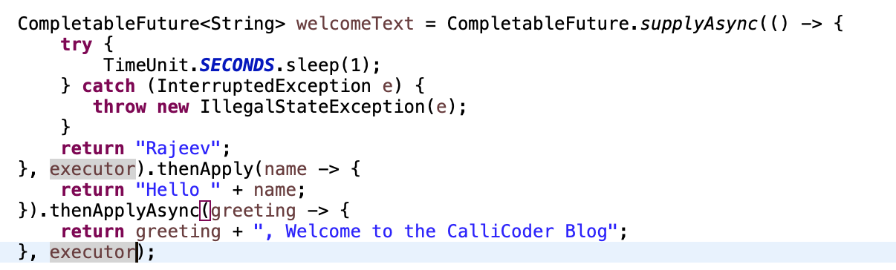
SUPPLYASYNC, THENAPPLY, THENAPPLYASYNC

Slide 11
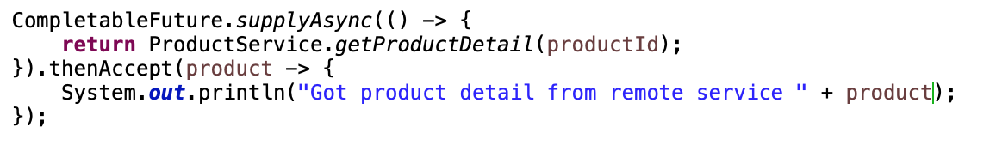
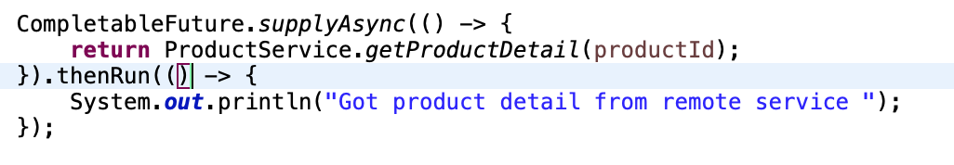
THENACCEPT vs THENRUN

Slide 12
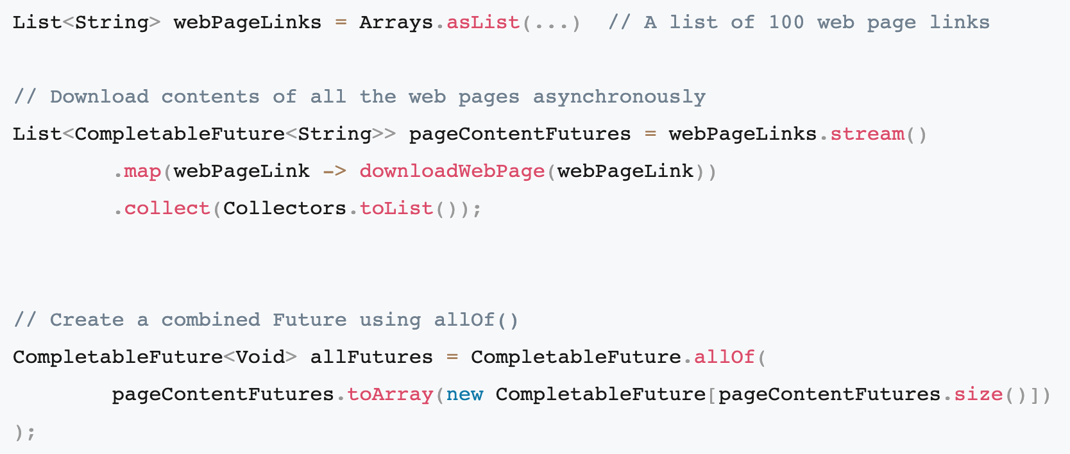
ALLOF/ANYOF

Slide 13
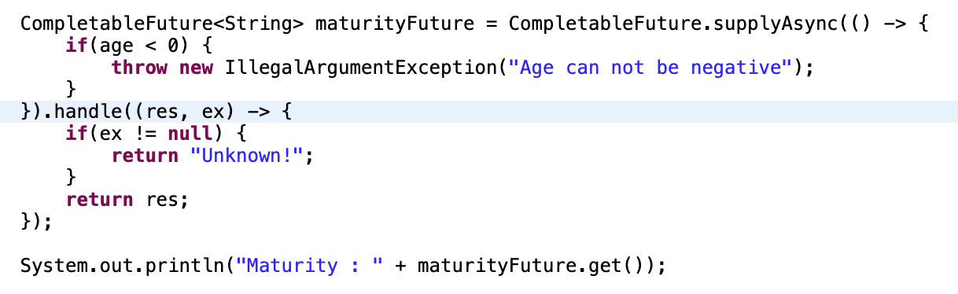
HANDLE EXCEPTION

Slide 14
THINGS TO DO
Edit the source code in DefaultSearchingService.java
Execute generate URL parallel and use the Executor
Execute API call in the same thread of each URL generated thread
Process convert to BookDTO when any response’s done
Use timeout with 10 seconds if request is pending but do not stop other thread

