Slide 2
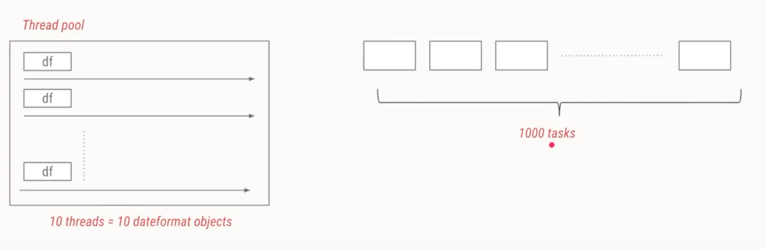
JAVA FUTURE
WHAT IS JAVA EXECUTOR?

Slide 3
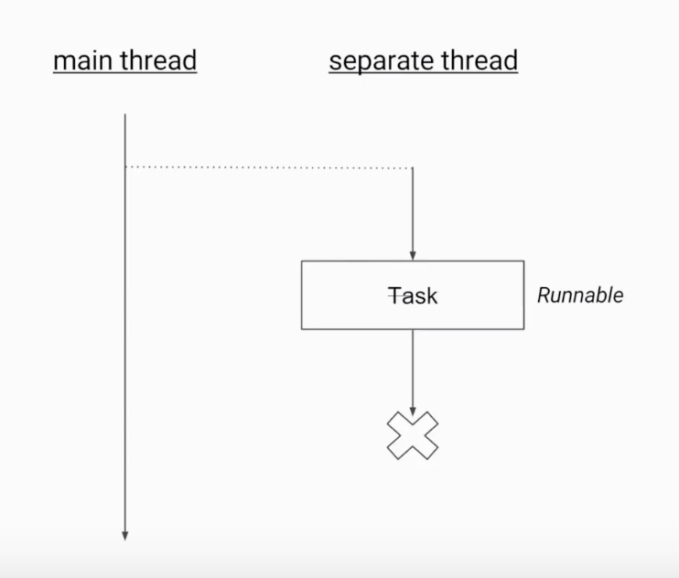
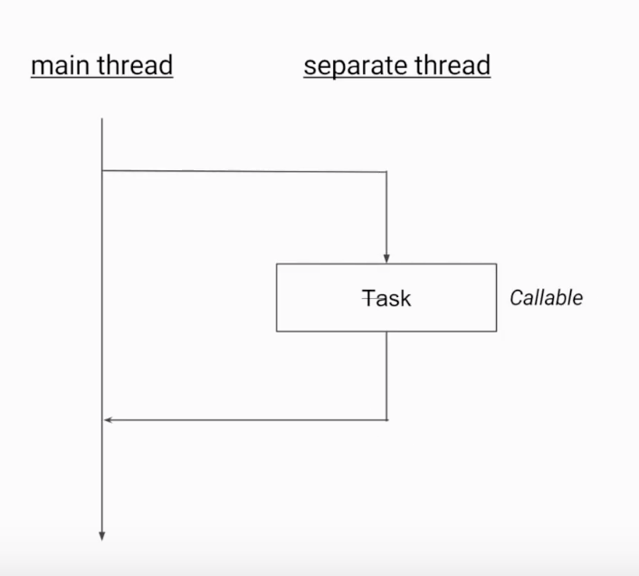
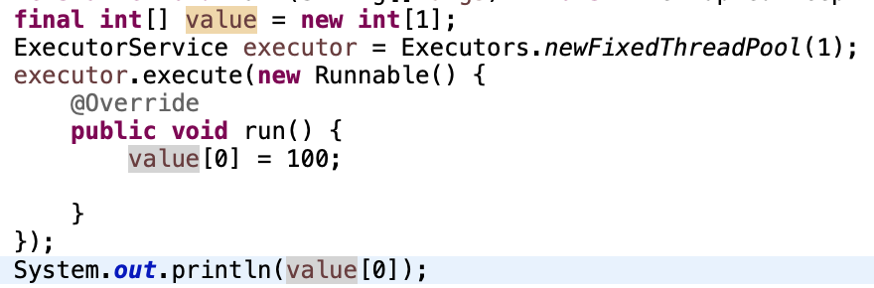
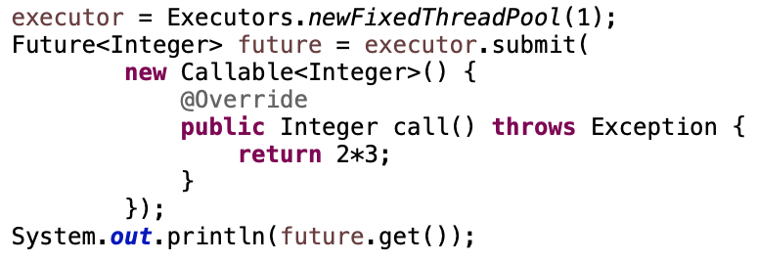
JAVA FUTURE
WHAT IS JAVA FUTURE?

Slide 4
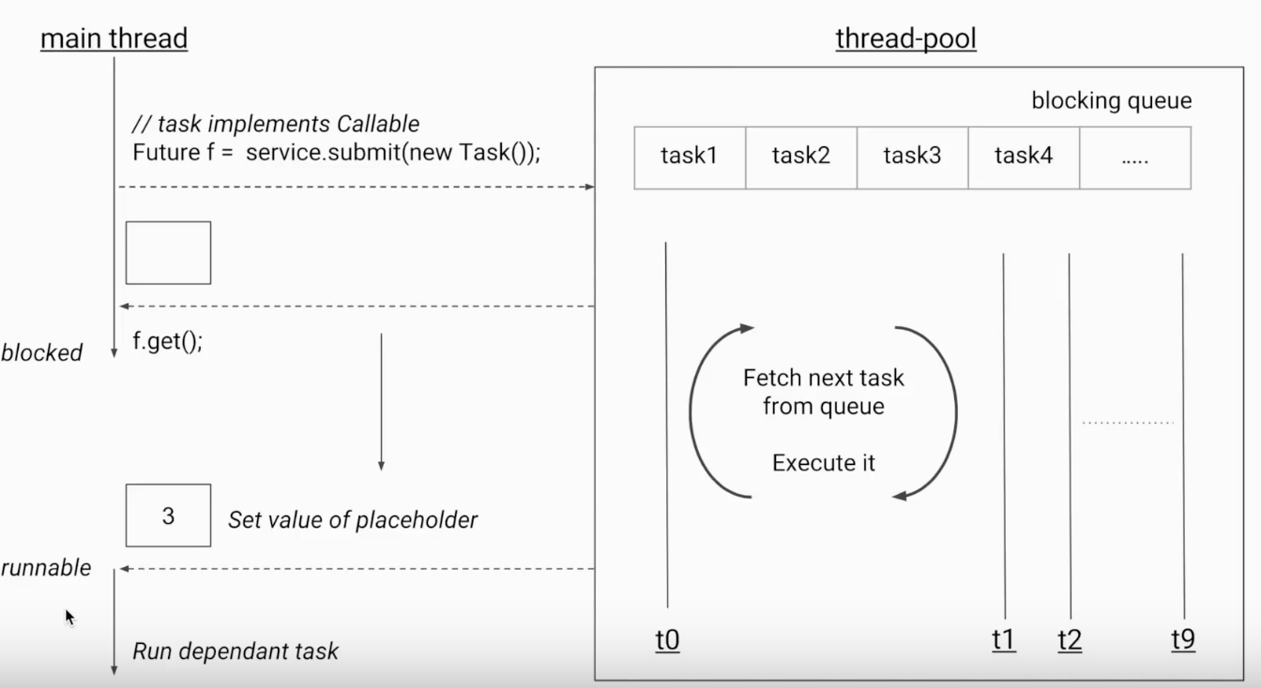
JAVA FUTURE
ANYTHING ELSE?
invokeAll():
Start all tasks same time
isDone():
Check a task is finished
get(timeout, unit ) :
Get return value in limit of time
isTerminal
cancel()
isCancel()

Slide 5
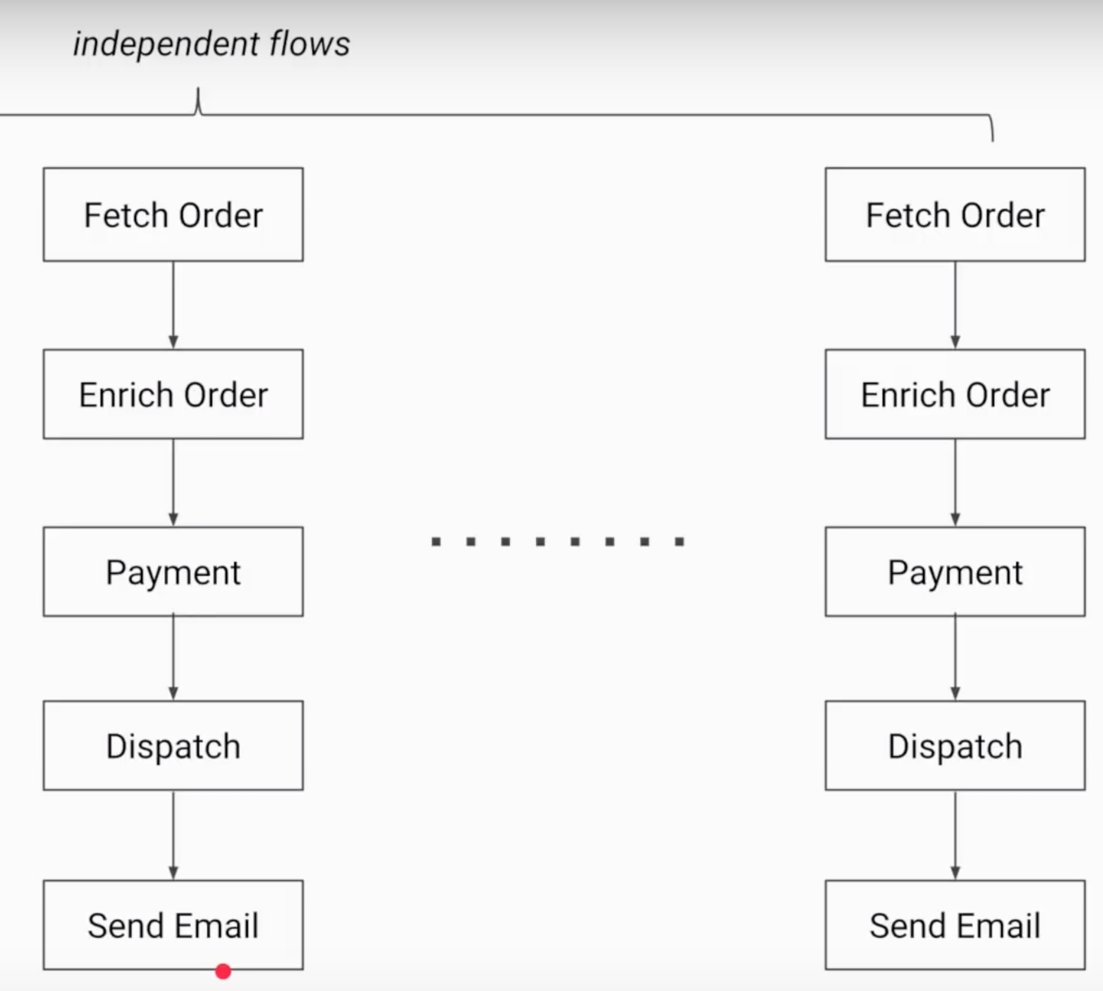
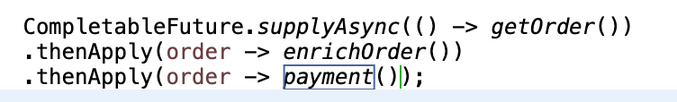
JAVA FUTURE
COMPLETABLE FUTURE

