Slide 2

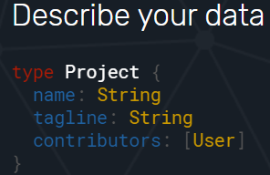
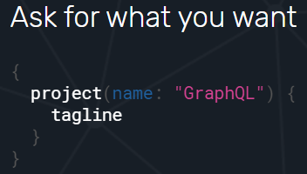
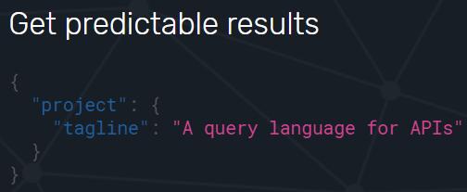






GraphQL
Describe your data
Ask for what you want
Get predictable results
Enable Contract Driven Development
Notes:
1. Describe what’s possible with a type system
2. Ask for what you need, get exactly that
3. Get many resources in a single request - 5. Bring your own data and code
4. Evolve your API without versions
https://graphql.org/
https://topdev.vn/blog/graphql/

Slide 3
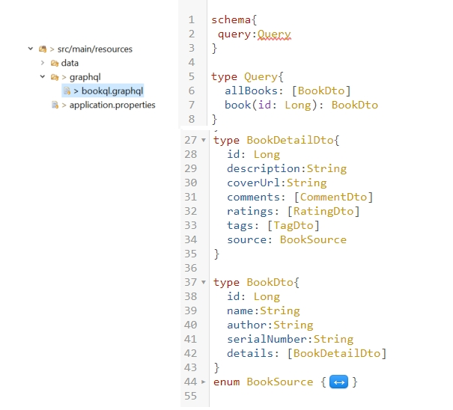
Describe your Data
Notes:
schema, queries, và resolvers
Resolver nói cho GraphQL biết nơi và cách thức để lấy data cần thiết cho field của query mà bạn yêu cầu

Slide 4
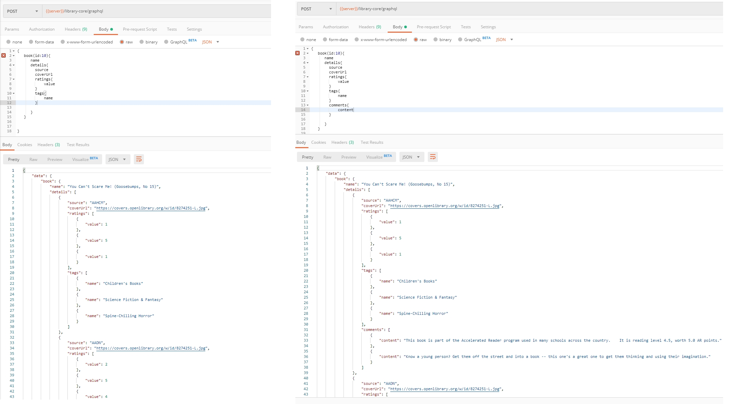
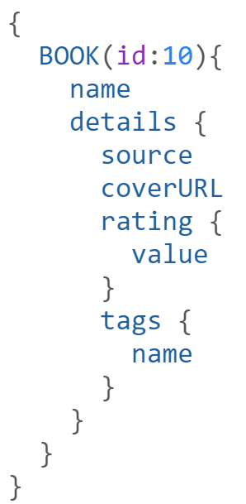
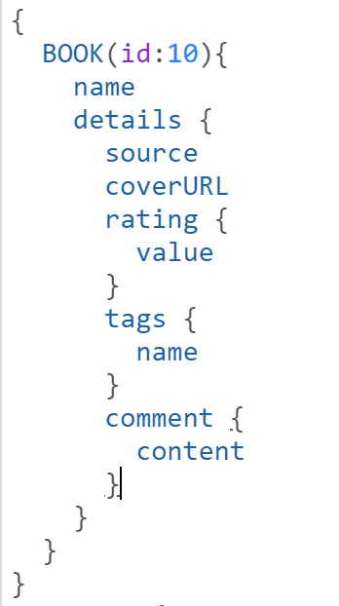
Ask for what you want (based on the schema, of course)

Slide 5
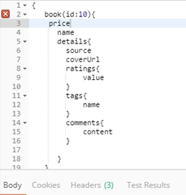
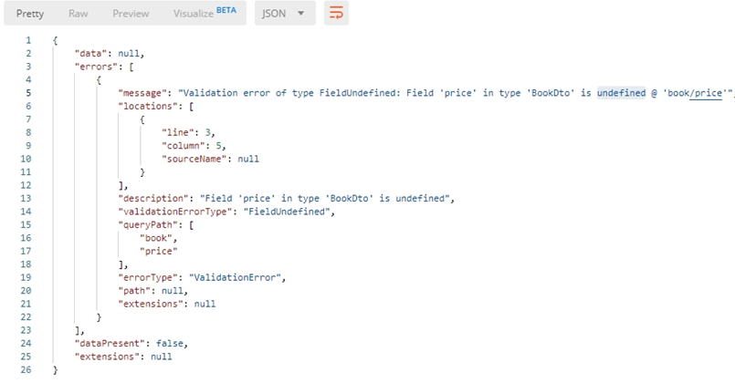
When I try to be naughty and ask for something not on the schema

Slide 6
Support Multiple API version
Everything will change and grow
Backward compatible (aka: not breaking existing clients)
How?
Point to point: URL
/library-core/api/v1
/library-core/api/v2
Compatible:
1. Query parameter /api/People?api-version=1.0
2. Custom request header:
api-version: 2
3. Accepted header: (Content negotiation)
Accept: application/vnd.haveibeenpwned.v2+json
4. Continuous versioning
Notes:
“The correct handling of API versioning has been one of the most difficult issues faced by developers of distributed systems. Various schemes have been proposed, ranging from the laissez faire approach taken by CORBA (Common Object Request Broker Architecture) to the stricter schemes used in DCOM (Distributed Component Object Model). With the advent of Web services, there are some new features that you can take advantage of that can help alleviate the problem, but the brutal fact of the matter is that versioning has not been built into the Web services architecture.”

Slide 7
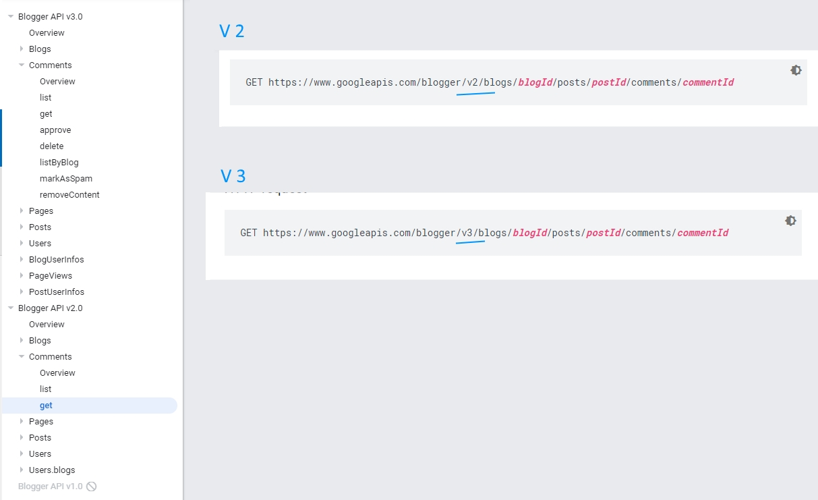
Point to point
URLs:
https://www.googleapis.com/blogger/v2/blogs/...
https://www.googleapis.com/blogger/v3/blogs/...
DevOps
Footprints
Maintenance
Notes:
Same approach: Twitter
Trace off:
need strong devops
Leave big footprint

Slide 8
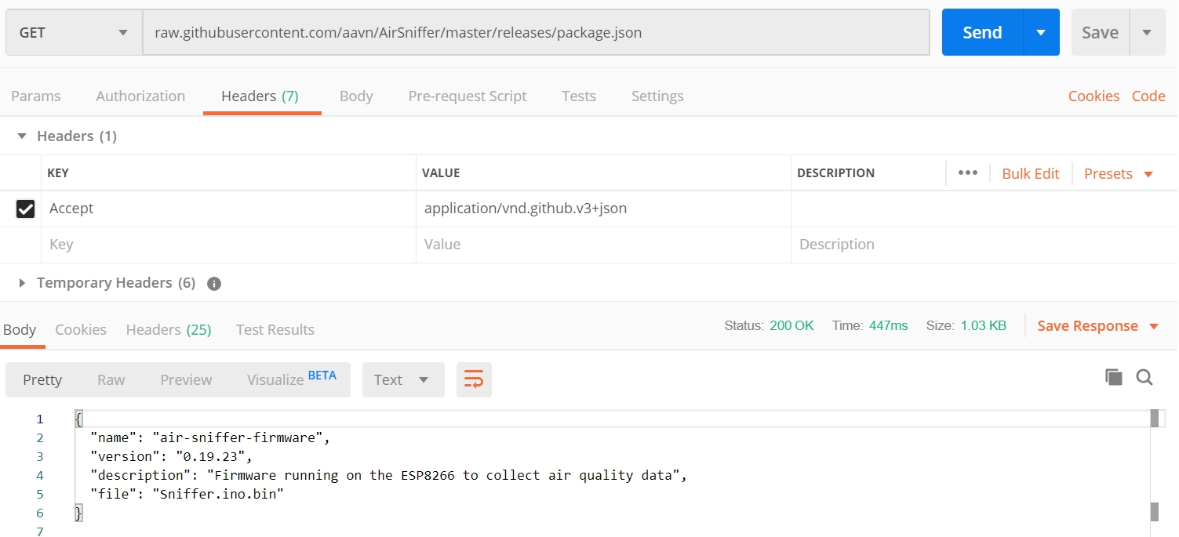
Compatible
Accepted header: Accept: application/vnd.github.v3+json
Consumer’s effort Not calling directly from browser
Not easy to test
Notes:
Control more
Not Expose version on url
Trace off:
Be ware off firewall
Convention/Standardise?
HTML form
Difficult to test
Cannot call directly from browser

Slide 9
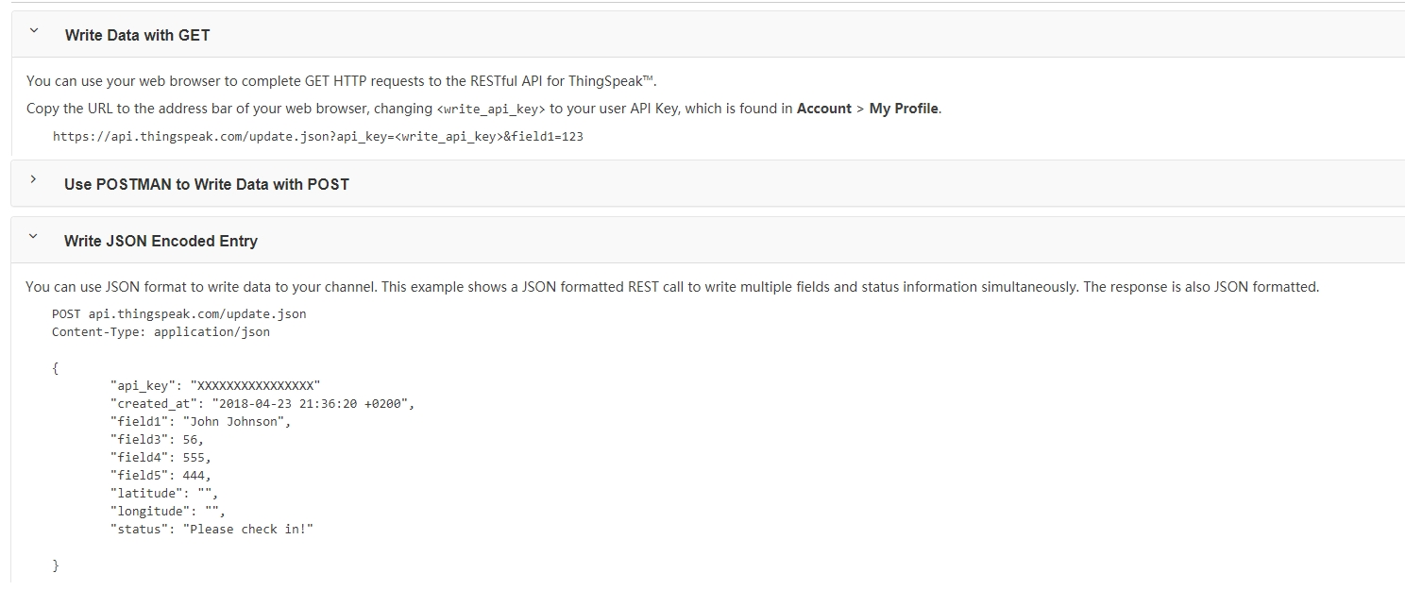
Compatible
Continuous versioning
Engineering awareness
Notes:
Trace off:

Slide 10
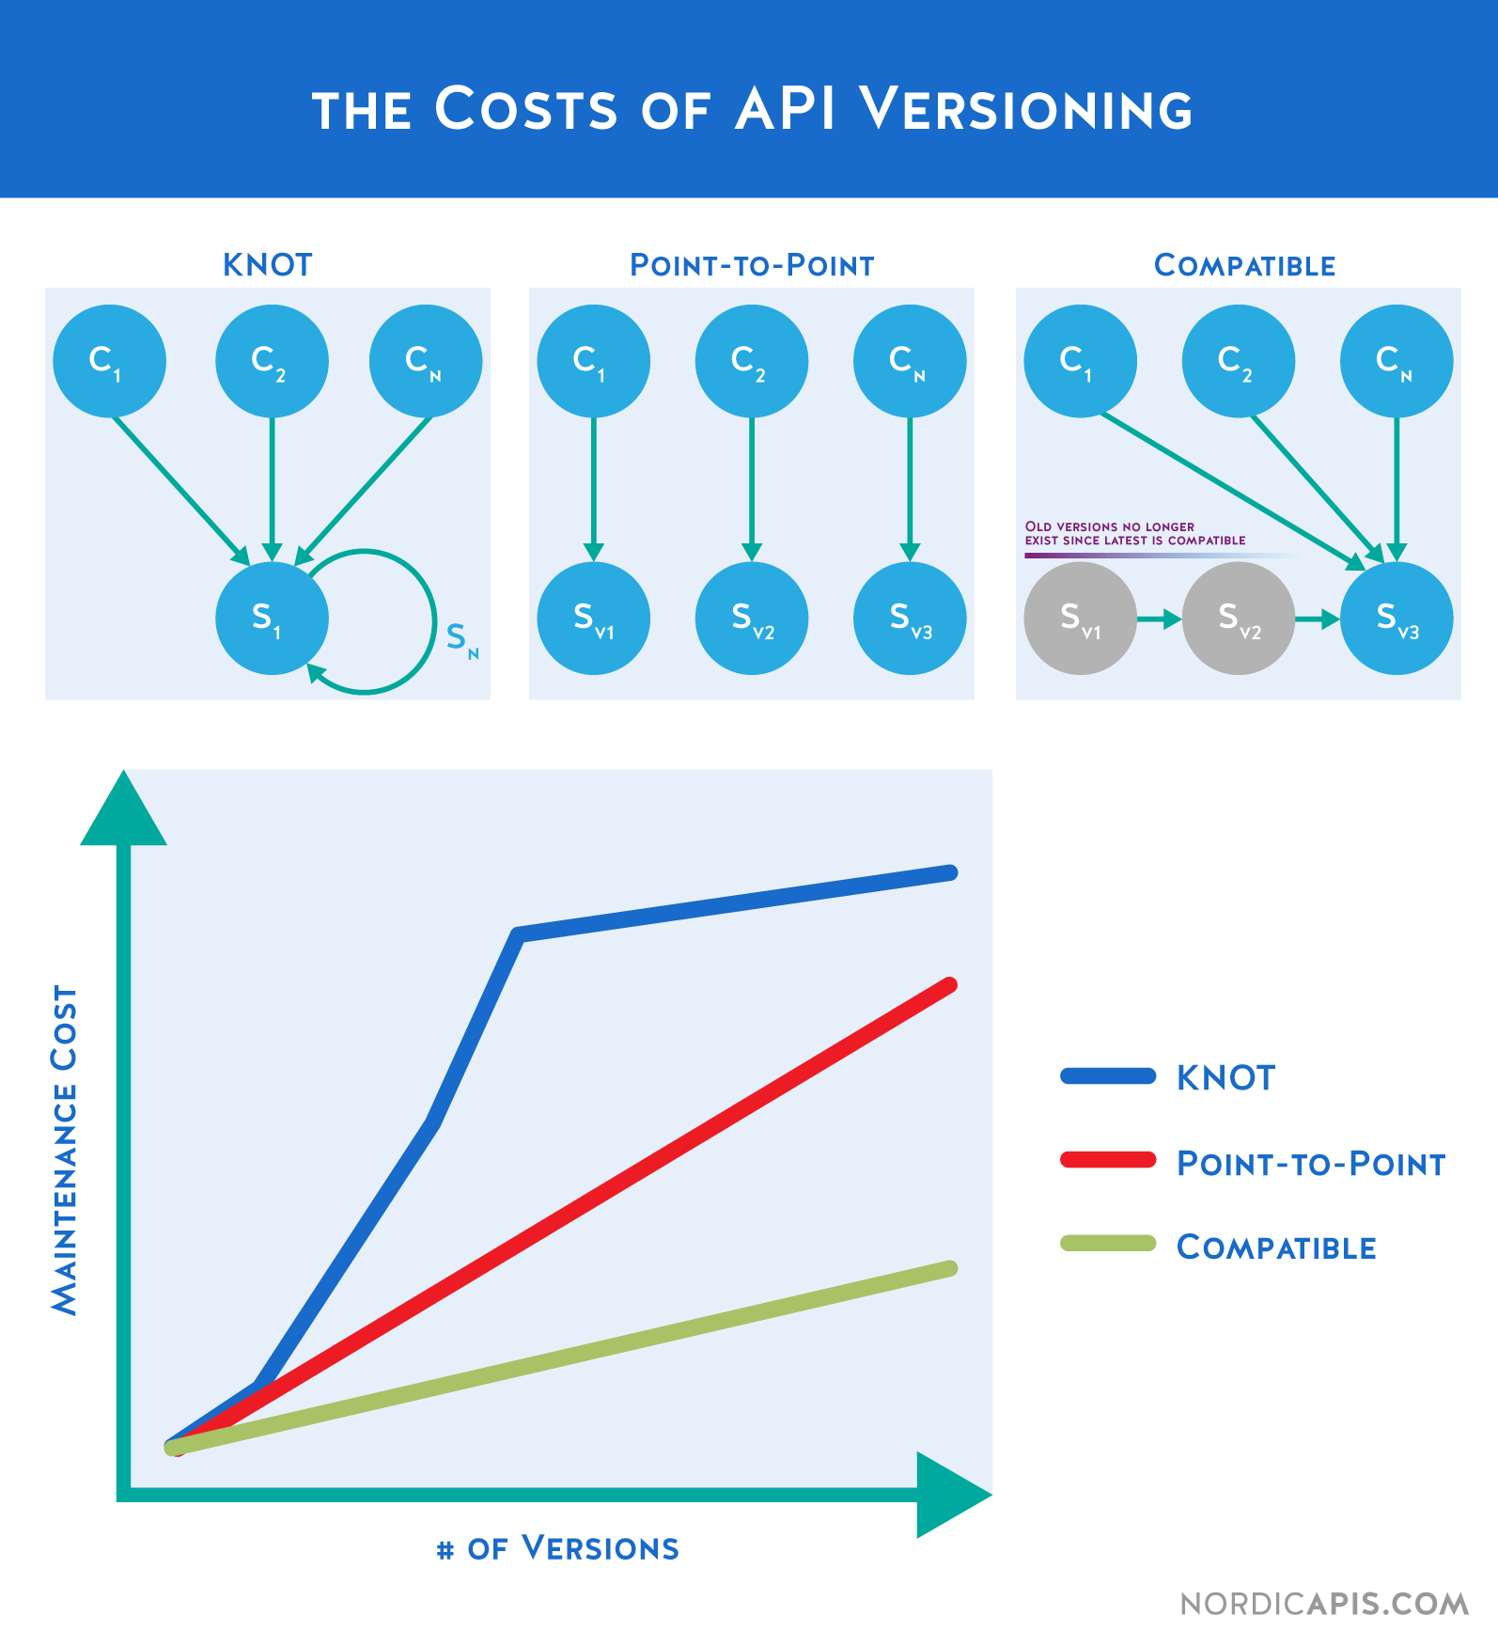
Which way is better?
Product need
Business motives
Vision
Notes:
The Knot. "All API consumers are tied to a single version of the API, when that API changes, all consumers have to change, in essence creating a massive ripple effect across the entire set of consumers / ecosystem.“
APIs can be among your greatest assets or liabilities. Good APIs create long-term customers; bad ones create long-term support nightmares.
Public APIs, like diamonds, are forever. You have one chance to get it right so give it your best.

Slide 11
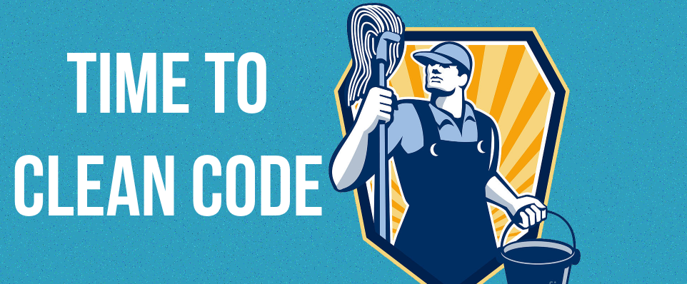
Clean Code
!
How to
write
clean code?
Devday 2014

Slide 12
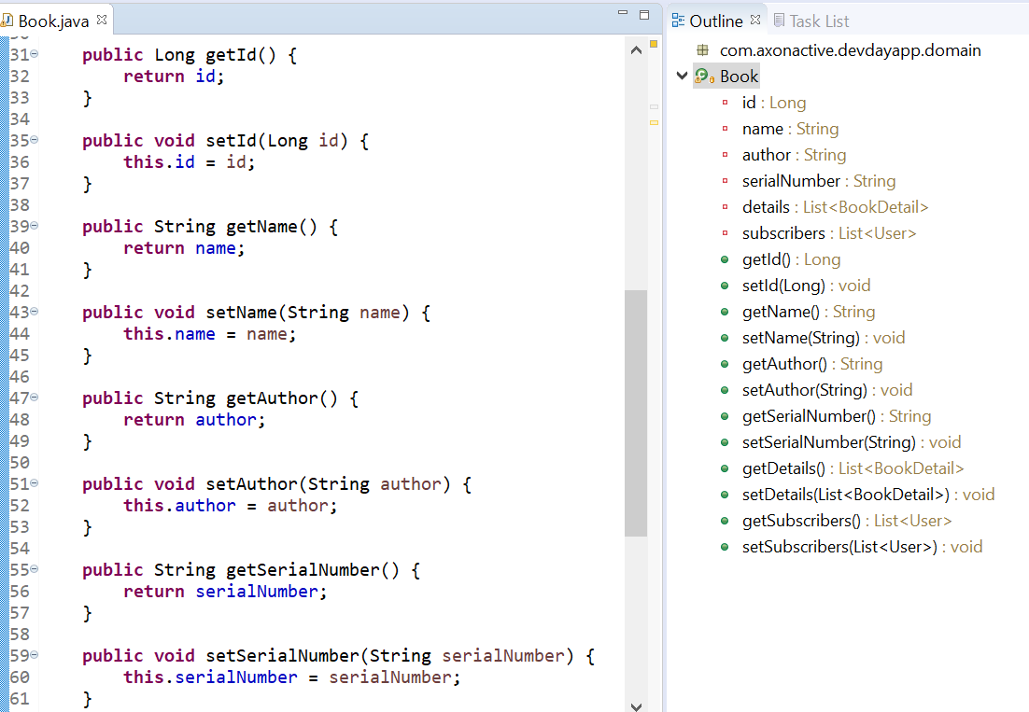

Clean Code
Clean code is a continuous process.
Don’t live with broken windows
Naming thoughtfully
Function should be small and smaller.
Do One Thing
Extract Till You Drop

Slide 13
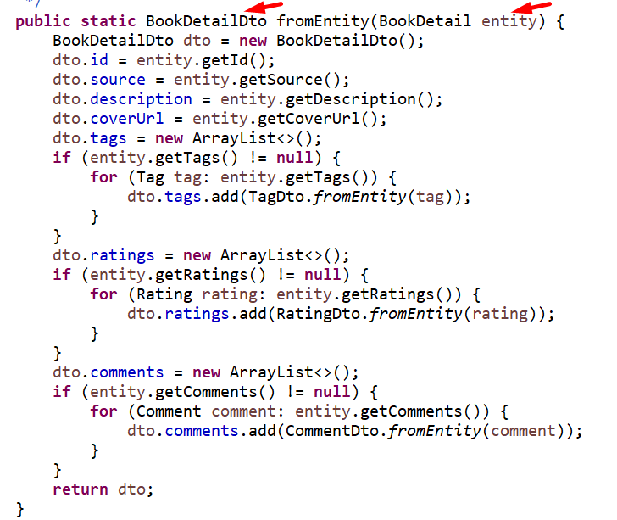
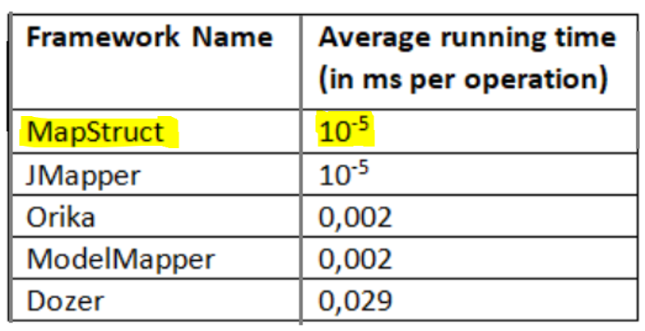
Another example
https://www.baeldung.com/java-performance-mapping-frameworks

Slide 14
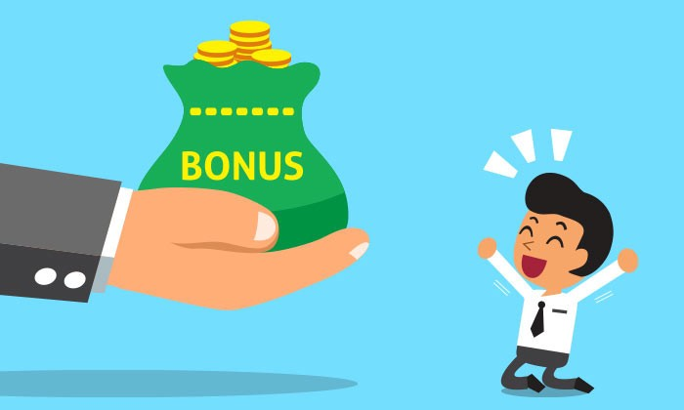
V2: Graphql, Versioning, Lombok & Mapstruct

