Slide 2







GraphQL
Describe your data
Ask for what you want
Get predictable results
Enable Contract Driven Development

Slide 3
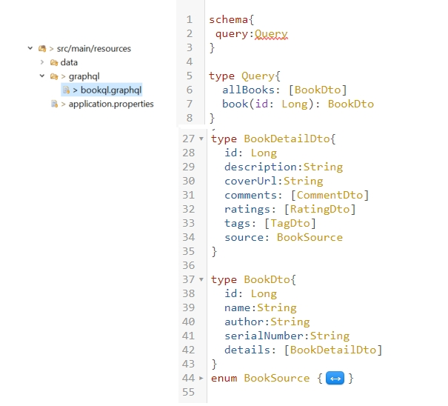
Describe Data

Slide 4
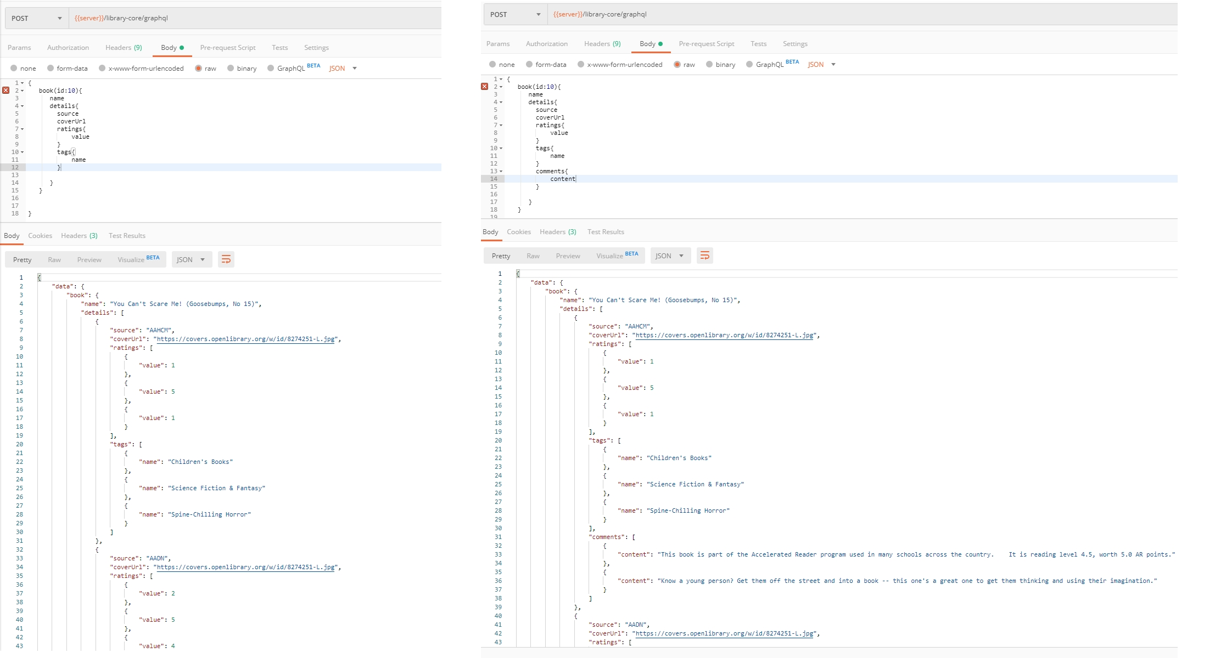
Ask for what you want (based on the schema, of course)

Slide 5
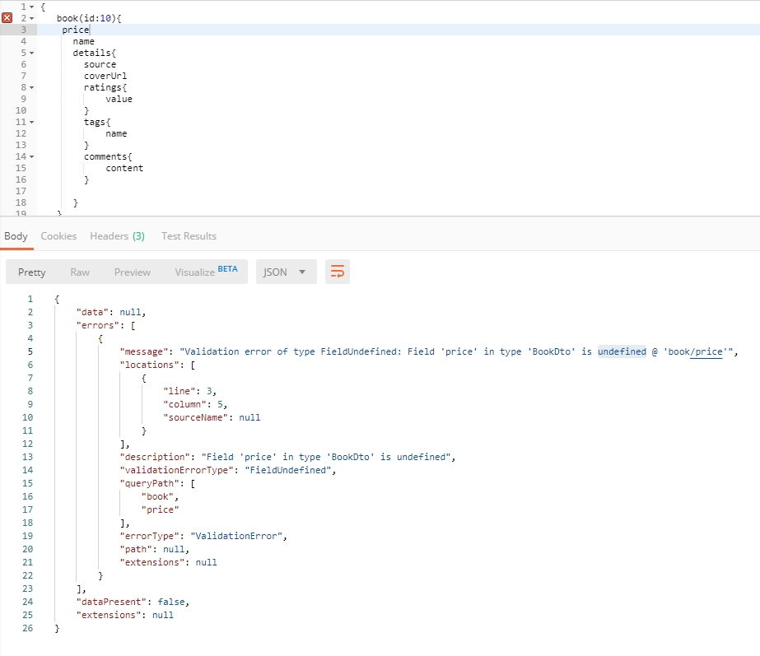
When I try to be naughty and ask for something not on the schema

Slide 6
Support Multiple API version
Everything will change and grow
Backward compatible
How?
Point to point: URL
/library-core/api/v1
/library-core/api/v2
Compatible:
Custom request header:
api-version: 2
Accepted header:
Accept: application/vnd.haveibeenpwned.v2+json
Continuous versioning
…
Notes:
“The correct handling of API versioning has been one of the most difficult issues faced by developers of distributed systems. Various schemes have been proposed, ranging from the laissez faire approach taken by CORBA (Common Object Request Broker Architecture) to the stricter schemes used in DCOM (Distributed Component Object Model). With the advent of Web services, there are some new features that you can take advantage of that can help alleviate the problem, but the brutal fact of the matter is that versioning has not been built into the Web services architecture.”

Slide 7
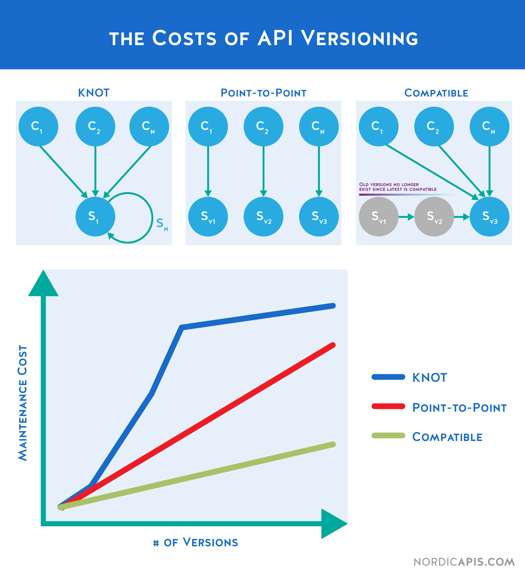
Which way is better?
Product need
Business motives
Vision

Slide 8
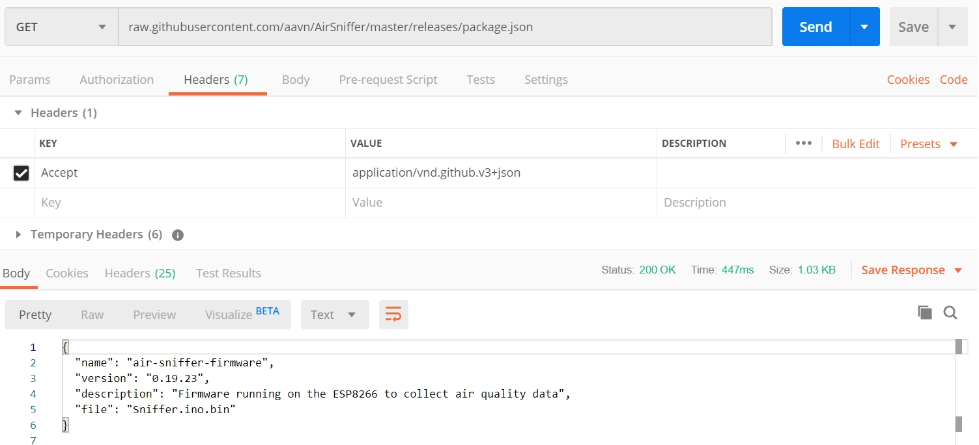
Eg: github approach
Notes:
Trace back:
Be ware off firewall
Convention/Standardise?
HTML form

Slide 9
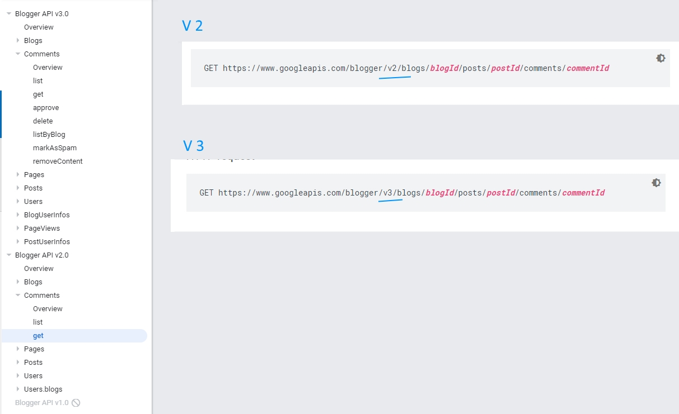
Eg: google approach
Notes:
Same approach: Twitter
Trace back:
need strong devops

Slide 10
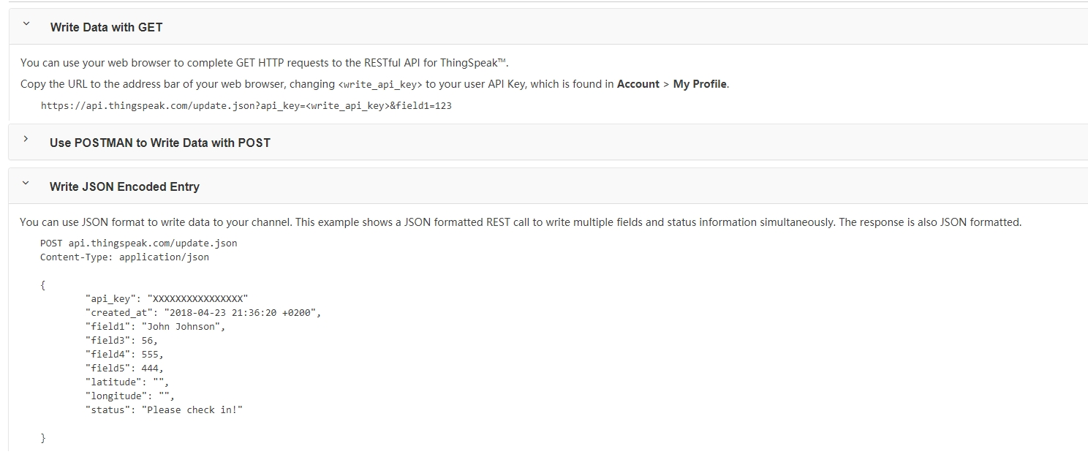
Eg: thinkspeak approach

