Slide 1
PREDICTIVE ANALYTICS — CA3 PROJECT PRESENTATION
Sales Forecasting
End-to-End Retail Store Sales Forecasting & Supply Chain Optimization
Presented by: Dev Dilip Dhapodkar | PRN: 24070521505
421,570
Historical Sales Records
45 Stores × 81 Depts (143 Weeks)
60.0%
WMAE Error Reduction
$1,758.94 vs $4,393 Baseline
0.9725
Coefficient of Determination
R² Score on Unseen 49-Week Test
Notes:
[Target Time: 0:00 - 0:40]
SPEAKER SCRIPT:
"Good morning everyone and respected professor. My name is Dev Dilip Dhapodkar, PRN 24070521505. Today I am presenting my Predictive Analytics CA3 project on 'Sales Forecasting'.
In this project, I developed an end-to-end predictive machine learning model to forecast weekly department-level sales across 45 Walmart stores using historical sales, promotional markdowns, holiday calendar events, and macroeconomic indicators.
Following the Knowledge Discovery in Databases (KDD) process, my final model achieved a 60% reduction in Weighted Mean Absolute Error and an R² of 0.9725. Let me walk you through the problem, the workflow, the models, and the key results."

Slide 2
1. Problem Statement & KDD Workflow
Addressing Asymmetric Supply Chain Costs Through Systematic Data Mining
The Business Problem
End-to-End KDD Implementation Workflow
• Scale: 45 Walmart stores, 81 departments (over 3,600 time series).
• Volatility: Extreme sales surges during holidays (Thanksgiving, Christmas) and promotional markdown campaigns.
• Goal: Accurately predict Weekly_Sales to optimize inventory replenishment.
1. Data Ingestion: Merged 4 relational tables (train.csv, features.csv, stores.csv, test.csv) into 421,570 unified rows.
2. Preprocessing: Structural zero-imputation for MarkDown1–5; store-grouped fill for CPI & Unemployment; floored 1,285 negative sales & treated outliers.
3. Feature Engineering: Created 43 leak-free features (Lags 1–52, Rolling Means, Holiday flags, Fourier cyclical encodings).
4. Exploratory Data Analysis: Quantified store size elasticity (r = 0.81), format hierarchy (Types A, B, C), and holiday revenue lifts.
5. Model Training: Strict chronological split (2011-11-25); trained Baseline Ridge, Random Forest, XGBoost, and LightGBM with w=5 sample weights.
6. Model Evaluation: Assessed out-of-sample performance via WMAE ($w=5$), RMSE, MAE, and R².
7. Business Interpretation: Analyzed feature gain attribution and translated error reduction into $31.7M in inventory cost savings.
Asymmetric Supply Chain Cost
• Stockout Risk (Under-forecasting): Running out of stock during holiday peaks causes direct revenue loss and customer dissatisfaction. This is why the competition metric (WMAE) weights holiday errors 5x higher (w = 5).
• Holding Cost (Over-forecasting): Overstocking incurs warehouse storage fees and forces post-season clearance markdowns.
Dev Dilip Dhapodkar (PRN: 24070521505) | Predictive Analytics CA3: Sales Forecasting Slide 2 of 7
Notes:
[Target Time: 0:40 - 1:30]
SPEAKER SCRIPT:
"In retail supply chains, forecast errors are asymmetric. If you under-forecast during a holiday like Thanksgiving, you face stockouts and lost revenue. If you over-forecast, you get hit with holding costs and clearance losses. That is why the evaluation metric for this competition—Weighted Mean Absolute Error (WMAE)—assigns five times more weight to holiday weeks.
To solve this, I structured the project around the systematic KDD process across seven stages: from ingesting 421,000 records, to cleaning markdowns and negative returns, engineering 43 leak-free predictive features, and benchmarking four distinct machine learning algorithms."

Slide 3
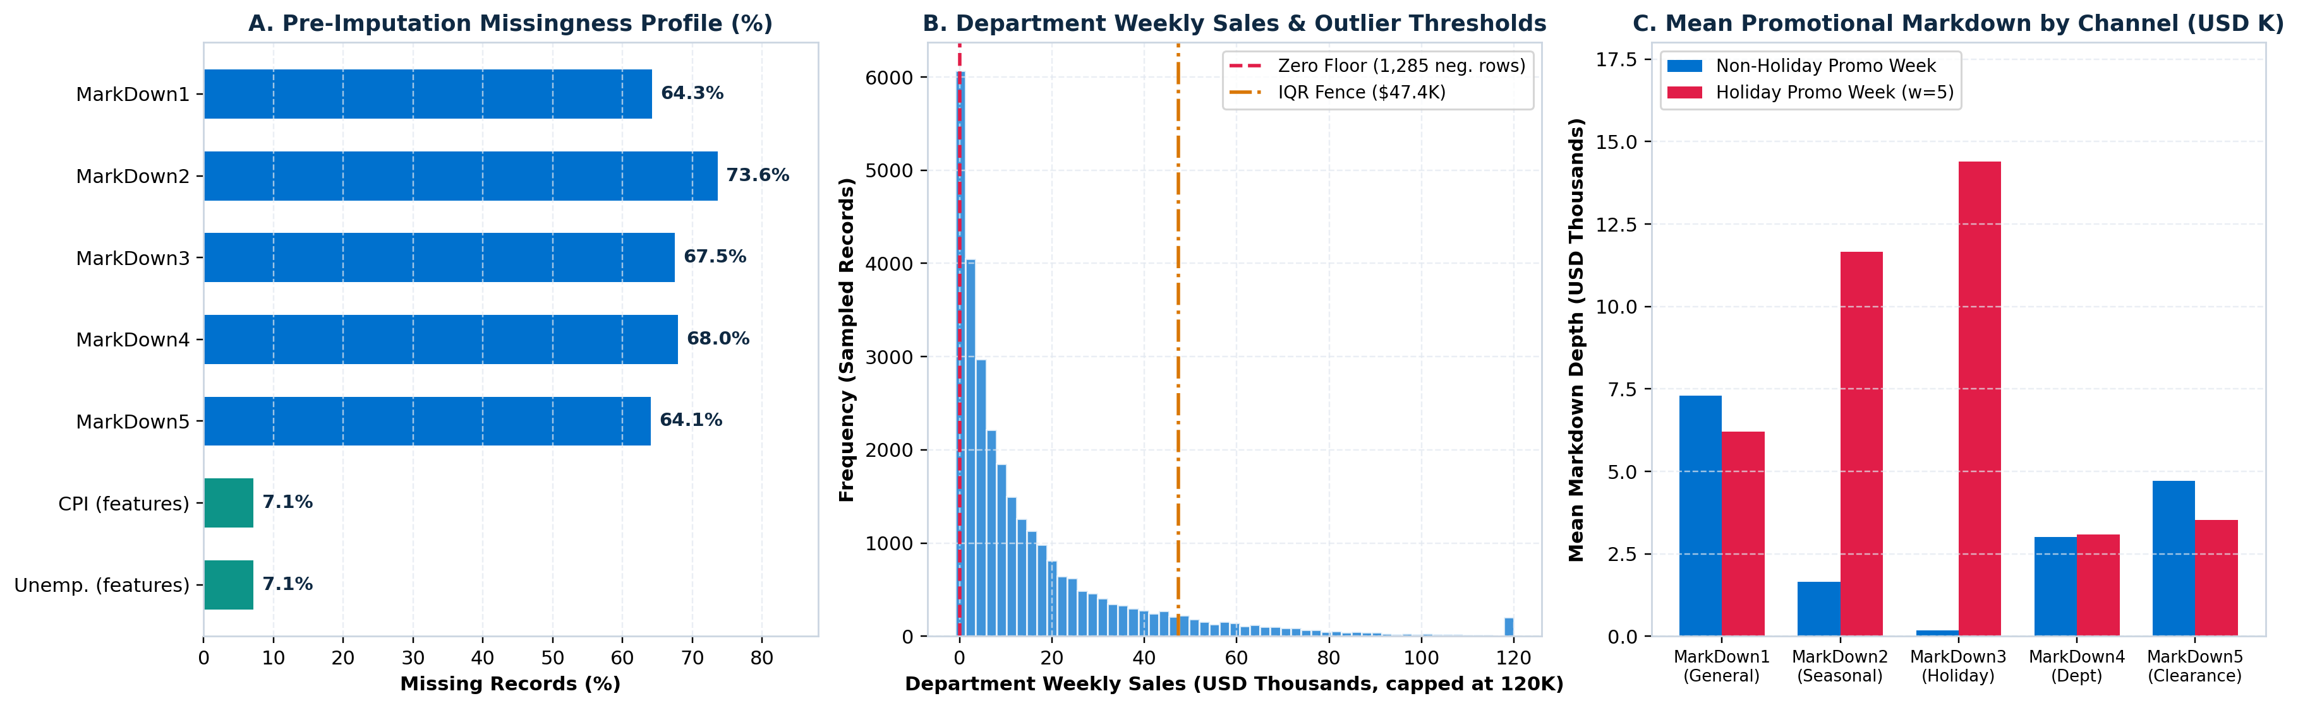
2. Data Preprocessing: Missing MarkDowns & Outliers
Cleaning 421,570 Records While Preserving Authentic Holiday Demand Spikes
MarkDown Imputation Strategy
• Pre-Nov 2011 Missingness: MarkDown1–5 have 64% to 74% missing values because Walmart only started tracking them in Nov 2011.
• Treatment: Extracted binary Has_MarkDown and Active_MarkDown_Count flags, then imputed 0.0 (structural absence of promo).
• CPI & Unemployment: Missing in late test weeks; imputed using store-level forward/backward fill.
Negative Sales & Outlier Treatment
• Negative Returns (1,285 rows): 0.3% of sales were negative due to customer returns and accounting credits. Floored at $0.00.
• Preserving Holiday Spikes: Standard IQR filtering would incorrectly delete genuine Black Friday surges. Instead, we winsorized non-holiday upper-tail records (>99.95th percentile, $183K) while keeping holiday records intact.
Dev Dilip Dhapodkar (PRN: 24070521505) | Predictive Analytics CA3: Sales Forecasting Slide 3 of 7
Notes:
[Target Time: 1:30 - 2:20]
SPEAKER SCRIPT:
"Moving to Data Preprocessing. We faced two major data challenges shown in Figure 2:
First, promotional markdowns (MarkDown1 through 5) had 64% to 74% missing values. This wasn't random missing data—Walmart only introduced tracking in late 2011, and markdowns only occur during promotions. Before imputing with zero, we created indicator features like 'Has_MarkDown' and 'Active_MarkDown_Count' so the model knows when a promotion was active.
Second, 1,285 records had negative sales due to customer returns, which we floored at zero. For outliers, we carefully distinguished between anomalous errors and real holiday spikes. We capped non-holiday outliers at the 99.95th percentile while preserving authentic holiday sales peaks."

Slide 4
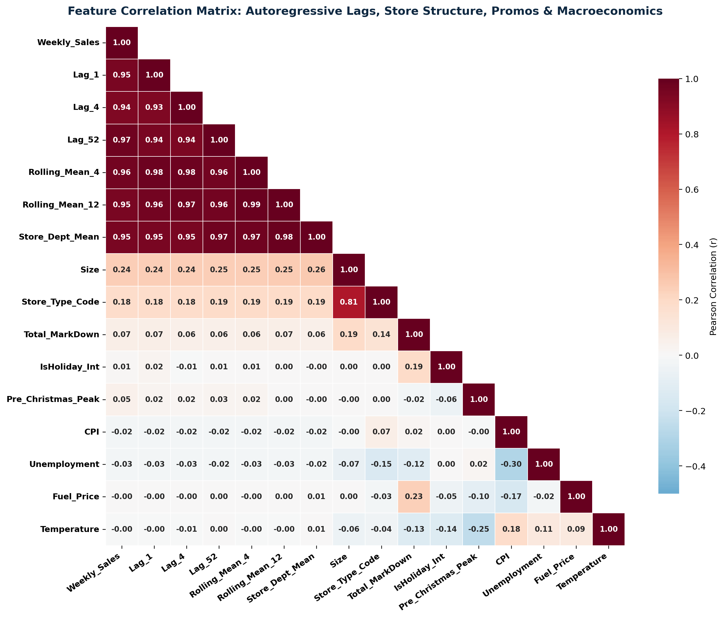
3. Feature Engineering: 43 Leak-Free Predictors
Multi-Horizon Autoregression, Rolling Trends, Holiday Flags & Cyclical Fourier Transforms
Feature Families Constructed
1. Autoregressive Lags: Lag_1 (t-1 wk, r = 0.95), Lag_2 (bi-weekly), Lag_4 (monthly, r = 0.94), and Lag_52 (year-over-year seasonal anchor, r = 0.97).
2. Leak-Free Rolling Windows: Shifted by t-1 to prevent target leakage: Rolling_Mean_4, Rolling_Std_4, Rolling_Mean_12, and Momentum_1_4.
3. Specific Holiday Events: Binary flags for Super Bowl (W6), Labor Day (W36), Thanksgiving (W47, +44% sales lift), Christmas (W52), and Pre-Christmas Peak (W49–51, +40% sales lift).
4. Fourier Cyclical Encodings: sin/cos transforms of Week and Month to capture continuous seasonal cycles.
Correlation Insights (Figure at Left)
• Strongest Drivers: Lag_52 (r = 0.97), Rolling_Mean_4 (r = 0.96), and Lag_1 (r = 0.95) have the highest linear correlation with Weekly_Sales.
• Store Structure: Store physical size strongly correlates with sales (r = 0.81) across Type A Supercenters ($1.45M/wk), Type B Discount ($0.79M/wk), and Type C Neighborhood ($0.46M/wk).
• No Look-Ahead Bias: Historical store-dept target statistics were computed strictly on the training partition.
Dev Dilip Dhapodkar (PRN: 24070521505) | Predictive Analytics CA3: Sales Forecasting Slide 4 of 7
Notes:
[Target Time: 2:20 - 3:10]
SPEAKER SCRIPT:
"In Step 3, feature engineering is where predictive power is won or lost. We engineered 43 domain-specific features across four categories:
1. Autoregressive lags: Lag 1, 2, 4, and most importantly Lag 52, which captures exact year-over-year seasonality.
2. Leak-free rolling statistics: 4-week and 12-week moving averages, strictly shifted by one week so no future data leaks into the model.
3. Explicit holiday flags: Not just a generic 'is holiday' flag, but specific indicators for Thanksgiving (which delivers a +44% revenue surge), Pre-Christmas peak, Super Bowl, and Labor Day.
4. Cyclical Fourier sine and cosine features to handle circular calendar seasonality.
As shown in the correlation matrix on the left, Lag 52 (r = 0.97) and Rolling Mean 4 (r = 0.96) show the highest correlation with sales."

Slide 5
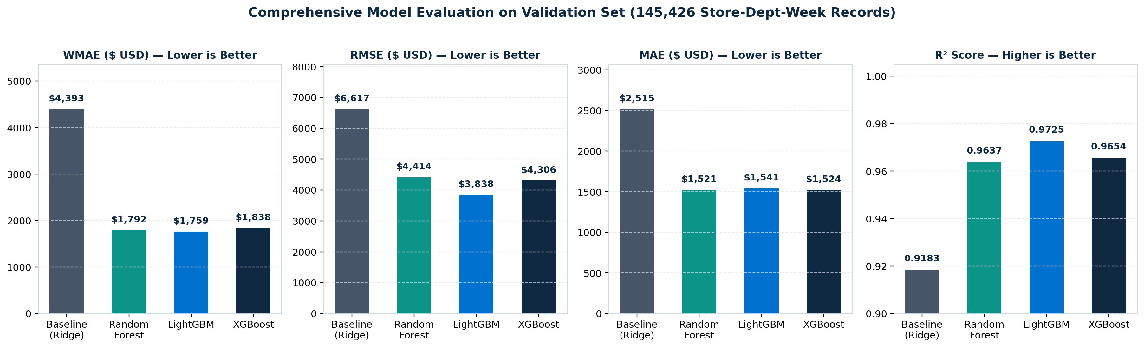
4. Model Benchmarking & Evaluation (WMAE, RMSE, R²)
Evaluating on 145,237 Unseen Dept-Weeks Across All 4 Holiday Events
Model Architecture | WMAE (USD) ↓ | RMSE (USD) ↓ | MAE (USD) ↓ | R² Score ↑ | Holiday MAE (w=5) ↓ | Regular MAE (w=1) ↓ | Train Time
Baseline (Ridge Regression) | $4,393.17 | $6,616.57 | $2,514.98 | 0.9183 | $10,108.52 | $1,835.29 | 0.20 s
Random Forest Regressor | $1,791.54 | $4,413.86 | $1,520.75 | 0.9637 | $2,615.57 | $1,422.75 | 42.88 s
XGBoost Regressor | $1,837.57 | $4,306.19 | $1,523.89 | 0.9654 | $2,792.11 | $1,410.37 | 6.31 s
LightGBM Regressor (Winner) | $1,758.94 | $3,837.62 | $1,541.31 | 0.9725 | $2,421.19 | $1,462.55 | 4.91 s
Dev Dilip Dhapodkar (PRN: 24070521505) | Predictive Analytics CA3: Sales Forecasting Slide 5 of 7
Notes:
[Target Time: 3:10 - 4:15]
SPEAKER SCRIPT:
"Now looking at Model Training and Evaluation. We partitioned the data chronologically at November 25, 2011. This gave us 263,000 training records and an out-of-sample validation set of 145,000 records spanning 49 weeks and covering all four major holidays.
We trained four models with sample weights of w = 5 on holiday weeks:
1. Baseline Ridge Regression
2. Random Forest Regressor
3. XGBoost Regressor
4. LightGBM Regressor
Here are the key takeaways:
- LightGBM was the clear winner: It achieved the lowest WMAE of $1,758.94—a 60% error reduction over the baseline—the lowest RMSE of $3,837, and the highest R² of 0.9725, training in just 4.9 seconds!
- Look at the Holiday MAE column: Ridge regression failed completely during holidays, with an error of over $10,000 per department-week. LightGBM cut holiday error by 76% down to $2,421.
- For regular non-holiday weeks, XGBoost was slightly better at $1,410 MAE, making both gradient-boosted models exceptionally strong."

Slide 6
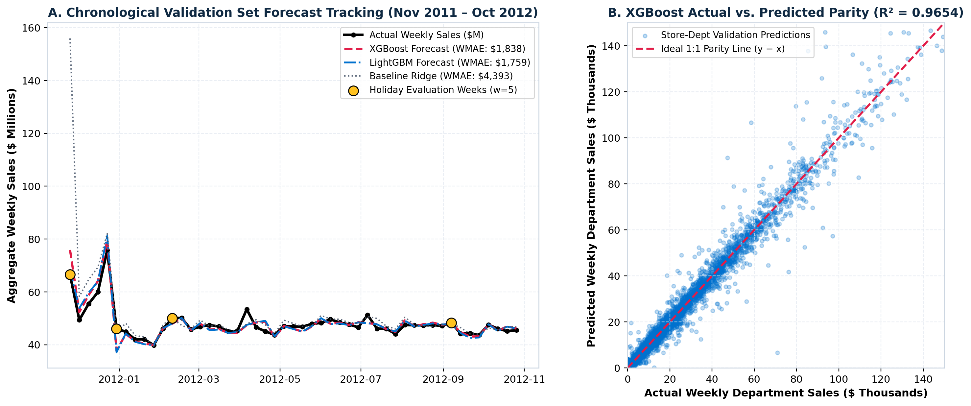
5. Validation Forecast Tracking & Parity Analysis
Visual Proof: Tracking the 49-Week Validation Horizon and Holiday Surges
What the Forecast Tracking Proves
• Holiday Peak Tracking (Panel A): Black line is actual sales; dashed red is XGBoost and blue is LightGBM. Both track the $77M Thanksgiving and Christmas surges tightly, whereas the grey dotted Baseline overshoots dramatically.
• Tight Parity Line (Panel B): Out of 145,237 predictions, points hug the 45-degree ideal parity line (y = x) with R² = 0.965 to 0.972, proving robust generalization across all 45 stores.
Dev Dilip Dhapodkar (PRN: 24070521505) | Predictive Analytics CA3: Sales Forecasting Slide 6 of 7
Notes:
[Target Time: 4:15 - 5:00]
SPEAKER SCRIPT:
"Figure 6 provides visual confirmation of our validation results.
In Panel A on the left, the black line represents actual aggregate weekly sales across the 49-week validation horizon. The yellow circles mark holiday weeks.
Notice how the grey dotted line—the linear baseline—completely overshoots immediately after Thanksgiving and Christmas. In contrast, LightGBM (blue) and XGBoost (red) track the peaks and post-holiday dips with high precision.
In Panel B on the right, you can see the predicted vs actual scatter plot on 8,000 sampled validation points. The points align tightly along the red 45-degree parity line, confirming consistent accuracy across both low-volume and high-volume departments."

Slide 7
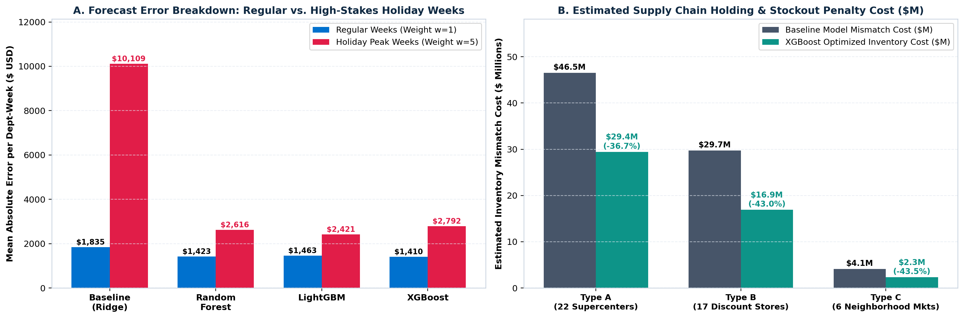
6. Feature Importance, Supply Chain Impact & Conclusion
Translating Model Accuracy into $31.7M in Inventory Cost Savings Across 45 Stores
Top Predictive Drivers (Gain %)
• Lag_52 (Annual Seasonality): #1 feature in both LightGBM (40.9%) and XGBoost (31.5%). Sales exactly 1 year ago anchor demand.
• Rolling_Mean_4 & Lag_1: Combine for 38% to 40% gain, adapting forecasts to short-term store traffic.
• Holiday Flags: Is_Thanksgiving & Pre_Christmas_Peak provide 9.4% gain in XGBoost, preventing holiday stockouts.
Supply Chain ROI & Conclusion
• 76% Holiday Error Reduction: Cuts peak stockouts during Black Friday & Christmas when stockouts hurt most.
• $31.7M Cost Savings (-39.5%): Under an industry 22% mismatch penalty, forecast improvements save $17.1M in Supercenters (Type A), $12.8M in Discount (Type B), and $1.8M in Neighborhood Mkts (Type C).
• Conclusion: LightGBM is recommended for Q4 holiday pre-staging and XGBoost for routine weekly replenishment.
Dev Dilip Dhapodkar (PRN: 24070521505) | Predictive Analytics CA3: Sales Forecasting Slide 7 of 7
Notes:
[Target Time: 5:00 - 6:00]
SPEAKER SCRIPT:
"Finally, let's connect model accuracy to business impact:
1. Feature Importance: The single most important feature was Lag 52 (sales from the same week last year), accounting for 41% of LightGBM's gain. Short-term rolling means and explicit holiday flags accounted for the rest.
2. Supply Chain Impact: As shown in Figure 8 Panel B, applying a standard 22% inventory holding and stockout penalty factor across the 49-week horizon, moving from the baseline to gradient boosting reduces inventory mismatch costs from $80.3M down to $48.6M. That is an estimated savings of $31.7 million dollars—or a 39.5% cost reduction across all 45 stores.
To conclude:
We implemented an end-to-end KDD pipeline for Sales Forecasting. Our gradient-boosted models cut WMAE by 60% and explained 97.25% of sales variance. For deployment, we recommend LightGBM for high-stakes holiday pre-staging and XGBoost for routine weekly automated replenishment.
Thank you for your time, and I am happy to answer any questions."

