Slide 1
Map

Slide 2
In this Lesson
1. 地图题考点简介
2. 常用表达
3. 变迁图写法
4. 选址图写法

Slide 3
In this Lesson
1. 地图题考点简介
2. 常用表达
3. 变迁图写法
4. 选址图写法

Slide 4
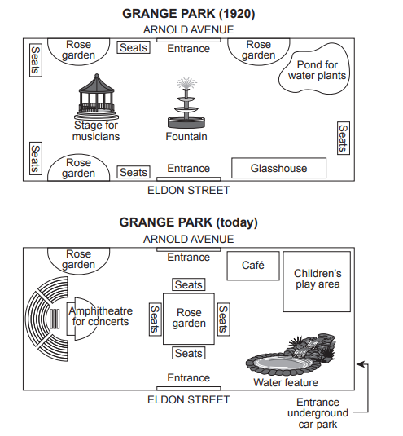
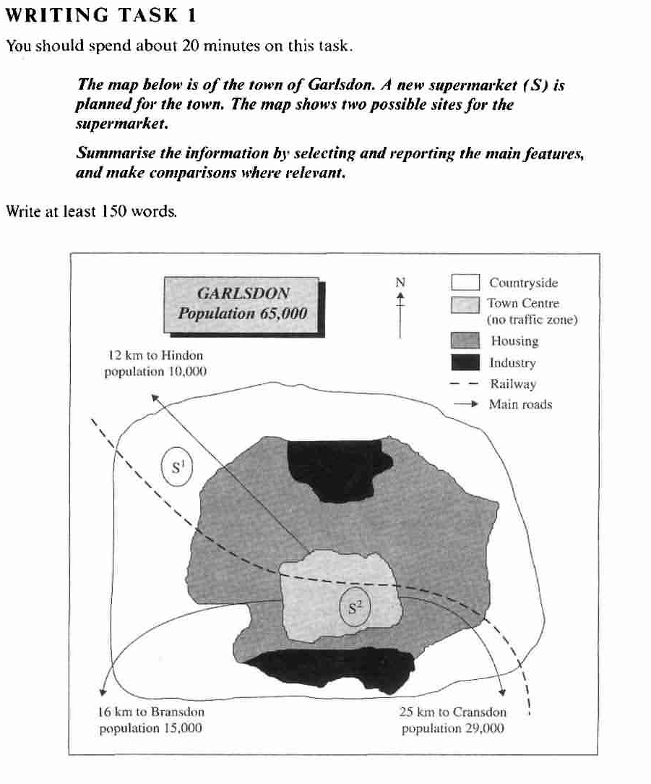
地图题两大类题型
选址图C5T3
变迁图C14T4

Slide 5
变迁图写作要点
（1）描述对象：一个地点过去到现在，或者现在到未来，发生的变化
↓
TA：① 变化前图上所有设施的方位
② 对比前后发生的变化 & 不变项
↓
分段方式：一图一段
主体段一：变化前（原有布局）
主体段二：变化后（对比前后变化）

Slide 6
变迁图写作要点
（2）多种时态
 | 主体段一 before | 主体段二 after
过去 vs 现在 | 一般过去时 | 现在完成时 has done（动作） + 一般现在时（状态）
现在 vs 将来 | 一般现在时 | be projected/expected/planned to
过去 vs 更过去 | 一般过去时 | 过去完成时 had done（动作） + 一般过去时（状态）
（3）描述变化时多用被动语态（被改变）

Slide 7
选址图写作要点
（1）TA：① 每个选址的地点方位
② 对比两个选址的特点（优劣势）
此题型不同于其他小作文，可以出现
合理的个人推测
（2）分段方式：一址一段
主体段一：地址一位置特点
主体段二：地址二位置特点

Slide 8
In this Lesson
1. 地图题考点简介
2. 常用表达
3. 变迁图写法
4. 选址图写法

Slide 9
布局类常用表达
表示“位于”的动词
be located | to 外部 | Guangdong province is located to the south of Hubei province
be situated | in 内部 | Tianhe Airport is situated in the northwestern part of Wuhan
be sited | on 接壤 | Hunan province is sited on the south of Hubei province
lies-lay |  | Hunan province lies on the south of Hubei province

Slide 10
布局类常用表达
2. 常用方位表达
附近 | close to | The hotel is conveniently situated close to the beach
 | next to | There is a fitness centre next to the mall entrance
 | nearby | there is now a children’s play area with a café nearby.
 | adjacent to | Our farm land was adjacent to the river.
 | in close proximity to | The hotel is in close proximity to the airport.
对面 | opposite | The prison is opposite the law court.

Slide 11
布局类常用表达
2. 常用方位表达
东南西北 | east/south/west/north | Guangdong province is located to the south of Hubei province
背靠（A在B上方） | A backs on to B | The house backs on to a beautiful park.
左右 | left/right | a stage is situated centre left
 |  | a glasshouse is to the right of the entrance
角落 | corner | Geographically, the old capital was in the extreme southeast corner of the country
边缘 | border（外部） | , near the border with China
 | edge（内部） | We were on a hill, right on the edge of town.

Slide 12
布局类常用表达
3. 河流/道路类
位置动词 | 环绕 surround | The lake was surrounded by tall trees.
 | 穿过 cross | This road crossed the town from east to west
 | 相交 intersect | These two roads intersect at a T-junction
功能动词 | 连接 link with/connect to | Hospital road linked the ring road with the city road
 | 通向 lead to | this road leads to the People's Park
 | 提供入口 provide access to with access from | Grange Park was a rectangular area with access from Arnold Avenue on the north side
介词 | 沿着 along
 | 路的两边 on both sides of the road on the southern/northern side on the other side | there were three bus stops on each side of the road
名词 | 交叉口 junction/intersection

Slide 13
Exercise
1. 停车场位于A大街和C大街的交汇处。
2. 房屋建在沿河两岸。
3. 道路的右手边是一家餐厅。
4. 博物馆的东南边是两个音乐厅。

Slide 14
Exercise
1. 停车场位于A大街和C大街的交汇处。
At the junction of A Street and C Street lies a car park.
2. 房屋建在沿河两岸。
Houses were built along both sides of the river.
3. 道路的右手边是一家餐厅。
On the right side of the road locates/lies/is a restaurant.
4. 博物馆的东南边是两个音乐厅。
To the southeast of the museum stand/situate/lie/are two concert halls.

Slide 15
变化类常用表达
原有的 | original/former/previous
增 | 新增 | be bulit/constructed/established/added
 | 原有基础上增 | 尺寸增 | the size has been enlarged/extended/expanded
 |  | 数量增 | the number has increased/risen/doubled
删 | 没了 | disappear/has gone
 |  | has been removed/demolished
 | 原有基础上减 | 尺寸减 | the size has been reduced
 |  | 数量减 | The number has decreased/dropped/declined
改 | 被替代 | be replaced/substituted by
 |  | given way to / make way for
 | 被变成 | be coverted/transformed/changed into
 | 被移到 | be relocated/moved to
不变 | remain unchanged
 | remain at the original site

Slide 16
Exercise
翻译：
如今，原先的停车场被拆掉，改成了一个仓库。
The former car park has been removed and replaced by a warehouse.
2. 从2023年到2050年，A市的房屋数量将增加20%。
The number of houses in City A is estimated to increase by 20% from 2023 to 2050.
It is estimated that the number of houses in City A would increase by 20% from 2023 to 2050.
3.2010年，在D市新建了一个体育场。
A stadium was built/established in City D in 2010.

Slide 17
Exercise
1. 一个工业园区(industrial complex)被建在了岛屿的西海岸。
2. 小诊所将被改作一家综合医院。
3. 一条小路将被延伸并拓宽成一条主路。
4. 小的停车场将被扩建成公园。
5. 银行将被搬到展览馆原来的位置上。
6. 位于B大道和D大街交汇处的图书馆将被一个剧院所替代。
7. 位于两个停车场中间的音乐厅将保持不变。
8. 之前的小花园还位于公园的东北角。

Slide 18
Exercise
1. 一个工业园区(industrial complex)被建在了岛屿的西海岸。
An industrial complex has been built on the western coast of the island.
2. 小诊所将被改作一家综合医院。
The clinic will be converted into a comprehensive hospital.
3. 一条小路将被延伸并拓宽成一条主路。
The path will be extended and widened into a major road.
4. 小的停车场将被扩建成公园。
The small car park will be enlarged into a park.

Slide 19
Exercise
5. 银行将被搬到展览馆原来的位置上。
The bank will be moved to the former/previous/original location of the exhibition hall.
6. 位于B大道和D大街交汇处的图书馆将被一个剧院所替代。
The library at the junction of B Avenue and D Street will be converted into a theatre.
7. 位于两个停车场中间的音乐厅将保持不变。
The concert hall in the middle of the two car parks will remain unchanged.
8. 之前的小花园还位于公园的东北角。
The previous small garden remains at the northeastern corner of the park.

Slide 20
In this Lesson
1. 地图题考点简介
2. 常用表达
3. 变迁图写法
4. 选址图写法

Slide 21
变迁题首段写法
The plans below show a public park when it first opened in 1920 and the same park today
重点：换宾语（名词和从句互换）
The maps illustrate changes in the layout of ______
The maps illustrate how the layout of ______ has been redeveloped.
The maps compare the current layout of ______ and its future layout.
(previous/current/future layout).
The maps illustrate changes in the layout of Grange park.
The maps show how Grange park has been redeveloped since 1920.
The maps compare the previous layout of Grange park and its current layout.

Slide 22
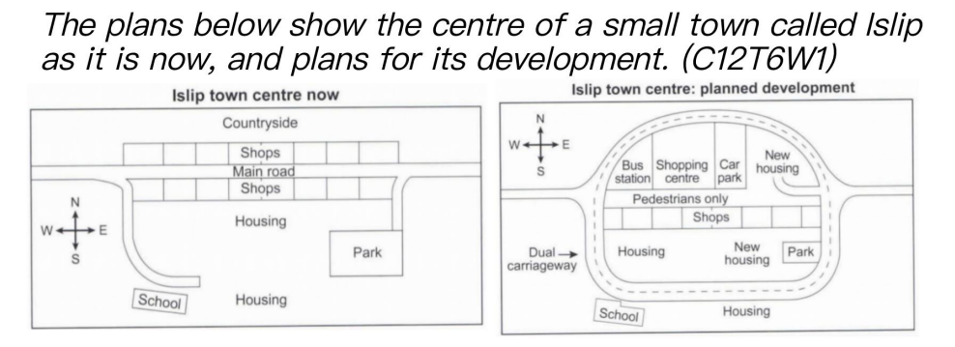
首段写作练习

Slide 23
首段写作练习
The maps show how Islip town center is predicted to be redeveloped in the future.
The maps show the current layout of Islip town center and its future layout.

Slide 24
范文赏析（布局段）
Grange Park was opened in 1920, a rectangular area with access from Arnold Avenue on the north side and from Eldon Street on the south side.
There was a fountain in the center, with a stage for musicians situated center left, a glasshouse to the right of the Eldon Street entrance and a pond for water plants in the northeast corner opposite.
Around the edges of the park there were rose gardens, with seats nearby for people to smell the flowers and listen to music.
思考：范文是按什么顺序进行描写的

Slide 25
布局段写法总结
按照一定的顺序描写：
由整体到局部
• 由中心到周围，或由内部到外部
• 由一个方向到另一个方向（如：南—北，西—东）
• 顺时针或逆时针

Slide 26
布局段写法总结
描写完中心设施后，用with伴随状语从句引出周围设施
There was 大建筑, with 周围小建筑 +地点状语
e.g. There was a fountain in the center, with a stage for musicians situated center left, a glasshouse to the right of the Eldon Street entrance and a pond for water plants in the northeast corner opposite.

Slide 27
范文赏析（变化段）
The park has altered considerably since then.
Now there is one large-ish rose garden, occupying the central area where the fountain stood, and with seats all around it. One of the smaller rose gardens remains on the north side of the park.
The bandstand(stage for musicians)has also been replaced, by an amphitheatre for concerts and associated seating.
The glasshouse has gone and in its places is a water feature;
similarly, where the pond for water plants stood there is now a children’s play area with a café nearby.
Access to the park is still via the two original entrances but there is now a third entrance near the water feature from an underground car park.
思考：1. 首句作用；2. 描写顺序；
3. 高能句型

Slide 28
变化段写作思路总结
第一步：立基调（变化很大）
↓
第二步：找不同
按上一段（改变前地图布局）的描述顺序，
一一比较图内各个标志：增/删/改/不变
↓
第三步：写作
从最显著的变化开始写起（没了/新增）
合并相似变化项，用similarly/also等衔接词衔接
不变项也要提及

Slide 29
句型总结
首句句型
______ altered considerably over the given period.
被替代的三种句型
Now there is _____, occupying the area where _____ stood
A has been replaced by B
A has gone/disappeared/has been removed, and in its place is B

Slide 30
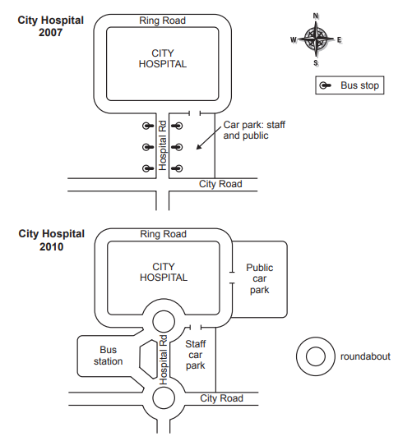
主体段写作练习
The two maps below show road access to a city hospital in 2007 and in 2010.
Summarise the information by selecting and reporting the main features, and make comparisons where relevant.

Slide 31
范文赏析
It is clear from the 2007 map that the city hospital was located to the north of the city road and was surrounded by the rectangular ring road. The hospital road linked the former two roads, additionally providing three bus stops on either side of it. The car park for both staff and the public use was situated on the east side of the hospital road, with an entrance on the ring road.

Slide 32
范文赏析
The hospital's vehicle access altered considerably between the years. In 2010 the previous bus stops disappeared and instead a new bus station was built to the west of the hospital road. Although the three main roads remained unchanged, the junctions between these roads were converted to two roundabouts, thus proving access to the new bus station. Finally, a new car park, on the east side of ring road, was constructed for public use, and consequently the old car park became a designated area for staff parking only.

Slide 33
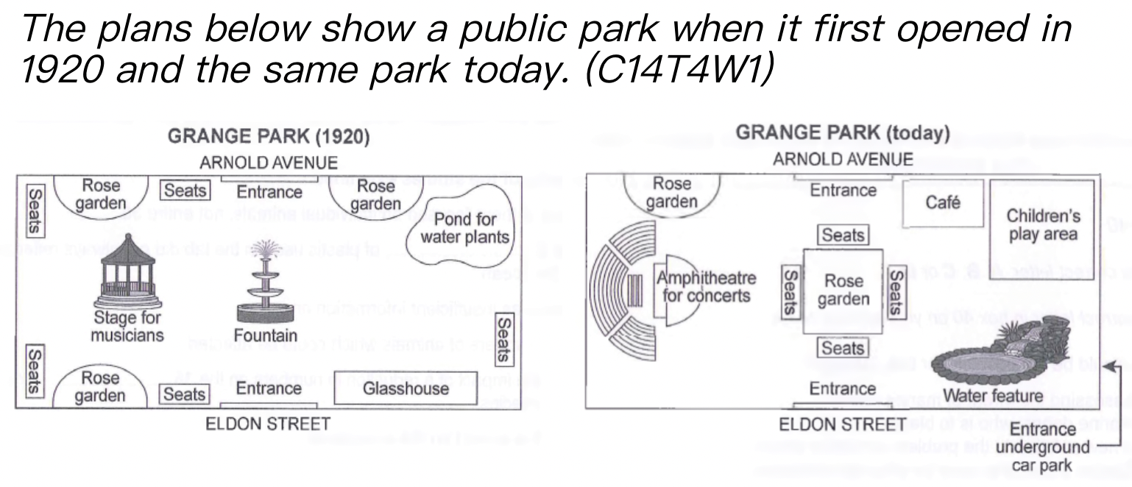
总结段
内容：
①改变大，
②主要新增设施类型，
③未改变之处
句式补充：
Overall, ③despite the retaining of 未改变处, ①sth experienced apparently significant changes, ②with the addition of 额外添加的设施.
设施：modernized facilities, commercial sites, recreational amenities, sports facilities
Overall, despite the retaining of two entrances and a semi-circular rose garden, this park has experienced apparently significant changes, with the addition of some modernized facilities.

Slide 34
总结段练习
内容：
①改变大，
②主要新增设施类型，
③未改变之处
句式补充：
Overall, ③despite the retaining of 未改变处, ①sth experienced apparently significant changes, ②with the addition of 额外添加的设施.
设施：modernized facilities, commercial sites, recreational amenities, sports facilities
Overall, despite the retaining of the main road design, facilities around the hospital have experienced apparently significant changes, with the addition of a new bus station, a public car park and two roundabouts.

Slide 35
In this Lesson
1. 地图题考点简介
2. 常用表达
3. 变迁图写法
4. 选址图写法

Slide 37
范文赏析
The map shows two proposed locations for a new supermarket for the town of Garlsdon.
The first potential location (S1) is outside the town itself, and is sited just off the main road to the town of Hindon, lying 12 kms to the north-west. This site is in the countryside and so would be able to accommodate a lot of car parking. This would make it accessible to shoppers from both Hindon and Garlsdon who could travel by car. As it is also close to the railway line linking the two towns to Cransdon (25 km to the south-east), a potentially large number of shoppers would also be able to travel by train.

Slide 38
范文赏析
In contrast, the suggested location, S2, is right in the town centre, which would be good for local residents. Theoretically the store could be accessed by road or rail from the surrounding towns, including Bransdon, but as the central area is a no-traffic zone, cars would be unable to park and access would be difficult.
Overall, neither site is appropriate for all the towns, but for customers in Cransdon, Hindon and Garlsdon, the out-of-town site (S1) would probably offer more advantages.（和其他小作文不同，可以有合理推测）

Slide 39
Recap on this Lesson
1. 地图题考点简介
2. 常用表达
3. 变迁图写法
4. 选址图写法

Slide 40
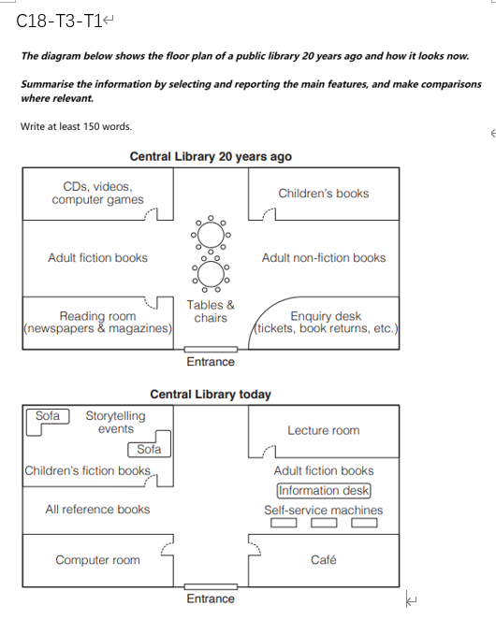
homework

Slide 41
PRACTICE MAKES PERFECT !
THANK YOU.

