Slide 1

雅思写作技巧
Task 2
Argumentation
论证方法

Slide 2
IELTS WRITING LESSON 7
1. 关于论证的评分标准
2. 常用论证方法
3. 论证方法的结合使用

Slide 3
IELTS WRITING LESSON 7
1. 关于论证的评分标准
2. 常用论证方法
3. 论证方法的结合使用

Slide 4
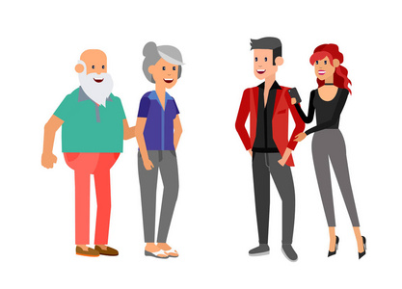
1.关于论证的评分标准
In some cultures, it is argued that the old age should be valued, while in some cultures
youth is more valued. Discuss both views and give you opinion.（2019.11.0 7）
请给以下两篇学生作文主体段1的TR(task response)评分

Slide 5
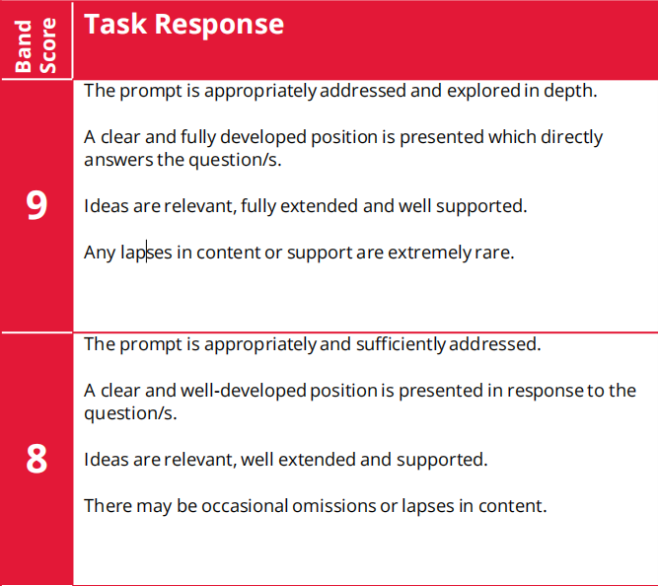
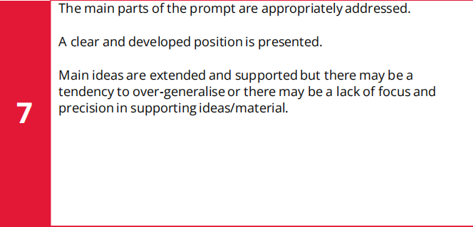
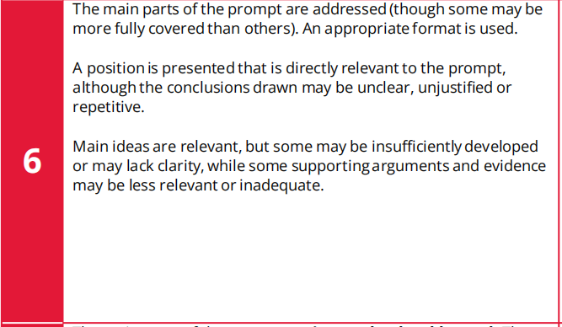
1.关于论证的评分标准

Slide 6
议论文基本逻辑结构
position
idea1
idea2
idea3
supporting
details
supporting
details
supporting
details
论证过程

Slide 7
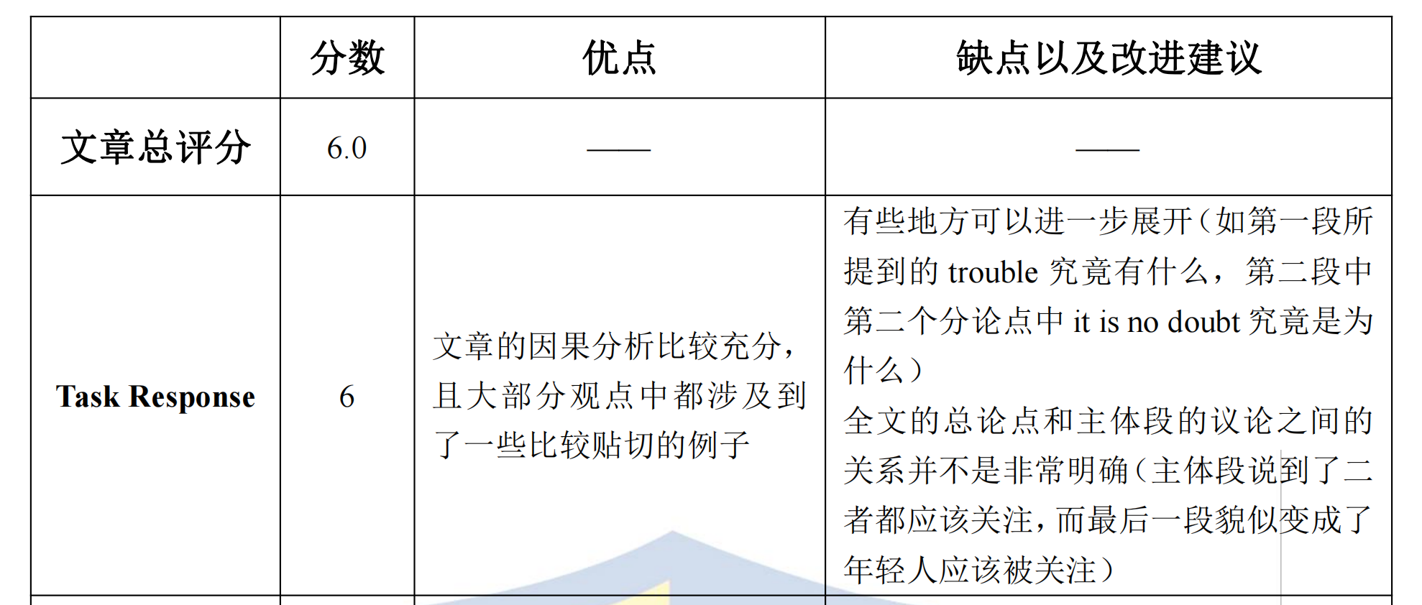
1.关于论证的评分标准
sample answer 1
A wealth of evidence in support of that elderly people should be valued. First of all, the old generation is the vulnerable group, which without any support, will get into trouble immediately. It is often reported that old people starve to death only due to their children do not take any supporting responsibilities. Therefore, the old need more attention to guarantee their basic living condition. In addition, it is not doubt that elderly people are the treasures for the whole society. With rich life experience, they can provide the young with advice that can help them avoid making mistakes.

Slide 8
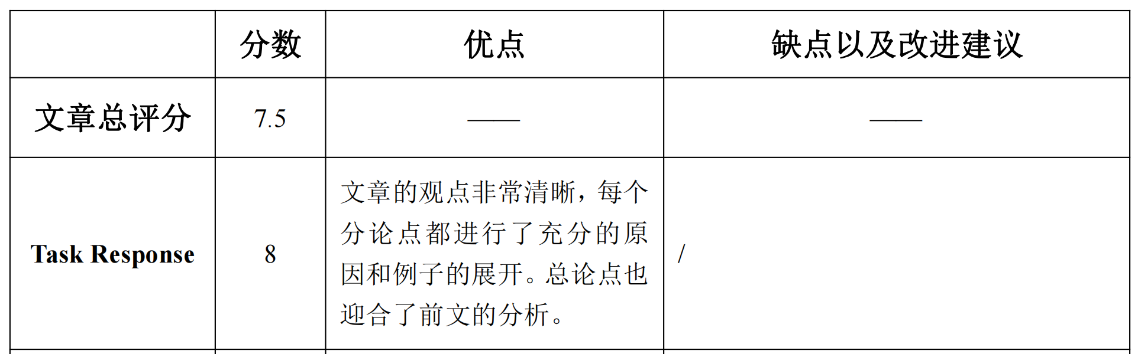
1.关于论证的评分标准
sample answer 2
For one thing, the old age is one of the most crucial periods in one’s lifetime.When people enter their twilight years, they have accumulated abundant life experience in facing challenges and overcoming adversity, which is wisdom for them to solve problems that are likely to emerge in later life. Furthermore, individuals in their advanced age may enjoy more respect and reputation brought by
their wealth and wide social contacts. This sense of achievement makes it possible for them to feel less confused and more calm during this period.

Slide 9
IELTS WRITING LESSON 7
1. 关于论证的评分标准
2. 常用论证方法
3. 论证方法的结合使用

Slide 10
三大常用论证方法
Development by Reason
Development by Exemplification
Development by Contrast

Slide 11
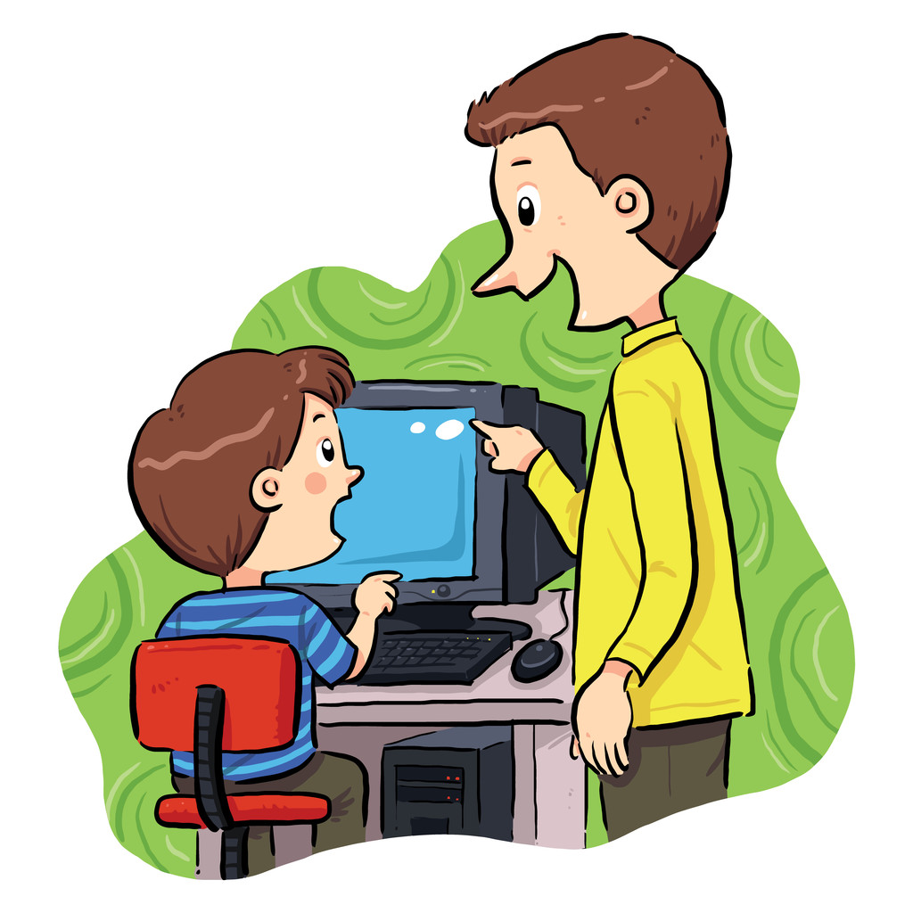


因果论证
根据客观事物之间都具有这种普遍的和必然的因果联系的规律性，通过揭示原因来论证结果，就是因果论证。
More and more parents are allowing their children to play on computers and tablets as they think that children should learn technology skills. Do the advantages of this development outweigh the disadvantages? (2019.08.17)
impair eyesight
become short-sighted
have more screen time
eyestrain
visual fatigue
overuse of eyes

Slide 12


Playing on computers and tablets can also have a negative impact on children, both physically and mentally. From the mental perspective, children who indulge themselves in it ____________ have difficulty forming friendships and productive social networking. In their imagination, the world is shrinking ____ they begin to stop engaging in real-life, preferring the fantasy world offered by technology instead.
are likely to
as
indulge themselves in playing computer
have difficulty forming friendships and productive social networking
stop engaging in real-life, preferring the fantasy world offered by technology instead

Slide 13
常见逻辑关系词 （因果）
原因（连词）: as/because/since+句子
Because/since there is fierce competition among colleagues, people have too much pressure.
原因（介词）: due to / owing to / because of+名词/动名词/名词性从句（that… ）
Due to the fierce competition among colleagues, people have too much pressure.
原因（名词）: The reason why... is+名词/动名词/名词性从句（that… ）
The reason why people have too much pressure is the fierce competition among colleagues.
The reason why people have too much pressure is that there is fierce competition among colleagues.

Slide 14
常见逻辑关系词 （因果）
结果（副词）: as a result/ therefore/ hence/ consequently/ thus/ therefore/ as a consequence/ accordingly
There is fierce competition among colleagues; therefore, people have too much pressure.
There is fierce competition among colleagues. Therefore, people have too much pressure.
结果（动词）: result in/ create/ lead to/ bring about/ give rise to/ contribute to/ be responsible for/ attribute…to…/be likely to...
The fierce competition among colleagues creates / leads to/ gives rise to increasing pressure on people.
结果（连词）: so that…/so...
There is fierce competition among colleagues, so people have too much pressure.

Slide 15
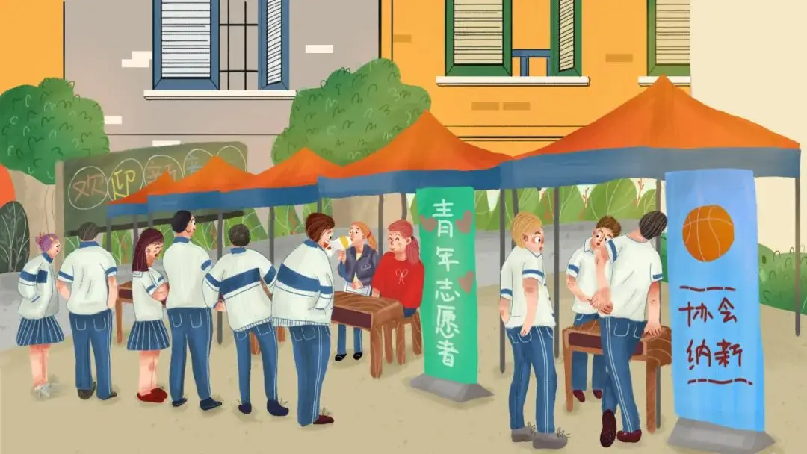
练习1
使用因果论证完成段落：
Write one of the positive effects of going to a university
One obvious advantage for students going to university is that studying in university may ____________ enhancing the students’ communicative abilities. This is primarily ________ students living on the university campus can get plenty of opportunities to communicate with different people, such as their roommates, classmates and tutors.
contribute to
because

Slide 16
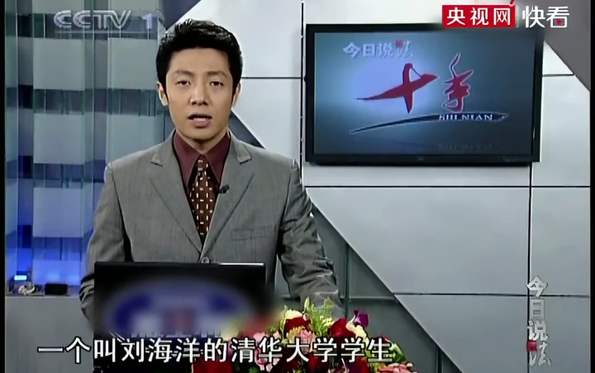
练习2
In some countries, some criminal trials are shown on the TV and the general public can watch them. Do the advantages outweigh the disadvantages?(2016.10.22)
Two benefits could be considered in terms of criminal trials on TV. For one thing, this practice can be regarded as a deterrent for potential lawbreakers. If severe punishment could be noticed by possible offenders through TV programs, they might think twice before committing crimes, ___________ lower crime rates in particular areas. For another, residents watching criminal trials tend to have a sense of security. It is undeniable that the crime rates in a large number of metropolises have been increasingly high recently __________ people are likely to live under great anxiety and intense pressure. If they became aware of how criminals commit crimes literally, they would know how to carry out self-protection __________.
contributing to
so that
accordingly

Slide 17
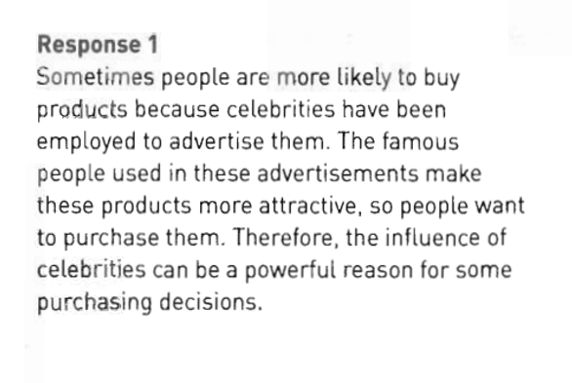
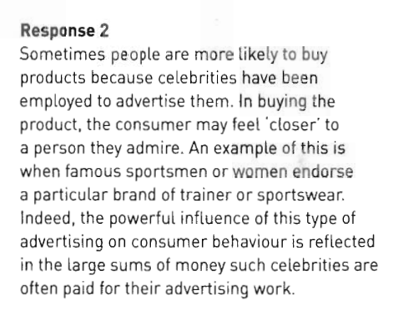

举例论证
Do we mainly buy things because we need them, or are other factors involved ?

Slide 18
举例论证
举例论证,是指运用典型事例来证明论点的方法,所举的具体事例能证明论点
注意：
1.例子要有普遍性和典型性，过于片面不具有说服性。 2.所列举的内容必须符合常识和逻辑，要有事实依据，不能凭主观想象捏造
Notes:
Defend against

Slide 19
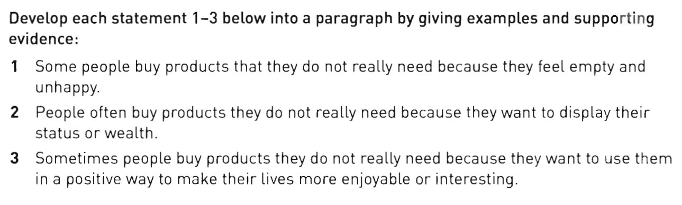
练习1-3
《第七代强化版》P62
烟酒/甜食alcohol/cigarettes/sugary foods---enhance mood
买限量版 limited edition
买名牌high-value brands (prominently display logos)
可支配收入disposable income用于hobbies（e.g. blind box）
（和survival无关，但是contribute to quality of life）

Slide 20

常见逻辑关系词 （举例）
例如（副词）: for example, for instance, as a proof, as an illustration/example
用于举出一个具体案例, 一般只举同类人或物中的"一个"为例
作插入语,可位于句中：
例子（主语），for example，谓语（+宾语）...
There may indeed be good arguments for allowing certain posts to remain predominantly male or female. Where all-male or all-female groups exist, there may be a need for related posts to be held by men and women respectively. Patients in all-female hospital wards, , would probably appreciate having female nurses to look after them. It could also be argued that certain jobs requiring a great deal of physical strength; coal mining or logging, , should continue to be done mainly by men.
for example
as an illustration

Slide 21
常见逻辑关系词 （举例）
例如（句型）:
A good case in point is +名词+ who/which等定从
A typical example can be found in +名词 + who/which等定从
This is true given the example of +名词 + who/which等定从
…（论点句），which may include +名词+ who/which等定从
There may indeed be good arguments for allowing certain posts to remain predominantly male or female. Where all-male or all-female groups exist, there may be a need for related posts to be held by men and women respectively. This is ture given the example of patients who would probably appreciate having female nurses to look after them. It could also be argued that certain jobs requiring a great deal of physical strength; coal mining or logging, as an illustration, should continue to be done mainly by men.
-> A typical example can be found in coal mining or logging which should continue to be done mainly by men.

Slide 22
举例说明常用表达
例如（介词）: such as, like, including
用于列举事物时
后面只能跟名词或动名词
such as/like/including后不打逗号
例如:
Students do not need to travel to school or attend classes at a fixed time if they register a distance-learning programme. This convenience means much to some group of people with special need to get education, such as full-time workers who are busy with work, mothers who need to take care of their babies and disabled people.
In addition to academic knowledge, a university is supposed to equip students with many other skills, including leadership and organizing skills developed by working for students’ union, cooperation and social skills gained through participating in various clubs.

Slide 23
对比论证
对比论证，是把两种事物或者一种事物的两种情形加以对照、比较后，推导出其间的差异，使结论映衬而出的论证方法。
（1）正反对比：同一对象正反两个方面的对比
（2）横向对比：不同对象在同一情况下的对比
（3）纵向对比：同一对象在不同时间的对比

Slide 24
常见逻辑关系词 （对比）
相反地（副词）: On the other hand / Conversely/In contrast/ Nevertheless/ Instead
相反地（连词）: while/ whilst/ whereas
相反地（介词）: Unlike…/In contrast with…/In comparison with… / Compared with…+名词/动名词

Slide 25

（1）正反对比：通过假设观点不成立时会产生相应消极结果，证明观点的合理性
It is important that college students should learn adequate computer skills. This is an information age when a good understanding of technology will give them an edge. On the other hand, if one had little knowledge of computer skills, a student would lag behind the times.
表示与现在事实情况的假设
if/supposing that/provided that+从句, 主句。
从句：谓语动词用一般过去式（be用were）
主句：谓语动词用过去将来时（ should/would/could/might+动词原形）

Slide 26
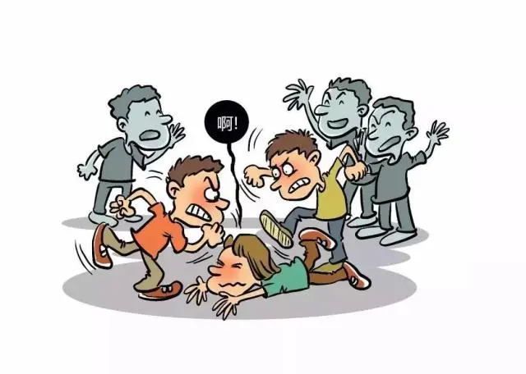
练习1
反之，如果年轻人在没有来自父母的适当保护的情况下直接面对社会上所有的诱惑，他们就会比和父母生活在一起的同龄人更有可能走上犯罪道路。
Sample answer
________, ____ young adults ______ exposed to all the temptations and evils of society without proper protection from their parents, they __________ more likely to commit crime than their peers who live with their parents.
Conversly
if
were
would be

Slide 27
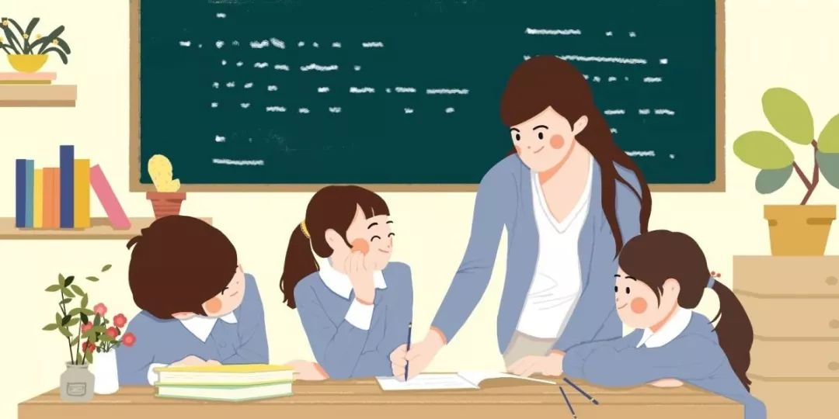
（2）横向对比：通过论述不同对象之间的差异，来证明本论点的正确性
Only under the supervision of a teacher can students study effectively. A computer can easily distract students due to the user’s tendency to engage in online games, a chat with friends and a host of other non-productive pastimes. By contrast, a teacher always tries to draw every student’s attention through interactions in class.

Slide 28

练习2
Many people prefer to watch foreign films rather than locally produced films. Why could this be?
There are various reasons why many people find foreign films more enjoyable than the films produced in their own countries. Firstly, the established film industries in certain countries have huge budgets for action, special effects and to shoot scenes in spectacular locations. The poor quality, low-budget filmmaking in many countries suffers in comparison.

Slide 29

（3）纵向对比：同一对象在不同时间的对比，如从过去-现在-将来三个角度进行对比
As we are ushered into a new era, the demand for labour has shifted its focus. In the past, companies only required their employees to be loyal and to follow the supervisors’ instructions. But nowadays, employees with creativity and imagination are most welcome in the job market.
in the past/previously/formerly
nowadays/currently/contemporarily

Slide 30

练习3
New technologies and ways of buying and selling are transforming the lives of consumers.
Sample answer
The development of online shopping has meant that the market for goods available to the individual has grown exponentially(指数地). It is possible to buy anything virtually from a world-wide retail market, namely: exotic foods, rare books, and so forth. Products that _____ once only available to those who ______ in large cosmopolitan(国际化的) cities with a wide variety of shops now __________ bought by those living in small towns with few local amenities(便利设施).
were
lived
can be

Slide 31
IELTS WRITING LESSON 7
1. 关于论证的评分标准
2. 常用论证方法
3. 论证方法的结合使用

Slide 32
3. 论证方法的结合使用
因果+举例
因果+对比
因果+对比+举例

Slide 33
因果+举例
（中心句）Participation in non-academic activities has several benefits. Firstly, the experience gained in social activities, including community service, marketing surveys and volunteer work, can help students to better understand society and their relationships with it. These activities also improve their communication skills and teamwork skills. Secondly, unlike academic activities which are generally stressful, extra-curricular activities such as sports and artistic activities are usually fun and enjoyable. Participation in these activities can help students to reduce stress and anxiety. Thirdly, some extra-curricular activities can help to boost students’ academic performance. For example, playing chess improves students’ logical and critical thinking abilities, while writing for the university newspaper helps students to develop their writing and analytical skills, which are also important skills for academic success.

Slide 34
因果+对比
On one hand, in terms of the limited time in school education, it is better for teachers to focus on only teaching academic subjects. In fact, the studying schedule of children in school is very tight and stressful, because a variety of academic courses, from math to physics to literature, contain too much knowledge, too many skills and theories that should be instilled into minds of children by teachers. In contrast, if children were forced to learn extra information about ethics, they would be defeated with an overwhelming amount of knowledge, assignments and exams. Therefore, such information overload will make children lose the energy, concentration and passion on general studying.

Slide 35
因果+对比+举例
Some people believe that children should stay at home until they are six or seven years old. This idea is based on the belief that parents are children’s best early teachers. Parents’ interaction with them can build their confidence, stimulate their language development and encourage them to solve problems creatively. It can also be argued that some children are not mature enough for school before the age of six or seven. If they attend school too early, they may develop behavior problems such as being easily distracted and breaking school rules.

Slide 36
Homework
Employers should give its staff at least four weeks holidays a year to make employees better at their jobs. To what extent do you agree or disagree? (2014.05.15 & 2019.03.02 & 2019.05.18)

