Slide 1

Academic Writing
Task 2 审题

Slide 2
如何审题？

Slide 3
1. 审题 | 写作任务
题型 | 背景事实 | 背景观点 | 写作任务
权衡利弊
双方讨论
同不同意
报告
1. 利大于弊还是弊大于利
2. 好事还是坏事
√
（√）
（√）
√
讨论双方观点，并给出自己的观点
（√）
√
是否同意，以及是完全（不）同意还是部分同意
√
1. 分析原因 2. 分析影响 3. 提供解决方案

Slide 4
审题 | 题干信息
常见忽略信息
限定 | 目的
 | 范围 | 对象
特殊关系 |  | 条件
 |  | 因果
In order to/so as to/for…
绝对词
1. 绝对程度（最高级） 2. 绝对范围（全/唯一） 3. 绝对频率（总是/几乎不）
比较 vs. 代替
instead of/rather than
因果
because/so…that…
比较
并列

Slide 5


IELTS writing – Task Response 看懂题
限定词 – 绝对词
Most of world’s problems are caused by over-population. To what extent do you agree or disagree? (2019.05.11)
Intro: 同意
Body1: 问题1由人太多导致
Body2: 问题2由人太多导致
Body3: 问题3由人太多导致
Con: 同意
Intro: 倾向于反对
Body1: 确实有很多问题由人多导致
Body2: 但还是有更多问题并非由人多导致
Con: 倾向于反对

Slide 6
IELTS writing – Task Response 看懂题
限定词 – 绝对词
most/best/at least
always/never/hardly
impossible/not … anymore/no longer/too … to …
the only/no one/all/everyone
must/be required/be necessary/should

Slide 7
practice| 绝对词
The best way to reduce crimes by young people is to educate their parents with parental skills. To what extent you agree or disagree？
Introduction: partly disagree
Body1: -psychological problem of teenagers
-help teenagers build sound personality
Body2: -education- provide psychology/law-related lectures/ announcement to help teenagers have correct values
-social media – spread positive message
-build a safe and stable social society/cyber environment

Slide 8
犯罪类话题
高频表达
commit crimes/ break the law
犯罪
犯轻罪
犯重罪
罪犯
上升的犯罪率
青少年犯罪
预防犯罪
commit minor crimes
(vandalism, shoplifting, driving without a license)
commit serious/ severe crime (burglary, murder, rape)
criminals/ law breakers/ offenders/ culprits/ prisoners
people who commit crimes
people who break the law
the increasing/ rising crime rates
juvenile delinquency
prevent crimes

Slide 9
犯罪类话题
高频表达
punish/penalise criminals
惩罚罪犯
震慑罪犯
被关到监狱
反思行为
被释放
有犯罪记录的人
稳定收入来源
导致怨恨
deter criminals
be sent to/into prison/ jail
reflect on their actions
be released from prison
people with a criminal record
a steady source of income
lead to resentment

Slide 10
犯罪类话题
高频表达
reform criminals
改造罪犯
社区服务
心理咨询
就业培训
增强就业适应性
重新走入社会
守法和奉献的公民
community service
counseling
job training
increase employability
reenter society
law-abiding and contributing citizens
Notes:
introspect reflect on oneself

Slide 11
犯罪类话题
how?
2
enhance education and rehabilitation; become law-abiding citizens;
offer job training; prepare them for employment; help them reenter society; reform into contributing members of the society;
take non-violent means; engage in the community service;
enforce harsh/severe/tough punishment; have a deterrent effect; serve prison terms; deter crimes;
enhance social welfare system; ensure basic living standard, medical care;
take preventive measures; security measures; increase police control; install security cameras;
prevent crimes; use arms for self-defense;

Slide 12
IELTS writing – Task Response 看懂题
目的
Employers should give staff at least four weeks holidays a year to make employees better at their job. To what extent do you agree or disagree? (2019.03.02/2019.05.18)
Intro: 同意
Body1: 放假可以劳逸结合
Body2: 放假有时间去提升能力
Con: 同意
Intro: 倾向于反对
Body1: 适当放假确实有助于更好工作
Body2: 但至少4个星期可能太长, 反而不利于工作
Con: 倾向于反对

Slide 13
IELTS writing – Task Response 看懂题
目的
to/in order to/so as to
in order that/so that
for the sake of
be aimed at

Slide 14
practice | 目的
Most government money should be spent in teaching science rather than any other subjects in order for the development and progress of a country. To what extent do you agree or disagree?

Slide 15
Introduction: partly disagree
Body1: cultivate scientific talents to increase country competitiveness
engineering-help build social infrastructure
computer science – advanced technology
Body2: economics - foster relevant talents –
arts- enhance cultural diversity – promote domestic cultural development
protect traditional culture
PE – build up students’health – fit labor
psychology- transmit correct values- enhance the quality of the public

Slide 16
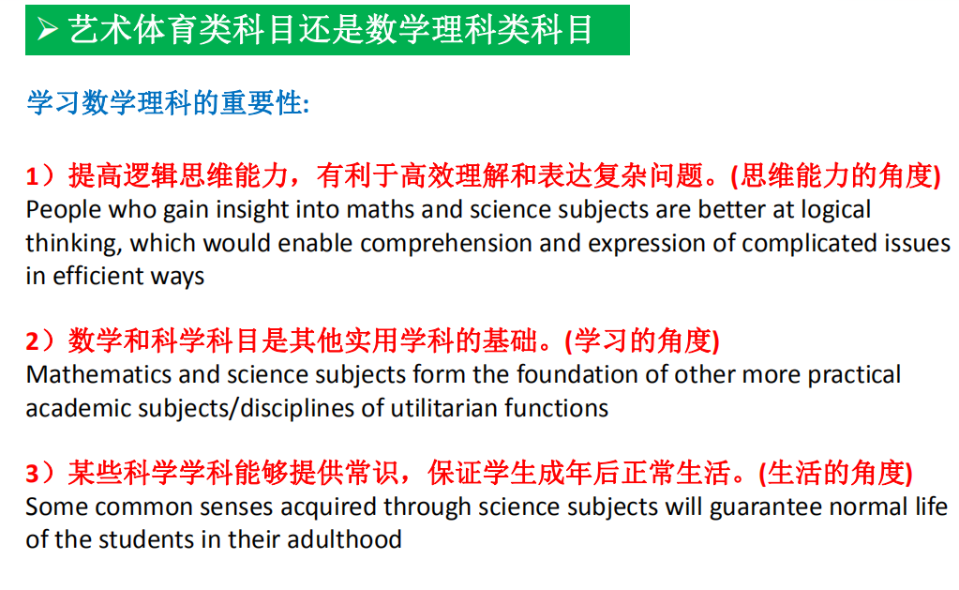

Slide 17
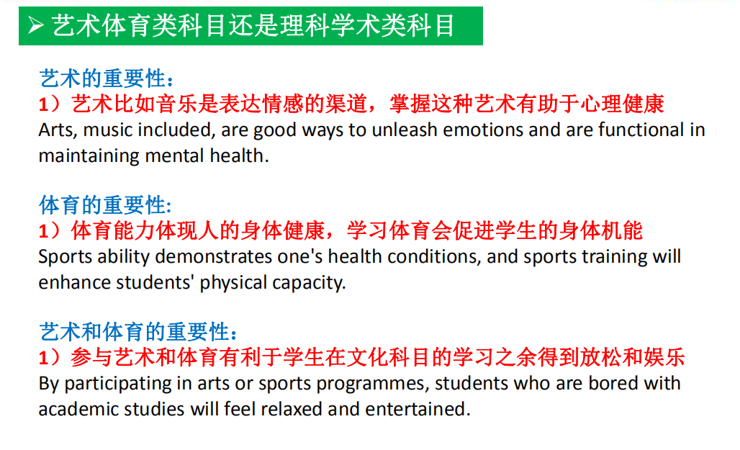

Slide 18
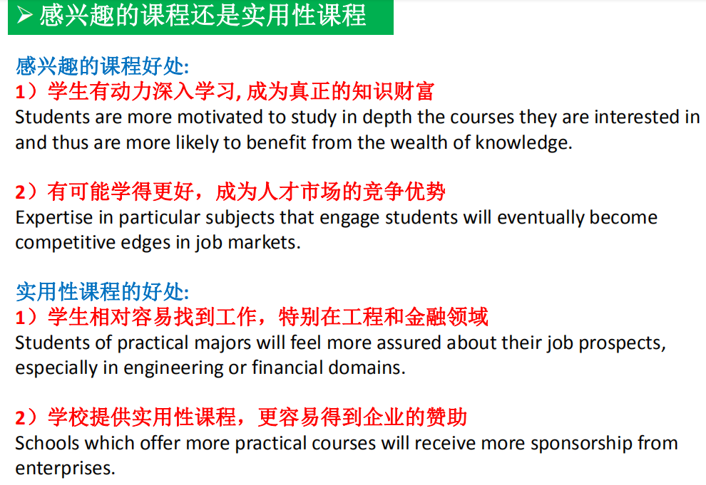

Slide 19
IELTS writing – Task Response 看懂题
因果
Some people say that economic growth is the only way to end world poverty and hunger, while some say that economic growth is harmful to environment, so we must stop it now. Discuss both views and give your own opinion. (2020.09.07)
View2: 经济确实对环境有害
View2: 经济对环境有害，
停止搞经济的确可能减缓环境恶化

Slide 20
IELTS writing – Task Response 看懂题
因果
因为
1）because/since/as/for/ considering that/ given that ..., ....
2）because of /owing to/ due to…，...
所以
1) for such reasons/ as a result / therefore/ consequently/ thus / hence/in consequence/ as a consequence/under these conditions,...
2) …, so/ so that....

Slide 21
practice | 因果
Schooling is no longer necessary, since more and more information is accessible on the Internet, and students can study just as well at home. To what extent do you agree or disagree？

Slide 22
教育类话题
教育目的
德： | Morally:
智： | Intellectually:
体： | physically:
美： | psychologically:
劳： | work:
提高道德标准
to improve moral standard
学习理论知识
theoretical knowledge
independent and critical thinking
analyzing skills and problem solving ability
communication and social skills
培养独立思考，批判性思维
分析和解决问题的能力
提高人际交流技巧和社交技能
提高身体素质
养成良好的生活习惯
to develop physical fitness
healthy lifestyle
提升文化修养
对艺术的欣赏水平
self-cultivation an appreciation of art
学习实用知识，加强动手能力
有助于将来就业
practical skills
to improve career prospects

Slide 23
教育类话题
教育功能
个人
社会
国家
能力：
发挥潜力
全面发展
为将来打基础
日新月异
社会及道德观
提供平等机会
权利和义务
民族融合
发展迅速
道德：
改变行为模式
性格：
塑造性格
增强适应力
Notes:
教育的功能分为三个层面去说，对于个人，教育意味着。。。

Slide 24
教育类话题
教育功能
个人
Individual
能力：
发挥潜力
全面发展
为将来打基础
1) development of inborn potentialities
2) an all-round development
3) preparing for the future
道德：
改变行为模式
4) modifying behaviour
性格：
塑造性格
增强适应力
5) shaping personality
6) helping for adjustability

Slide 25
教育类话题
教育功能
社会
Society
The society is progressive and dynamic rather than stationary.
Education helps people walk with the development of science and technology.
People should not believe in the blind beliefs, which are hindrances(阻碍) towards our development.
日新月异
社会及道德观
提供平等机会
Notes:
knows no bound 知识无界限，无尽头

Slide 26
教育类话题
教育功能
国家
Nation:
obligations
Inculcation(灌输) of social responsibility
National integration
Real education is an essential ingredient for all ages and stages of the life of an individual, society as well as the nation.
Education can be a real panacea [ˌpænəˈsi:ə](灵丹妙药) for all social evils.
权利和义务
民族融合
发展迅速
Notes:
Inculcation 谆谆教诲

Slide 27
IELTS writing – Task Response 看懂题
比较
Today, advanced science and technology have made great changes to people’s life, but artists are still valued high, such as musicians, painters and writers. What can arts tell us about life that science and technology cannot? (2020.09.12)
Intro: A, B
Body1: 艺术告诉我们A
Body2: 艺术告诉我们B
Con: A, B
Intro: A, B
Body1: 艺术告诉我们A, 但科技做不到
Body2: 艺术告诉我们B, 但科技做不到
Con: A, B

Slide 28
IELTS writing – Task Response 看懂题
比较
A是, B非:
A can…B cannot…
It is A … but not B …
rather than
instead of
A > B:
more … (important)
more than
better than

Slide 29
practice | 比较
Environmental problems are so big that they cannot be solved by any person or country alone. Instead, it should be solved at an international level. To what extent do you agree or disagree with this view?

Slide 30
Introduction: completely agree
Body1: 很多环境问题会从地区性转变成全球性，这就需要国际社会共同解决，仅仅依靠某个国家单方面单努力是无效的。 比如，全球变暖…
Body2： 某些国家经济落后、技术落后，需要其他国家的援助才能解决环境问题
Body3：权利-义务

Slide 31
环境类话题
导致原因
环境污染
non-biodegradable materials; buy packaged and canned food on a daily basis for convenience;
traffic pollution; increase greenhouse gas emissions; carbon dioxide emissions;
nuclear accidents; nuclear wastes; toxic waste;
生态破坏(动物相关)
log forests; destroy wildlife habitats; reduce biodiversity;
endangered animals; illegal wildlife products; become extinct
animal testing; cause suffering to animals; cruel and inhumane

Slide 32
环境类话题
解决方法
individuals should also try to be greener
使用公共交通，减少私家车出行
take more public transportation rather than drive around in private cars
尽量不适用一次性产品disposable，选择包装简单的商品choose products with less packaging，多回收利用recycle as much as possible
个人
Notes:
sort the daily garbage; consume less and recycle more;

Slide 33
环境类话题
解决方法
守法 obey the related environmental regulations and give serious thought to the severe consequence of contamination
引进设备技术处理污染 import advanced facilities to treat sewage and exhaust discharged from the process of production
使用新能源，清洁能源 clean/ alternative energy 提高能源利用率 increase the fuel efficiency
使用高科技环保材料hi-tech environmentally friendly materials替代传统材料，如可降解塑料袋 degradable plastic bags
企业

Slide 34
环境类话题
解决方法
立法 introduce some practical laws and regulations to ensure that both individuals and companies to take the environment into consideration when buying or producing something (限制塑料袋 ban the use of plastic bags in the supermarkets to tackle the problem of “white pollution”; 限制工厂排放 limit emissions from factories)
收税 impose “green taxes” on drivers and airline companies
投资科技 invest in renewable energy from solar, wind or water power
提高意识 government campaigns should raise public’s green awareness
建立自然保护区 set up natural reserve
国家
Notes:
exploit renewable energy; encourage low carbon lifestyle; avoid using throw-away products;offer subsidies to hybrid car buyers;

Slide 35
环境类话题
解决方法
国际合作global cooperation的原因： 1>共享地球资源 share the earth supply 2>有些环境问题会从地区性的regional变成全球性的worldwide，单方面的努力是不够的 unilateral moves are not enough
国际合作的措施：1> reach the agreement 2> set international standards for environmental protection 3> cover the shortage of the technology and labor force
国际

