Slide 1
Apache DevLake
A Decision-Maker’s Guide | Eldrick Wega · Microsoft

Slide 2
What this guide covers
Part 1 — Understanding DevLake. What it is, what you get, how the architecture works, and the core concepts.
Part 2 — Making the decision. When DevLake fits and when it doesn’t, how it compares to alternatives, and what it costs to run.
Part 3 — Adopting DevLake. A phased path from laptop to production, plus the dashboards you’ll actually see.
For engineering leaders, DevEx/platform teams, and architects evaluating Apache DevLake.

Slide 3
Part 1
Understanding DevLake

Slide 4
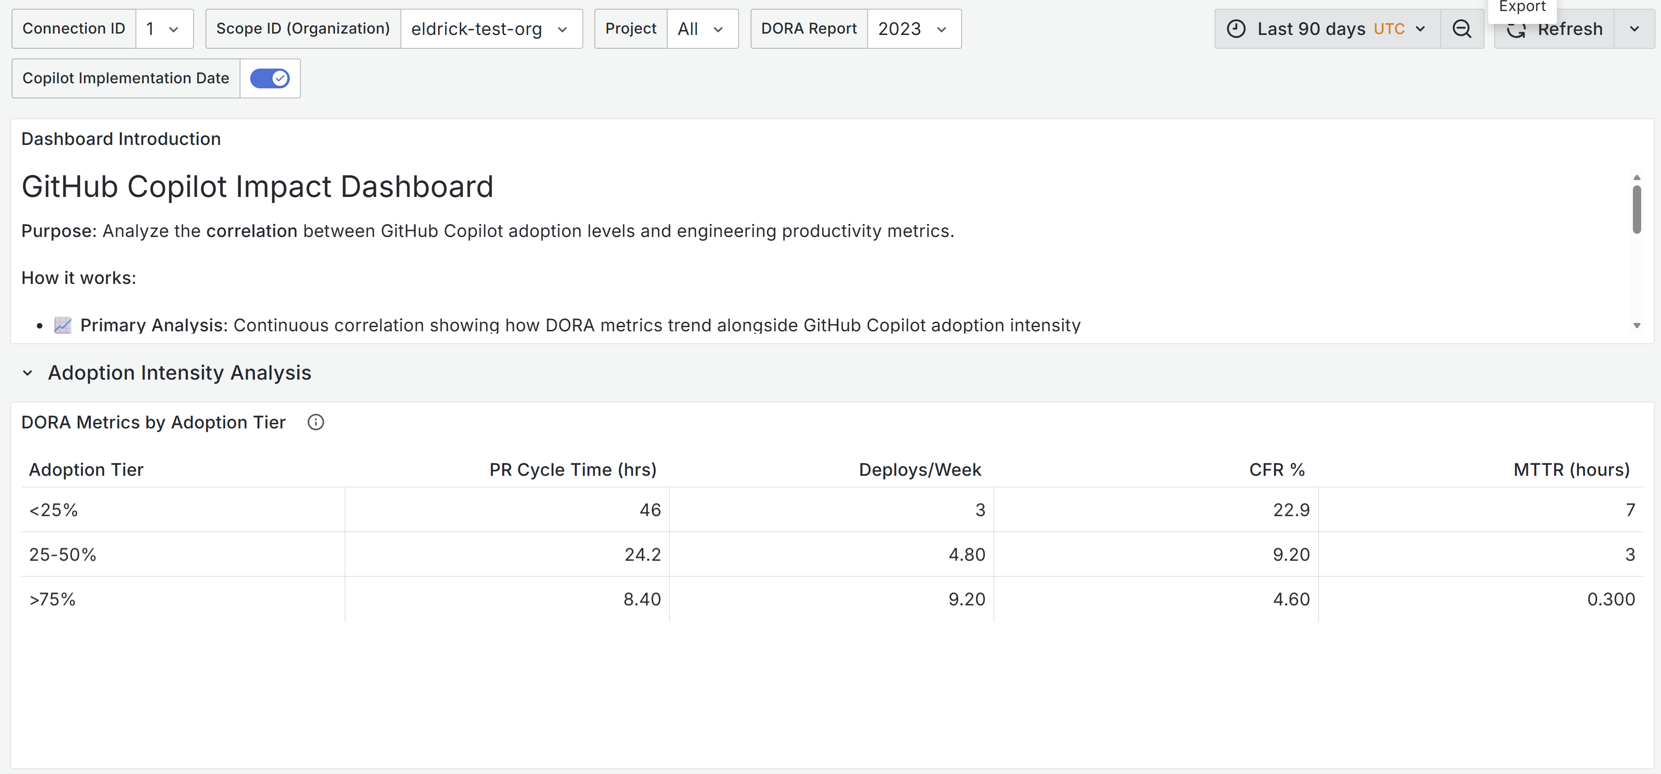
Copilot adoption tells you it’s being used — not whether it’s helping
GitHub’s built-in Copilot metrics (seats, acceptance rates, editor mix) show rollout health. They don’t tell you what that usage is doing to software delivery.
Answering the impact question requires correlating adoption with DORA metrics — which live in separate systems (CI/CD, issue tracker, source control).
Apache DevLake brings those signals into one place so the correlation becomes visible.
Example: teams in the >75% adoption tier show faster PR cycles, more frequent deploys, lower CFR, and faster recovery.

Slide 5
What Apache DevLake is
Open source. An Apache Software Foundation (Incubating) project — not a vendor product.
A dev data warehouse, not a dashboard. It ingests raw data from your DevOps tools into a normalised schema, then visualises it through Grafana.
20+ connectors. GitHub, Azure DevOps, Jira, Jenkins, GitLab, Bitbucket, SonarQube, PagerDuty, CircleCI, Copilot, and more.
Fully SQL-queryable. Every panel is backed by a SQL query you can inspect, modify, or extend.

Slide 6
What’s included out of the box
DORA dashboards
Copilot Adoption
Copilot Impact (Microsoft-built)
Deployment Frequency · Lead Time for Changes · Change Failure Rate · Mean Time to Restore.
Built-in Elite/High/Medium/Low benchmarking against DORA research.
30+ panels — DAU/WAU/MAU, acceptance rates, language/editor/model breakdowns, seat utilisation, feature mix (completions vs chat vs PR summaries).
Correlates adoption intensity (<25%, 25–50%, 50–75%, >75%) with DORA: PR cycle time, deployment frequency, CFR, MTTR, review time.

Slide 7
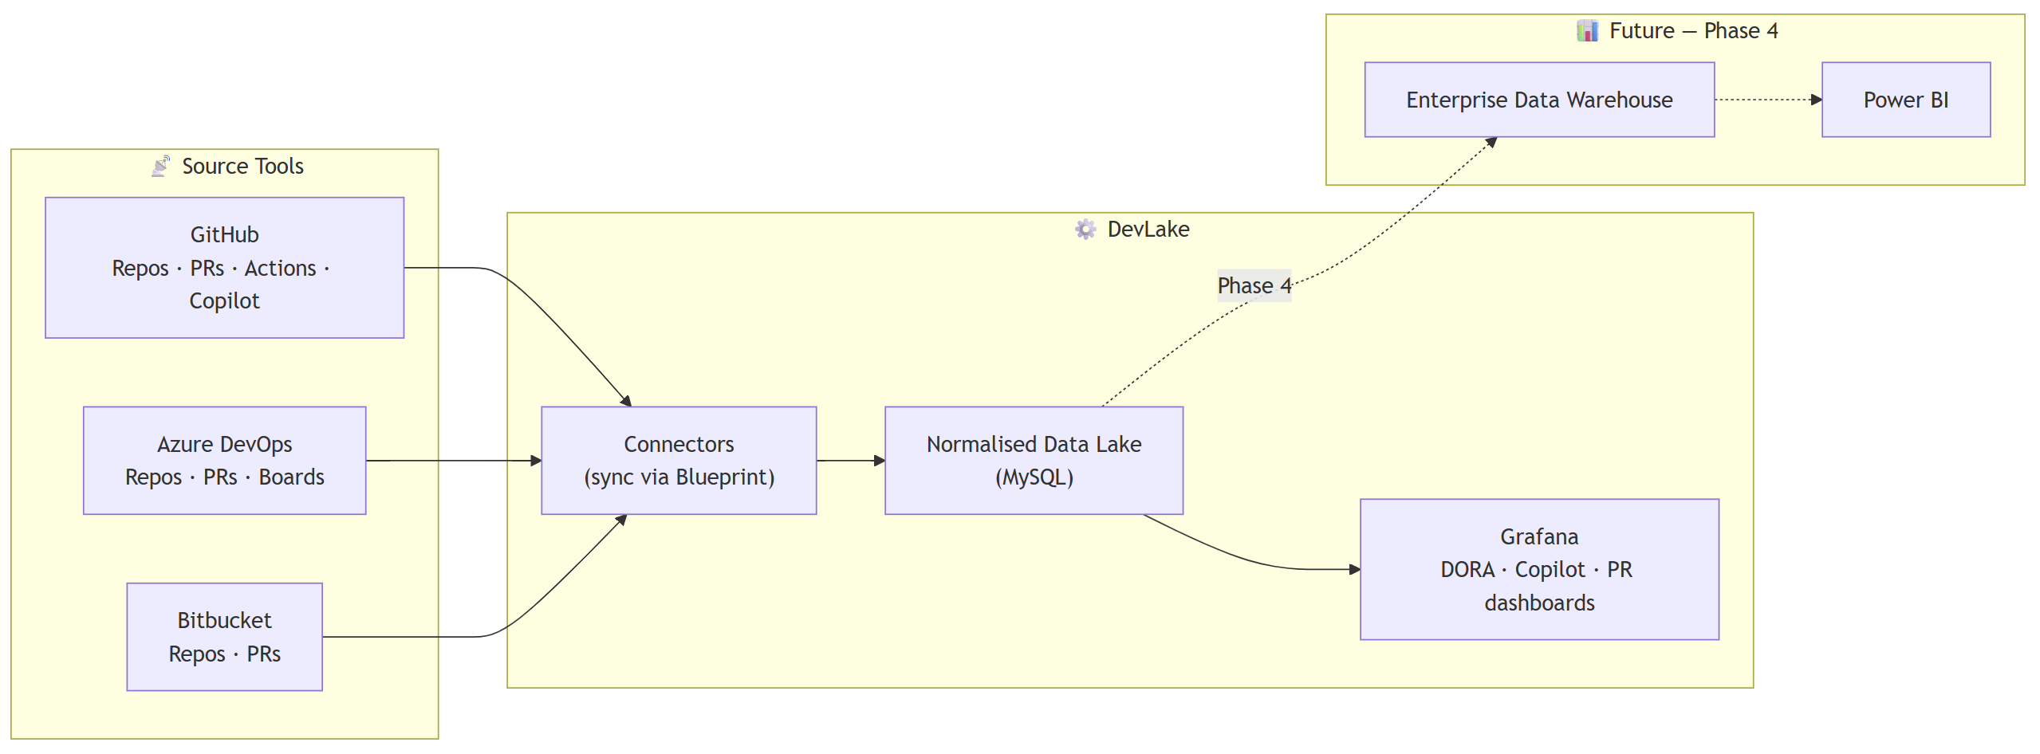
How it works
DevLake ingests data from your DevOps tools through connectors, normalises it into a MySQL data lake, and exposes it via Grafana dashboards.
Phase 4 (future): export to an enterprise data warehouse to blend engineering data with business/financial signals in Power BI.

Slide 8
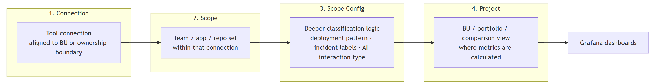
Four concepts drive everything
Connection. Authenticated link to a tool (e.g., your GitHub org).
Scope. What to collect within a connection — a repo set, a Jira board.
Scope Config. Rules for how raw data maps to DORA concepts: deployment patterns, incident labels, environment naming.
Project. Logical grouping of scopes — DORA is calculated at this level.
Blueprint. Recurring sync schedule (created automatically).

Slide 9
Part 2
Making the decision

Slide 10
When DevLake fits — and when it doesn’t
Fits well when…
You’ve rolled out Copilot and leadership wants to see measurable impact on delivery
Your toolchain is mostly GitHub, Azure DevOps, Jira, Jenkins, GitLab, or Bitbucket
You have a DevEx, platform, or engineering productivity team to operate it
You want to own the data and extend with SQL
You’re comfortable running self-hosted Grafana
Less suitable when…
You’re a small team without dedicated DevEx ownership
You have no CI/CD or incident signals (DORA depends on both)
You need a fully managed SaaS with no operational overhead
Your stack is primarily niche tools with no DevLake connector
You want out-of-box insights with zero configuration

Slide 11
DevLake in context
Capability
Copilot usage data
DORA metrics
Cross-tool correlation
SQL-level extensibility
Cost model
Apache DevLake
Yes (normalised)
Built-in
Yes (SQL)
Full
OSS + infra (~$30–50/mo on Azure)
GitHub built-ins
Yes (native)
No
No
Limited
Included
Commercial DevEx
(LinearB, Jellyfish, Swarmia)
Via integrations
Yes
Yes (proprietary)
Limited
$ per seat
Not a feature scorecard — a shape-of-landscape view. Choose based on ownership model, data access, and your team’s extensibility needs.

Slide 12
Cost, ownership, and the fine print
Cost & operations
Things to know
Local: free (Docker on a developer laptop)
Azure: ~$30–50 USD/month — Azure Container Instances + managed MySQL + Key Vault
Owned by a DevEx, platform, or engineering productivity team — not individual devs
Access via PATs or service credentials per data source
Apache Software Foundation Incubating — maturing project, not yet top-level
Some tools need webhooks or custom plugins (e.g., Azure Pipelines)
Data freshness depends on Blueprint sync cadence (daily default)
DORA accuracy depends on Scope Config (deployment patterns, incident labels) being set correctly

Slide 13
Part 3
Adopting DevLake

Slide 14
A practical adoption path
Phase 1 — Foundation
~1 week
Phase 2 — Expand
weeks 2–4
Phase 3 — Optimise
month 2
Phase 4 — Mature
month 3+
Local Docker deployment. Connect one or two source tools. Onboard 2 pilot teams. Prove DORA + Copilot data flows end-to-end.
Move to Azure-hosted instance. Add remaining connectors. Onboard priority teams or business units. Produce first cross-team AI impact views.
Tune Scope Configs. Build comparison dashboards across teams. Add PR lifecycle metrics. Migrate source hosts if in progress.
Extend with custom plugins or webhooks for unsupported tools. Integrate incidents. Export to enterprise data warehouse for business blending.

Slide 15
Getting started with gh-devlake
Install & initialise
gh extension install DevExpGBB/gh-devlake
gh devlake init
One command — install the GitHub CLI extension
Deploy anywhere — local Docker or Azure via Bicep (~$30–50/mo)
Guided wizard — deploy → connect → scope → project → first sync
Dashboards live at http://localhost:3002 (admin / admin)
Repo: github.com/DevExpGbb/gh-devlake

Slide 16
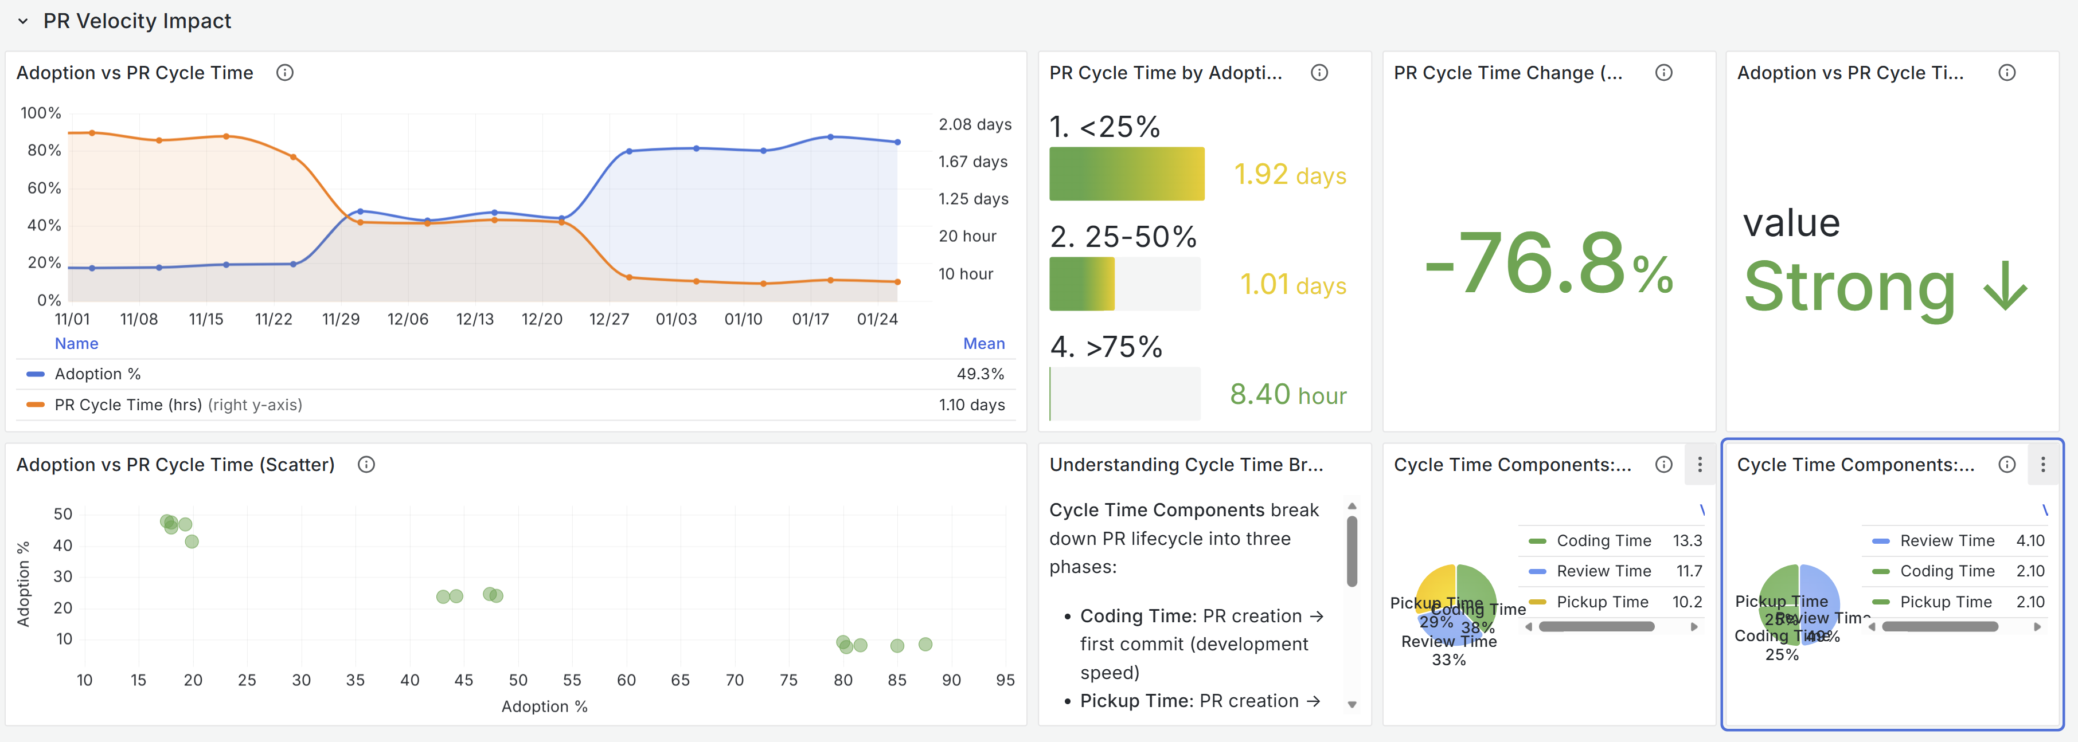
Example: PR Velocity Impact
Correlating Copilot adoption with PR cycle time reveals a −76.8% change in cycle time between the lowest and highest adoption tiers. Every panel is a SQL query you can inspect and extend.

Slide 17
Resources & next steps
Read
Deploy
devlake.apache.org
github.com/apache/incubator-devlake
DORA & Copilot metric docs
gh-devlake (GitHub CLI extension)
Docker Compose (local)
Azure Bicep templates
Reference
Dashboards
DORA research: dora.dev
Blueprint & Scope Config guide
Connector catalogue (20+ tools)
Grafana at localhost:3002
Default login: admin / admin
DORA + AI Impact presets included
Community
Next steps
Apache incubator mailing list
DevLake Slack workspace
GitHub Discussions & Issues
Run a two-team local pilot
Agree on DORA + AI metric set
Identify DevEx/platform owner

