Slide 1

North Wind
Real Estate Agency
Finding a Perfect Property Has Never Been Easier

Slide 2
About Us
Full-service real estate agency
Local market expertise
Residential & commercial
At North Wind,
we specialize in helping families, investors, and individuals find their dream properties.

Slide 3
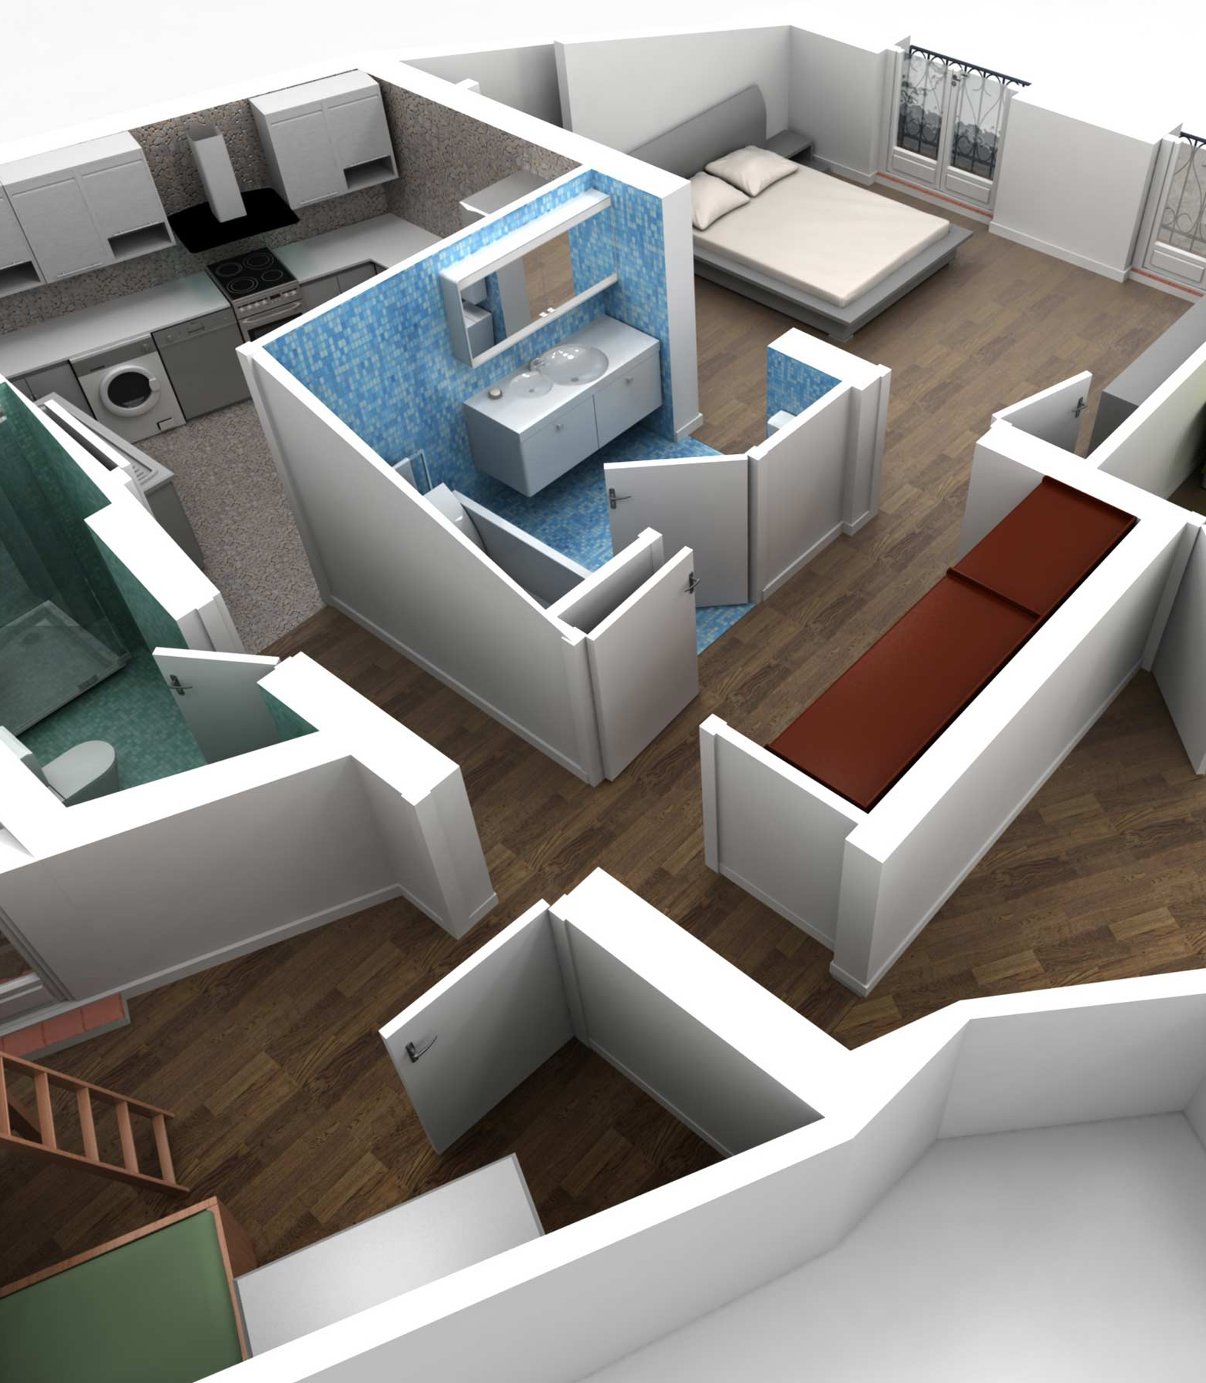
Our Services
We provide top-notch real estate services tailored to your needs.
Residential Sales and Rentals
Commercial Property Services
Property Management
Investment Advisory
Legal and Financial Assistance

