Slide 1

North Wind
Real Estate Agency
Finding a Perfect Property Has Never Been Easier

Slide 2
About Us
Full-service real estate agency
Local market expertise
Residential & commercial
At North Wind, we specialize in helping families, investors, and individuals find their dream properties.

Slide 3
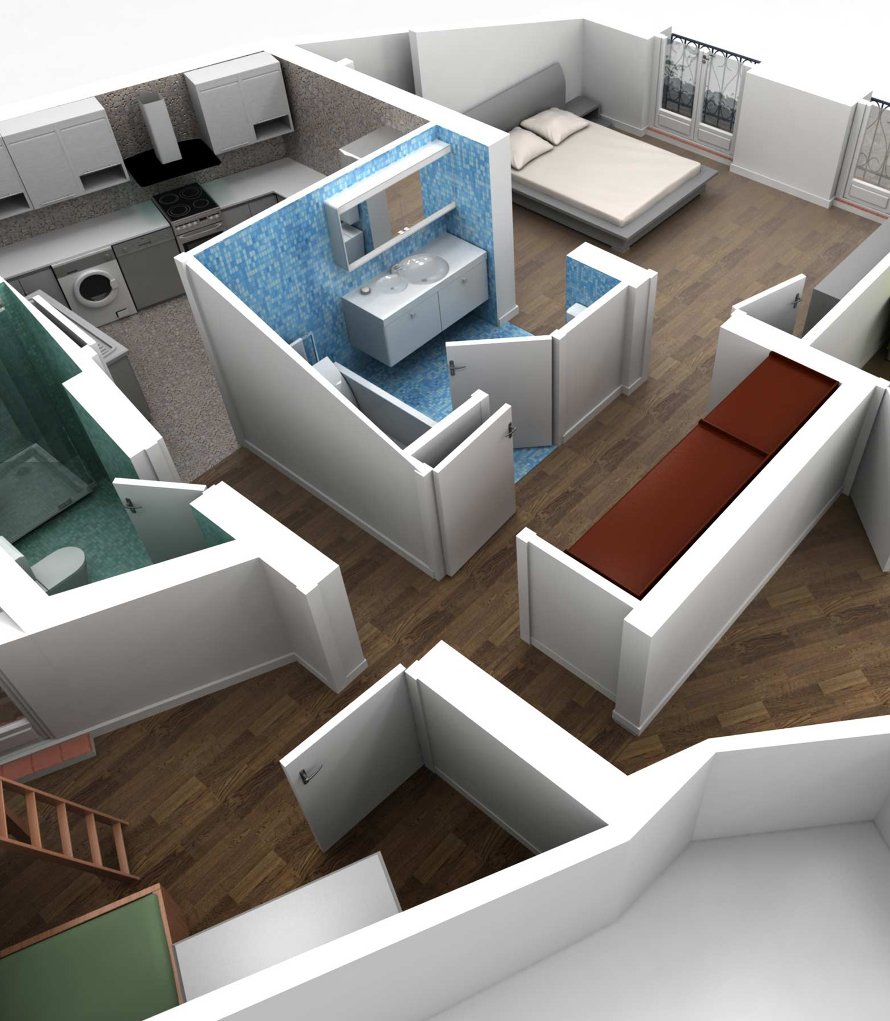
Our Services
We provide top-notch real estate services tailored to your needs.
Residential Sales and Rentals
Commercial Property Services
Property Management
Investment Advisory
Legal and Financial Assistance

Slide 4





Why Choose North Wind?
Trusted by thousands of clients
Award-winning customer service
Strong negotiation skills
Extensive property listings
Transparent and ethical practices

Slide 5
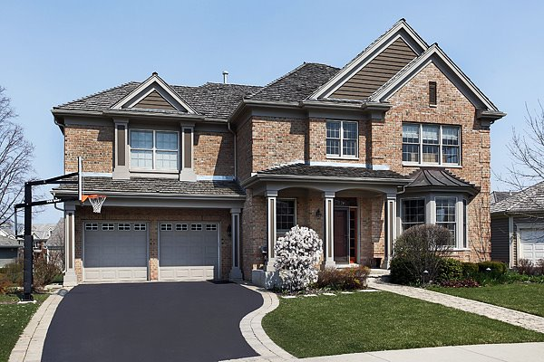
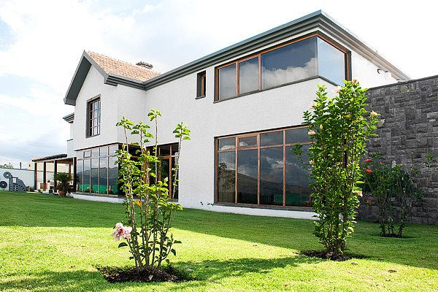
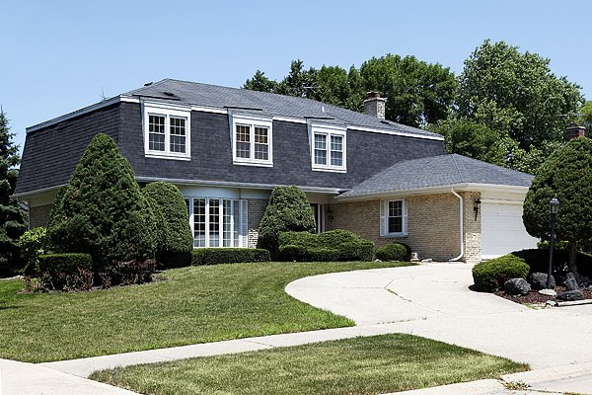
Featured Properties
Elegant Brick Colonial |  | Modern Garden Retreat |  | Stylish Family Residence
4 Bed, 3 Bath, 2-Car Garage, Landscaped Front Yard Spacious family home with a classic look, formal entry, and built-in playground. |  | 3 Bed, 2.5 Bath, Floor-to-Ceiling Windows, Private Backyard Contemporary design with open layout, full of light and outdoor views. |  | 4 Beds, 2.5 Bath, Attached Garage, Private Drive Bright colonial-style home with brickwork and a welcoming front entry.

Slide 6


Meet Our Agents
John Doe
Expert in commercial real estate and investment opportunities.
1-206-555-1417
john.doe@northwind.real
Jane Doe
Residential property specialist with 10 years of experience.
1-206-555-1418
jane.doe@northwind.real

Slide 7




Contact Us
One Unknown Way,
Twin Points WA, 98156
Phone:
1-206-555-1417
Email: contact@northwind.real
Website: www.northwind.real

