Slide 1

Removing financing obstacles through project structuring
Access to Finance for Local Governments
IV World Water Forum
March 17, 2006
Antonio Vives
Manager, a.i.
Sustainable Development Department
Inter-American Development Bank

Slide 2
Outline of the presentation
Project preparation
Project structuring

Slide 3
Project finance cycle
NEEDS
Preparation
Structuring
Financing

Slide 4
Project preparation
One of the major obstacles to water and sanitation finance is project preparation
Low institutional capacity
A local affair, sometimes removed from decision making centers
Difficult political and economic conditions
Scarcity of financial resources: users, taxpayers, markets
Project preparation not given the key role

Slide 5
Project preparation
Donors and multilaterals financial institutions must emphasize support for the early stage.
We at the IDB hope to approve on Monday a Project Preparation Fund with grants for capacity building and project preparation
Donors should consider “debt for water swaps” as part of their official assistance.
Both would leverage other funds: “teach them how to fish instead of giving them fish”

Slide 6
Project structuring
Financial structures adapted to local realities
Exploit all possibilities to maximize synergies between scarce resources: own labor, tariffs, donors, multilaterals, public and private resources
At one extreme, cooperatives, water microenterprises, municipal utilities
In the middle, management contracts, for operation, maintenance, collections, etc.
At the other extreme, full-fledged concessions

Slide 7
Project structuring: local conditions
Willingness to pay/local views
Tariff sustainability
Site and location
Institutional capacity
Fiscal space
Legal framework
Political risk
Macroeconomic conditions

Slide 8
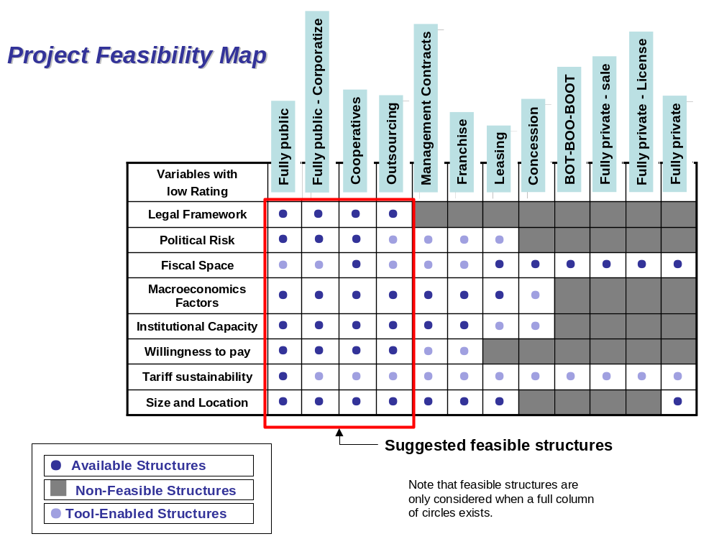
Local conditions

Slide 9
Water financing model
Sesión FT3.40,
Domingo 19 marzo, 11:00 am
Diezmo 4

Slide 10
In summary
Project preparation and structuring may not be a source of funds, but can help bring funds and enhance the long term sustainability of water projects
All actors, all sources, all structures must be explored

Slide 11
Removing financing obstacles through project structuring
Access to Finance for Local Governments
IV World Water Forum
March 17, 2006
Antonio Vives
Manager, a.i.
Sustainable Development Department
Inter-American Development Bank

