Slide 1
PPT_FONTS_MATH_HANDOUT_009
Fixture ID: powerpoint-fonts-math-handout-009
ABCDEFGHIJKLMNOPQRSTUVWXYZ abcdefghijklmnopqrstuvwxyz 0123456789
Symbols: € £ ¥ Ω π ± × ÷

Slide 2
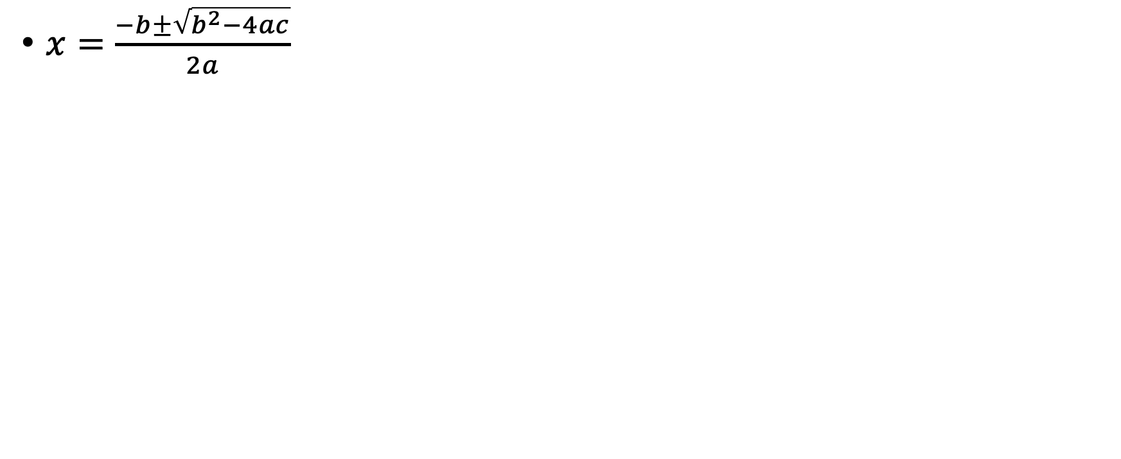
NATIVE_EQUATIONS_009

Slide 3
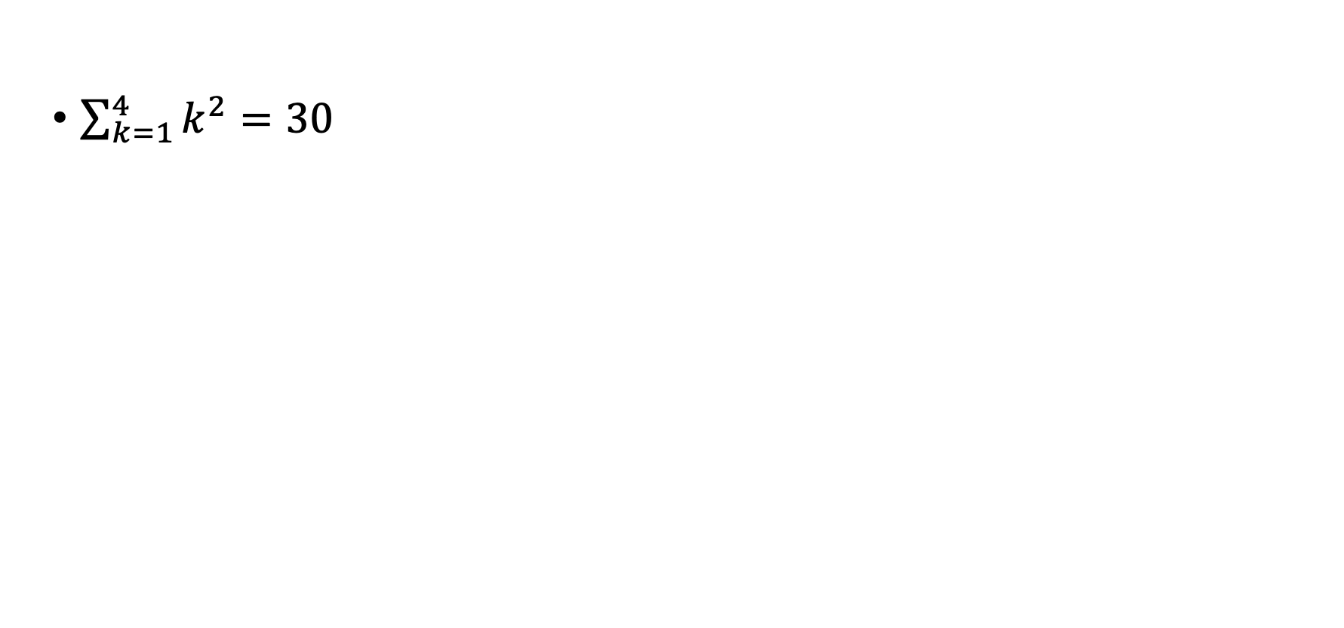
NARY_EQUATION_009

Slide 4
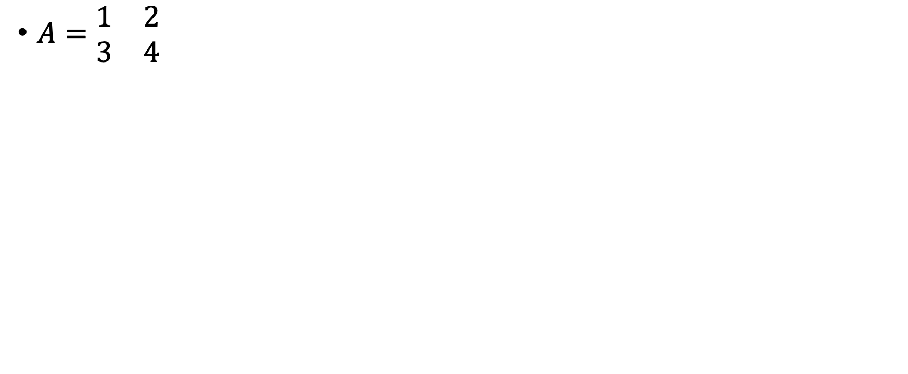
MATRIX_EQUATION_009

