Slide 1
Native PowerPoint visual objects
Fixture ID: powerpoint-visual-objects-002
Pictures, drawings, charts and SmartArt

Slide 2
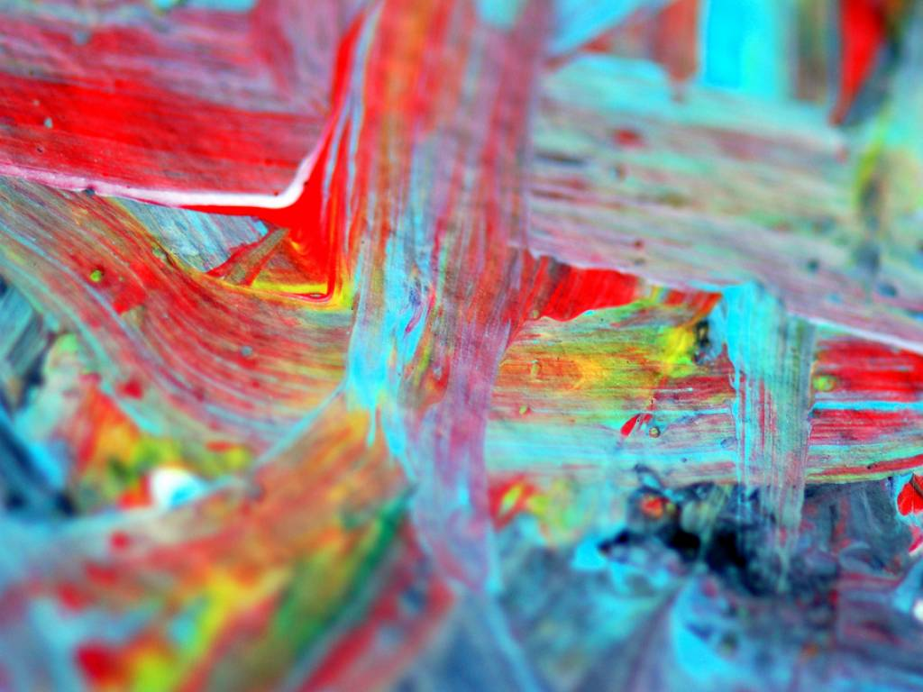
EMBEDDED_PICTURE_002

Slide 3
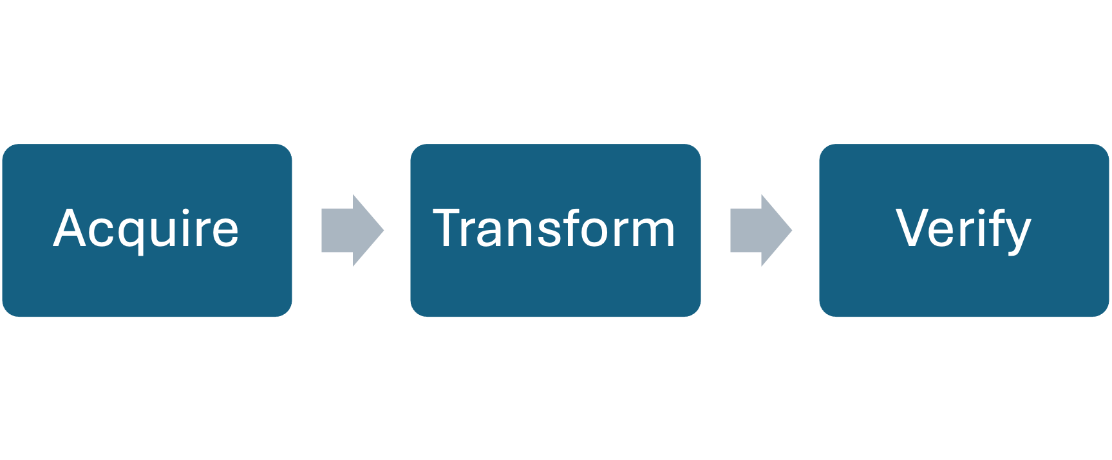
SMARTART_PROCESS_002

Slide 4
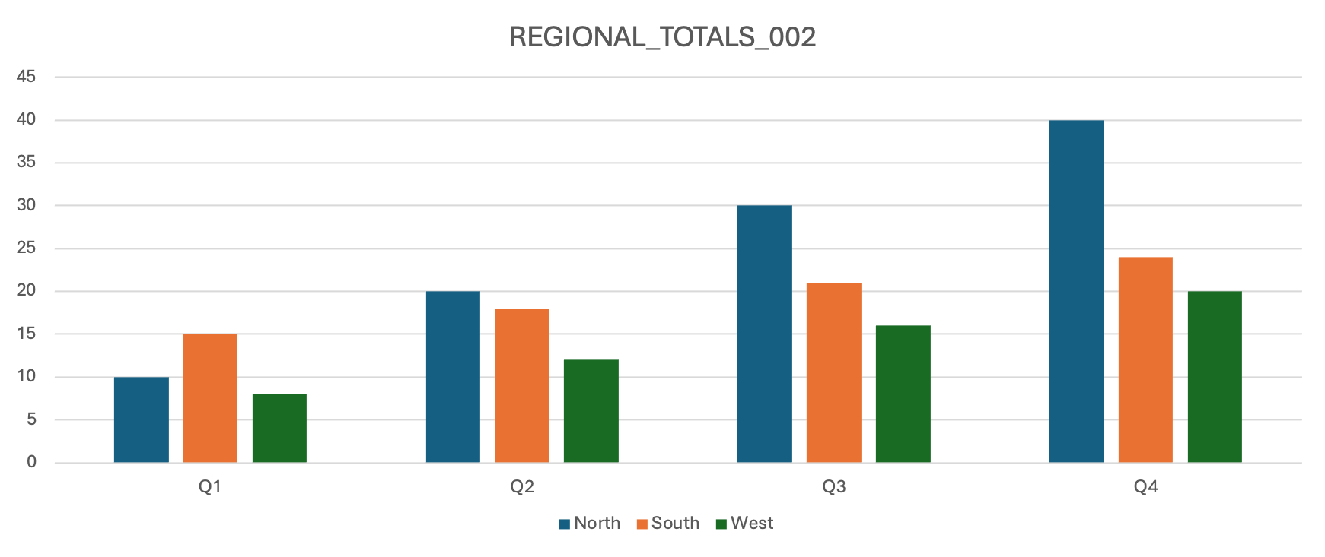
EMBEDDED_CHART_002

Slide 5
DRAWINGS_CONNECTOR_002
SOURCE_002
TARGET_002

