Slide 1
Eviction-Based Memory Management for 3D Gaussian Splatting SLAM
Devon Goshorn Phillip Li
Master Student, CE PhD Student, CS
Infrastructure/Systems Algorithmic Design
Development

Slide 2
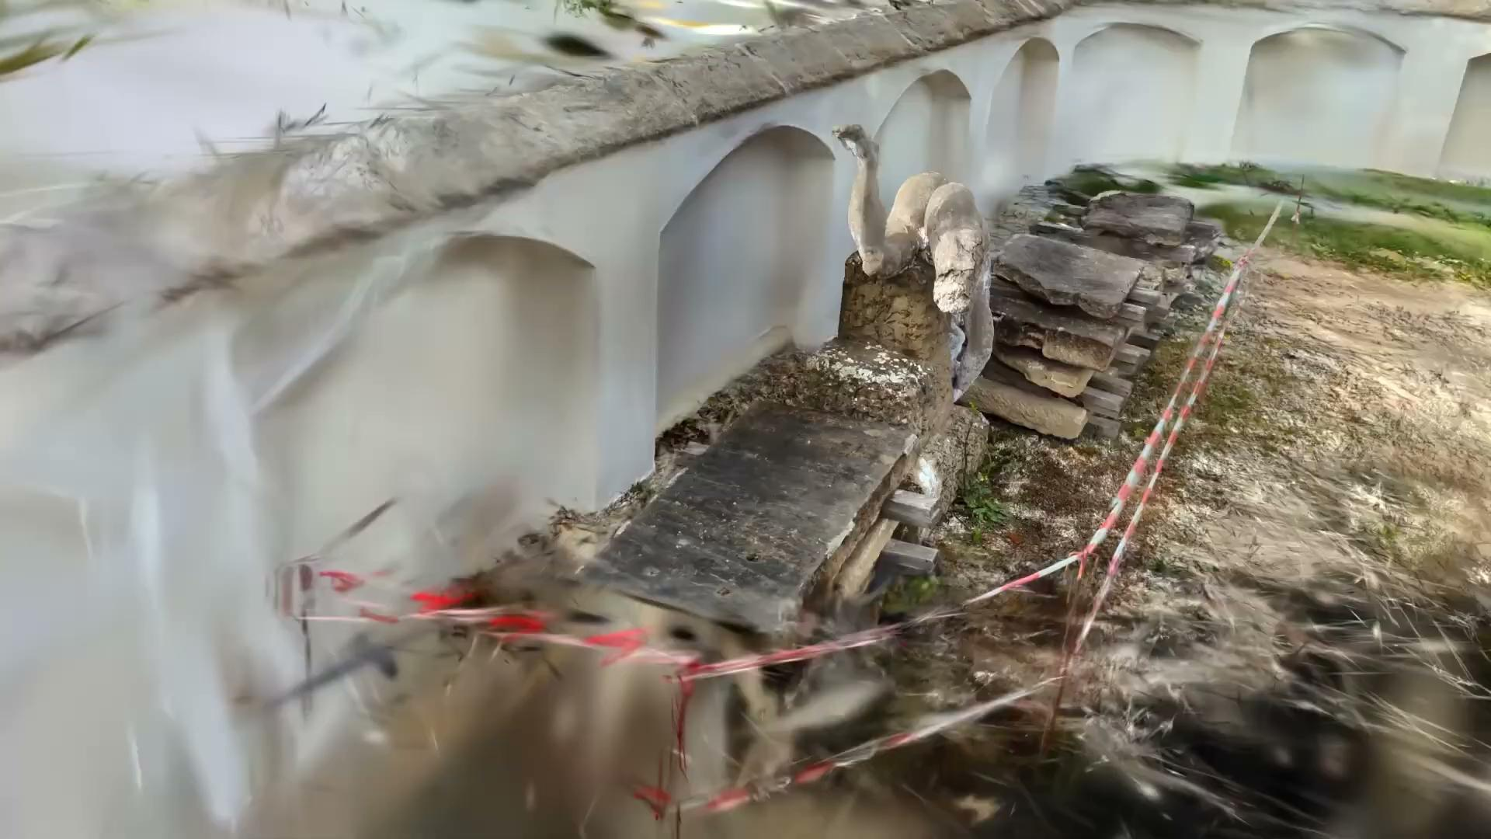
Problem: Bounding VRAM Growth in Real-Time 3DGS SLAM
The Problem: 3DGS SLAM maps grow continuously, causing OOM crashes on edge devices.
The Setting: Real-time robotics and mobile systems, systems where memory and power are strictly limited.
ML Systems Perspective: Trade-off between strict VRAM budgeting and tracking accuracy/reconstruction quality.
Core Hypothesis: Visibility-aware pruning caps VRAM usage and limits power consumption.

Slide 3
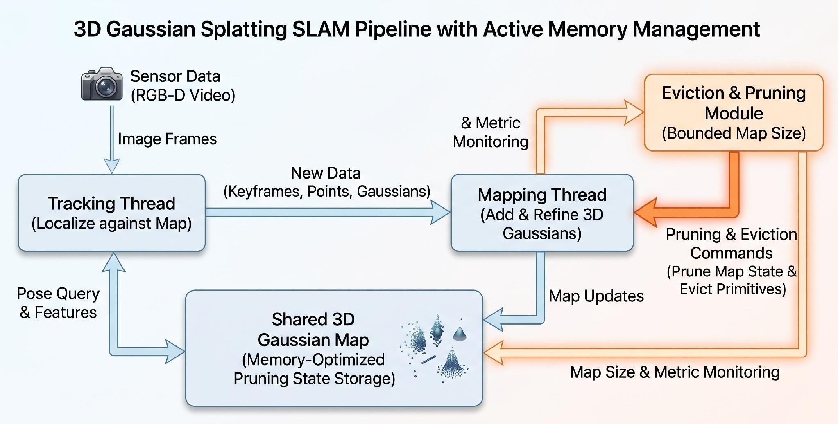
Proposed Solution: Active Pruning Module for 3DGS
The Artifact: 3DGS SLAM pipeline with a configurable memory-limit and active Gaussian culling.
What We Re-use: Existing open-source 3DGS SLAM systems (e.g., MonoGS).
Our Contribution: Implementing a custom eviction queue and pruning heuristics in the mapping thread.

Slide 4
Evaluation: Measuring the VRAM vs. Accuracy Trade-off
Research Question: Which eviction policy best balances VRAM usage, inference latency (FPS), and trajectory tracking drift?
Independent Variables: Strict memory budget (e.g., 4GB, 8GB) and the pruning heuristic used (e.g., Visibility Cullling, Voxel Grid Pruning).
Baseline: Unmodified, unbounded open-source 3DGS SLAM implementation.
Environment: NVIDIA Jetson AGX Orin evaluating TUM-RGBD / Replica datasets.
Metrics:
  System: Peak VRAM allocation (GB), throughput (FPS)
  Quality: Absolute Trajectory Error (ATE RMSE), PSNR, and SSIM.
Expected Evidence: Comparative plots of VRAM allocation over time and curves mapping ATE against different Memory Budgets.

