Slide 1
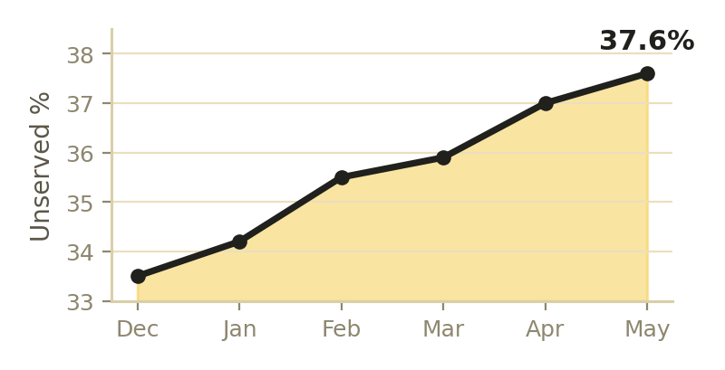
The Gap
The Model
The Pick
The Rollout
Economics
Decision
blinkit
blinkit
PROBLEM STATEMENT — Blinkit's missing store
NCR DARK-STORE GTM
Blinkit already leads NCR — so the question isn't "where is there a gap." It's: on the growth frontier, which corridor earns the next dark store (the most incremental, profitable demand we're losing), and where would we only cannibalise ourselves?
A go-to-market decision, backed by SQL
2,243
₹14,386 Cr
243 M
₹20 Cr+
dark stores · Q4 FY26
NOV · Q4 FY26
orders/qtr · +121% YoY
NCR food-economy frontier
THE DEMAND GAP · why incremental demand leaks
WHERE BLINKIT SITS VS RIVALS (FY26)
The leader's real question
37.6%
of NCR demand goes unserved — and climbs every month
Player
Stores
AOV
Contrib.
Blinkit
2,243
₹525
+₹30
+50–76%
frontier corridors grow vs flat +11–28% mature core
Instamart
1,136
₹746
−2.5%
Zepto
~1,150
—
thin
~8.4 km
to nearest store from the top corridor (outside 10-min)
THE FRONTIER IS WHERE WE'RE THIN
supply-bound
Blinkit itself flags NCR store rollout as the bottleneck
Unserved share rose every month across 20 NCR zones & ~300k order-attempts (6 mo) — a structural supply gap, not noise.

Slide 2
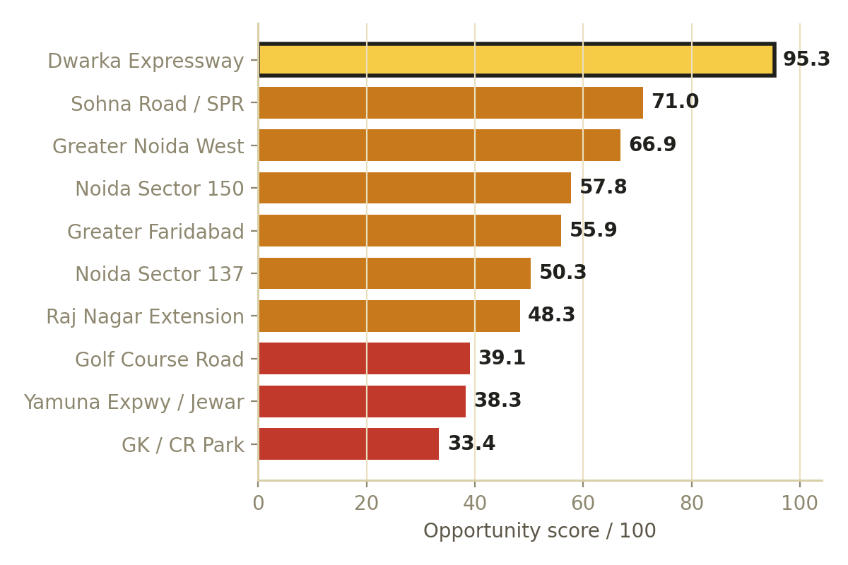
The Gap
The Model
The Pick
The Rollout
Economics
Decision
blinkit
A weighted opportunity model — built in SQL, with two hard guards.
Demand size
OPPORTUNITY SCORE BY CANDIDATE CORRIDOR
30%
recent-quarter order attempts
20%
Demand density
attempts / 1,000 households
25%
Growth
6-month demand trajectory
How we score the frontier
Under-service
25%
% of demand left unserviceable
THE SCORE
opp = 100 × (0.30·demand + 0.20·density + 0.25·growth + 0.25·unmet), each min-max-normalised across candidates.
GUARDS — applied after scoring
≥90% already served → DON'T (cannibalisation). Catchment < 40k HH → DON'T (sub-scale).
Dwarka Expressway tops the model at 95.3 / 100 — well clear of Sohna Road (71.0) and Greater Noida West (66.9). It's the only candidate strong on all four drivers at once.
Data: reproducible SQL over a synthetic-but-realistic order log (20 zones · 6 mo · ~300k attempts), modelled on Blinkit's public NCR footprint.

Slide 3
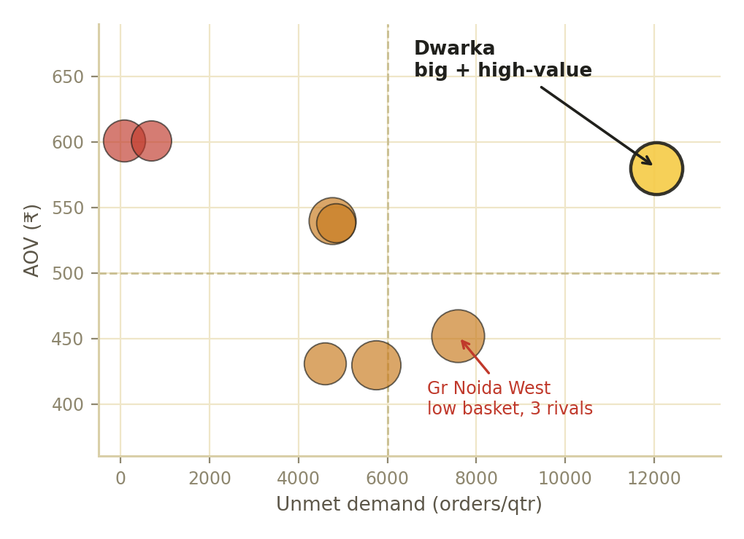
The Gap
The Model
The Pick
The Rollout
Economics
Decision
blinkit
LAUNCH · Dwarka Expressway / New Gurugram
95.3
The largest pocket of unmet, high-value demand on Blinkit's NCR frontier.
opportunity / 100 · next 71.0
Biggest
Fastest
Emptiest
Richest
15.7k attempts/qtr
+76% in 6 months
77% unserved today
₹580 AOV · 1 rival
HEAD TO HEAD · Dwarka vs the bigger Greater Noida West
DECISION MATRIX · unmet demand × basket value
Metric
Dwarka
Gr N West
The corridor that earns the next store
Households
92k
95k
AOV
₹580
₹452
Competitors
1
3
6-mo growth
+76%
+64%
Opp score
95.3
66.9
The call: phase Greater Noida West. Entering now = a 3-way price war on a thin basket, against Blinkit's "no growth on discounting." The model finds candidates; strategy sequences them toward margin.

Slide 4
The Gap
The Model
The Pick
The Rollout
Economics
Decision
blinkit
From a 92k-household catchment to a profitable store — in four phases.
MARKET SIZING
90-DAY → 6-MONTH ROLLOUT
92,000
Phase 1 · Wk −8→0
Phase 2 · Wk 1–2
households in catchment
Foundations
Soft launch
Secure site & permits, fit-out 5–7k sqft, hire, localise 1P assortment.
Tight delivery radius; re-target previously-unserviceable customers first.
~20,000
quick-commerce-active (~22%)
From catchment to 1,300 orders/day
~1,340/day
Phase 3 · Wk 3–8
Phase 4 · Mo 3–6
orders unmet today
Ramp
Optimise & scale
Widen radius; geo-targeted CAC, no deep discounts → ~850 orders/day.
Drive 80% utilisation; once cannibalisation <10%, green-light Gr Noida West.
~1,300/day
conservative target at maturity
Break-even is ~815 orders/day. The conservative 1,300/day maturity target clears it with room — and is below Blinkit's ~1,300 network average, so it's not heroic.
1
2
3
4
5
6
Permits
Cycle/site live
GNN notif pilot
Lottery + influencers
Split-cart + late-night
Scale to next corridor

Slide 5
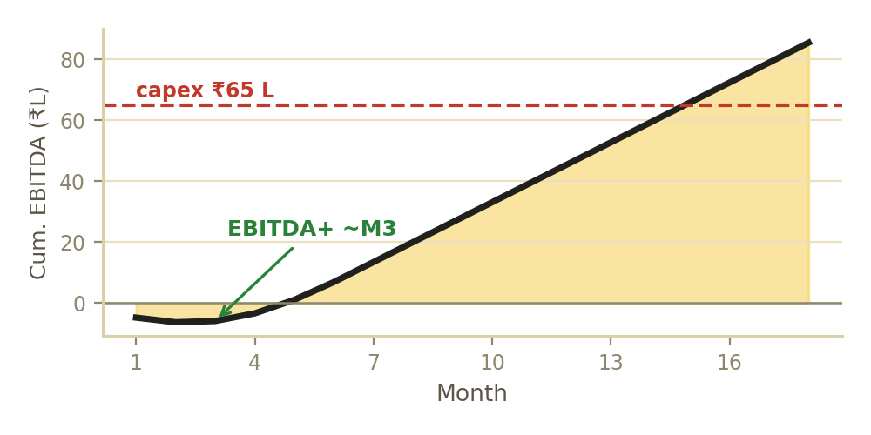
The Gap
The Model
The Pick
The Rollout
Economics
Decision
blinkit
Break-even ~815/day; EBITDA-positive by Month 3; ~8% of NOV at maturity.
PATH TO PROFIT · cumulative store EBITDA (18 mo)
STORE P&L AT MATURITY (₹ / MONTH)
Line
₹ / month
Orders (1,300/day)
39,000
Revenue (AOV ₹560)
₹2.18 Cr
Contribution (₹45/order)
₹17.6 L
Fixed opex
−₹11.0 L
Does one store make money?
Store EBITDA
₹6.6 L
KPIs & GUARDRAILS
₹560
₹45
815
~₹1.5 Cr
Orders/day
Delivery p50
450→1,300 by M12
≤12 min (vs ~24)
AOV
contribution/order
break-even/day
cash to open
Unserviceable
Utilisation
77% → <10% in 60d
80% by M6
Anchored to Blinkit's real economics: blended ~₹30/order today, mature NCR guided to 5–6% of NOV. A premium corridor runs ahead — modelled at ₹45 → ~8% of NOV.
Cannibalisation
Cluster contrib.
< 10% of volume
stays net positive

Slide 6
The Gap
The Model
The Pick
The Rollout
Economics
Decision
blinkit
Launch one, phase the queue, densify one, decline the rest.
Dwarka Expressway
95.3
Biggest warm unmet pool + premium AOV + one rival. Accept ₹1.5 Cr + ramp risk.
LAUNCH
Gr Noida West · Sohna · Faridabad
57–71
Real demand; queue behind the marquee. Gr Noida West only on margin, not discounts.
PHASE
Indirapuram
—
Has a store but capacity-strained (11-min, 26% SLA breach). Add a relief store.
DENSIFY
Golf Course · GK/CR · Jewar
26–39
~99% already served (cannibalisation) or sub-scale catchments.
DON'T
The call, the field & the risks
COMPETITIVE EDGE (NCR · FY26)
KEY RISKS & MITIGATIONS
Player
Stores
Contrib.
NCR #1
Profit
Site supply
Secure the site first; start permits in Phase 1.
Blinkit
2,243
+₹30
✓
✓
Instamart
1,136
−2.5%
✗
✗
Cannibalisation
Guardrail < 10%; track cluster-level contribution.
Zepto
~1,150
thin
✗
✗
Premium AOV
Phase the ramp; re-underwrite at Month 3 gate.
Blinkit is the only player with NCR scale and a contribution profit — it should press, not defend.
The model finds candidates. Strategy sequences them — toward margin, not volume. · Sources: Eternal/Blinkit FY26 (Q3–Q4). Demand data illustrative.

