Slide 1
LedgerPilot
LedgerPilot
An AI finance copilot for small-business owners
It watches the cash, flags trouble early, and finds the right financing — and it never acts without your yes.
Topic E · SME Finance Copilot
WeBank FinTechathon 2026 · International Track
"AI as a Financial Participant"
Notes:
Open: Meet LedgerPilot — an AI finance copilot for small-business owners, our entry for Topic E. One line to remember: it watches the cash, flags trouble early, finds the right financing — and never acts without your yes. ~30 sec.

Slide 2
Small businesses fly blind on money
The owner is the CEO, the salesperson, and the accountant — so the finance job gets done last, if at all.
Cash crunches arrive unannounced
Financing is a guessing game
No one is reading the numbers
Money looks fine until payroll week. By the time the gap is obvious, the options are bad and expensive.
Dozens of loan types, opaque terms. Owners pick what a relative suggested, not what fits — and overpay.
Margins slip and costs creep with no analyst watching. The trend is only clear once it has already hurt.
63M+ MSMEs in India alone — most without a single finance hire.
LedgerPilot · SME Finance Copilot
FinTechathon 2026 · Topic E
Notes:
The problem. An SME owner wears every hat, so finance comes last. Three consequences: cash crunches that arrive with no warning; financing chosen by guesswork and overpaid for; and nobody actually reading the numbers until a trend has already hurt. This is a huge market — 63M+ MSMEs in India alone, almost none with a finance hire. ~1 min.

Slide 3
One copilot, three jobs
LedgerPilot is an agent, not a chatbot: it decides which tools to run, executes them, and can take action — with a human in the loop.
01
Cash-flow management with alerts
Reconstructs monthly cash flow, projects the next 30 days, and speaks up early — shortfall risk, thin buffer, expense spikes, overdue invoices.
02
Financing-option matching
Matches the business to the right instrument with an explainable fit score, estimated cost, and the reasons behind every pick — and why some are off the table.
03
Business financial analysis
Computes margin, leverage, trend and cost drivers into one explainable 0–100 health score you can actually act on.
LedgerPilot · SME Finance Copilot
FinTechathon 2026 · Topic E
Notes:
The solution: one copilot, three jobs — cash-flow alerts, financing matching, financial analysis. The key framing for the judges: this is an AGENT, not a chatbot. It decides which tools to run, runs them, and can take action — always with a human in the loop. ~45 sec.

Slide 4
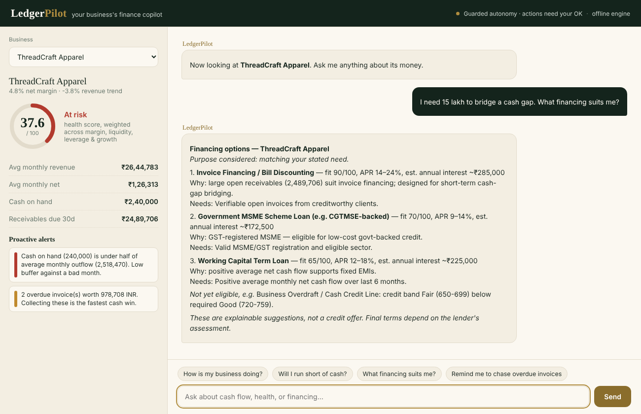
The product, working today
A live snapshot of the business on the left; a copilot you just talk to on the right.
LedgerPilot · SME Finance Copilot
FinTechathon 2026 · Topic E
Notes:
This is the working product. Left: a live snapshot of the business — health score, cash, proactive alerts. Right: you just talk to it. Note the header — guarded autonomy, actions need your OK, and the engine indicator. Everything shown here runs today. If doing a live demo, switch to the app now. ~1 min.

Slide 5
It warns you before the gap, not after
Cash-flow engine · proactive alerting
How it works
Live example — ThreadCraft Apparel
Buckets 6 months of transactions into monthly inflow / outflow and net
Runway = cash ÷ monthly burn; flagged red under 3 months
Expense-spike detection: a category beyond 2σ of its own history
30-day projection with a conservative half-collection on near invoices
Profitable on paper, but cash-starved by 60–90 day client terms.
HIGH
Cash on hand ₹2.4L is under half of average monthly outflow (₹25.2L). Thin buffer against a bad month.
MED
2 overdue invoices worth ₹9.8L — collecting these is the fastest cash win.
MED
Raw-materials spend last month ran well above its usual range.
LedgerPilot · SME Finance Copilot
FinTechathon 2026 · Topic E
Notes:
Capability 1 — cash flow. Left: the mechanics (monthly buckets, runway, 2-sigma spike detection, a conservative 30-day projection). Right: real output for ThreadCraft — profitable on paper but cash-starved by long client terms. The agent speaks up unprompted: thin buffer, overdue invoices, expense spike. ~1 min 15 sec.

Slide 6
The right financing, with the reasons
Explainable matcher · 6 product types · eligibility + fit scoring
Ask: "I need ₹15 lakh to bridge a cash gap." LedgerPilot ranks what actually fits — and shows its work.
Invoice Financing
fit 90
Large open receivables suit it; built for short-term cash-gap bridging.
Govt MSME Scheme
fit 70
GST-registered MSME → eligible for low-cost, collateral-free credit.
Working Capital Loan
fit 65
Positive net cash flow supports fixed EMIs.
Every reply ends: "explainable suggestions, not a credit offer." Transparency is the compliance feature.
LedgerPilot · SME Finance Copilot
FinTechathon 2026 · Topic E
Notes:
Capability 2 — financing. Ask in plain language; it ranks what actually fits with an explainable score and shows the reasons. Invoice financing tops the list for a receivables-driven cash gap. Crucially, every reply says explainable suggestions, not a credit offer — transparency is the compliance feature, not a disclaimer bolted on. ~1 min.

Slide 7
A health score that shows its math
Financial analysis · explainable 0–100 score
Four weighted components — each defensible
Margin
30%
25% net margin → 100
89.5
Liquidity
25%
2 months of cash → 100
Strong
Leverage
25%
debt-free → 100
Growth
20%
flat revenue → 50
PixelForge Studios
The score returns its components and weights — so an owner (or an auditor) sees exactly why.
LedgerPilot · SME Finance Copilot
FinTechathon 2026 · Topic E
Notes:
Capability 3 — the health score. One number, but it shows its math: four weighted components — margin, liquidity, leverage, growth — each independently defensible. The tool returns the components and weights, so an owner or an auditor can see exactly why the score is what it is. ~45 sec.

Slide 8
How it works under the hood
A four-stage agent loop over typed tools, with every step logged.
Plan
→
Permission gate
→
Execute
→
Narrate
analyze_cashflow
financial_analysis
match_financing
schedule_action
T0 · read
T0 · read
T1 · recommend
T2 · act
Read-only datastore
Dual LLM backend
3 sample SMEs · 6 months of transactions · invoices · financing catalog. One seam to swap in live accounting/bank data.
Any OpenAI-compatible API for the live demo; a deterministic offline engine runs the whole loop with no key — reproducible evidence.
LedgerPilot · SME Finance Copilot
FinTechathon 2026 · Topic E
Notes:
Architecture. A four-stage loop — plan, permission gate, execute, narrate — over four typed tools, each tagged with its permission tier. A read-only datastore (the one seam to swap in live bank/accounting data) and a dual LLM backend: live API for the demo, deterministic offline engine for reproducible evidence. ~1 min.

Slide 9
Security is the design, not a wrapper
30% of the score — and the hardest thing to retrofit
Confirmation-always
T0
Read-only analysis
Every money-adjacent action stops for a human yes. Proven live in three cases.
No side effects. Always allowed.
Full audit trail
Recommend / draft
Every message, plan, tool call, result and denial is logged to JSONL.
T1
No side effects. Allowed up to the ceiling.
Explainable & non-advice
Reasons on every recommendation; a clear not-a-credit-offer disclaimer.
T2
State-changing action
No hallucinated numbers
Always needs explicit confirmation — the agent never self-approves.
All figures come from deterministic tools, never the model.
LedgerPilot · SME Finance Copilot
FinTechathon 2026 · Topic E
Notes:
Security — 30% of the score and the part you cannot retrofit. Three permission tiers; T2 actions ALWAYS need explicit confirmation and the agent never self-approves. Plus a full audit trail, explainable non-advice, and no hallucinated numbers — all figures come from deterministic tools, never the model. ~1 min 15 sec.

Slide 10
Built straight to the rubric
40%
Task completion
All three capabilities implemented with real financial logic and verified end-to-end.
30%
Security & compliance
3-tier permissions, confirmation-always, full audit log, explainable non-advice.
30%
Innovation & interaction
Live snapshot panel, proactive alerts, purpose-aware matching, pluggable offline/live engine.
Plus: runs today with no setup, 12 passing tests, and reproducible execution evidence in the repo.
LedgerPilot · SME Finance Copilot
FinTechathon 2026 · Topic E
Notes:
We built straight to the rubric: task completion (all three capabilities, verified end-to-end), security and compliance (tiers, confirmation, audit, non-advice), innovation and interaction (live snapshot, proactive alerts, purpose-aware matching, offline/live engine). Plus it runs today with no setup, 12 passing tests, and reproducible evidence. ~45 sec.

Slide 11
What's real, and what's sandbox
We're upfront about the line — judges value that.
Real and working
Simulated for the sandbox
The full agent loop — plan, gate, execute, narrate
All three capabilities with genuine financial logic
The permission system — all three cases proven live
Complete audit log + actions ledger as evidence
12 automated tests, all passing
Web app + offline engine, runnable with no key
SME data stands in for live accounting/bank feeds
Financing catalog is representative; APRs are ranges
Actions write to a ledger instead of firing real alerts
No real account, customer, or money is ever touched
LedgerPilot · SME Finance Copilot
FinTechathon 2026 · Topic E
Notes:
Integrity slide — judges value honesty about the line. What is real: the whole agent loop, all three capabilities, the permission system proven live, the audit log, 12 tests, the runnable app. What is simulated: the data sources and the financing catalog; actions write to a ledger rather than firing. No real money is ever touched. ~45 sec.

Slide 12
Where this goes next
1
2
3
4
Connect
Quote
Guard
Reach
Live accounting & bank connectors (Tally, Zoho, account aggregator) replacing the sandbox.
Lender-API integration for real, binding financing quotes instead of indicative ranges.
Input-policy layer in front of the planner; per-field data scoping for tighter privacy.
Multi-currency for cross-border SMEs; background alerts that reach the owner between sessions.
LedgerPilot
The finance teammate every small business deserves.
Thank you — questions welcome.
LedgerPilot · SME Finance Copilot
FinTechathon 2026 · Topic E
Notes:
Roadmap and close. Next: live connectors, real lender quotes, a stronger input-policy guard, and multi-currency for cross-border SMEs. Close on the line: the finance teammate every small business deserves. Invite questions. ~45 sec.

