Slide 1


MINI EGYPT NEWS
All in one application!

Slide 2


All in one place
You can easily find all Egyptian news in one application from many trusted places.
We are using google API which provide us a lot of news in many fields such as :
Sports
Business & Economics
Science
Technology
Health
Entertainment

Slide 3

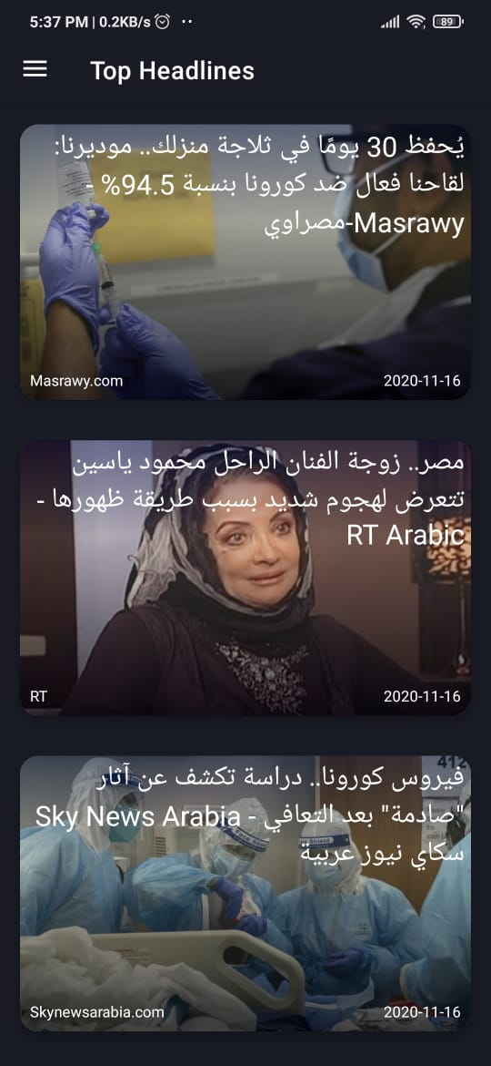
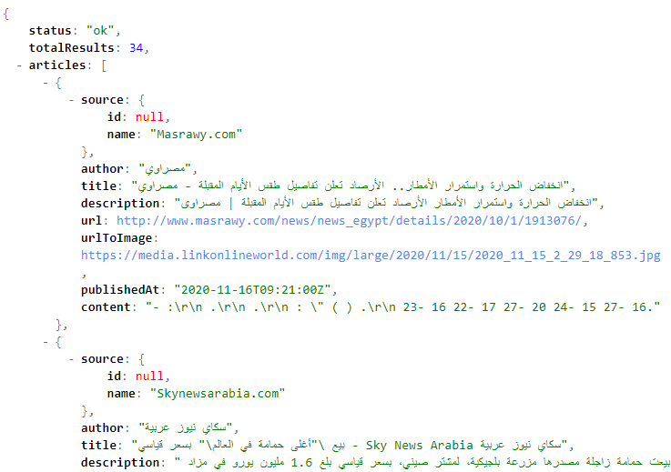
SEE FOR YOURSELF!
NEWS API
APK

Slide 4
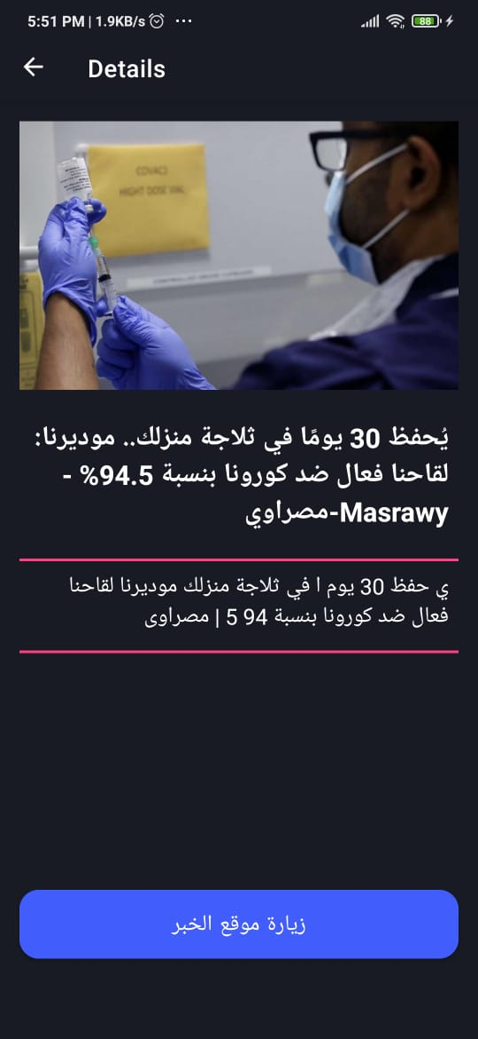
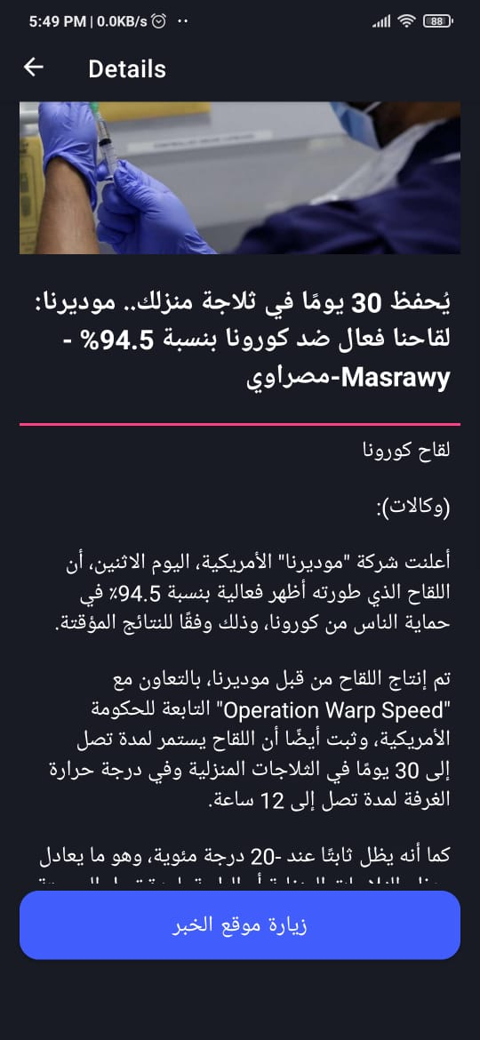
View full details.
Cause Google news API is not free,
we wrote some code that get full details for free ☺
Before
AFTER

Slide 5
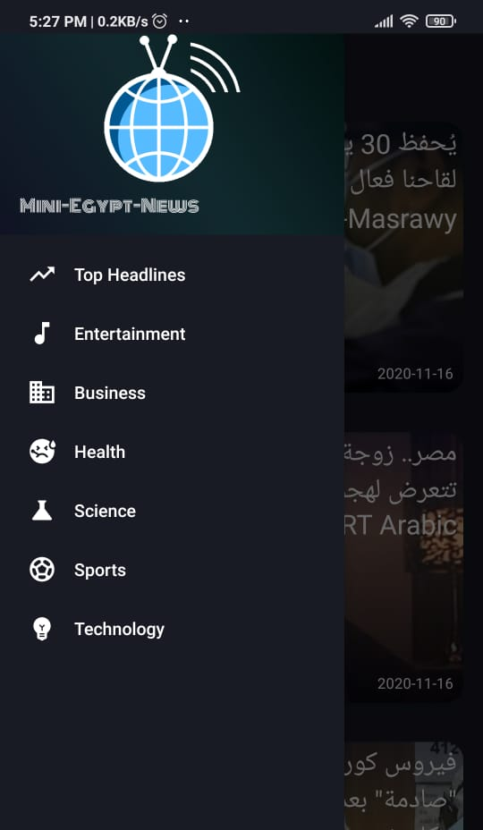
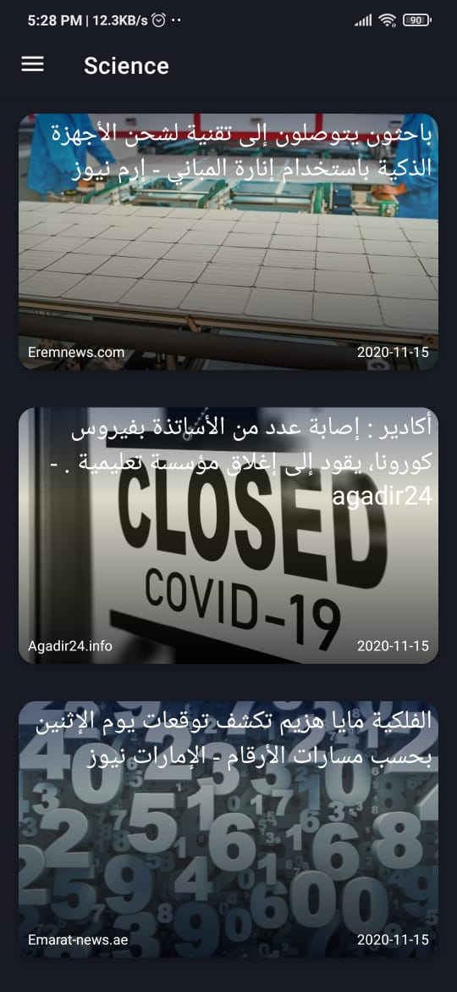
Sample UI design

Slide 6
MINI EGYPT NEWS
Under supervision: Eng.Omar Ahmed
Team members : Abanoub Moris
AbdelHalim Mohammed
Thanks!

