Slide 1
SENTIO
Emotion-adaptive
chess intelligence
♞
A hybrid AI system combining perception, game search, symbolic reasoning, and natural-language coaching.
PERCEIVE
SEARCH
REASON
EXPLAIN
PROLOG SPOTLIGHT
How live chess positions become transparent, prioritized advice.
AI FEATURES · TECHNICAL PRESENTATION
Notes:
Open with the core idea: Sentio does not use one model. It coordinates several forms of intelligence around a live chess game.
[Sources]
- Local repository: README.md
- Local repository: AI_SYSTEM.txt
- Local repository: app/globals.css

Slide 2
SENTIO / AI SYSTEM
02
The opponent adapts to the human—not only the board
Sentio treats emotional state as a live game signal, then changes challenge and communication.
01
02
03
04
Observe
Interpret
Adapt
Explain
Face blendshapes + game telemetry
Six game-relevant emotion states
Depth, skill level, and ELO
Coach language + Prolog advice
Goal: sustain flow—reduce friction when the player struggles, raise challenge when confidence grows.
Notes:
Frame Sentio as a closed adaptive loop. The project responds to both chess position and player state.
[Sources]
- Local repository: README.md
- Local repository: AI_SYSTEM.txt
- Local repository: lib/emotionFusion.ts

Slide 3
SENTIO / AI SYSTEM
03
Five intelligence layers cooperate in one experience
PERCEPTION
MediaPipe / face models
Valence, arousal, expressions
ADAPTATION
Emotion fusion
Player state → engine profile
SEARCH
Stockfish + Minimax / MCTS
Moves, scores, decision traces
SYMBOLIC LOGIC
SWI-Prolog
Explainable prioritized advice
LANGUAGE & VOICE
LLM + STT / TTS
Natural coaching and Burmese access
Notes:
Emphasize that these are different AI paradigms. Their value comes from division of labor rather than forcing one model to do everything.
[Sources]
- Local repository: README.md
- Local repository: AI_SYSTEM.txt
- Local repository: lib/agents.ts
- Local repository: prolog/ai_system.pl

Slide 4
SENTIO / ARCHITECTURE
04
Signals become moves, advice, and explanations through explicit boundaries
BROWSER
NEXT.JS
FASTAPI
AI ENGINES
OUTPUT
Webcam · board · voice
API routes · validation
Engine pool · FEN bridge
Stockfish · Prolog
Move · advice · coach
/api/bot-move
/api/prolog
/api/coach
/api/transcribe
Every boundary has a fallback: the game stays playable even when Prolog, the LLM, or cloud speech is unavailable.
Notes:
Walk left to right. The architecture separates state capture, routing, engine execution, and audience-facing outputs.
[Sources]
- Local repository: README.md
- Local repository: backend/main.py
- Local repository: app/api/prolog/route.ts
- Local repository: app/api/coach/route.ts
- Local repository: app/api/transcribe/route.ts

Slide 5
SENTIO / PERCEPTION
05
Emotion estimation fuses anatomy with gameplay context
FACIAL SIGNAL
GAME SIGNAL
52 blendshapes
12s+ think time
Focused / calm boost
Smile, frown, brow, eye, jaw, and mouth motion are mixed into valence and arousal.
150cp setback
Stress evidence
Recent mistakes
Neutral dampening
valence ↔ positive / negative
+300cp advantage
Confidence reinforcement
arousal ↕ calm / activated
Fusion adjusts soft scores; it does not blindly overwrite the face signal.
Notes:
Explain the design choice: a quiet face alone cannot reliably separate calm, neutral, and focused. Gameplay telemetry adds context.
[Sources]
- Local repository: lib/blendshapeEmotion.ts
- Local repository: lib/emotionFusion.ts

Slide 6
SENTIO / ADAPTATION
06
Six emotion profiles reshape the engine’s challenge in real time
EMOTION
ELO
RELATIVE STRENGTH
DEPTH / SKILL
Stressed
1320
1 / 1
Frustrated
1320
2 / 3
Calm
1600
4 / 6
Neutral
2000
6 / 10
Focused
2600
8 / 15
Confident
3190
10 / 20
Hints deliberately bypass adaptation and use a stronger fixed profile for quality.
Notes:
Call out the three levers: depth, Stockfish Skill Level, and UCI ELO limiting. Prolog mirrors the same static profiles as declarative facts.
[Sources]
- Local repository: backend/main.py
- Local repository: prolog/ai_system.pl
- Local repository: README.md

Slide 7
SENTIO / PROLOG SPOTLIGHT
07
Search finds strong moves; Prolog makes reasoning inspectable
Stockfish answers:
The Logician answers:
“What move scores best?”
“Which rule applies—and why now?”
Deep search is powerful, but its evaluation is not automatically a clear explanation for a learner.
Advice is traceable to explicit facts and rules: check safety, hanging pieces, free captures, castling, development, center control, and king activation.
SYMBOLIC AI
Notes:
Introduce Prolog as complementary, not competitive. It is an explainability layer and a teaching layer alongside search.
[Sources]
- Local repository: prolog/ai_system.pl
- Local repository: components/LogicianPanel.tsx

Slide 8
SENTIO / PROLOG SPOTLIGHT
08
The knowledge base separates observable facts from reusable rules
DYNAMIC FACTS
DERIVED CONCEPTS
PRIORITIZED ADVICE
piece(e4, white, pawn)
hanging_mine/2
99 safety / check
turn(white)
free_capture/2
95 tactics / hanging
move_number(7)
undeveloped_minor/2
90 tactics / free capture
attacked_by(c3, black)
needs_castling/0
85 opening / castle
defended_by(c3, white)
no_center_presence/0
60 endgame / activate king
Priority is data—not hidden model behavior—so the UI can sort advice deterministically.
Notes:
Distinguish three levels. Python supplies facts. Prolog derives concepts. Advice rules convert those concepts into ranked human-readable guidance.
[Sources]
- Local repository: prolog/ai_system.pl

Slide 9
SENTIO / PROLOG BRIDGE
09
The bridge converts an imperative board state into declarative logic
1
2
3
4
5
6
FEN
python-chess
FACT ASSERTION
PROLOG QUERY
JSON
LOGICIAN UI
r1bqk… w KQ
parse board
piece · turn · attacks
advice(P,C,T)
top 6 sorted
category + reason
Concurrency safeguard
A lock protects the shared Prolog instance while old facts are retracted, new facts are asserted, and the query runs.
Prolog remains observational: it never executes a chess move.
Notes:
This is the key bridge slide. Explain the representation change: FEN is compact state; Prolog needs explicit relational facts.
[Sources]
- Local repository: backend/main.py
- Local repository: app/api/prolog/route.ts
- Local repository: components/LogicianPanel.tsx

Slide 10
SENTIO / PROLOG EXAMPLE
10
A hanging piece becomes a transparent priority-95 recommendation
ASSERTED FACTS
TACTICS · PRIORITY 95
turn(white).
piece(c3, white, bishop).
Your bishop on c3 is attacked and undefended—defend it or move it.
attacked_by(c3, black).
% no defended_by(c3, white)
hanging_mine(c3, bishop).
Why this is explainable
Every phrase is grounded in a visible predicate and a named rule.
Notes:
Use this as the concrete demonstration. The absence of defended_by is meaningful through negation-as-failure, triggering hanging_mine and advice priority 95.
[Sources]
- Local repository: prolog/ai_system.pl
- Local repository: backend/main.py

Slide 11
SENTIO / HYBRID AI
11
Each engine owns the job it can do best
STOCKFISH
PROLOG
LLM COACH
Role
Role
Role
Search and evaluation
Rules and explanation
Dialogue and language
Output
Output
Output
Best move · score
Ranked advice
Natural coaching
Strength
Strength
Strength
Tactical depth
Transparent logic
Flexible communication
Limit
Limit
Limit
Hard to narrate directly
Narrow encoded knowledge
Needs grounding + fallback
Hybrid design turns one opaque ‘AI’ into accountable, composable capabilities.
Notes:
Avoid claiming that one paradigm is universally superior. The system is robust because responsibilities are explicit.
[Sources]
- Local repository: backend/main.py
- Local repository: prolog/ai_system.pl
- Local repository: app/api/coach/route.ts

Slide 12
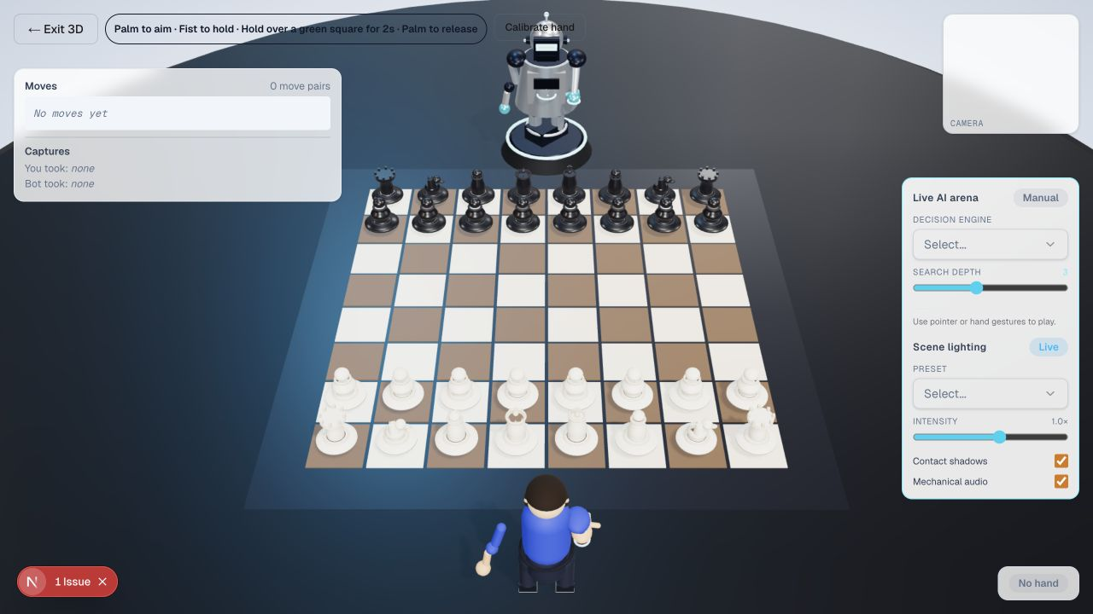
SENTIO / SEARCH LAB
12
Four agents reveal how evaluation priorities change a search tree
Materialist
1.8× material
Positional
1.8× activity
Defender
2.1× king safety
Tactician
deeper forcing lines
Same FEN. Different heuristic weights. Selectable Minimax or MCTS traces.
Notes:
The four agents are an analysis and visualization feature. They expose tradeoffs rather than replacing the production Stockfish opponent.
[Sources]
- Local repository: lib/agents.ts
- Local repository: lib/minimax.ts
- Local repository: lib/mcts.ts
- Local repository: components/AgentsGraph3D.tsx
- Local repository: Local light-mode screenshot: .presentation-light/assets/sentio-light-3d.png

Slide 13
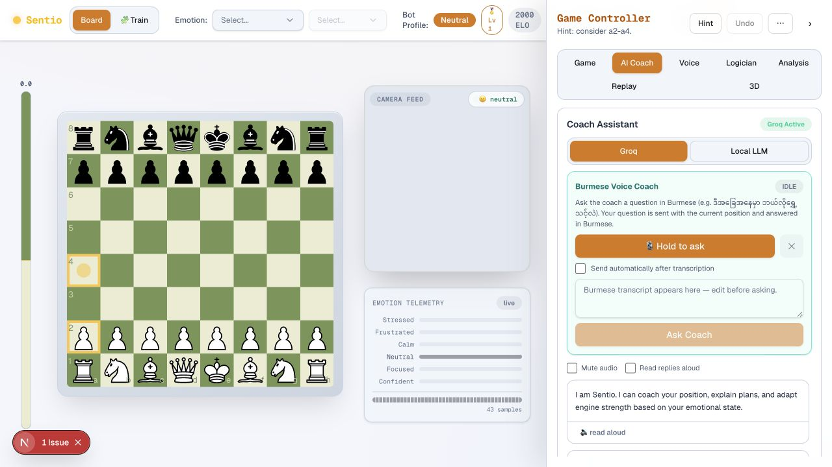
SENTIO / LANGUAGE AI
13
The coach grounds natural language in the live position
INPUT
FEN · emotion · question
GROUNDING
legal moves · best move
GENERATION
Groq or local LLM
FALLBACK
structured chess advice
The interface can offer a playable move, but chess.js validation remains the authority.
Notes:
Explain graceful fallback: the route builds structured advice first, then enhances it with an LLM when available.
[Sources]
- Local repository: app/api/coach/route.ts
- Local repository: lib/coachPrompt.ts
- Local repository: components/AIAnalysisTab.tsx
- Local repository: Local light-mode screenshot: .presentation-light/assets/sentio-light-main.png

Slide 14
SENTIO / VOICE AI
14
Burmese voice supports two separate—and safer—interaction paths
VOICE MOVE
VOICE COACH
Audio → transcript → parseChessMove() → legal move validation → board
Audio → transcript → editable text → /api/coach → Burmese answer → optional TTS
A command executes only after it resolves to a legal move.
Asking a question never auto-plays a move.
LOCAL WHISPER
GROQ
ELEVENLABS
GEMINI
ASSEMBLYAI
Notes:
Stress the separation of intent. Speech-to-move is command execution with validation; speech-to-coach is an editable conversational path.
[Sources]
- Local repository: README.md
- Local repository: app/api/transcribe/route.ts
- Local repository: lib/speechParser.ts
- Local repository: components/VoiceCoachControl.tsx

Slide 15
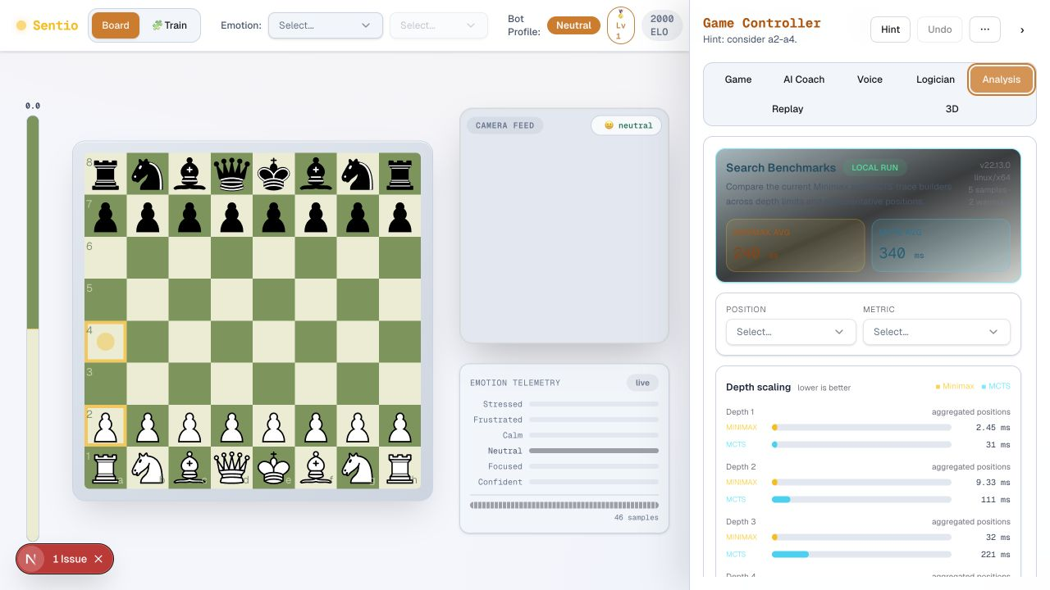
SENTIO / PRODUCT SURFACE
15
The AI remains visible, controllable, and inspectable during play
LIVE EVAL
Stockfish score
EMOTION TELEMETRY
soft evidence over time
BOT PROFILE
ELO · depth · skill
AI TABS
coach · logic · analysis
Manual emotion override keeps the human in control.
Notes:
Show that the adaptive system exposes its current state: emotion, engine profile, evaluation, and analysis tools.
[Sources]
- Local repository: components/BoardWorkspace.tsx
- Local repository: components/ControllerPanel.tsx
- Local repository: components/EmotionMonitor.tsx
- Local repository: Local light-mode screenshot: .presentation-light/assets/sentio-light-analysis.png

Slide 16
SENTIO / RELIABILITY
16
Graceful degradation keeps the core game available
PROLOG UNAVAILABLE
Logician shows setup guidance; game logic is unaffected
LLM UNAVAILABLE
Structured fallback coach still returns position-aware advice
CLOUD STT UNAVAILABLE
Local Whisper or another configured provider can take over
STOCKFISH BUSY
Bounded engine pool returns an explicit 503 instead of corrupt state
STALE UI RESPONSE
Sequence checks ignore obsolete Logician requests
A robust AI product is defined as much by its boundaries as by its models.
Notes:
This slide is useful for technical evaluation: each optional AI service fails independently and reports a meaningful state.
[Sources]
- Local repository: backend/main.py
- Local repository: app/api/prolog/route.ts
- Local repository: app/api/coach/route.ts
- Local repository: app/api/transcribe/route.ts
- Local repository: components/LogicianPanel.tsx

Slide 17
SENTIO / TEAM HANDOFF
17
Five presenters can tell one connected AI story
MEMBER 1
Problem + architecture
Slides 1–4
MEMBER 2
Emotion perception + adaptation
Slides 5–6
MEMBER 3
Prolog deep dive + bridge
Slides 7–10
MEMBER 4
Hybrid search + agents + coach
Slides 11–13
MEMBER 5
Voice + product + reliability + close
Slides 14–18
Transition phrase
“That layer creates the signal the next layer needs.”
Notes:
Use this ownership split as a rehearsal guide. Member 3 gets the largest technical Prolog sequence, matching the requested emphasis.
[Sources]
- Local repository: .presentation-build/slide-plan.txt

Slide 18
SENTIO / SYNTHESIS
One adaptive loop.
Four forms of intelligence.
PROLOG’S BRIDGE
position state → explicit facts → prioritized explanation
PERCEPTION
SEARCH
PROLOG
LANGUAGE
reads the player
reads the board
makes rules visible
makes guidance usable
Sentio demonstrates that trustworthy AI is not one model—it is a well-designed conversation between models, rules, state, and people.
Notes:
Close by resolving the opening. Prolog is the bridge that turns machine-readable board state into inspectable human reasoning, inside a broader adaptive loop.
[Sources]
- Local repository: README.md
- Local repository: AI_SYSTEM.txt
- Local repository: prolog/ai_system.pl

