Slide 1
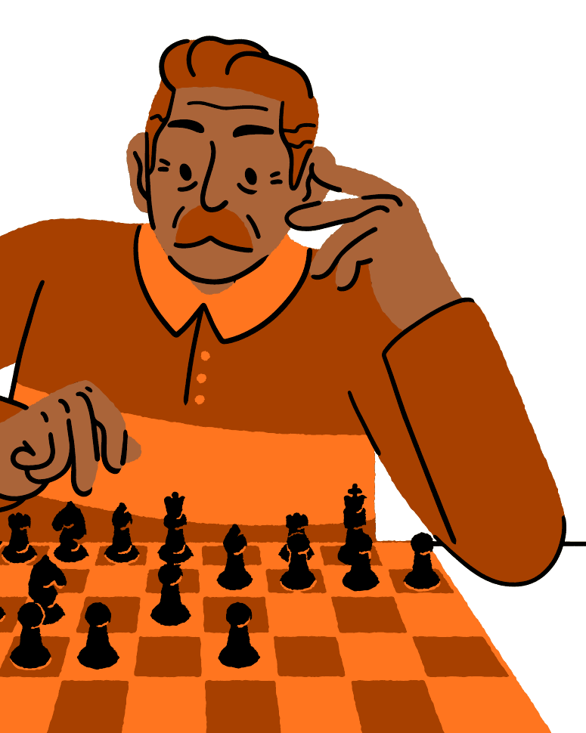
SENTIO
SENTIO
Chess that reads the player
Emotion-adaptive chess intelligence powered by search, symbolic Prolog reasoning, language, voice, and a new learning loop.
PROLOG SPOTLIGHT
POSITION -> FACTS -> PRIORITIZED ADVICE
AI FEATURES + CURRENT PROJECT UPDATE / 2026
Notes:
Open with the product idea: Sentio adapts to both the board and the person sitting behind it.
[Sources]
- /Users/yuza/Downloads/Orange Beige Retro Illustration Night Chess Presentation.pdf (visual template and all decorative assets)
- /Users/yuza/Downloads/Sentio_AI_Features_Prolog_Light_Ember (1).pptx
- /Users/yuza/chess-agent-v2/README.md

Slide 2
SENTIO / AI SYSTEM
02
THE OPPONENT ADAPTS TO THE HUMAN
THE OPPONENT ADAPTS TO THE HUMAN
A different way to play
01
02
03
04
OBSERVE
INTERPRET
ADAPT
EXPLAIN
Face blendshapes + game telemetry
Six game-relevant emotion states
Depth, skill level, and ELO
Coach language + Prolog advice
GOAL: sustain flow - reduce friction when the player struggles and raise the challenge when confidence grows.
THE BOARD CHANGES. THE CHALLENGE AND COMMUNICATION CHANGE WITH IT.
Notes:
[Sources]
- /Users/yuza/Downloads/Orange Beige Retro Illustration Night Chess Presentation.pdf (visual template and all decorative assets)
- /Users/yuza/Downloads/Sentio_AI_Features_Prolog_Light_Ember (1).pptx
- /Users/yuza/chess-agent-v2/lib/emotionFusion.ts
- /Users/yuza/chess-agent-v2/lib/engineProfiles.ts

Slide 3

SENTIO / ARCHITECTURE
03
FIVE INTELLIGENCE LAYERS COOPERATE
FIVE INTELLIGENCE LAYERS COOPERATE
One experience
PERCEPTION
MediaPipe + face models
valence, arousal, expressions
ADAPTATION
Emotion fusion
player state -> engine profile
SEARCH
Stockfish + Minimax / MCTS
moves, scores, decision traces
SYMBOLIC LOGIC
SWI-Prolog
explainable prioritized advice
LANGUAGE + VOICE
LLM + STT / TTS
natural coaching + Burmese access
Notes:
[Sources]
- /Users/yuza/Downloads/Orange Beige Retro Illustration Night Chess Presentation.pdf (visual template and all decorative assets)
- /Users/yuza/Downloads/Sentio_AI_Features_Prolog_Light_Ember (1).pptx
- /Users/yuza/chess-agent-v2/AI_SYSTEM.txt
- /Users/yuza/chess-agent-v2/package.json

Slide 4
SENTIO / SYSTEM BOUNDARIES
04
SIGNALS CROSS EXPLICIT BOUNDARIES
SIGNALS CROSS EXPLICIT BOUNDARIES
Every boundary has a fallback
BROWSER
NEXT.JS
FASTAPI
AI ENGINES
OUTPUT
webcam
board
voice
>
API routes
validation
>
engine pool
FEN bridge
>
Stockfish
Prolog
>
move
advice
coach
/api/bot-move /api/prolog /api/coach /api/transcribe
The core game remains playable when Prolog, the LLM, or cloud speech is unavailable.
Notes:
[Sources]
- /Users/yuza/Downloads/Orange Beige Retro Illustration Night Chess Presentation.pdf (visual template and all decorative assets)
- /Users/yuza/Downloads/Sentio_AI_Features_Prolog_Light_Ember (1).pptx
- /Users/yuza/chess-agent-v2/app/api/bot-move/route.ts
- /Users/yuza/chess-agent-v2/app/api/prolog/route.ts
- /Users/yuza/chess-agent-v2/app/api/coach/route.ts
- /Users/yuza/chess-agent-v2/app/api/transcribe/route.ts
- /Users/yuza/chess-agent-v2/backend/main.py

Slide 5

SENTIO / PERCEPTION
05
EMOTION IS A LIVE SIGNAL - NOT A LABEL
EMOTION IS A LIVE SIGNAL - NOT A LABEL
Anatomy meets gameplay context
FACIAL SIGNAL
GAME SIGNAL
52 blendshapes
Smile, frown, brow, eye, jaw, and mouth motion mix into valence and arousal.
valence: positive / negative
arousal: calm / activated
12s+ think time -> focus / calm
150cp setback -> stress evidence
Recent mistakes -> neutral damping
+300cp advantage -> confidence
Fusion adjusts soft scores; it does not blindly overwrite the face signal.
Notes:
[Sources]
- /Users/yuza/Downloads/Orange Beige Retro Illustration Night Chess Presentation.pdf (visual template and all decorative assets)
- /Users/yuza/Downloads/Sentio_AI_Features_Prolog_Light_Ember (1).pptx
- /Users/yuza/chess-agent-v2/hooks/useEmotionDetection.ts
- /Users/yuza/chess-agent-v2/lib/emotionFusion.ts
- /Users/yuza/chess-agent-v2/lib/blendshapeEmotion.ts

Slide 6

SENTIO / ADAPTATION
06
SIX PROFILES RESHAPE DIFFICULTY
SIX PROFILES RESHAPE DIFFICULTY
In real time
EMOTION ELO RELATIVE STRENGTH DEPTH / SKILL
STRESSED
1320
1 / 1
FRUSTRATED
1320
2 / 3
CALM
1600
4 / 6
NEUTRAL
2000
6 / 10
FOCUSED
2600
8 / 15
CONFIDENT
3190
10 / 20
HINTS USE A STRONGER FIXED PROFILE SO ADVICE QUALITY STAYS HIGH.
Notes:
[Sources]
- /Users/yuza/Downloads/Orange Beige Retro Illustration Night Chess Presentation.pdf (visual template and all decorative assets)
- /Users/yuza/Downloads/Sentio_AI_Features_Prolog_Light_Ember (1).pptx
- /Users/yuza/chess-agent-v2/prolog/ai_system.pl
- /Users/yuza/chess-agent-v2/lib/engineProfiles.ts

Slide 7

SEARCH FINDS
STRONG MOVES
SEARCH FINDS
STRONG MOVES
Prolog makes reasoning visible
STOCKFISH
What move scores best?
THE LOGICIAN
Which rule applies - and why now?
PROLOG IS THE EXPLAINABLE BRIDGE BETWEEN POSITION STATE AND HUMAN GUIDANCE.
Notes:
[Sources]
- /Users/yuza/Downloads/Orange Beige Retro Illustration Night Chess Presentation.pdf (visual template and all decorative assets)
- /Users/yuza/Downloads/Sentio_AI_Features_Prolog_Light_Ember (1).pptx
- /Users/yuza/chess-agent-v2/prolog/ai_system.pl
- /Users/yuza/chess-agent-v2/components/LogicianPanel.tsx

Slide 8
SENTIO / PROLOG SPOTLIGHT
08
FACTS, RULES, AND ADVICE STAY SEPARATE
FACTS, RULES, AND ADVICE STAY SEPARATE
Priority is data
DYNAMIC FACTS
DERIVED CONCEPTS
PRIORITIZED ADVICE
piece(e4, white, pawn)
turn(white)
move_number(7)
attacked_by(c3, black)
defended_by(c3, white)
hanging_mine/2
free_capture/2
undeveloped_minor/2
needs_castling/0
no_center_presence/0
99 safety / check
95 tactics / hanging
90 tactics / free capture
85 opening / castle
60 endgame / activate king
The UI can sort deterministically because priority lives in the knowledge base - not in hidden model behavior.
Notes:
[Sources]
- /Users/yuza/Downloads/Orange Beige Retro Illustration Night Chess Presentation.pdf (visual template and all decorative assets)
- /Users/yuza/Downloads/Sentio_AI_Features_Prolog_Light_Ember (1).pptx
- /Users/yuza/chess-agent-v2/prolog/ai_system.pl

Slide 9
SENTIO / PROLOG BRIDGE
09
FEN BECOMES DECLARATIVE LOGIC
FEN BECOMES DECLARATIVE LOGIC
Imperative state -> explicit facts
1
2
3
4
5
6
FEN
>
PYTHON
CHESS
>
ASSERT
>
QUERY
>
JSON
>
LOGICIAN
live board
parse
facts
advice(P,C,T)
top 6 sorted
category + reason
CONCURRENCY SAFEGUARD
A lock protects the shared Prolog instance while old facts are retracted, new facts are asserted, and the query runs.
PROLOG REMAINS OBSERVATIONAL: IT NEVER EXECUTES A CHESS MOVE.
Notes:
[Sources]
- /Users/yuza/Downloads/Orange Beige Retro Illustration Night Chess Presentation.pdf (visual template and all decorative assets)
- /Users/yuza/Downloads/Sentio_AI_Features_Prolog_Light_Ember (1).pptx
- /Users/yuza/chess-agent-v2/backend/main.py
- /Users/yuza/chess-agent-v2/app/api/prolog/route.ts

Slide 10
SENTIO / PROLOG EXAMPLE
10
A HANGING BISHOP BECOMES PRIORITY 95
A HANGING BISHOP BECOMES PRIORITY 95
Every phrase is grounded
ASSERTED FACTS
TACTICS / PRIORITY 95
turn(white).
piece(c3, white, bishop).
attacked_by(c3, black).
% no defended_by(c3, white).
hanging_mine(c3, bishop).
YOUR BISHOP ON C3 IS ATTACKED AND UNDEFENDED - DEFEND IT OR MOVE IT.
>
WHY THIS IS EXPLAINABLE
The advice names a visible predicate, a named rule, and a deterministic priority.
Notes:
[Sources]
- /Users/yuza/Downloads/Orange Beige Retro Illustration Night Chess Presentation.pdf (visual template and all decorative assets)
- /Users/yuza/Downloads/Sentio_AI_Features_Prolog_Light_Ember (1).pptx
- /Users/yuza/chess-agent-v2/prolog/ai_system.pl

Slide 11
SENTIO / HYBRID AI
11
EACH ENGINE OWNS THE JOB IT DOES BEST
EACH ENGINE OWNS THE JOB IT DOES BEST
One system, three strengths
STOCKFISH
PROLOG
LLM COACH
ROLE
Search and evaluation
OUTPUT
Best move + score
STRENGTH
Tactical depth
LIMIT
Hard to narrate directly
ROLE
Rules and explanation
OUTPUT
Ranked advice
STRENGTH
Transparent logic
LIMIT
Narrow encoded knowledge
ROLE
Dialogue and language
OUTPUT
Natural coaching
STRENGTH
Flexible communication
LIMIT
Needs grounding + fallback
HYBRID DESIGN TURNS ONE OPAQUE 'AI' INTO ACCOUNTABLE, COMPOSABLE CAPABILITIES.
Notes:
[Sources]
- /Users/yuza/Downloads/Orange Beige Retro Illustration Night Chess Presentation.pdf (visual template and all decorative assets)
- /Users/yuza/Downloads/Sentio_AI_Features_Prolog_Light_Ember (1).pptx
- /Users/yuza/chess-agent-v2/backend/main.py
- /Users/yuza/chess-agent-v2/app/api/coach/route.ts
- /Users/yuza/chess-agent-v2/prolog/ai_system.pl

Slide 12
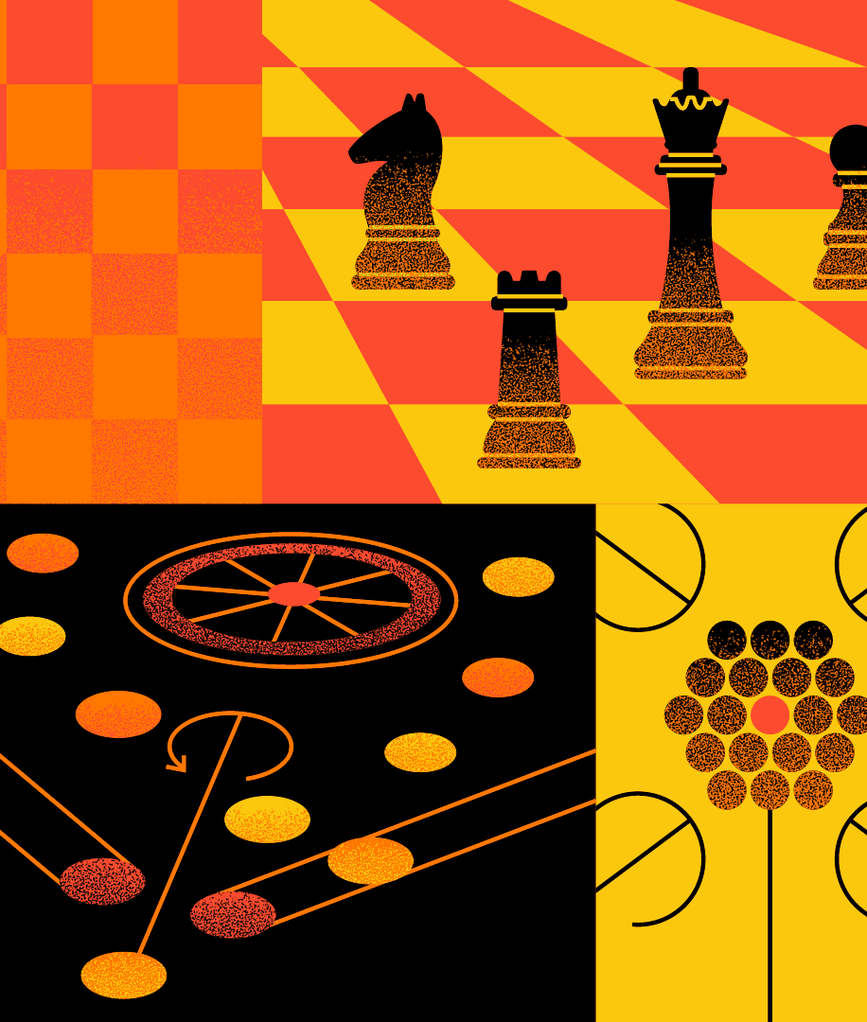
SENTIO / CURRENT UPDATE / AI LAB
12
SEARCH BEHAVIOR BECOMES INSPECTABLE
SEARCH BEHAVIOR BECOMES INSPECTABLE
Live analysis, not a black box
LIVE-GAME SCOPE
Analysis waits for the first real move and follows the current position.
TWO ALGORITHMS
Switch between Minimax branch-and-prune traces and MCTS rollouts.
TWO VIEWS
Inspect the position as a board or orbit the 3D search graph.
VISIBLE WORK
Surface depth, evaluated leaves, rollouts, root visits, and pruned branches.
CURRENT CHECKOUT: the full-width component follows the live position and waits for the first real move.
Notes:
[Sources]
- /Users/yuza/Downloads/Orange Beige Retro Illustration Night Chess Presentation.pdf (visual template and all decorative assets)
- /Users/yuza/chess-agent-v2/components/AILabWorkspace.tsx
- /Users/yuza/chess-agent-v2/components/AIAnalysisTab.tsx
- /Users/yuza/chess-agent-v2/components/AgentsGraph3D.tsx
- /Users/yuza/chess-agent-v2/app/page.tsx

Slide 13
SENTIO / CURRENT UPDATE / BENCHMARKS
13
SEARCH TRADE-OFFS ARE MEASURABLE
SEARCH TRADE-OFFS ARE MEASURABLE
One position, six depths, two algorithms
OPENING RESPONSE / DEPTH 6 / 5 SAMPLES + 2 WARMUPS
MINIMAX
MCTS
MINIMAX 837.8 ms
837.8 ms
1,103 evaluated leaves
1,572 pruned branches
578.7 ms
144 rollout work units
145 search nodes
MCTS 578.7 ms
Interpretation: workload definitions differ - Minimax counts evaluated leaves; MCTS counts rollout iterations. The UI exposes both instead of forcing a misleading single ranking.
BENCHMARK GENERATED 2026-08-15 / LOCAL TRACE BUILDERS
Notes:
[Sources]
- /Users/yuza/Downloads/Orange Beige Retro Illustration Night Chess Presentation.pdf (visual template and all decorative assets)
- /Users/yuza/chess-agent-v2/benchmarks/search-benchmark.json
- /Users/yuza/chess-agent-v2/components/BenchmarkTab.tsx

Slide 14
SENTIO / LANGUAGE + VOICE
14
LANGUAGE STAYS GROUNDED AND SAFE
LANGUAGE STAYS GROUNDED AND SAFE
Two voice paths, two different permissions
COACH
VOICE MOVE
VOICE COACH
FEN + emotion + question
-> legal moves + best move
-> Groq or local LLM
-> structured fallback advice
Audio -> transcript
-> parseChessMove()
-> legal move validation
-> board
A command executes only after it resolves to a legal move.
Audio -> transcript
-> editable text
-> /api/coach
-> Burmese answer
-> optional TTS
A question never auto-plays a move.
CHESS.JS VALIDATION REMAINS THE AUTHORITY FOR EVERY PLAYABLE MOVE.
Notes:
[Sources]
- /Users/yuza/Downloads/Orange Beige Retro Illustration Night Chess Presentation.pdf (visual template and all decorative assets)
- /Users/yuza/Downloads/Sentio_AI_Features_Prolog_Light_Ember (1).pptx
- /Users/yuza/chess-agent-v2/app/api/coach/route.ts
- /Users/yuza/chess-agent-v2/app/api/transcribe/route.ts
- /Users/yuza/chess-agent-v2/components/VoiceCoachControl.tsx
- /Users/yuza/chess-agent-v2/lib/speechParser.ts

Slide 15

SENTIO / CURRENT UPDATE / PRODUCT
15
SENTIO SEPARATES PLAY AND LEARNING
SENTIO SEPARATES PLAY AND LEARNING
A clearer workspace model
BOARD
Live game, evaluation, camera signal, emotion timeline, and coach controller.
AI LAB
Dedicated full-width component for current-position search inspection.
TRAIN
Puzzle Rush, lessons, XP progression, and game-improvement analysis.
ALSO UPDATED
Dock / float / widen the controller
Switch dark / light mode
Choose piece designs
Export PGN + replay games
Notes:
[Sources]
- /Users/yuza/Downloads/Orange Beige Retro Illustration Night Chess Presentation.pdf (visual template and all decorative assets)
- /Users/yuza/chess-agent-v2/app/page.tsx
- /Users/yuza/chess-agent-v2/components/BoardWorkspace.tsx
- /Users/yuza/chess-agent-v2/components/AILabWorkspace.tsx
- /Users/yuza/chess-agent-v2/components/TopBar.tsx
- /Users/yuza/chess-agent-v2/components/ControllerPanel.tsx
- /Users/yuza/chess-agent-v2/hooks/useSidebarPreferences.ts

Slide 16
SENTIO / CURRENT UPDATE / TRAINING
16
TRAINING CLOSES THE LEARNING LOOP
TRAINING CLOSES THE LEARNING LOOP
Play -> practice -> review -> improve
PUZZLE RUSH
LEARN POSITIONS
PROGRESS
Rush: 3-minute clock
Survival: 3 strikes
Difficulty rises with level
Hints reveal theme and halve XP
Curated openings, endgames, and attacks
Every SAN sequence is validated by chess.js
Step through narration or start a game from the lesson FEN
XP + level + tier
Streak and theme statistics
On-demand game analysis
Accuracy, blunders, ACPL, and PGN export
SENTIO TWIST: live mood can adapt the puzzle difficulty when the player is tense.
Notes:
[Sources]
- /Users/yuza/Downloads/Orange Beige Retro Illustration Night Chess Presentation.pdf (visual template and all decorative assets)
- /Users/yuza/chess-agent-v2/components/train/TrainingWorkspace.tsx
- /Users/yuza/chess-agent-v2/components/train/PuzzleRush.tsx
- /Users/yuza/chess-agent-v2/components/train/LearnPositions.tsx
- /Users/yuza/chess-agent-v2/components/train/ProgressView.tsx
- /Users/yuza/chess-agent-v2/lib/puzzleProgress.ts
- /Users/yuza/chess-agent-v2/lib/gameAnalysis.ts
- /Users/yuza/chess-agent-v2/lib/lessons.ts

Slide 17
SENTIO / RELIABILITY
17
THE CORE GAME SURVIVES PARTIAL AI FAILURE
THE CORE GAME SURVIVES PARTIAL AI FAILURE
Boundaries make the product trustworthy
PROLOG UNAVAILABLE
Logician shows setup guidance; game logic is unaffected.
LLM UNAVAILABLE
Structured fallback coaching remains position-aware.
145 / 145
CLOUD STT UNAVAILABLE
Local Whisper or another provider can take over.
tests passed
STOCKFISH BUSY
The bounded pool returns an explicit 503 instead of corrupt state.
15 unit test files
verified 2026-08-29
STALE RESPONSE
Sequence checks ignore obsolete Logician requests.
A ROBUST AI PRODUCT IS DEFINED AS MUCH BY ITS BOUNDARIES AS BY ITS MODELS.
Notes:
Verification: npm run test passed 15 files and 145 tests on 2026-08-29.
[Sources]
- /Users/yuza/Downloads/Orange Beige Retro Illustration Night Chess Presentation.pdf (visual template and all decorative assets)
- /Users/yuza/Downloads/Sentio_AI_Features_Prolog_Light_Ember (1).pptx
- /Users/yuza/chess-agent-v2/backend/main.py
- /Users/yuza/chess-agent-v2/components/LogicianPanel.tsx
- /Users/yuza/chess-agent-v2/app/api/coach/route.ts
- /Users/yuza/chess-agent-v2/package.json

Slide 18

SENTIO SYNTHESIS
ONE ADAPTIVE LOOP
Five forms of intelligence
ONE ADAPTIVE LOOP
PERCEPTION READS THE PLAYER / SEARCH READS THE BOARD / PROLOG MAKES RULES VISIBLE / LANGUAGE MAKES GUIDANCE USABLE / TRAINING MAKES IMPROVEMENT CONTINUOUS
Notes:
Close by returning to the thesis: trustworthy AI is a coordinated system of models, rules, state, safeguards, and learning feedback.
[Sources]
- /Users/yuza/Downloads/Orange Beige Retro Illustration Night Chess Presentation.pdf (visual template and all decorative assets)
- /Users/yuza/Downloads/Sentio_AI_Features_Prolog_Light_Ember (1).pptx
- /Users/yuza/chess-agent-v2/prolog/ai_system.pl
- /Users/yuza/chess-agent-v2/components/train/TrainingWorkspace.tsx

