Slide 1

AI PROJECT · 2026
♞
SENTIO
An Emotion-Adaptive Chess AI Agent
An emotion-aware chess system that adapts difficulty, explains positions, and supports Burmese voice interaction.
Presented by Group-X · Section-C
University of Information Technology
SENTIO
1
Notes:
[Sources]
- /Users/yuza/chess-agent-v2/README.md
- /Users/yuza/chess-agent-v2/AI_SYSTEM.txt
[/Sources]

Slide 2

GROUP-X · SECTION-C
Team & Responsibilities
1
2
3
4
Member 1
Member 2
Member 3
Member 4
TEAM LEADER
CONTRIBUTOR
CONTRIBUTOR
CONTRIBUTOR
Architecture · frontend · backend/API
Emotion AI · Stockfish · Prolog
Voice features · 3D integration
Voice coach idea
Burmese coaching concept
Voice-command idea
Spoken move concept
3D hand-tracking design
Interaction · UI feature
Full-System Developer
Feature Support
Feature Support
Feature Support
Member 1 built every system layer; Members 2–4 supported the listed concepts and interaction design.
SENTIO
2
Notes:
[Sources]
- Team responsibility details supplied by the user in this task.
[/Sources]

Slide 3
WHAT WE WILL COVER
Contents
01
Problem Statement
02
System Objectives
03
Functional Requirements
04
System Architecture
05
Methodology
06
Code Example
07
System UI
08
Benefits & Limitations
09
Future Work
10
Conclusion & References
SENTIO
3
Notes:
[Sources]
- Revised narrative structure for this presentation.
[/Sources]

Slide 4
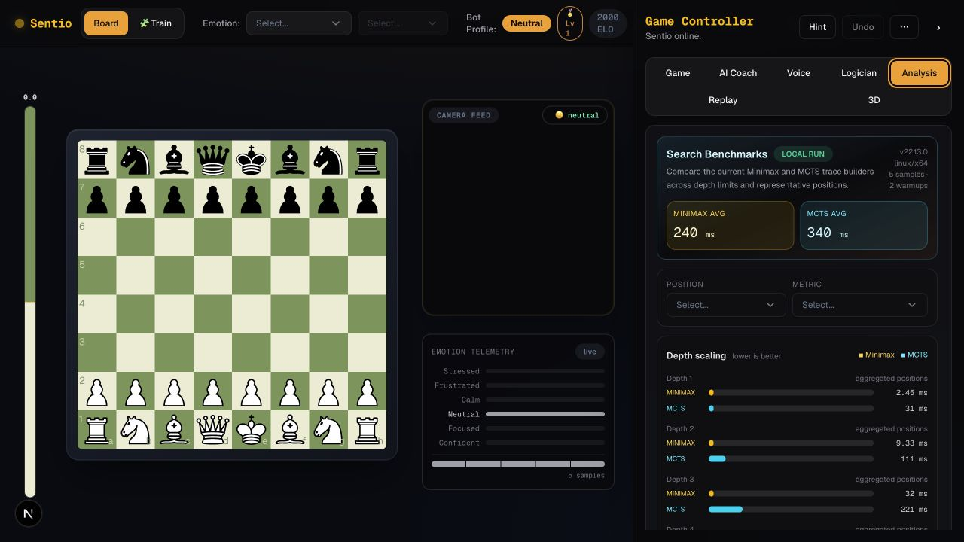
What is Sentio?
The project in one slide
●
Emotion-aware chess
A full-stack chess app that senses the player's state while the game is running.
●
Adaptive Stockfish
Emotion changes engine depth, skill level, and ELO automatically.
●
Explainable coaching
Prolog gives traceable rule-based advice; the LLM provides separate natural-language coaching.
●
Voice + 3D interaction
Burmese voice moves, voice coaching, and a hand-tracked 3D arena.
SENTIO
4
Notes:
[Sources]
- /Users/yuza/chess-agent-v2/README.md
- /Users/yuza/chess-agent-v2/AI_SYSTEM.txt
- /Users/yuza/chess-agent-v2/.presentation-build/assets/sentio-analysis.png
[/Sources]

Slide 5
Problem Statement
Why Sentio is needed
✕
Fixed difficulty
✕
Beginners give up
✕
Feelings are ignored
One fixed setting cannot match a player's changing focus, stress, or confidence.
Beginners lose motivation when every game feels impossible; stronger players stop being challenged.
No engine notices that the player is stressed, tilted, or completely focused.
The engine should adapt to the player — not the other way around.
✕
No encouragement
✕
Language barrier
A frustrated player receives no support — only another losing position.
Chess coaching tools are English-only, closing them off to many local players.
SENTIO
5
Notes:
[Sources]
- /Users/yuza/chess-agent-v2/README.md
- /Users/yuza/chess-agent-v2/AI_SYSTEM.txt
[/Sources]

Slide 6
System Objectives
What Sentio must deliver
01
Detect emotion in real time from the player's webcam
02
Adapt engine strength automatically to that emotional state
03
Give natural-language coaching through a large language model
04
Give explainable, rule-based advice from a Prolog knowledge base
05
Accept Burmese voice input for both moves and coaching questions
SENTIO
6
Notes:
[Sources]
- /Users/yuza/chess-agent-v2/README.md
- /Users/yuza/chess-agent-v2/AI_SYSTEM.txt
[/Sources]

Slide 7
Functional Requirements
Core system requirements
♟
Full legal chess
◉
Emotion capture
⚙
Strength mapping
Move validation, promotion picker, undo and PGN export.
Read webcam frames and classify them into six emotion labels.
Turn the emotion into engine depth, skill level and ELO.
⚑
Coach chat
▶
Voice moves
▦
Live feedback
Answer position questions in the AI Coach panel.
Accept spoken moves in Burmese and in English.
Evaluation bar, opening names and move hints on demand.
SENTIO
7
Notes:
[Sources]
- /Users/yuza/chess-agent-v2/README.md
- /Users/yuza/chess-agent-v2/app/page.tsx
[/Sources]

Slide 8
System Architecture
How Sentio connects every AI layer
BROWSER
React chessboard
face-api.js emotion
Coach chat panel
Three.js 3D board
HTTP / JSON
NEXT.JS SERVER
/api/bot-move
/api/coach
/api/transcribe
/api/tts
HTTP / JSON
PYTHON BACKEND
Stockfish pool
faster-whisper STT
SWI-Prolog + pyswip
FastAPI + Uvicorn
Next.js · React · TypeScript · Tailwind · chess.js · Python · FastAPI · Stockfish · SWI-Prolog · Groq LLM · Whisper · Three.js
SENTIO
8
Notes:
[Sources]
- /Users/yuza/chess-agent-v2/README.md
- /Users/yuza/chess-agent-v2/backend/main.py
[/Sources]

Slide 9
Methodology
Stable emotion detection
1
2
3
4
5
Capture
Detect
Classify
Buffer
Decide
A webcam frame every 2.2 seconds
TinyFaceDetector locates the face
FaceExpressionNet returns 7 expressions
The last 3 readings are stored
Majority label becomes the emotion
If two labels tie, the previous emotion is kept — this stops the engine strength from flickering mid-game.
SENTIO
9
Notes:
[Sources]
- /Users/yuza/chess-agent-v2/app/page.tsx
- /Users/yuza/chess-agent-v2/lib/blendshapeEmotion.ts
[/Sources]

Slide 10
Methodology
Emotion changes Stockfish strength
EMOTION
DEPTH
SKILL
ELO RATING
Stressed
1
1
1320
Frustrated
2
3
1320
Calm
4
6
1600
Neutral
6
10
2000
Focused
8
15
2600
Confident
10
20
3190
Stockfish accepts a UCI_Elo between 1320 and 3190 — the full supported range is used.
SENTIO
10
Notes:
[Sources]
- /Users/yuza/chess-agent-v2/lib/engineProfiles.ts
- /Users/yuza/chess-agent-v2/prolog/ai_system.pl
[/Sources]

Slide 11
Methodology
Stockfish moves; Prolog explains
Stockfish engine
The Logician — Prolog reasoning
fen + emotion
Your knight on f6 is hanging — attacked and undefended.
HIGH
resolve_strength_profile()
Stockfish engine pool
You have not castled; your king is still in the centre.
MEDIUM
botMove returned
Black controls d4 and e5 — good central presence.
A pool of persistent engine instances keeps replies fast.
Each request sets UCI_Elo, skill level and depth from the profile.
LOW
Stockfish searches for strong moves. Prolog reads the same position and returns rule-based advice that can be traced and explained.
SENTIO
11
Notes:
[Sources]
- /Users/yuza/chess-agent-v2/backend/main.py
- /Users/yuza/chess-agent-v2/prolog/ai_system.pl
- /Users/yuza/chess-agent-v2/app/api/prolog/route.ts
[/Sources]

Slide 12
Methodology
Two voice paths: move or ask
LLM Coach
Burmese voice interface
Receives the current FEN, the detected emotion and the question.
Produces position analysis in plain language.
Suggested moves appear as clickable “Play” buttons.
Tone follows emotion — encouragement or a challenge.
●
Record
Push-to-talk in the browser
◆
Transcribe
Local Whisper first, cloud as fallback
AI COACH
focused
Voice Moves
Voice Coach
What is the best plan here?
Parsed by speechParser.ts
Burmese chess vocabulary
Only legal moves are played
Sent to /api/coach
Answered in Burmese
Read aloud by Burmese TTS
Castle short first, then push d4 to open the centre.
SENTIO
12
Notes:
[Sources]
- /Users/yuza/chess-agent-v2/README.md
- /Users/yuza/chess-agent-v2/lib/speechParser.ts
- /Users/yuza/chess-agent-v2/components/VoiceCoachControl.tsx
[/Sources]

Slide 13
Code Example
One emotion profile, two implementations
lib/engineProfiles.ts
prolog/ai_system.pl
export const EMOTION_PROFILES = {
stressed: { depth: 1, skill: 1, elo: 1320 },
frustrated: { depth: 2, skill: 3, elo: 1320 },
calm: { depth: 4, skill: 6, elo: 1600 },
neutral: { depth: 6, skill: 10, elo: 2000 },
focused: { depth: 8, skill: 15, elo: 2600 },
confident: { depth: 10, skill: 20, elo: 3190 },
};
export function clampElo(elo: number) {
return Math.max(1320, Math.min(3190, elo));
}
% emotion to engine strength
profile(stressed, 1, 1, 1320).
profile(frustrated, 2, 3, 1320).
profile(calm, 4, 6, 1600).
profile(confident, 10, 20, 3190).
% face to emotion
expression(happy, confident).
expression(angry, frustrated).
% join the two together
engine_for(Expr, D, S, E) :-
expression(Expr, Emo),
profile(Emo, D, S, E).
One source of truth in TypeScript; the same knowledge as declarative facts in Prolog.
SENTIO
13
Notes:
[Sources]
- /Users/yuza/chess-agent-v2/lib/engineProfiles.ts
- /Users/yuza/chess-agent-v2/prolog/ai_system.pl
[/Sources]

Slide 14
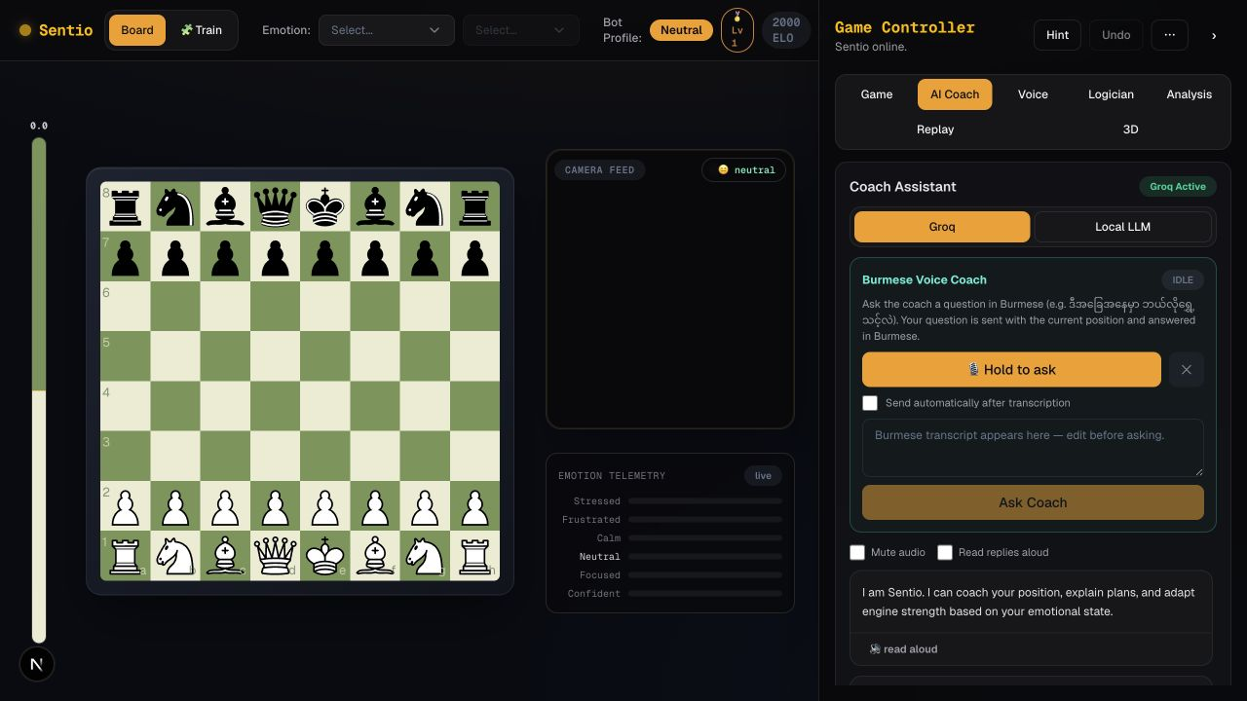
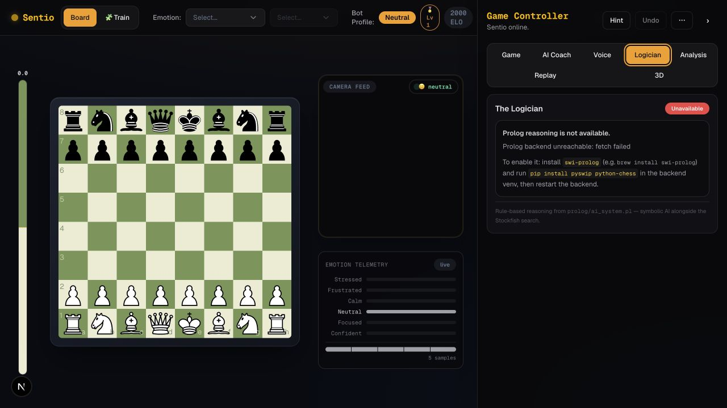
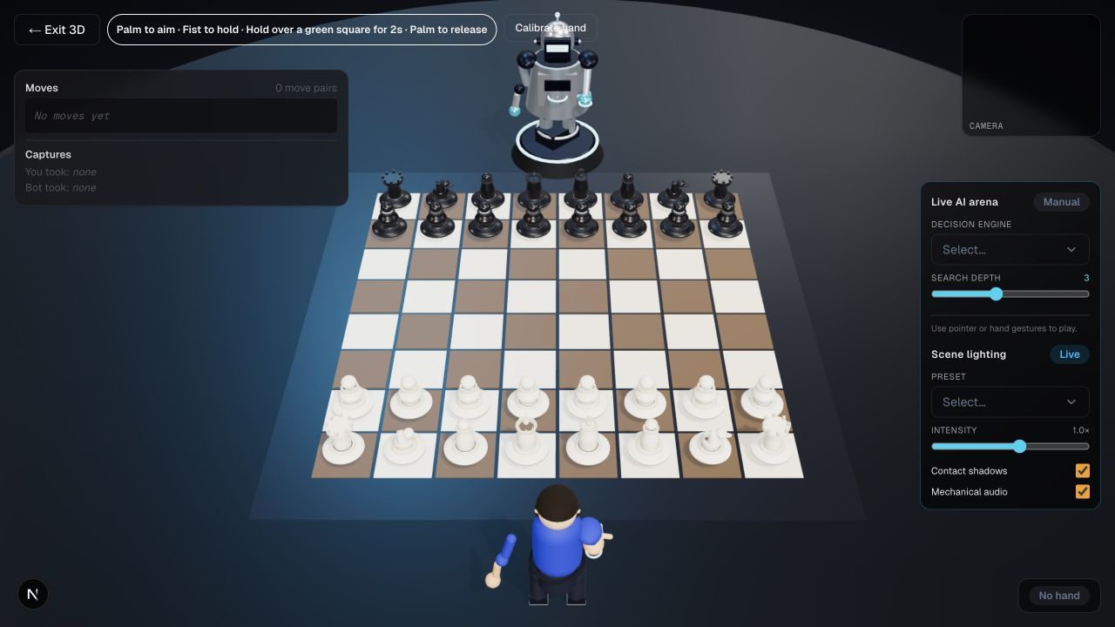
System UI
Real Sentio UI — game, reasoning, and 3D control
LIVE GAME + COACHING
PROLOG LOGICIAN
3D HAND-TRACKED ARENA
SENTIO
14
Notes:
[Sources]
- /Users/yuza/chess-agent-v2/.presentation-build/assets/sentio-main.png
- /Users/yuza/chess-agent-v2/.presentation-build/assets/sentio-logician.png
- /Users/yuza/chess-agent-v2/.presentation-build/assets/sentio-3d.png
[/Sources]

Slide 15
Benefits & Limitations
Benefits — and honest limits
BENEFITS
LIMITATIONS
✓
Always the right challenge
!
Expression ≠ emotion
Difficulty follows the player, so the game stays winnable.
A face is only an approximation of what a player feels.
✓
Beginners stay motivated
!
Environment sensitive
Emotion-aware feedback supports players through hard positions.
Accuracy drops with poor lighting or a turned head.
✓
Explainable advice
!
Privacy concerns
Prolog shows why a chess principle applies to the current position.
The webcam requirement will not suit every setting.
✓
Accessible in Burmese
!
Heavy on resources
Voice moves and coaching remove the English-only barrier.
Local Whisper and Stockfish both need real memory and CPU.
SENTIO
15
Notes:
[Sources]
- /Users/yuza/chess-agent-v2/README.md
- /Users/yuza/chess-agent-v2/AI_SYSTEM.txt
[/Sources]

Slide 16
Future Work
What comes next
1
2
3
4
5
Richer emotion signal
Better Burmese STT
Long-term player profile
Deeper knowledge base
Public deployment
Combine facial expression with move timing and blunder rate.
Train a custom model to improve spoken-move recognition.
Track progress and weaknesses across many sessions.
Add tactical motifs and endgame theory to the Prolog rules.
Host the web app and ship an optional mobile version.
SENTIO
16
Notes:
[Sources]
- Project roadmap summarized from the current deck and repository scope.
[/Sources]

Slide 17
Conclusion & References
Sentio brings four AI experiences together
Computer vision senses the player's current state.
Stockfish adapts difficulty automatically.
Prolog explains rules; the LLM provides natural-language coaching.
Burmese voice and 3D hand tracking expand how players interact.
REFERENCES
stockfishchess.org
github.com/vladmandic/face-api
swi-prolog.org
github.com/SYSTRAN/faster-whisper
github.com/jhlywa/chess.js
nextjs.org/docs
One connected system: adaptive, explainable, multilingual, and playable.
SENTIO
17
Notes:
[Sources]
- /Users/yuza/chess-agent-v2/README.md
- /Users/yuza/chess-agent-v2/components/Simulation3D.tsx
- /Users/yuza/chess-agent-v2/prolog/ai_system.pl
[/Sources]

Slide 18
GROUP-X · SECTION-C
♞
THANK YOU
Questions & Discussion
Sentio — Emotion-Adaptive Chess AI
Built and presented by Group-X · Section-C
University of Information Technology
SENTIO
18
Notes:
[Sources]
- Closing slide; no external claims or assets added.
[/Sources]

