Slide 1


SMART INDIA HACKATHON 2025
TITLE PAGE
Problem Statement ID –25034
Problem Statement Title- Al-Based Internship Recommendation Engine for PM Internship Scheme
Theme-
PS Category- Software
Team ID- SIH250327
Team Name - SkillMatchAI

Slide 2
IDEA TITLE
Skill MatchAI
Detailed Explanation:
We propose an AI-driven recommendation system that intelligently matches students with the most suitable internships.
Our system uses semantic embeddings (Sentence-BERT) combined with Retrieval-Augmented Generation (RAG) to understand internship postings beyond just keywords.
We integrate filters like stipend, duration, skills, and location to make results more personalized and practical.
How it Addresses the Problem:
Students no longer waste time manually browsing irrelevant postings.
Organizations get better-matched candidates, reducing hiring mismatches.
Hidden or less popular opportunities are surfaced, ensuring equal visibility.
Innovation & Uniqueness:
Unlike traditional keyword search, our approach understands context and meaning.
We combine semantic similarity, structured filters, and recency boosting for highly accurate matches.

Slide 3
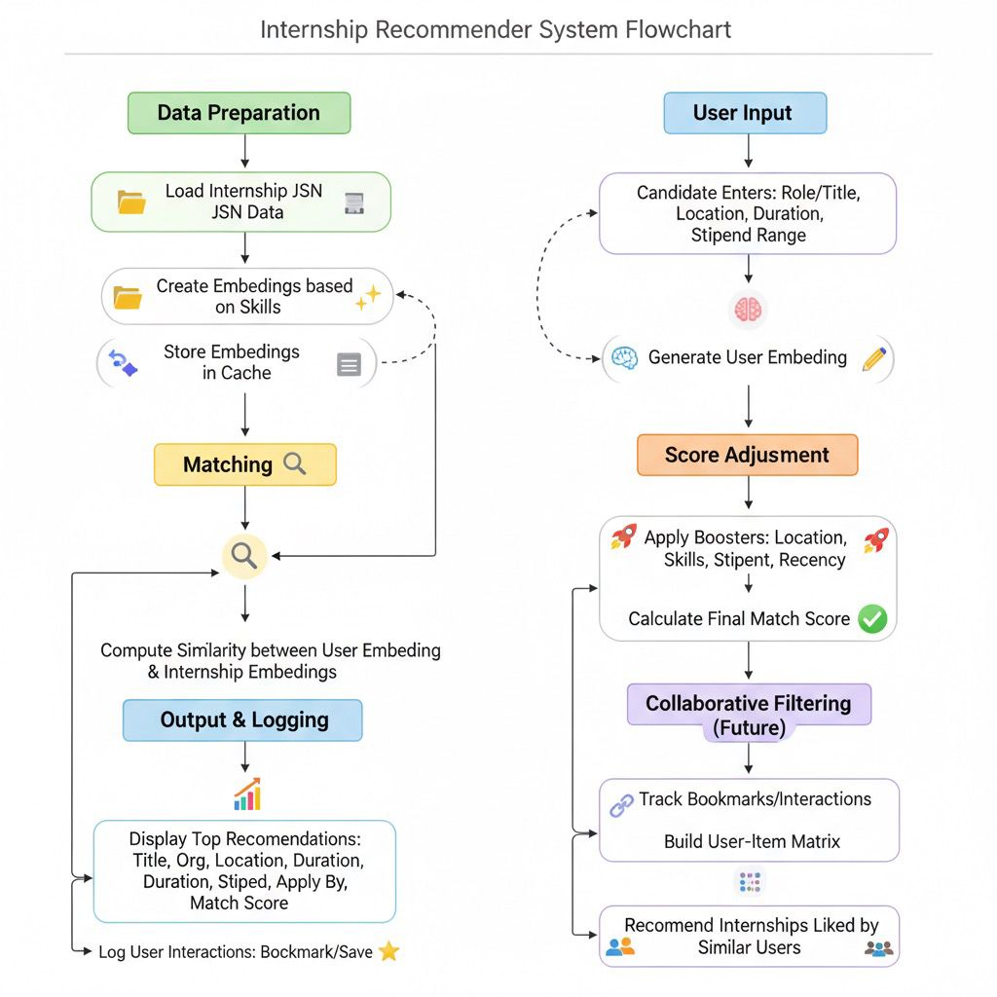
TECHNICAL APPROACH
Skill MatchAI
1.Programming Languages
Python
2. Frameworks & Libraries
Streamlit
FastAPI
SQLAlchemy
SentenceTransformers (SBERT)
Scikit-learn
3. Database
SQLite
PostgreSQL / MySQL (optional advanc):
4. Vector Store / Caching
FAISS or Milvus
5. Al / Machine Learning
SBERT embeddings comet internship data
and user input into vectors for semantic
matching Collaborative Filtering (Future
Enhancement)

Slide 4
FEASIBILITY AND VIABILITY
Skill MatchAI
The system can be built using simple AI models that don’t need heavy computers. It can be added to the existing PM Internship portal without much cost Open-source tools make it affordable. It will be very useful for students from rural and urban areas.
Lightweight AI Models: Uses embeddings (to capture meaning), rule-based filters (location, stipend, duration), and collaborative filtering (learns from choices of similar candidates). Low Cost: All methods can be implemented with open-source tools → no expensive licenses or GPUs required. Easy Deployment: Can run on simple cloud or government servers → does not need heavy infrastructure. Simple Maintenance: Only requires periodic updates of internship postings and candidate activity data. Scalable: Embeddings + rule-based filters are fast; collaborative filtering improves over time as more students use the system.
.
Feasibility
VIABILITY
Challenges and Risks :
The system may show more popular city internships and ignore rural ones.
Some students may not fill their details fully.
Users with low digital knowledge may find it difficult to use.
Only English/Hindi support may limit reach.
Too many users at once may slow it down.
Solutions to Overcome
Fairness: Regularly check and balance results so rural and small opportunities are also shown.
Backup Matching: If details are missing, use basic info like education or location.
Easy Design: Use simple icons, buttons, and visuals for smooth use.
Language: Add regional language support.Scalability: Use cloud servers so it works even if many users log in at the same time.

Slide 5
Impact and Benefits of AI-Powered Internship Recommendation System
Skill MatchAI
Potential Impact- Empowers rural, tribal, and first-generation learners with equal access to opportunities.
Boosts confidence through clear and personalized recommendations.
Promotes inclusivity by connecting talent from all regions of India to the right internships.
Social Impact- Empowers underserved youth with easy and guided access to internships.
Bridges the urban–rural divide through inclusive and multilingual design.-
Builds confidence by giving candidates clear, personalized choices
Economic Impact- Increases employability by aligning skills with the right opportunities.
Saves organizations time and cost by matching them with relevant candidates.
Strengthens the workforce pipeline with skilled, career-ready youth
Environmental Impact- Lightweight AI ensures efficient and sustainable use of resources.
Reduces unnecessary applications and travel, lowering the carbon footprint.
Promotes a green, tech-driven approach to career building
.

Slide 6
RESEARCH AND REFERENCES
Skill MatchAI
A. Kumar, “Personalized Job Search with AI: A Recommendation System Integrating Real-Time Data and Skill-Based Matching”, arXiv preprint arXiv:2406.18542, 2024.
2. S. Gupta, R. Sharma, “AI-Powered Job Recommendation System Using NLP and Machine Learning”, arXiv preprint arXiv:2308.14240, 2023.
3. P. Zhang, Y. Li, “A Personalized Job Recommendation System Using Deep Learning”, arXiv preprint arXiv:2006.02929, 2020.
4. M. Rahman, “Job Recommendation System Using Hybrid Filtering”, arXiv preprint arXiv:2004.02793, 2020.
5. J. Patel, K. Verma, “Design and Implementation of an AI-based Career Guidance and Job Recommendation System”, arXiv preprint arXiv:2011.06788, 2020.

Slide 7
IMPORTANT INSTRUCTIONS
Please ensure below pointers are met while submitting the Idea PPT:
Kindly keep the maximum slides limit up to six (6). ( Including the title slide)
Try to avoid paragraphs and post your idea in points /diagrams / Infographics /pictures
Keep your explanation precise and easy to understand
Idea should be unique and novel.
You can only use provided template for making the PPT without changing the idea details pointers (mentioned in previous slides).
You need to save the file in PDF and upload the same on portal. No PPT, Word Doc or any other format will be supported.
Note - You can delete this slide (Important Pointers) when you upload the details of your idea on SIH portal.

