Slide 1


Cyberbullying Detection
By:
John Hani
Mohamed Nashaat
Mostafa Ahmed
Zeyad Emad (Team Leader)
Under supervision of :
Dr. Eslam Amer
Eng. Menna Gamil

Slide 2

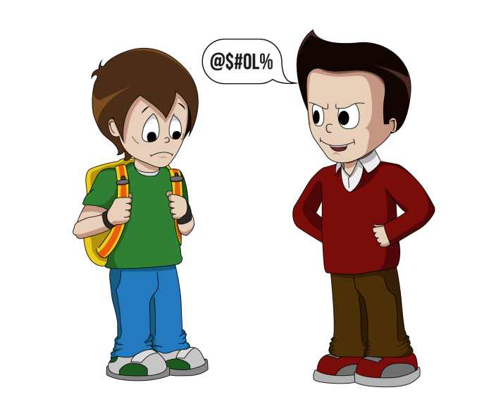


Introduction
Use superior strength or influence to intimidate someone

Slide 3
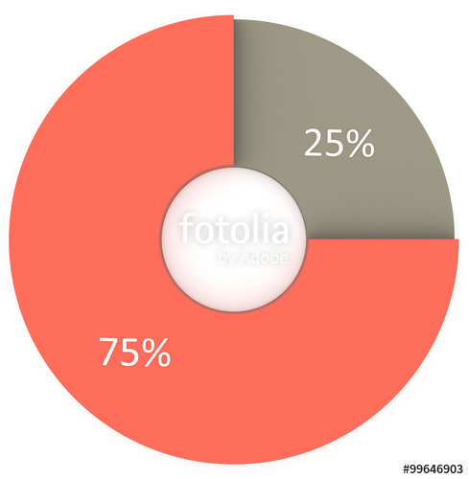

Analysis
More than 1 in 3 young people have experienced cyber threats online.
National Crime Prevention Council, “Cyberbullying”
Richard Webster, Harford County Examiner, “From cyber bullying to sexting: What on your kids’ cell?”
Over 25 percent of adolescents and teens have been bullied repeatedly through their cell phones or the Internet.
i-SAFE Inc., “Cyber Bullying: Statistics and Tips”

Slide 4



You’re
Trash
Personal pronoun used when directly addressing people
An offensive word when combined with personal pronouns creates a cyberbullying sample

Slide 5

Why
Don’t
you
go
kys
Kys is a slang word which stand for kill yourself also considered as a cyberbullying sample

Slide 6
What
a
shit
deal
A rather offensive word but no pronouns were found in that sentence implying the sentiment of discomfort or irritation

Slide 7
Objective
In previous cyberbullying detection frameworks there has been a problem in detecting false positive cyberbullied cases.
The accuracy in these papers is not high enough and could be improved.

Slide 8
Functional Requirement
User Registration | Login Sign Up Update Logout
Messages | Send messages Receive messages Encrypt Decrypt
Processing | Preprocessing Feature extraction Classification
System | Notify Result Rating Upgrade Classifier

Slide 9



Non Functional Requirements
Security
Maintainability
Portability
Have Encryption and Decryption
Self Learning
Both Desktop and Android

Slide 10
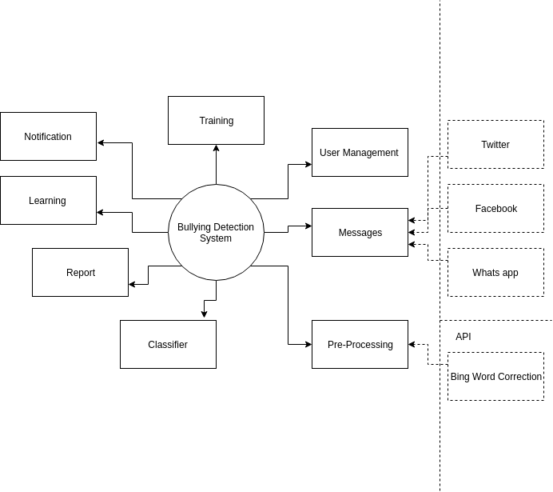

Slide 11
User Management: Responsible for the Management of the Users Roles
Pre-Processing: Limitization, Stemming,Tokenization, Word Correction Bing API for correction
Processing: (SVM , Random Forest, Naive Bayes)
Reports: Are automatically generated reports about the system overall the number of bully message detected , etc…
Learning: Self-Learning for the system based on the decision taken by the supervisor about the user rating
Notification: Notify the user about the new messages and bully messages received
Training: Train the model by data set or wrong classification
Messages: Receive messages from Twitter, Facebook , Whatsapp API

Slide 12
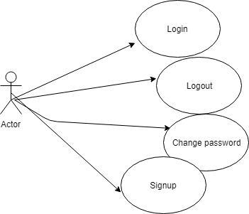
Use Case

Slide 13
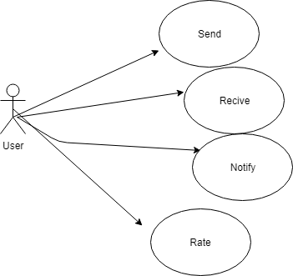
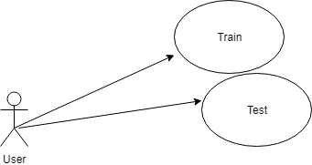
Admin

Slide 14
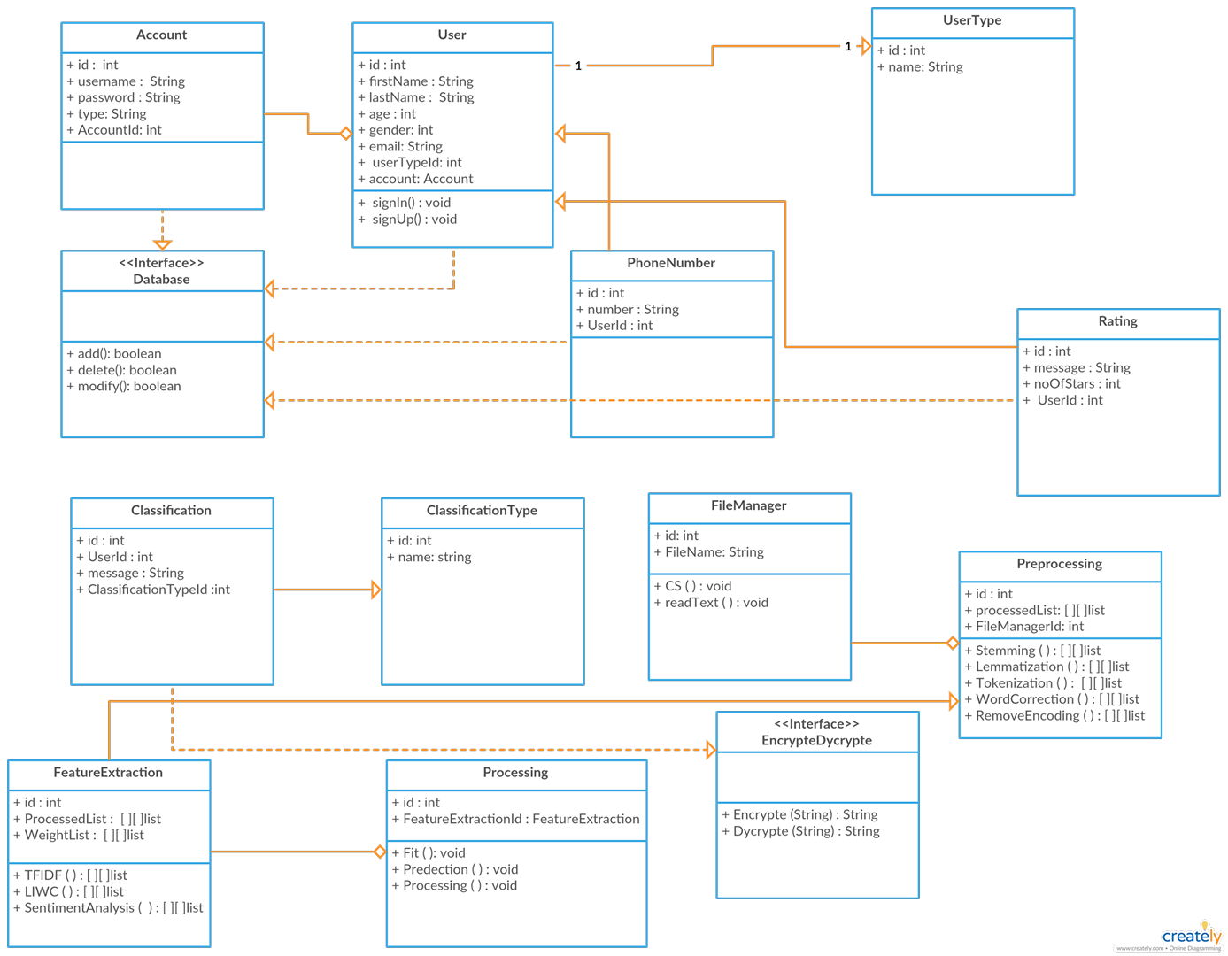
Class Diagram

Slide 15
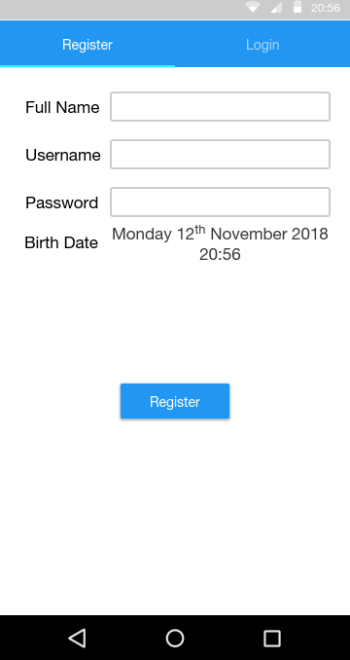
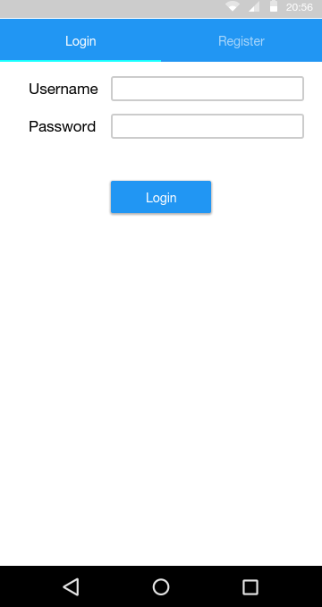
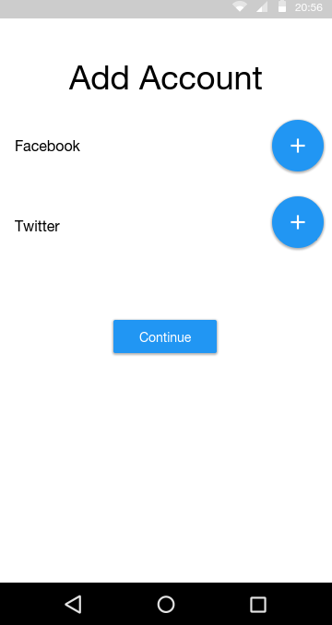
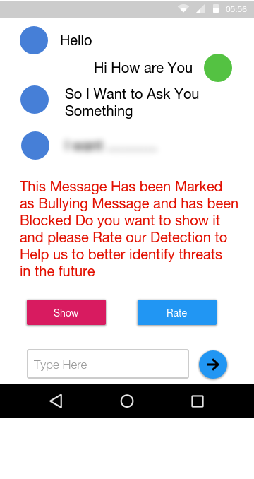
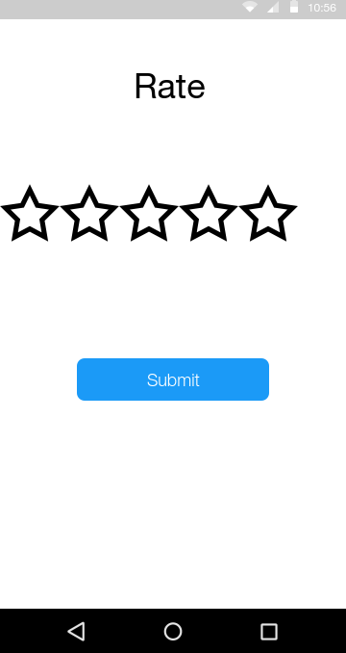
GUI

