Slide 1


ايذاء الاخرين لفظيآ
Cyberbullying Detection
By:
John Hani
Mohamed Nashaat
Mostafa Ahmed
Zeyad Emad (Team Leader)
Under supervision of :
Dr. Eslam Amer, Dr.Ammar
Eng. Menna Gamil
Date:4\2\2019

Slide 2


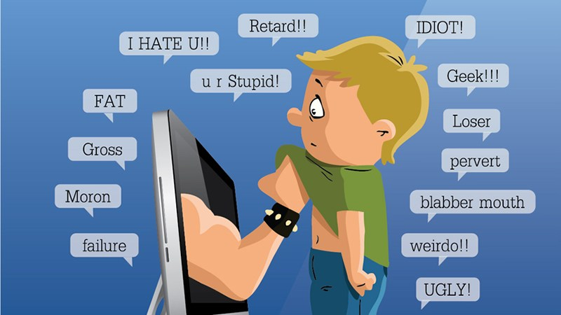
Introduction
What is cyberbullying?
The use of electronic communication to bully a personsending messages of an intimidating or threatening nature.

Slide 3



You’re
Trash
Personal pronoun used when directly addressing people
An offensive word when combined with personal pronouns creates a cyberbullying sample

Slide 4
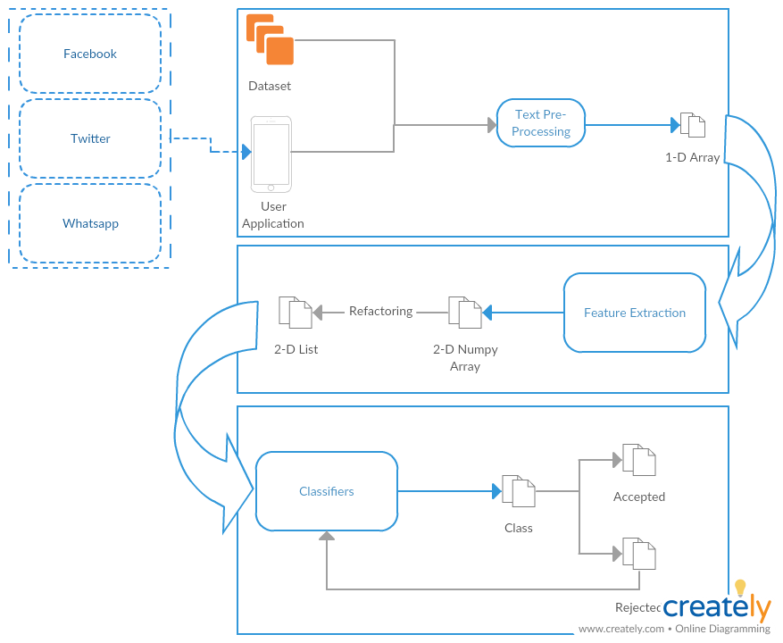
Business Model
Self Learning

Slide 5
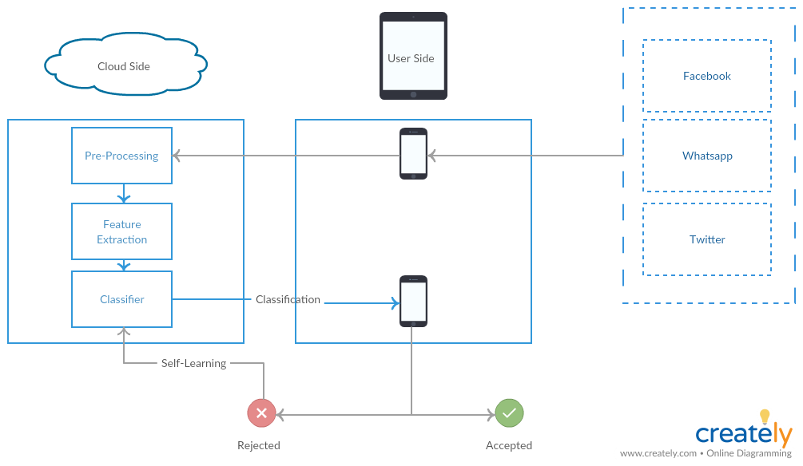



System Overview

Slide 6
Market motivation

Slide 7
Demo

Slide 8
Any Questions ?

Slide 9
Appendix

Slide 10
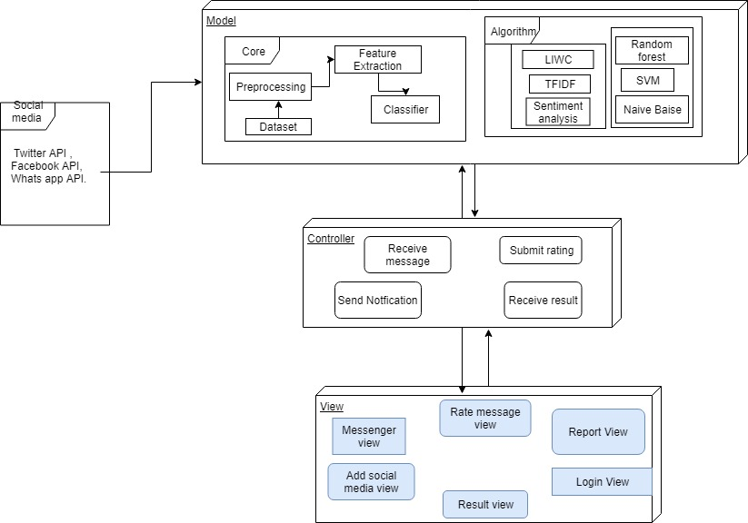
System Architecture
Feature
Extraction
Classifiers

Slide 11
Most Important Algorithm
Sentiment Analysis
What is Sentiment Analysis ?
Why we chose it ?
How it works ?

Slide 12
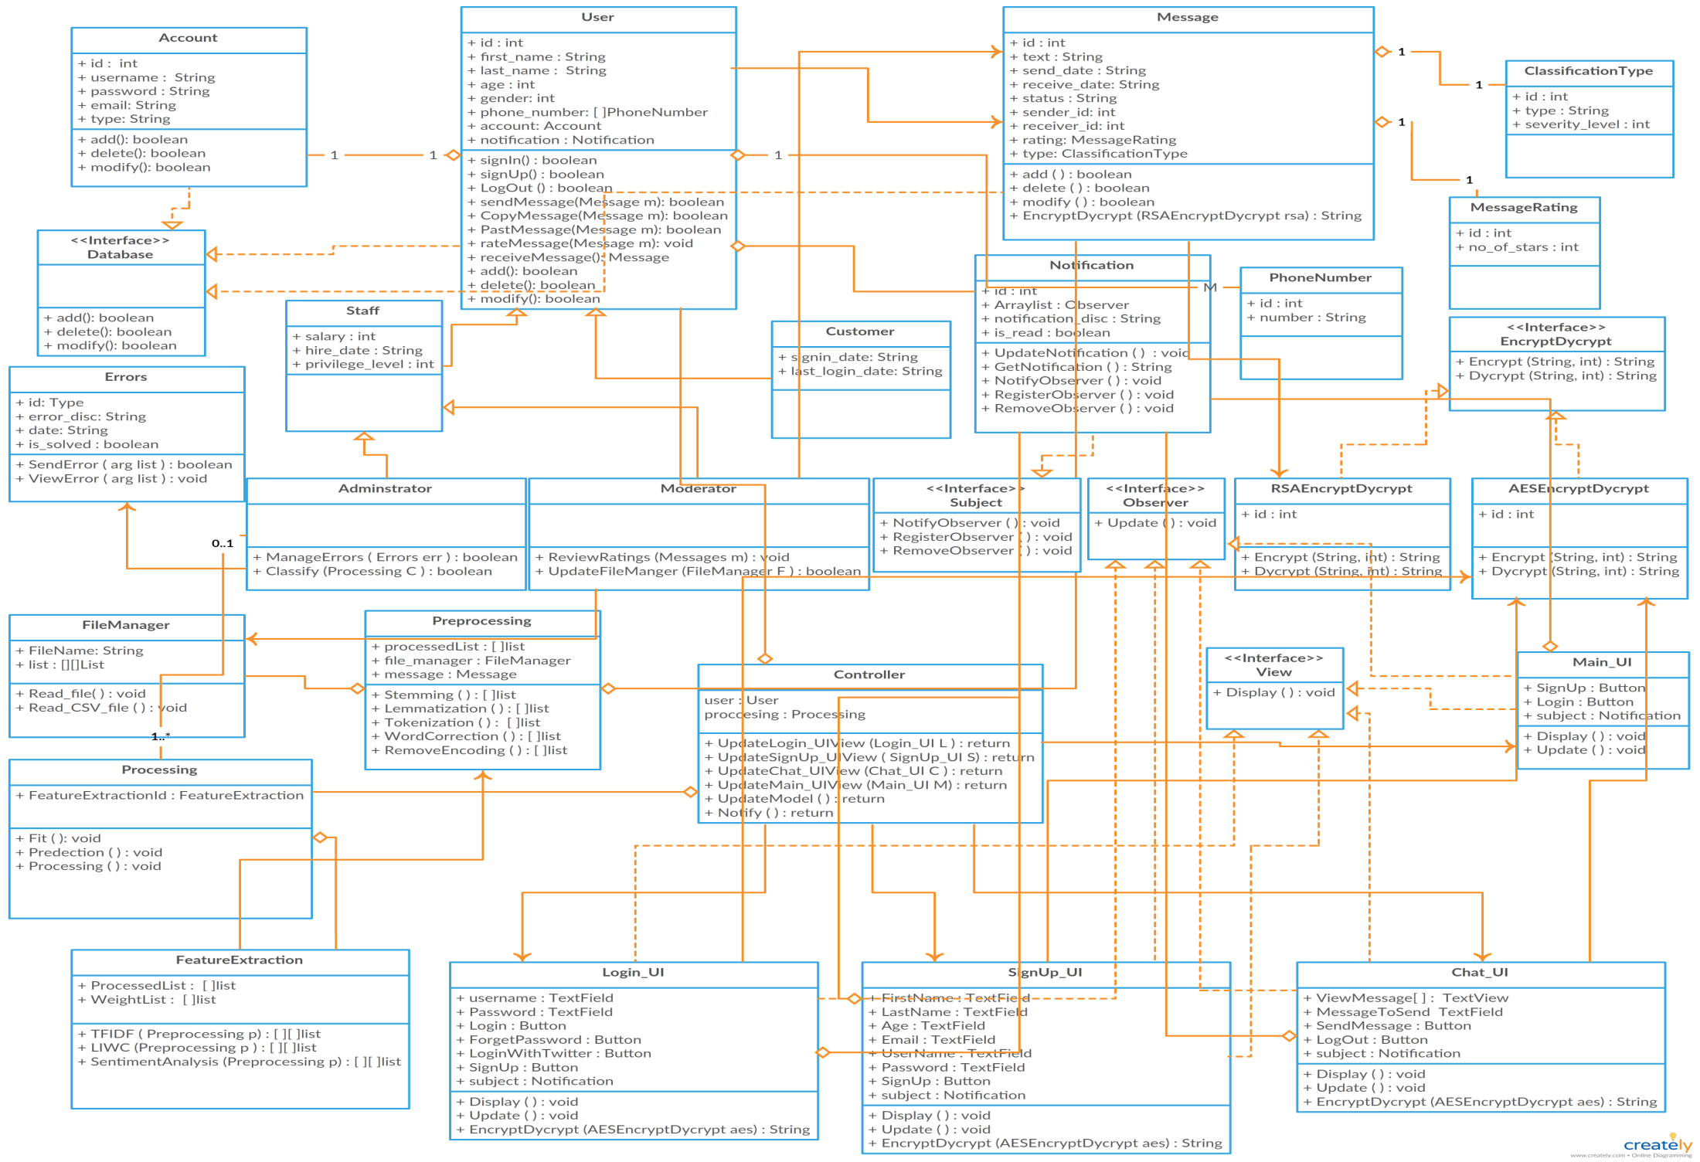
Class Diagram

Slide 13



Non Functional Requirements
Security
Maintainability
Portability
Have Encryption and Decryption
Self Learning
Both Desktop and Android

Slide 14
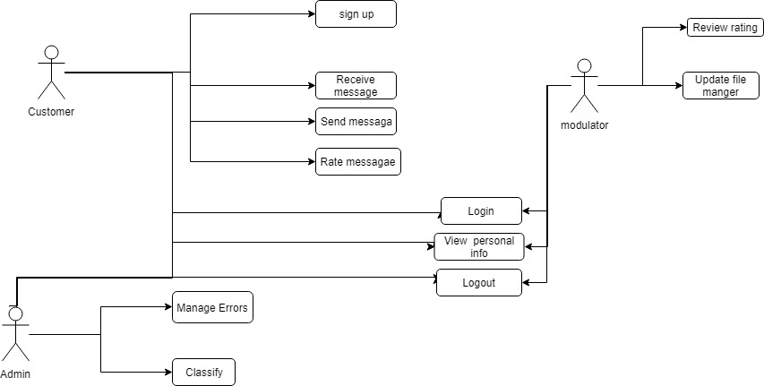
USE Case

Slide 15
Functional Requirement
User | Login with social media Rating
Messages | Send messages & Receive messages Encrypt & Decrypt
Processing | Preprocessing Feature extraction Classification
System | Notify Result Upgrade Classifier

Slide 16
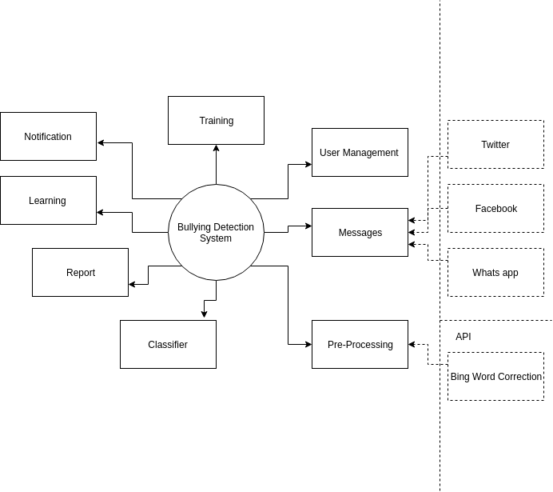
Context Diagram

Slide 17
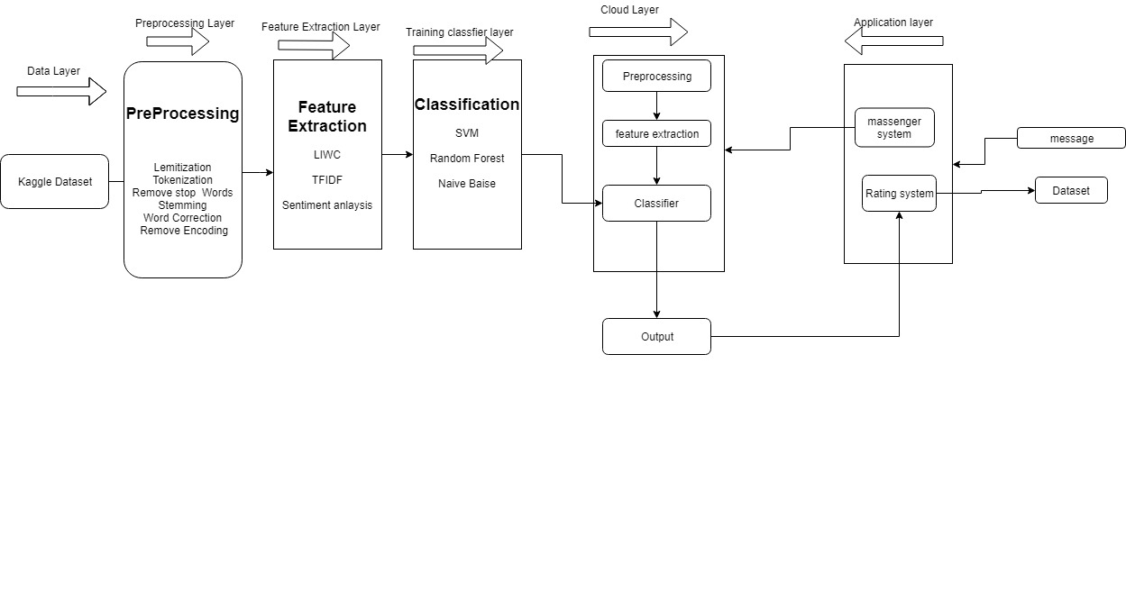
Block diagram

Slide 18
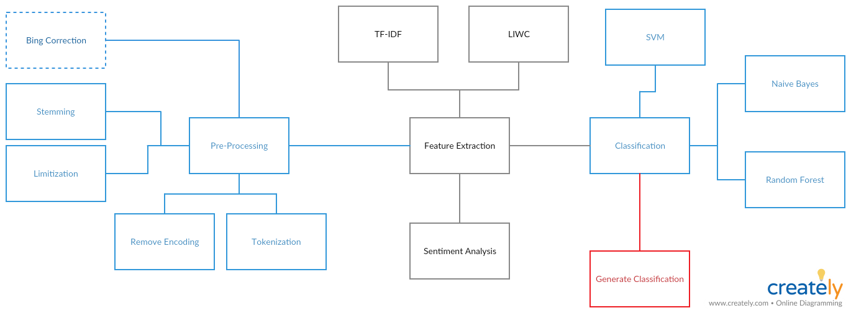
Block diagram

Slide 19
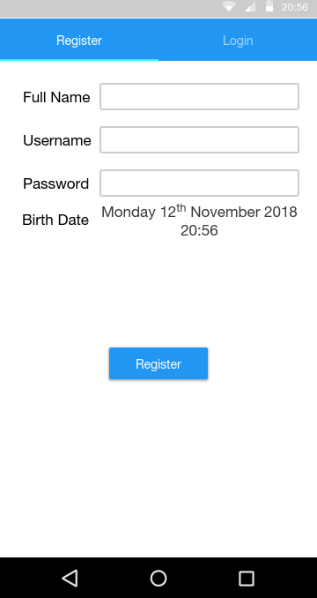
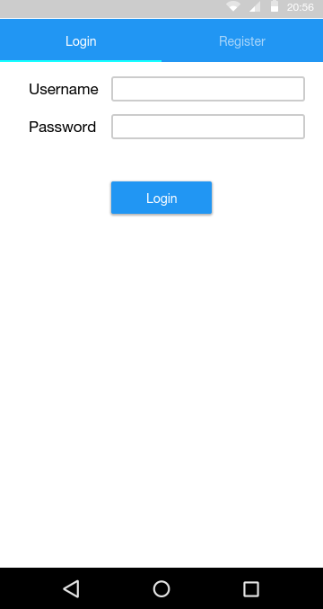
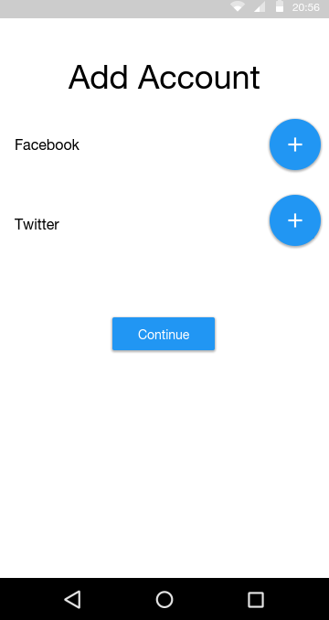
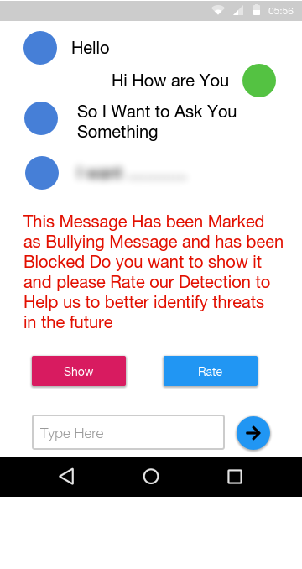
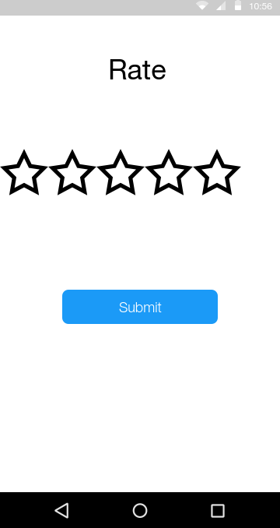
GUI

