Slide 1


ايذاء الاخرين لفظيآ
Cyberbullying Detection
By:
John Hani
Mohamed Nashaat
Mostafa Ahmed
Zeyad Emad (Team Leader)
Under supervision of :
Dr. Eslam Amer
Dr. Ammar
Eng. Menna Gamil
Date:28\2\2019

Slide 2

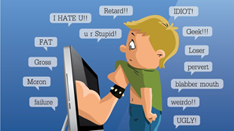
Introduction
Use of superior strength or influence to intimidate someone
Our Scope
Social Media platforms will benefit from our software as cyberbullying rates will drop
Real life
The Internet

Slide 3
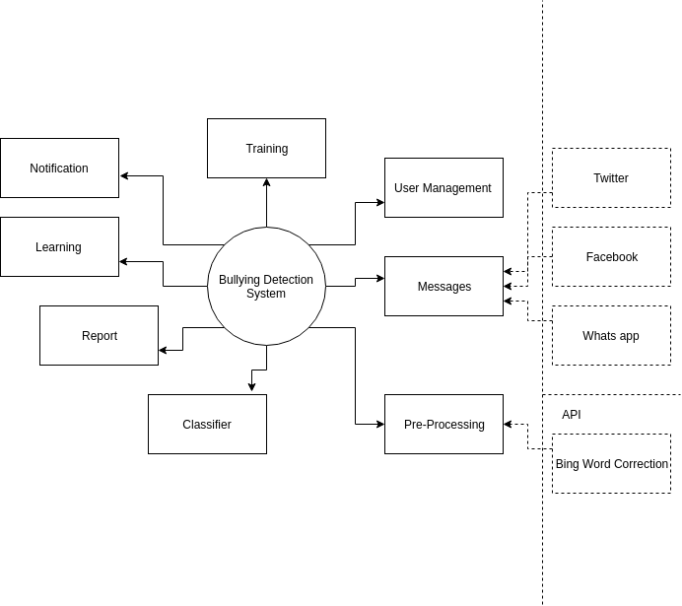

Context Diagram

Slide 4
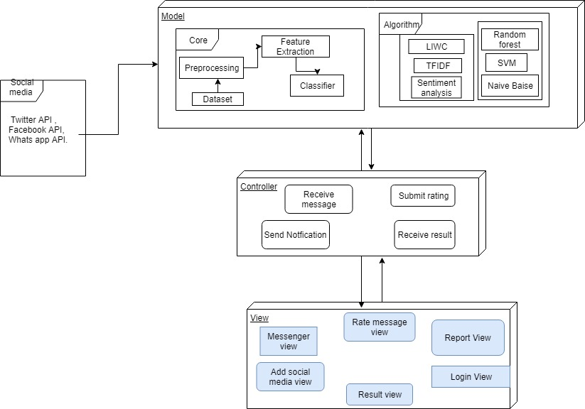
System Architecture
Feature
Extraction
Classifiers

Slide 5
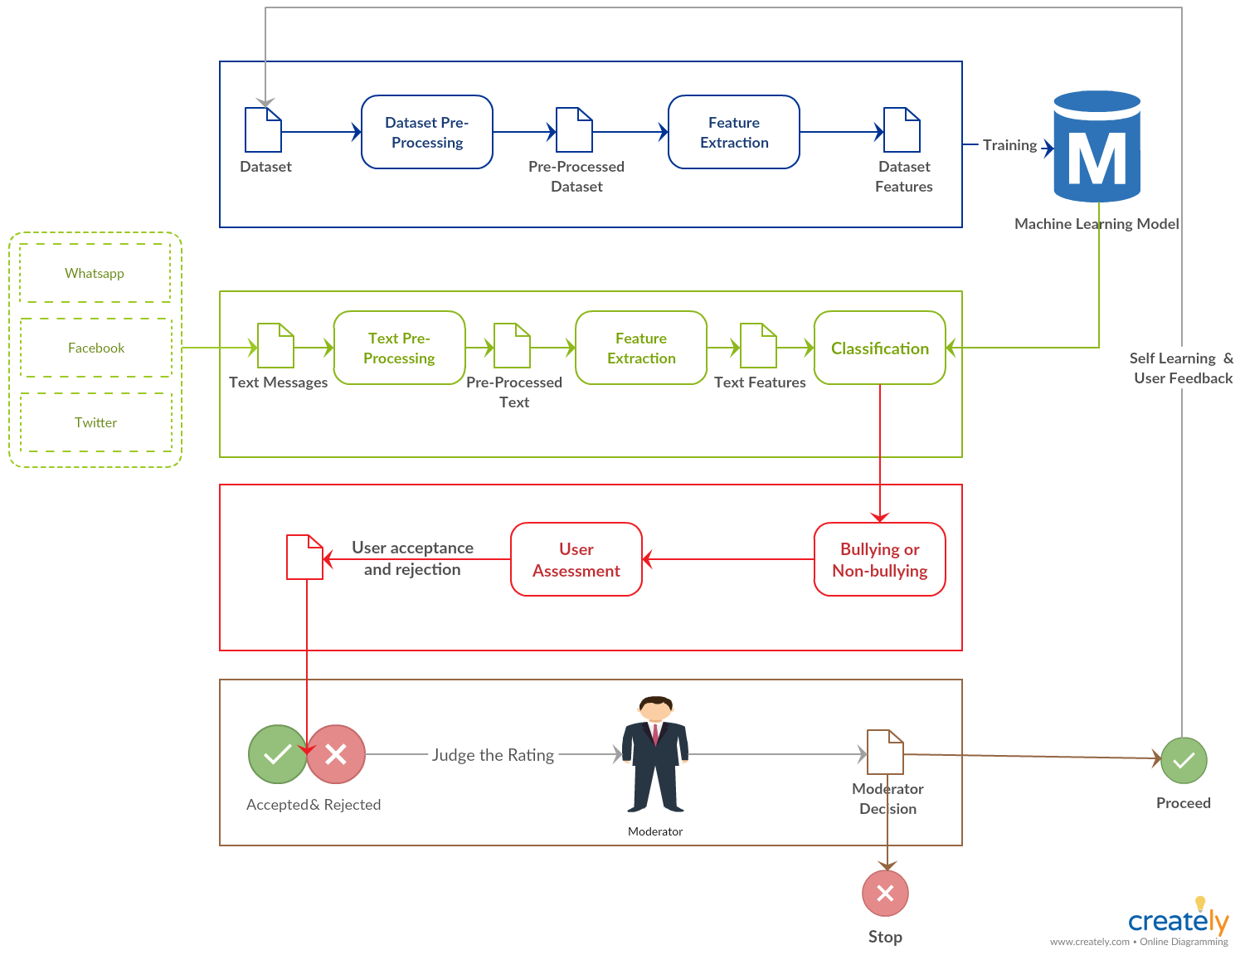
System overview

Slide 6
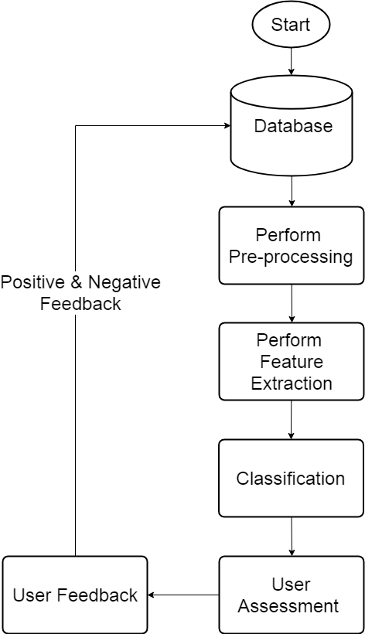
Activity diagram

Slide 7
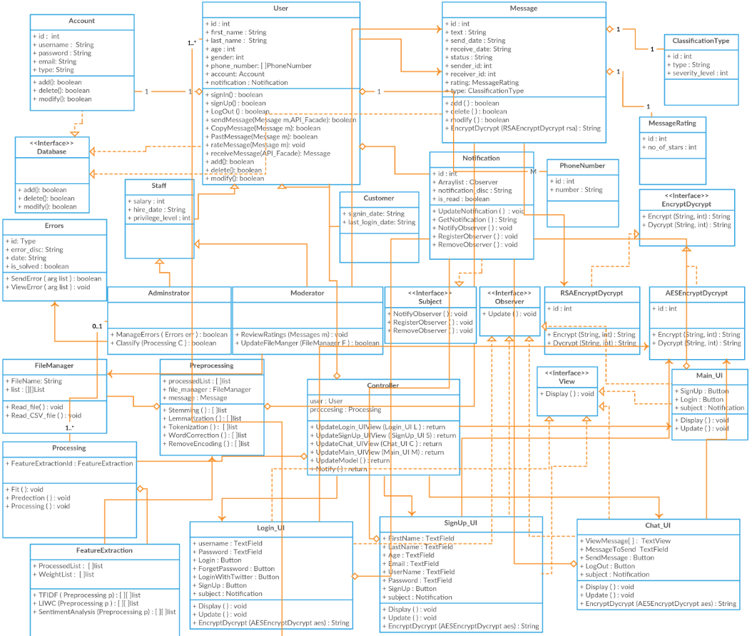
MVC Design Pattern

Slide 8
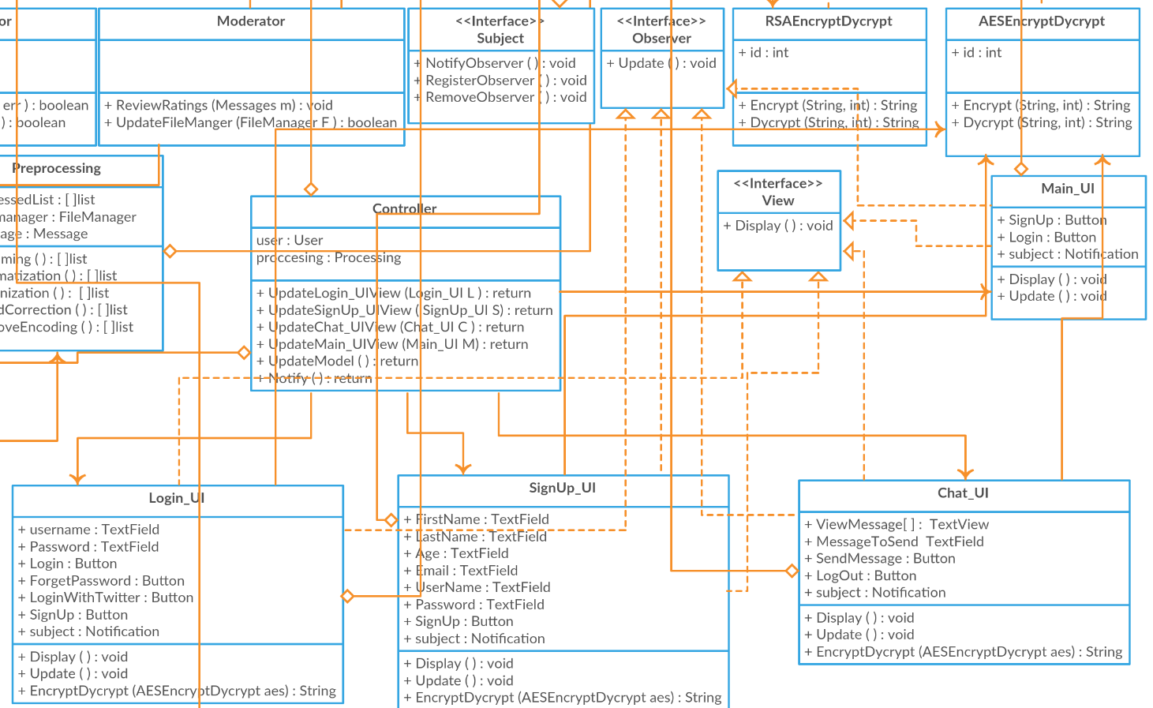
Observer Design Pattern

Slide 9
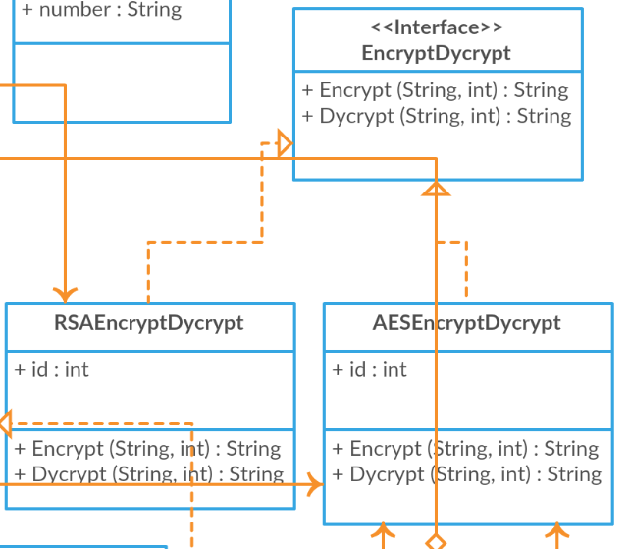
Strategy Design Pattern

Slide 10
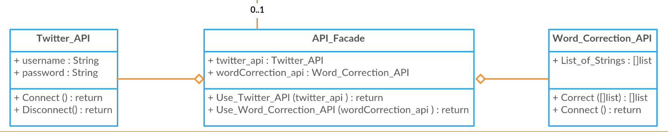
Facade Design Pattern

Slide 11
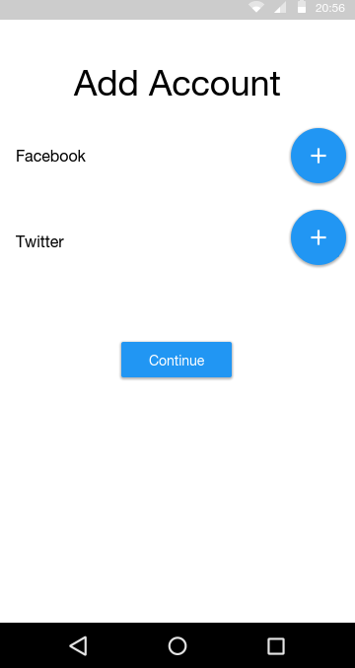
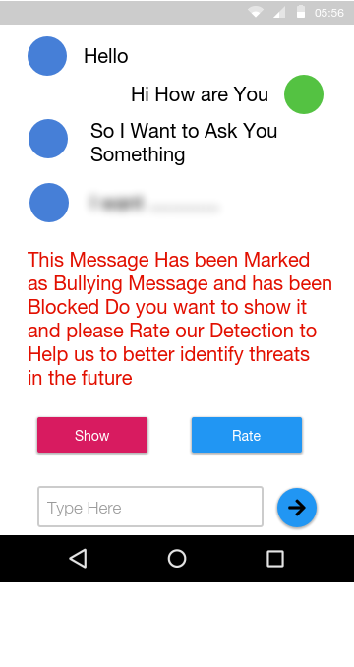
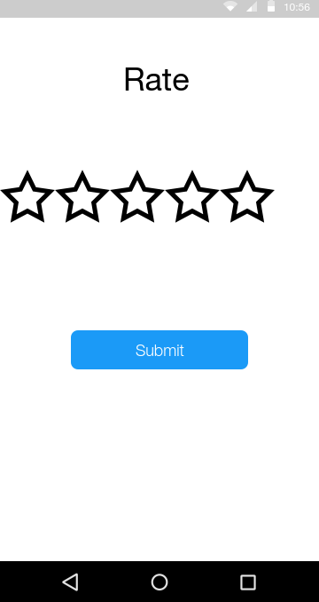
GUI

Slide 12
What we have used
TFIDF
Construct weight Vector for the sentence based of the fitted vocabulary from the dataset
Sentiment analysis
Calculate the Total Polarity of the Sentence
SVM
Used to classify the messages received from the Social Media receives the vector Resulted from TF-IDF and the polarities from the Sentiment analysis.
Ref:
Cyberbullying System Detection and Analysis
Experts and Machines Against Bullies A Hybrid Approach to Detect Cyberbullies
Cyberbullying Detection using Time Series Modeling
Machine Learning Approach for Detection of Cyber-Aggressive Comments by Peers on Social Media Network

Slide 13
Design Rationale
Bag of words
Bag of word models don’t respect semantics of the word.
KNN
Must compute the distance and sort all the training data at each prediction, which can be slow if there are a large number of training examples.
Skip gram
Failed to identify the combined word phrases and the different meanings of the same word because it is represented with one vector. Also Failed to identify the combined word phrases.

Slide 14
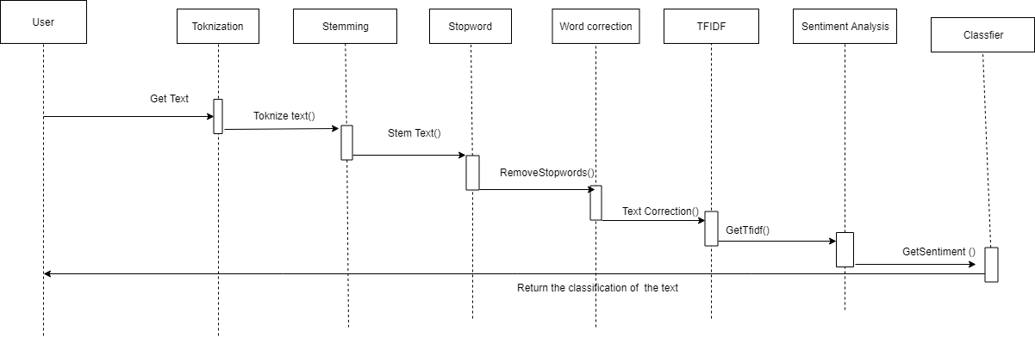
Sequence diagram
Lowering
Text
LoweringText()

Slide 15
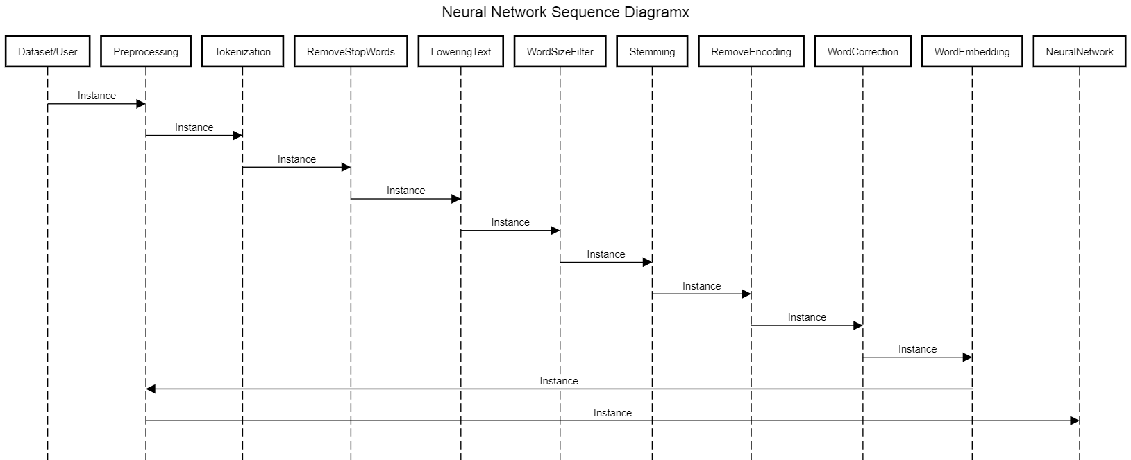
Sequence diagram

Slide 16
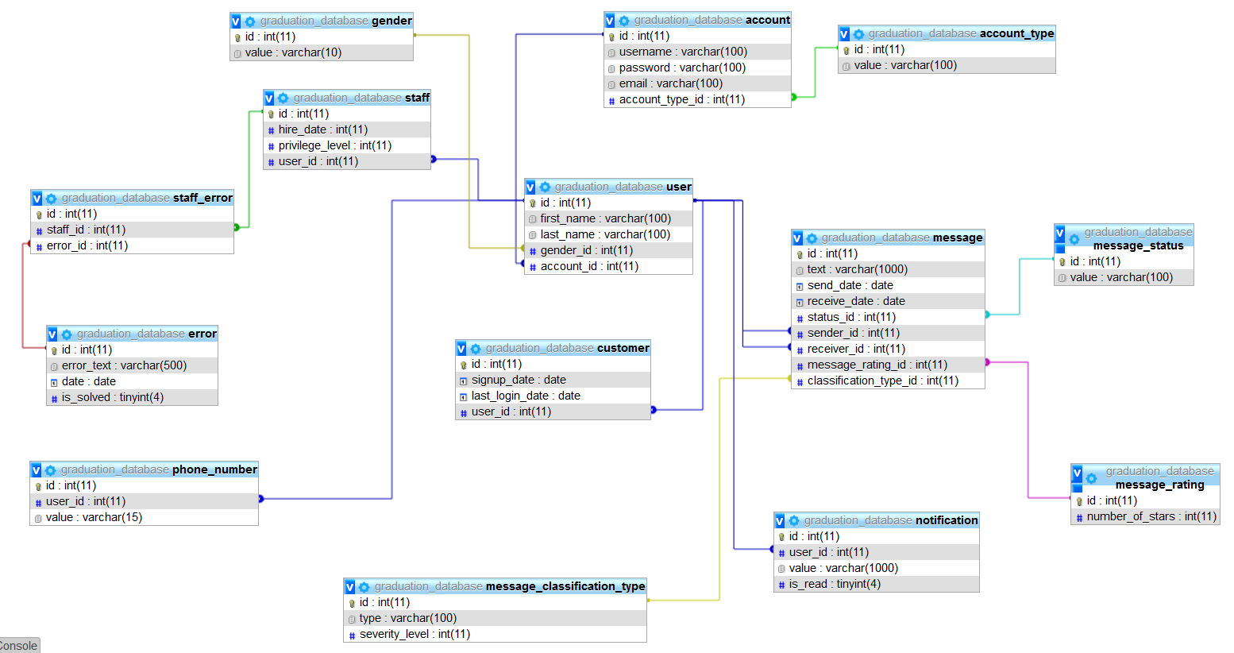
Database

Slide 17
Demo

Slide 18
Any Questions ?

Slide 19
Appendix

Slide 20



Non Functional Requirements
Security
Maintainability
Portability
Have Encryption and Decryption
Self Learning
Both Desktop and Android

Slide 21
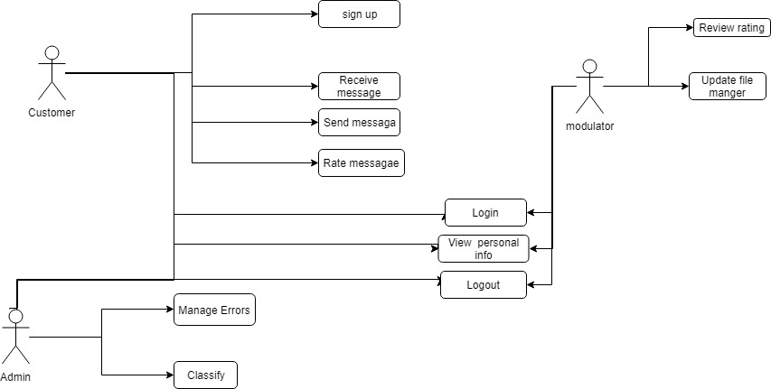
USE Case

Slide 22
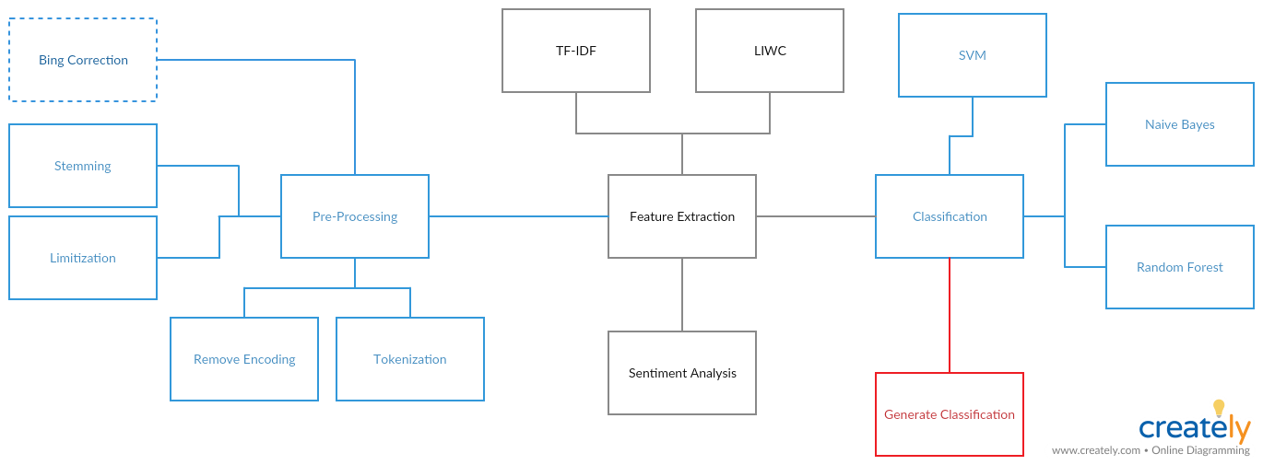
Block diagram

