Slide 1
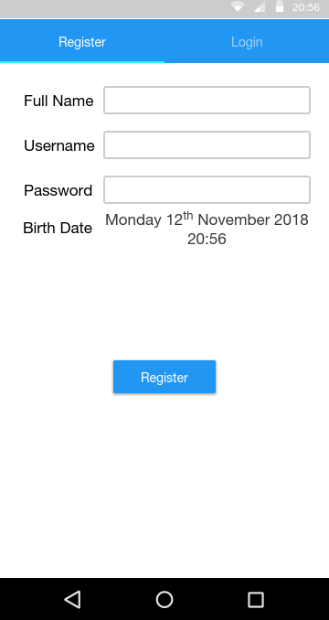
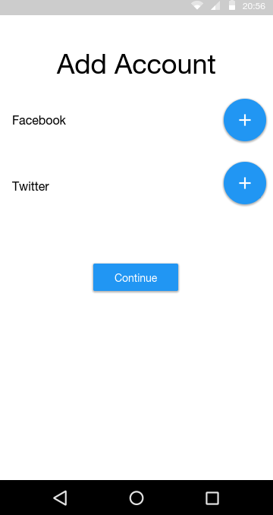
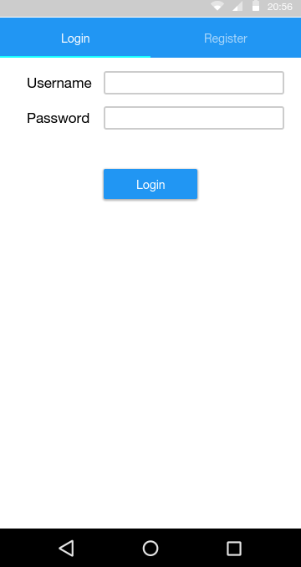
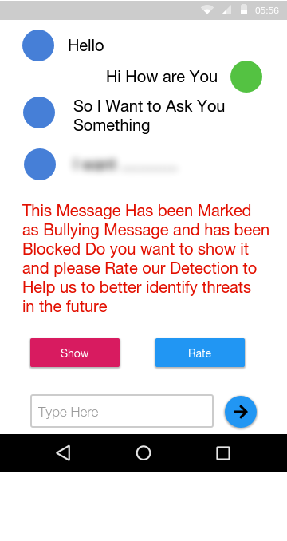
GUI

Slide 2



Non Functional Requirments
Portability
Security
Maintainability
Both Desktop and Android
Have Encryption and Decryption
Self Learning

