Slide 1


Cyberbullying Detection
By:
John Hani
Mohamed Nashaat
Mostafa Ahmed
Zeyad Emad (Team Leader)
Under supervision of :
Dr. Eslam Amer
Eng. Menna Gamil

Slide 2
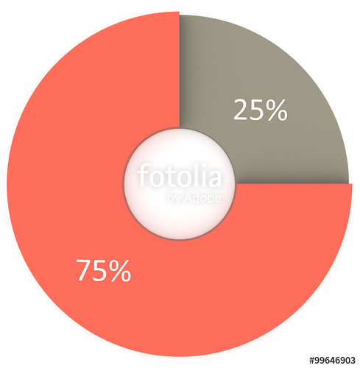

Analysis
More than 1 in 3 young people have experienced cyber threats online.
National Crime Prevention Council, “Cyberbullying”
Richard Webster, Harford County Examiner, “From cyber bullying to sexting: What on your kids’ cell?”
Over 25 percent of adolescents and teens have been bullied repeatedly through their cell phones or the Internet.
i-SAFE Inc., “Cyber Bullying: Statistics and Tips”

Slide 3
Objective
In previous cyberbullying detection frameworks there has been a problem in detecting false positive cyberbullied cases.
The accuracy in these papers is not high enough and could be improved.

Slide 4
Functional Requirement
User Registration | Login Sign up Change Password Logout
Messages | Send messages Receive messages
Processing | Preprocessing Feature extraction Classification
User Results | Notify Result Rating Update Classifier

Slide 5



Non Functional Requirments
Security
Maintainability
Portability
Have Encryption and Decryption
Self Learning
Both Desktop and Android

Slide 6
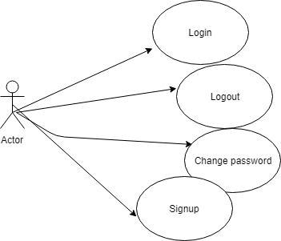
Use Case

Slide 7
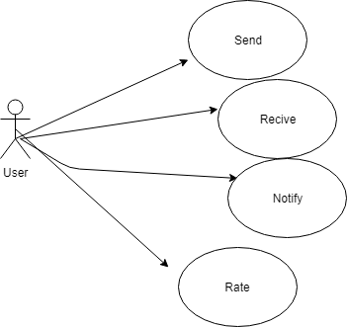
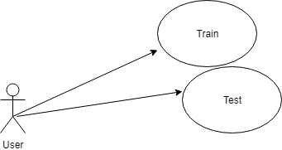
Admin

Slide 8
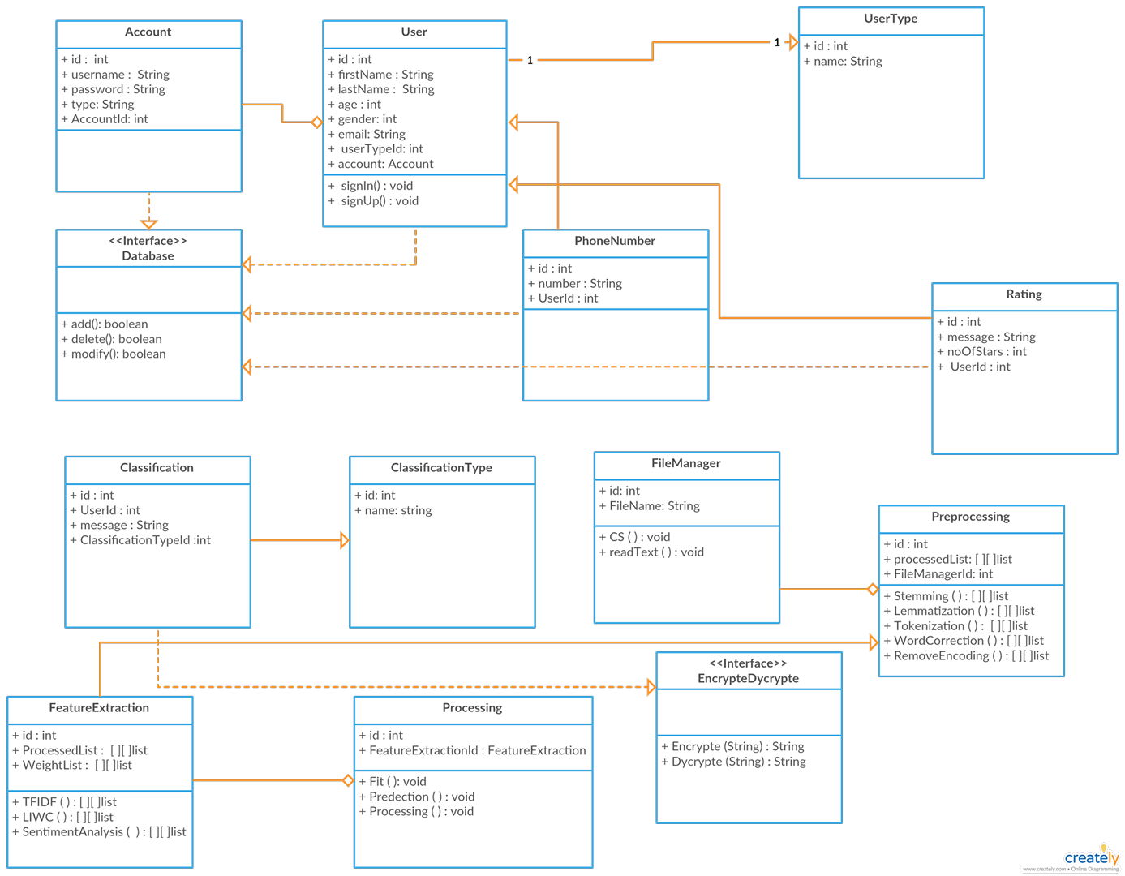
Class Diagram

Slide 9
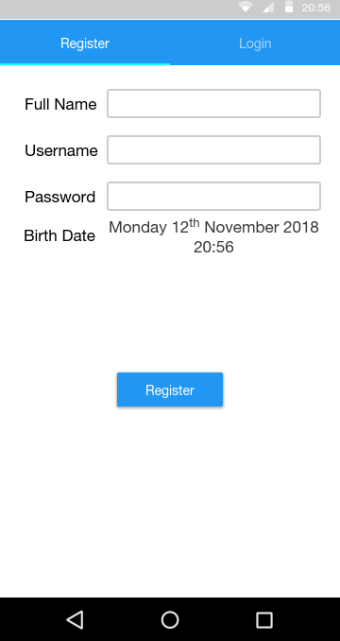
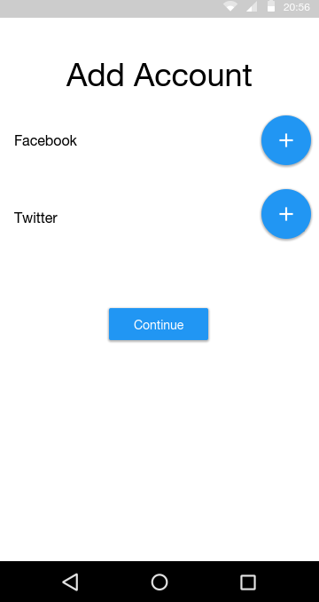
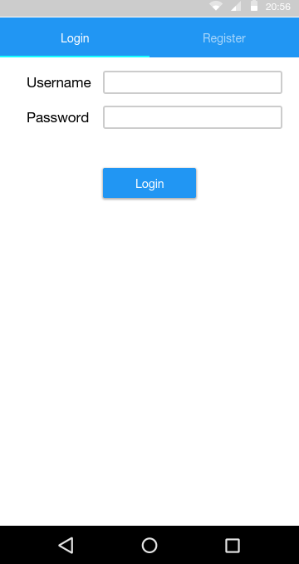
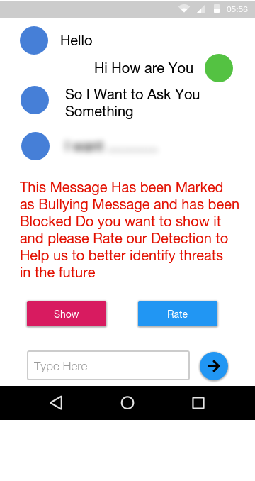
GUI

