Slide 1




Building Realtime Data Processing IoT Applications Using AWS
Compiled By : Godson Michael D’silva

Slide 2
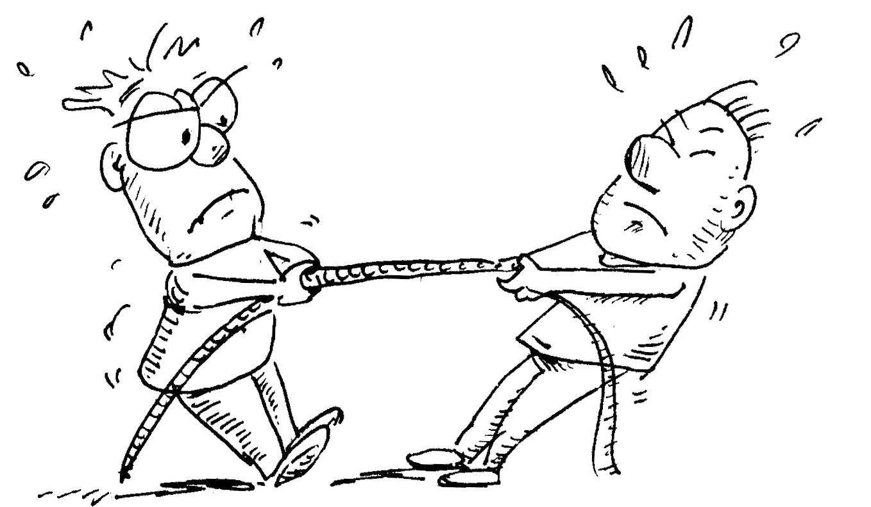

Objective of the STTP :

Slide 3




Day 1 : Session Plan
AWS S3
AWS
Beanstalk
AWS EC2
AWS RDS

Slide 4
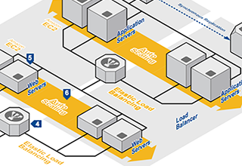
Day 1 : Outcome
Set up the Ground Work for
“Building Realtime Data Processing IoT Applications Using AWS “

Slide 5
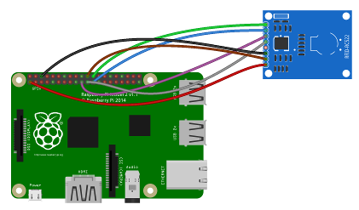
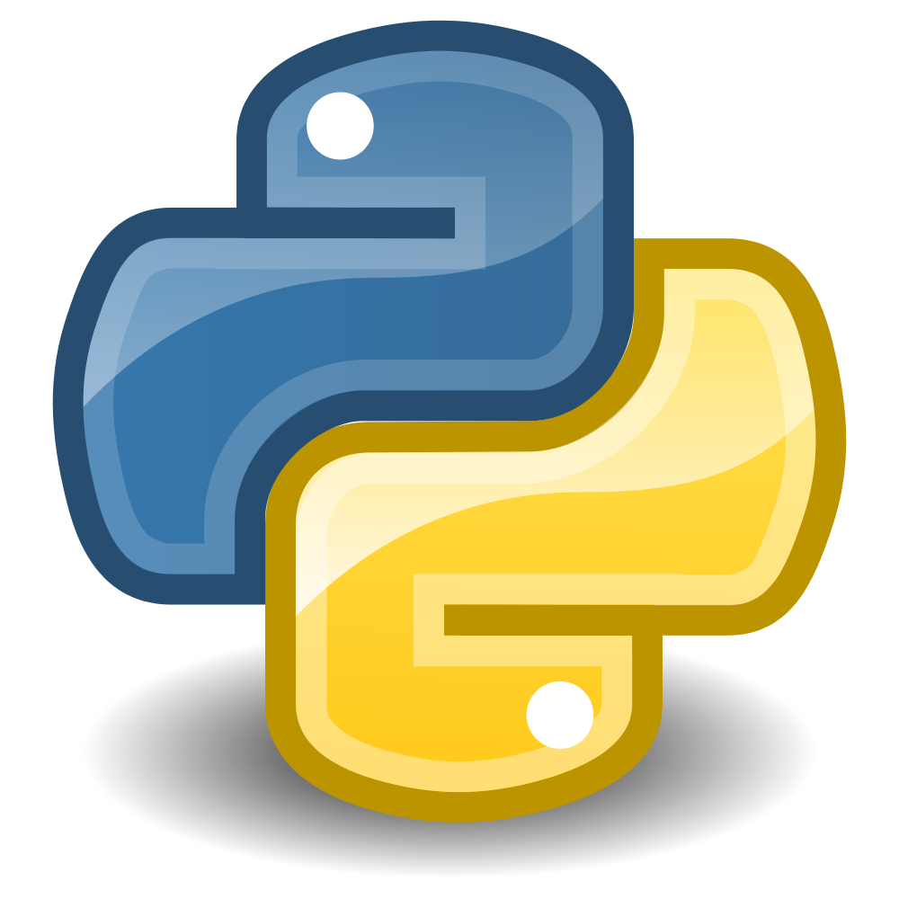

Day 2 : Session Plan
Capturing Data From RFID Tags using Raspberry Pi
Fundamentals of
Python
Understand and Configuring
AWS IoT

Slide 6
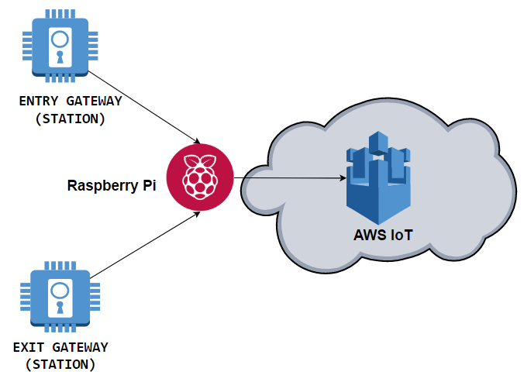
Day 2 : Outcome

Slide 7



Day 3 : Session Plan
Performing CRUD Operation on Mongo Db
Connecting Robomongo with Mongo DB EC2 Instances
Triggering
AWS Lambda from AWS IoT
Installing Mongo DB on AWS EC2

Slide 8
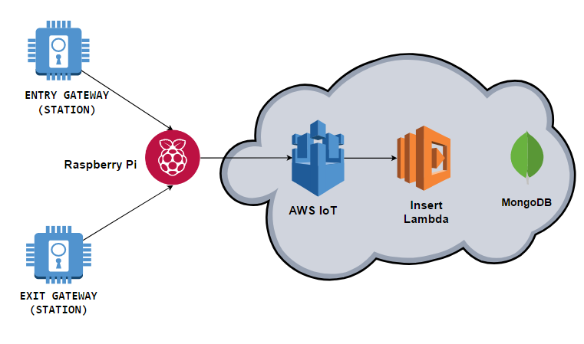
Day 3 : Outcome

Slide 9
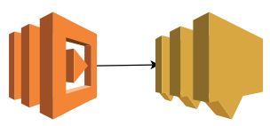
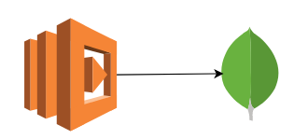

Day 4 : Session Plan
Sending Notification to Users using SNS from
Lambda
Persisting Data From
AWS Lambda to
Mongo DB
Predictive Analysis using Machine Learning Techniques

Slide 10
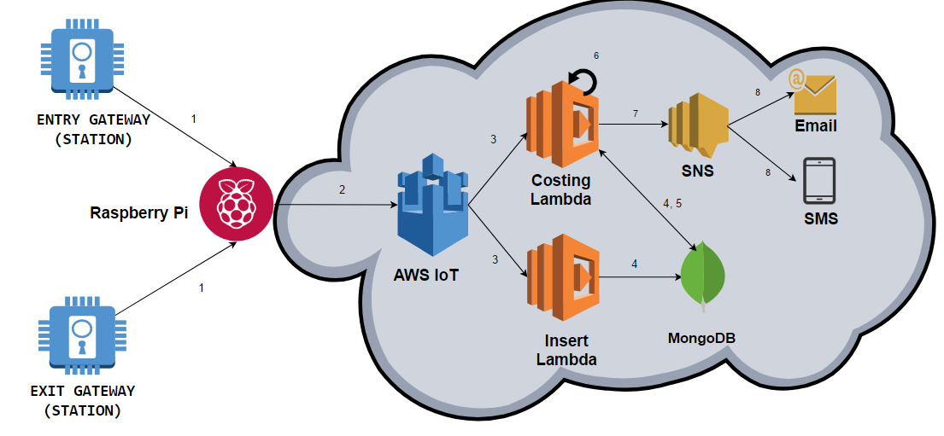
Day 4 : Outcome

Slide 11



Day 5 : Session Plan
Data Visualization using
D3.js and Dimple
Data Visualization using
Power BI
Creating API’s using
AWS API Gateway

Slide 12
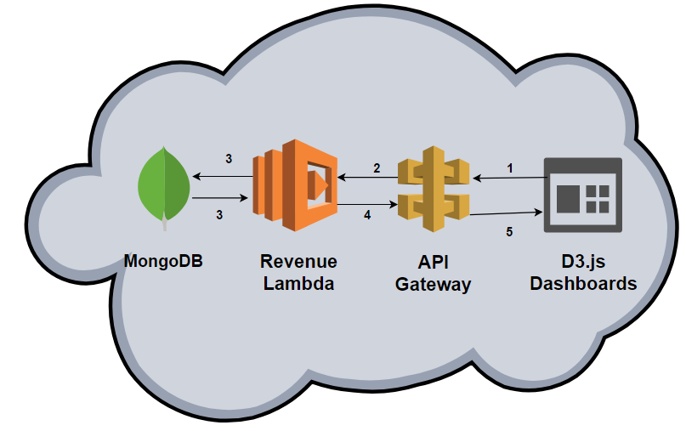
Day 4 : Outcome

Slide 13
Thank You

