Slide 1
Book Recommender System
Ami Parikh, Alisa Babikova, Hoang Nguyen, Josh Goldberg

Slide 2
Problem Statement
Design a book recommendation system for users based on data from the Book Crossing dataset
Predict ratings for books not yet read by a given user
Predict 10 unread books for a user based on the highest predicted ratings

Slide 3
I want to read something new but I don’t know what! ☹ Background
User activities have shifted online
Recommending relevant items to users can help customer engagement and business go up
Amazon directly attributes an estimated 35% of sales to their recommender system
Sometimes inadvertently can lead to problems - How Target Figured Out A Teen Girl Was Pregnant Before Her Father Did
Analyzing a user’s actions in the context of their other actions reveals much more about the user than a simple static record
A rich user context has within it multiple intents at any point in time
Types of recommender systems
Collaborative Filtering
SVD and the Surprise package
KNN
Learn-to-rank

Slide 4

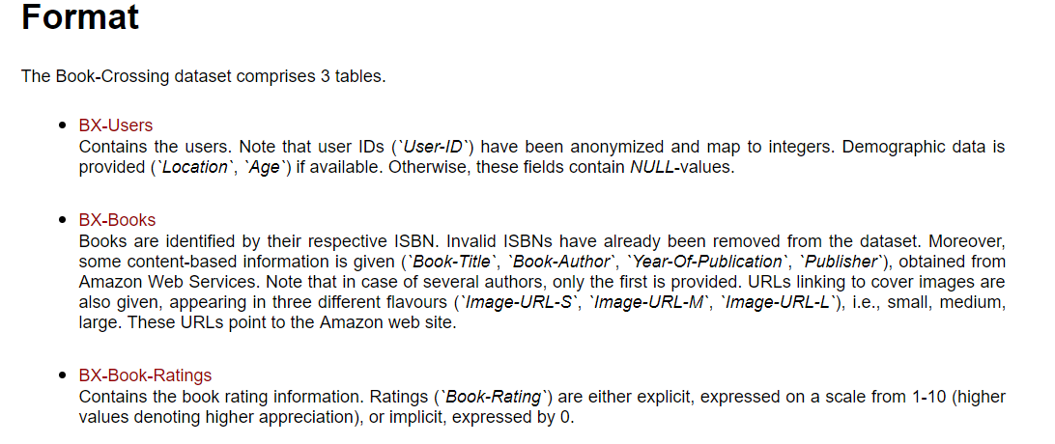
Who Read What? Data and Cleaning

Slide 5
Who Read What? Data and Cleaning
Users
Eliminated age <10 and >100
Split location into city, state, country
Books
Dropping rows with missing publication dates and publication dates after 2018
Replace missing publisher with “Other”
Ratings
Removed rows with an implicit book_rating of 0
Replace missing author with “Unknown”

Slide 6
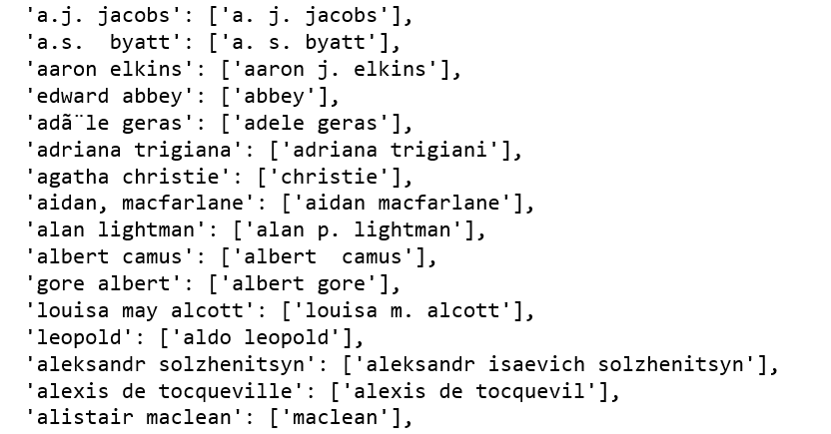
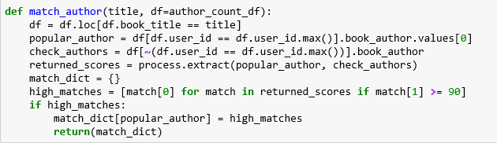
Who Read What? Data and Cleaning
Key Problems:
Duplicate ISBNs for same book due to different editions
Typos in author name

Slide 7
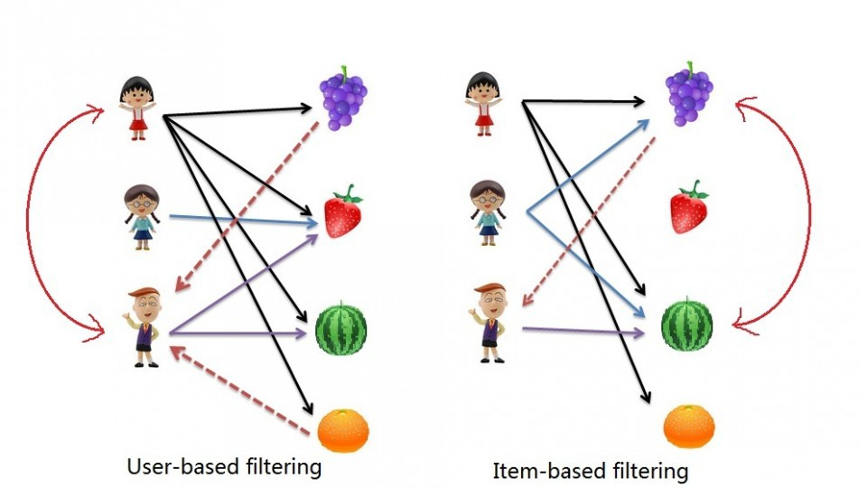
Collaborative Filtering
Collaborative Filtering : method of making automatic predictions (filtering) about the interests of a user by collecting preferences or taste information from many users (collaborating). The underlying assumption of the collaborative filtering approach is that if a person A has the same opinion as a person B on an issue, A is more likely to have B's opinion on a different issue than that of a randomly chosen person.

Slide 8
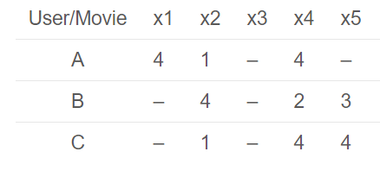
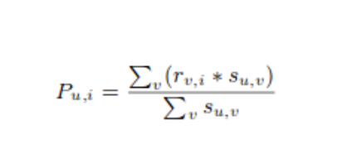
Collaborative Filtering
Correlation between the users (or items) is calculated based on items rated by both the users and the ratings given
Predictions calculated using similarity values
Users having higher correlation will tend to be similar
Recommendations are made using these predictions

Slide 9
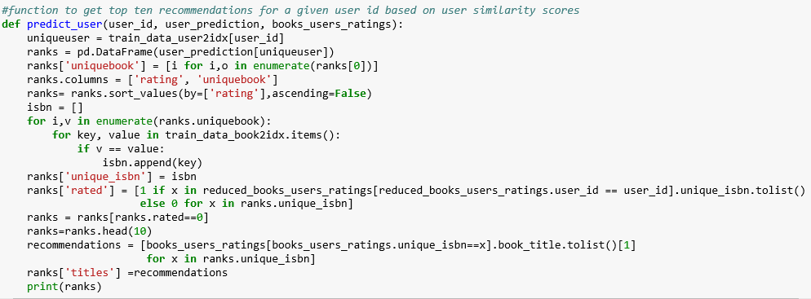
Collaborative filtering

Slide 10
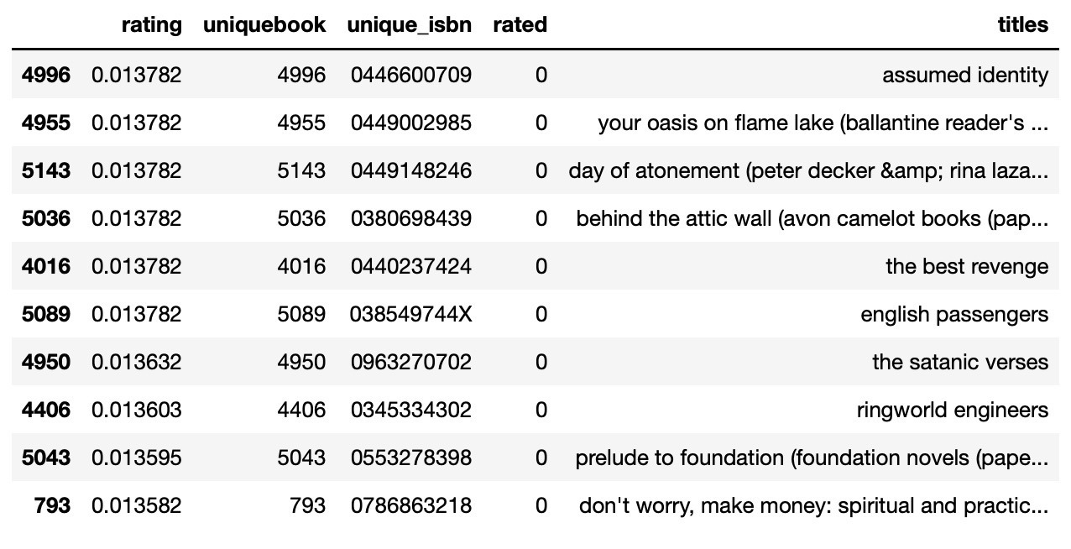
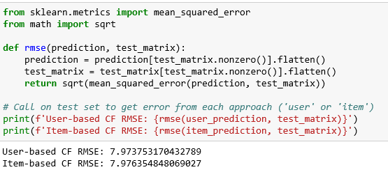
Collaborative Filtering

Slide 11
SVD

Slide 12
KNN

Slide 13
Learn-to-rank

Slide 14
Recommendations and Learning
More data would be nice
Data cleaning could be worked on more – we still see anomalies in spellings of authors names leading them to be listed as different authors

