Slide 1
Book Recommender System
Ami Parikh, Alisa Babikova, Hoang Nguyen, Josh Goldberg

Slide 2
Problem Statement
Design a book recommendation system for users based on data from the Book Crossing dataset
Predict ratings for books not yet read by a given user
Predict 10 unread books for a user based on the highest predicted ratings

Slide 3
I want to read something new but I don’t know what! ☹ Background
User activities have shifted online
Recommending relevant items to users can help customer engagement and business go up
Amazon directly attributes an estimated 35% of sales to their recommender system
Sometimes inadvertently can lead to problems - How Target Figured Out A Teen Girl Was Pregnant Before Her Father Did
Analyzing a user’s actions in the context of their other actions reveals much more about the user than a simple static record
A rich user context has within it multiple intents at any point in time
Types of recommender systems
Memory-based Collaborative Filtering
User-based and Item-based using Cosine Similarity
KNN
Model-based Collaborative Filtering
SVD and the Surprise package
Hybrid Content + Collaborative (Learn-to-rank)

Slide 4

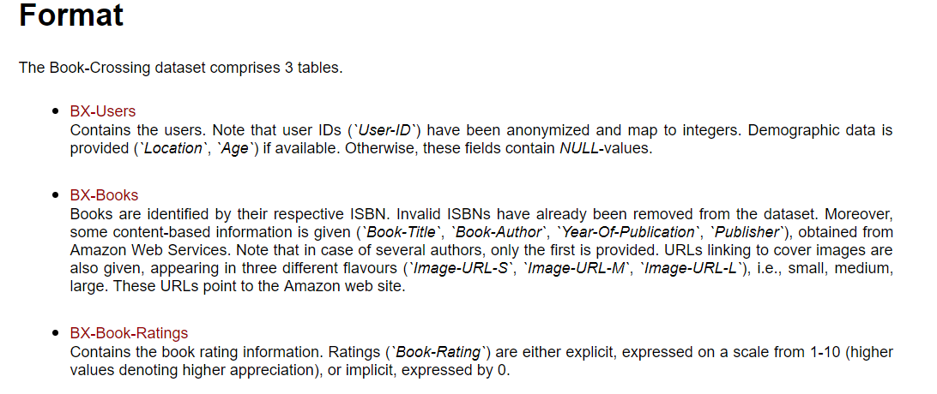
Who Read What? Data and Cleaning

Slide 5
Who Read What? Data and Cleaning
Users
Eliminated age <10 and >100
Split location into city, state, country
Books
Dropping rows with missing publication dates and publication dates after 2018
Replace missing publisher with “Other”
Ratings
Removed rows with an implicit book_rating of 0
Replace missing author with “Unknown”

Slide 6
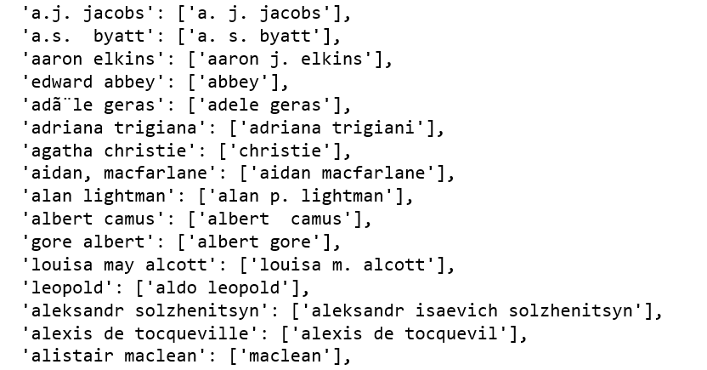
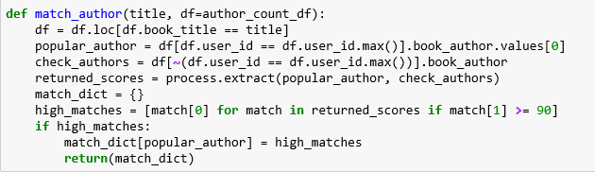
Who Read What? Data and Cleaning
Key Problems:
Duplicate ISBNs for same book due to different editions
Typos in author name

Slide 7
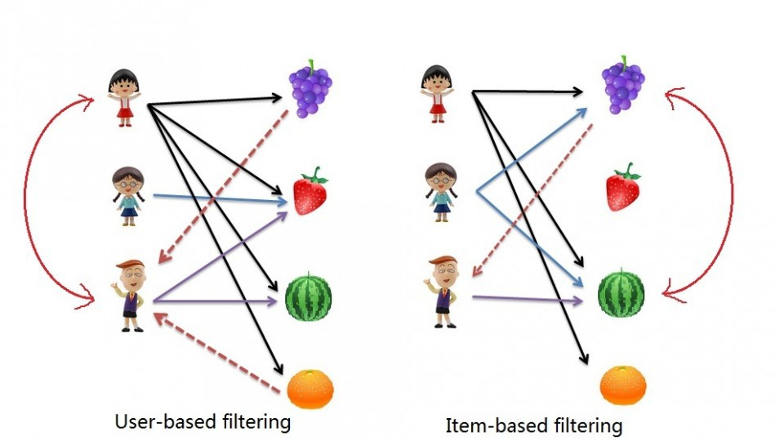
Memory-based Collaborative Filtering
This approach uses user rating data to compute the similarity between users or items
This is used for making recommendations. This was an early approach used in many commercial systems
The underlying assumption - if person A has the same opinion as a person B on an issue, A is more likely to have B's opinion on a different issue than that of a randomly chosen person
Represent dataset in a feature space- if two data are close to each other in terms of similarity, they should map to close points in the feature space

Slide 8
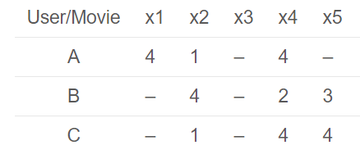
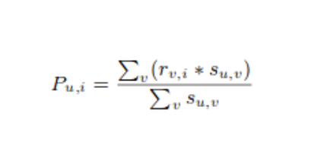
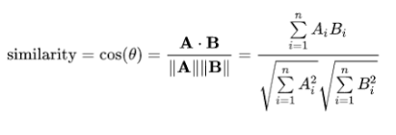
Memory-based Collaborative Filtering User-Based and Item-based using Cosine Similarity
Matrix of users vs. items created
Cosine similarity between the users (or items) is calculated
The cosine similarity function the difference in angle between two article directions
This difference in angle is normalized to the interval [-1, 1], where 1 implies the same direction and thus perfect similarity and -1 the complete opposite direction and thus no similarity
Prediction of ratings calculated using similarity values
Recommendations are made using the top predicted ratings

Slide 9
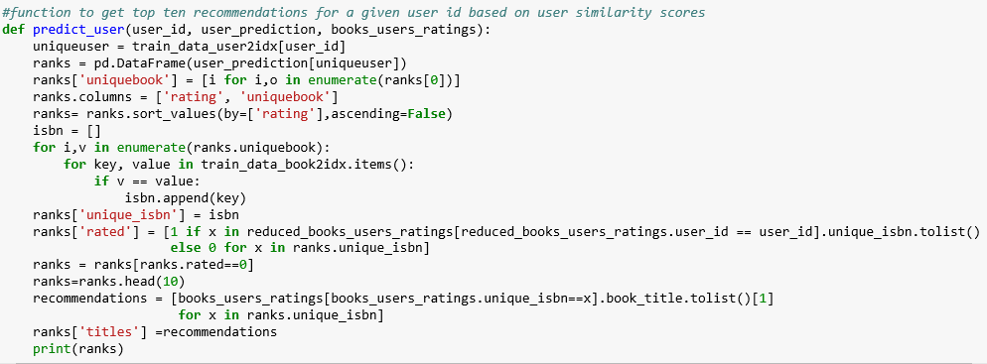
Memory-based Collaborative Filtering User-Based and Item-based using Cosine Similarity

Slide 10
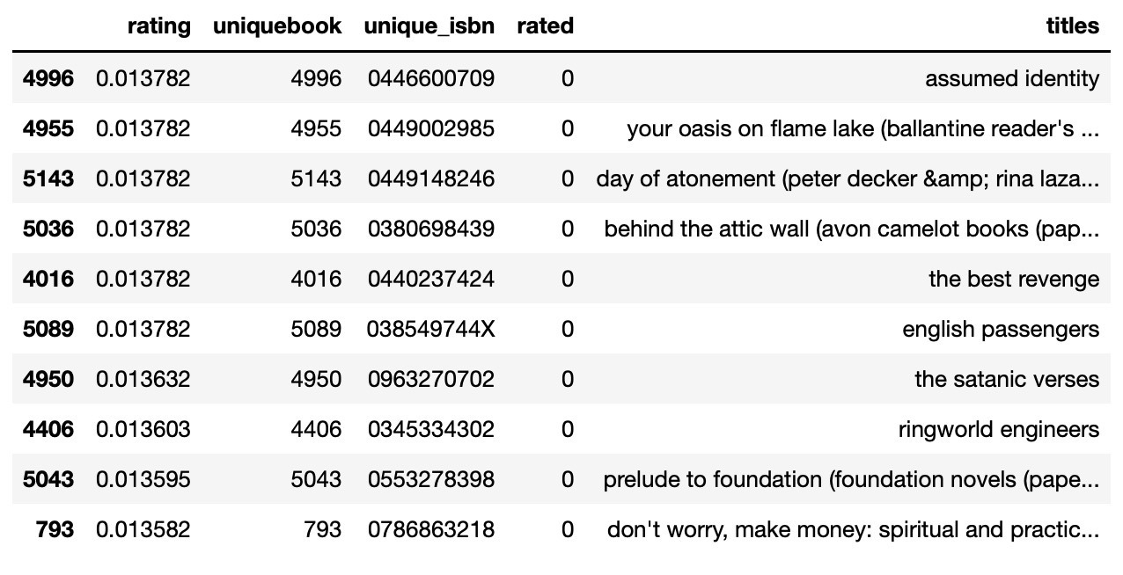
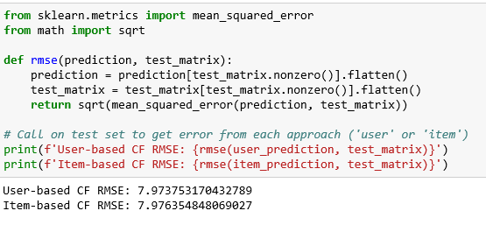
Memory-based Collaborative Filtering User-Based and Item-based using Cosine Similarity

Slide 11
Memory-based Collaborative Filtering KNN

Slide 12
Model-based Collaborative Filtering
Models are developed using different data mining, machine learning algorithms to predict users' rating of unrated items
Dimensionality reduction methods mostly used as complementary technique to improve robustness and accuracy of memory-based approach
Methods like singular value decomposition, principle component analysis, known as latent factor models, compress user-item matrix into a low-dimensional representation in terms of latent factors
Instead of having a high dimensional matrix containing abundant number of missing values we have a much smaller matrix in lower-dimensional space
Can be used for user-based or item-based neighborhood algorithms

Slide 13
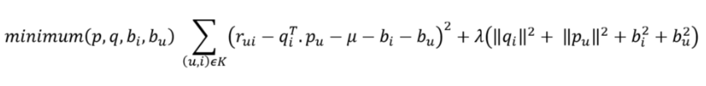
Model-based Collaborative filtering SVD
Matrix factorization technique that is usually used to reduce the number of features of a data set by reducing space dimensions from N to K where K < N
The matrix factorization is done on the user-item ratings matrix
Each item represented by vector `qi` , each user can be represented by a vector `pu`
Dot product of those 2 vectors is the expected rating
The goal is to minimise the square error difference between their dot product and the known rating in the user-item matrix
To avoid over-fitting and to reduce the error between the predicted and actual value, penalty and bias terms are added
The equation is minimised using SGD

Slide 14
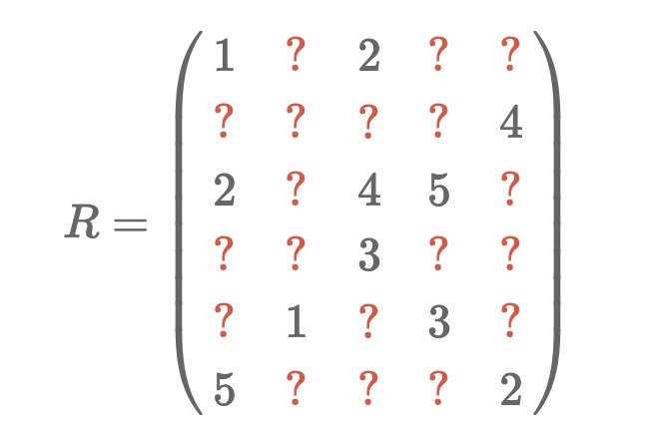
SVD Concepts
SVD of R is not defined (M and U)
We can actually find the matrices M and U if we can find all the vectors pu and qi such that (the pu make up the rows of M and the qi make up the columns of UT):
Source: surprise package author: http://nicolas-hug.com/blog/matrix_facto_3

Slide 15
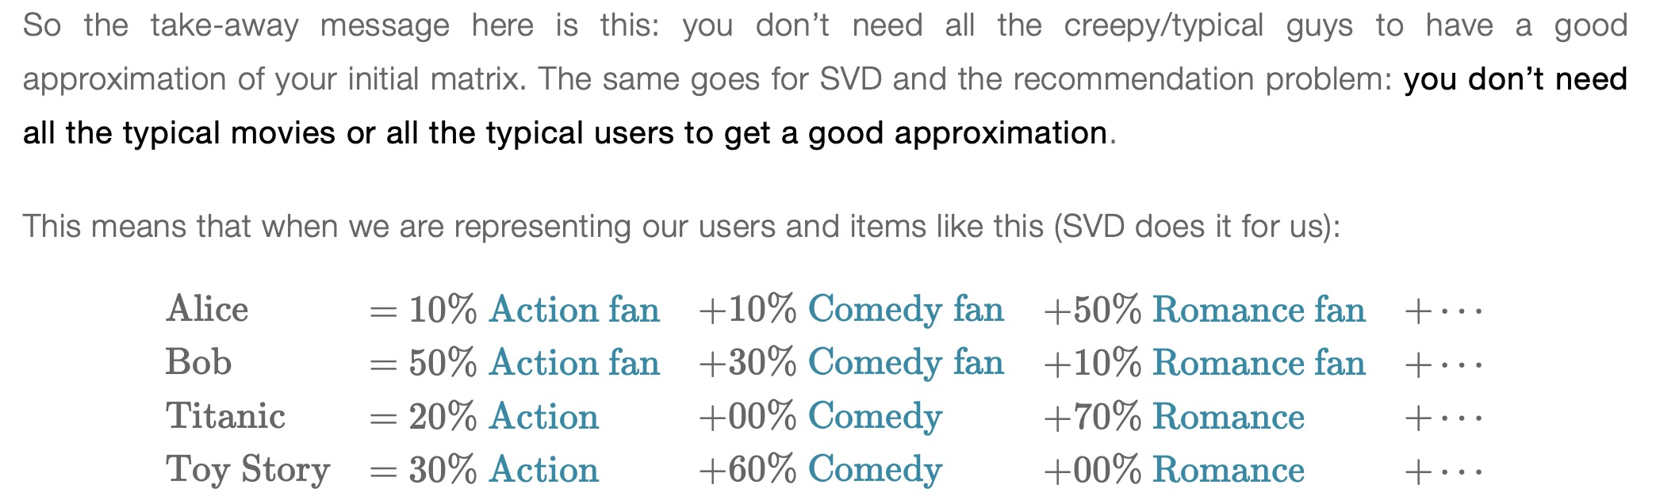
SVD Concepts
Source: surprise package author: http://nicolas-hug.com/blog/matrix_facto_3

Slide 16
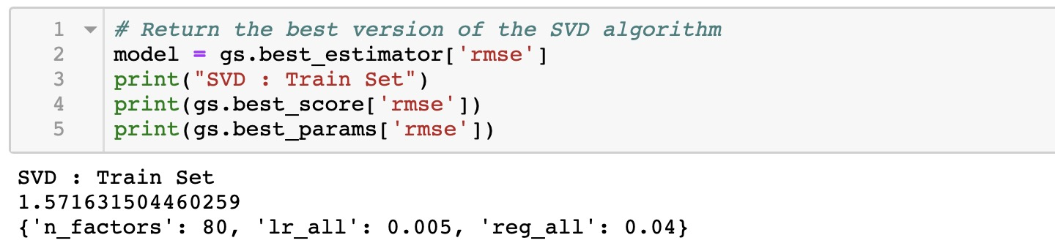
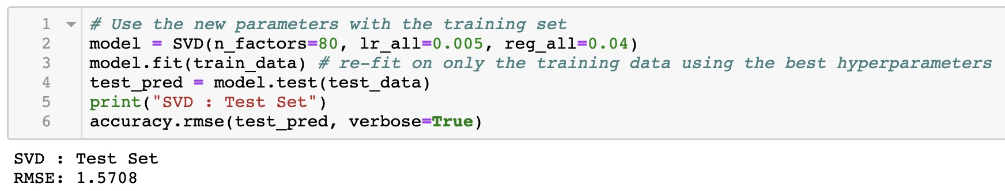
SVD Training & Grid Search

Slide 17
SVD Comparing n_factors

Slide 18
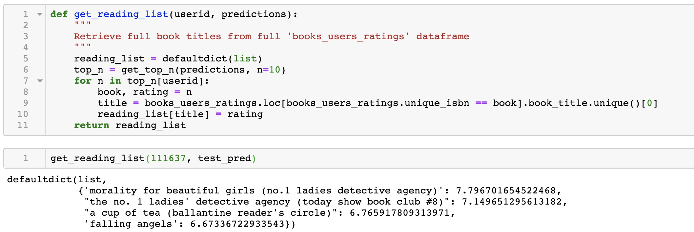
SVD Book Recommendations

