Slide 2
The only way you survive is you continuously transform into something else. It's this idea of continuous transformation that makes you an innovation company.

Slide 3
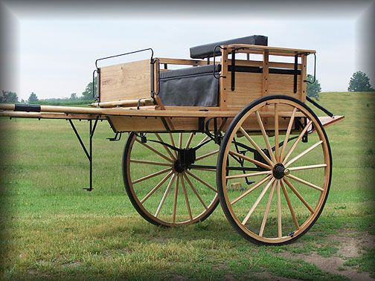
Early 1700

Slide 4
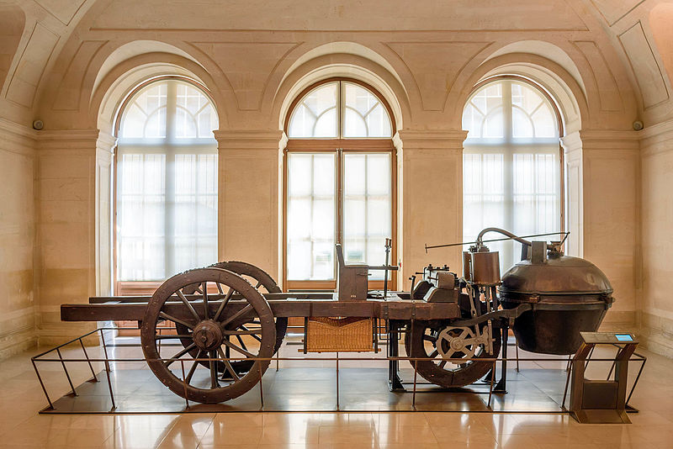
1771 - British Company

Slide 5
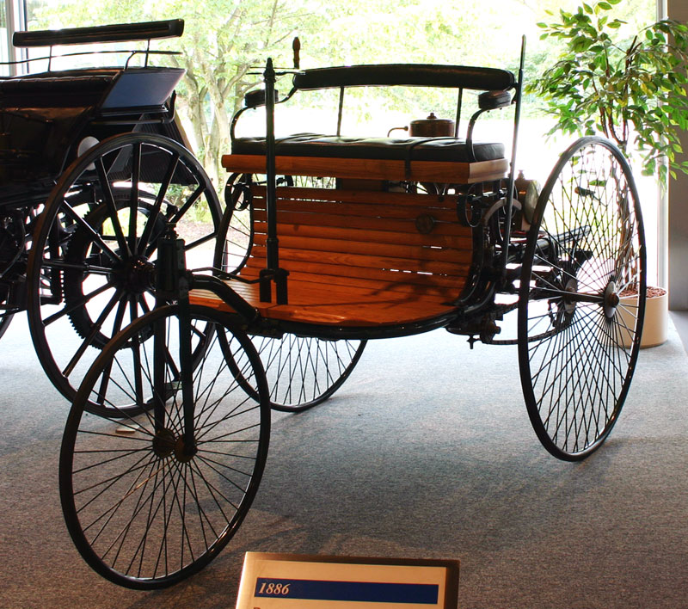
Benz - 1885

Slide 6
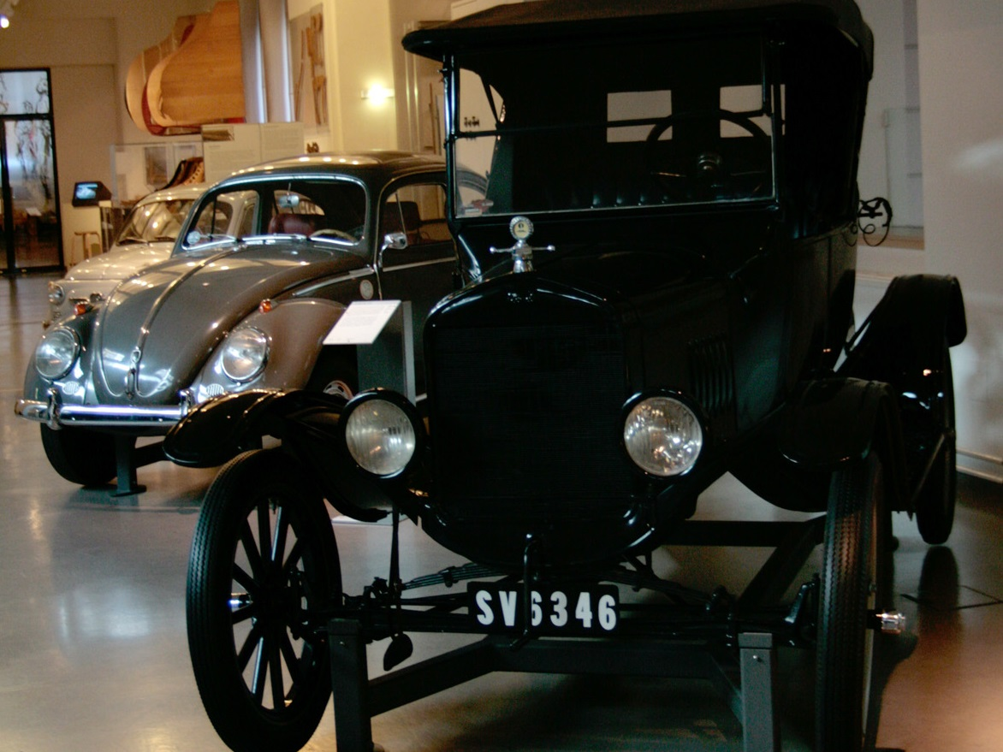

Slide 7
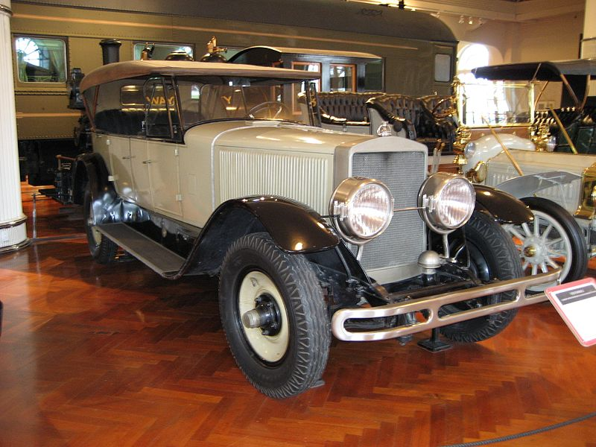
Ford - 1924

Slide 8
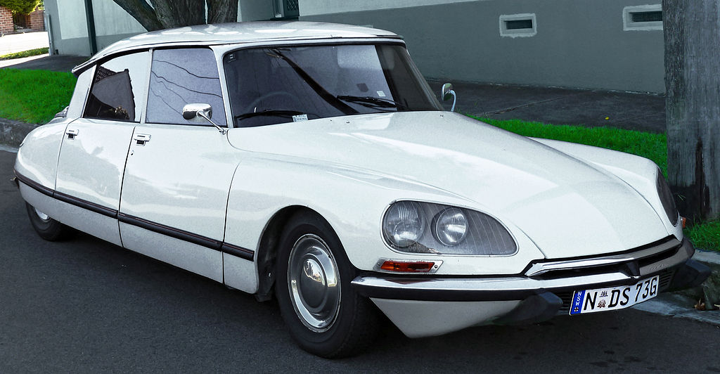
1974

Slide 9
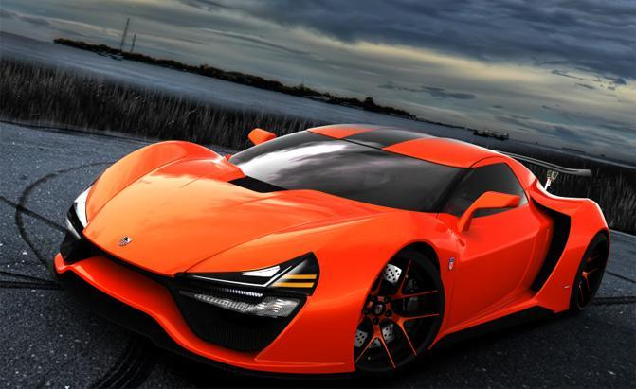

Slide 10
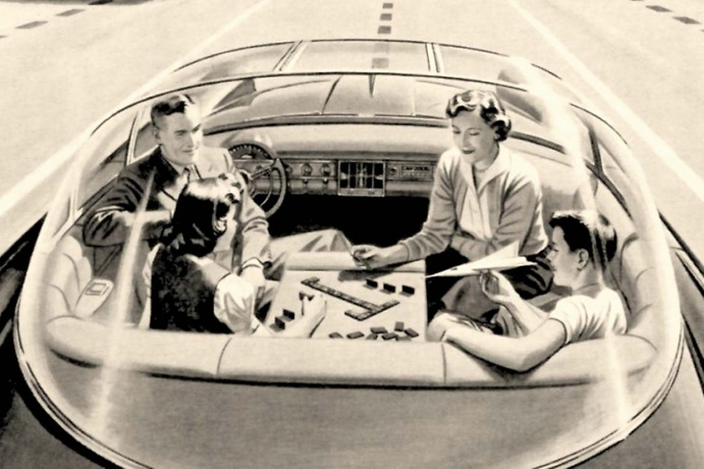
Driverless Car of the Future, advertisement for “America’s Electric Light and Power Companies,
” Saturday Evening Post, 1950s. Credit: The Everett Collection.

Slide 11
