Slide 1
Selenium Study Group – Session 1

Slide 2
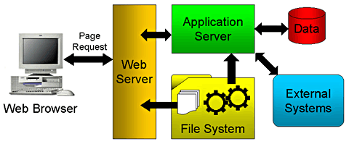
Web application architecture
Client Side
Browser: IE, Firefox, Chrome, Safari
Server Side
Application Server
Database Server
File System

Slide 3
Test Automation Tools
Two types of tool:
Open Source tool
Commercial tool
Examples:
Quick Test Professional By HP
Rational Functional Tester By Rational (IBM Company)
Silk Test By Borland
Test Complete By Automated QA
AutoIT ( Open Source)
Robotium (Open Source)
Selenium ( Open Source)
Sahi (Open Source)

Slide 4
Why Selenium?
Selenium is a robust set of tools that supports rapid development of test automation for web-based applications.
Selenium provides a rich set of testing functions specifically geared to the needs of testing of a web application.
Selenium operations are highly flexible, allowing many options for locating UI elements and comparing expected test results against actual application behavior.
OPEN SOURCE

Slide 5
Selenium Components
Selenium IDE
Selenium Remote Control
Selenium Grid

Slide 6
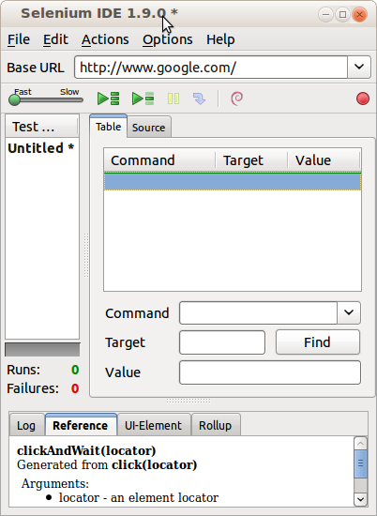
Selenium IDE
Mozilla extension
UI Based tool
Easy record and replay
OS- Windows, Linux
Test only web-based
application
Debug and set breakpoints
Save tests in HTML,
WebDriver and other
formats

Slide 7
Selenium IDE test cases
Selenium IDE uses HTML based language called Selenese
Each record consists of:
Command – tells Selenium what to do (e.g. “open”, “type”, “click”, “verifyText”)
Target – tells Selenium which HTML element a command refers to (e.g. textbox,
header, table)
Value – used for any command that might need a value of some kind (e.g. type something into a textbox)

Slide 8
How to record/replay with Selenium IDE
Start recording in Selenium IDE
Execute scenario on running web application
Stop recording in Selenium IDE
Verify / Add assertions
Replay the test.

Slide 9
Install Selenium IDE
Launch Firefox and navigate to http://seleniumhq.org/download/. Under the Selenium IDE section, click on the link that shows the current version number.
For security, a Firefox notification will pop up. Click on "Allow."
Wait until Firefox completes the download and then click "Install Now."

Slide 10
Selenium IDE Demo……

Slide 11
Adding Verifications/Assertions to the Script
Selenese allows multiple ways of checking for UI elements.
Verifications and assertions are used to check if
an element is present somewhere on the page?
specific text is somewhere on the page?
specific text is at a specific location on the page?
Verifications and assertions are not one and the same.
If an assertion fails, the script will be aborted but if a verification fails the script will continue.

Slide 12
Limitation of Selenium IDE
No multiple browsers support
It runs only in Mozilla Firefox.
Cannot launch an application. Runs on active browser
Not all actions can be recorded such as Mouse actions, Keyboard actions etc.
Cannot handle dynamic objects
No proper logs
Cannot create robust-framework
Doesn't supports parameterization
No manual scripts
E.g. conditions and Loops for Data Driven Testing

Slide 13
Selenium RC
A solution to cross browser testing.
A server, written in Java and so available on all the platforms.
Acts as a proxy for web requests from them.
Client libraries for many popular languages.
Bundles Selenium Core and automatically loads into the browser

Slide 14
Installing Selenium RC
Software Required
JDK 1.6 , selenium-remote-control-1.0.3 (this can be downloaded from http://seleniumhq.org/download/)
Installation Procedure
Selenium RC is simply a jar file and to run it we need java installed. (JDK 1.6 is preferred)
Once the Java is installed just unzip the selenium-remote-control-1.0.3. zip which was downloaded from the selenium site to a directory.

Slide 15
Limitations of Selenium RC
Selenium RC's architecture is way more complicated.
You first need to launch a separate application called Selenium Remote Control (RC) Server before you can start testing
The Selenium RC Server acts as a "middleman" between your Selenium commands and your browser
When you begin testing, Selenium RC Server "injects" a Javascript program called Selenium Core into the browser.
Once injected, Selenium Core will start receiving instructions relayed by the RC Server from your test program.
When the instructions are received, Selenium Core will execute them as Javascript commands.
The browser will obey the instructions of Selenium Core, and will relay its response to the RC Server.
The RC Server will receive the response of the browser and then display the results to you.
RC Server will fetch the next instruction from your test script to repeat the whole cycle.

Slide 16
Selenium RC demo...

Slide 17

Forget it!!!!

Slide 18
Let's have Eclipse IDE installation
Download the “Eclipse IDE for Java Developers” from the http://www.eclipse.org/downloads/ page.
Unzip the downloaded zip file from the above site into a directory.
Once the unzipping is over open the folder and double click on the icon and it will open a dialog box as shown below.

Slide 19
Create a Project and include external Jars
Right Click on the Project
Select Build Path and click on Configure Build path
On the next window click on the libraries tab and click on the add jars tab

Slide 20
Install Firebug and Firepath

Slide 21
Resources
www.docs.seleniumhq.org
http://software-testing-tutorials-automation.blogspot.in
http://gojko.net
http://www.openqa.org

Slide 22

Any Questions?

