Slide 1
Safehouse
2-Factor Authentication for Physical Security

Slide 2
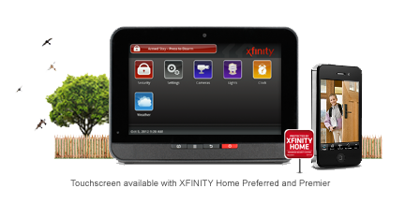
Smart Homes: A Security Risk
Adoption of advanced “connected” home systems
Expected to be a $100B industry by 2018¹
Projected 38% adoption in US by 2019²

Slide 3
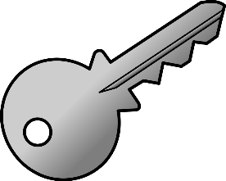
Smart Homes: A Security Risk
Poses massive security risk
Traditional physical security (keys, magnet cards) insufficient
3.7 Million Home Invasions per year in US⁴
“…researchers at the University of Michigan conducted a platform-wide study of SmartThings security. Computer scientists found that Schlage locks controlled through SmartThings apps could easily be “picked” by potential hackers…”
–TripWire “Could your Smart Home Put you at Risk?” May 2016

Slide 4

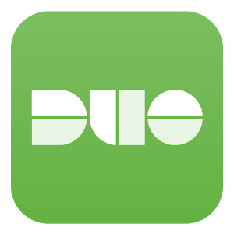
2 Factor Authentication
“Security is something you know, have, or are”
2FA forces user to provide two credentials from separate categories
Widespread adoption in software contexts (93% of major companies in US⁶)
Healthcare, Financial, etc.
Secure server login

Slide 5

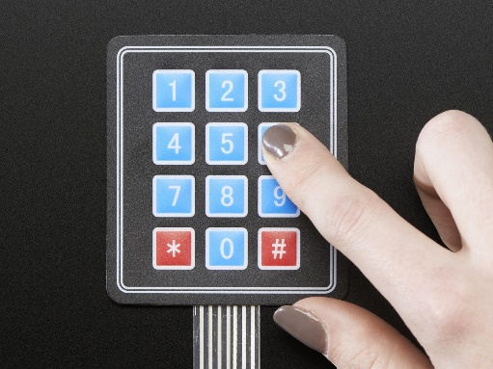
Solution
Use 2FA in a physical security application
One lock is “traditional” – unlocked via key, magnetic card, or smart home app
Second lock uses 2nd factor system

Slide 6
Market Viability
B2B model
Adds security and piece of mind for everyday consumers
Most sensitive assets
Homes
Cars
Businesses
Addresses vulnerabilities introduced by smart home technology

Slide 7
Technical Extensions
Strengthen anomaly detection system
Speed/pattern of inputting code
Frequency of entry attempts
Adaptive system
Develop risk profile for each user
When anomalous behavior is observed, offer/require alternative authentication method⁵

Slide 8
References
1 – Strategy Analytics 2014
2 – Acquity 2014
3 – Atul Prakash, University of Michigan 2016
4 – US Bureau of Justice Statistics
5 – ThisData.com
6 – SecureAuth Corp.

