Slide 1
A Comprehensive Performance Evaluation of Different Kubernetes CNI Plugins
2023.07.03
조승근 (wiw4477@skuniv.ac.kr)
김호중 (hotteok@skuniv.ac.kr)

Slide 2
Contents
Overview
Technical Background
Performance Evaluation
  Benchmark Framework
  PerfTest
  Experimental Results
Conclusions
Future Work

Slide 3
Overview

Slide 4
Overview
Title
  A Comprehensive Performance Evaluation of Different Kubernetes CNI Plugins
  for edge-based and containerized Publsih/Subscribe Applications
Research Objective
  Performance evaluation with a combination of Kubernetes and DDS technologies
  Evaluate performance overhead using various CNI plug-ins
  Evaluate from a variety of aspects, including virtualization overhead, QoS settings, etc
  -> Provides guidance on the correct CNI plug-in when hosting real-time IoT APP

Slide 5
Technical Background

Slide 6
Summary
Overall Structure
  1. Introduction
  2. Background on Underlying Technologies
  3. Evaluating DDS Performance in Kubernetes
  4. Related Work
  5. Conclusion

Slide 7
Technical Background (1/8)
DDS (Data Distribution Service)
  Real-time, data-driven pub/sub communication framework
Properties
  No time and space constraints
  Provides a variety of features and optimizations for performance and reliability
  Supports QoS policies to meet application requirements

Slide 8
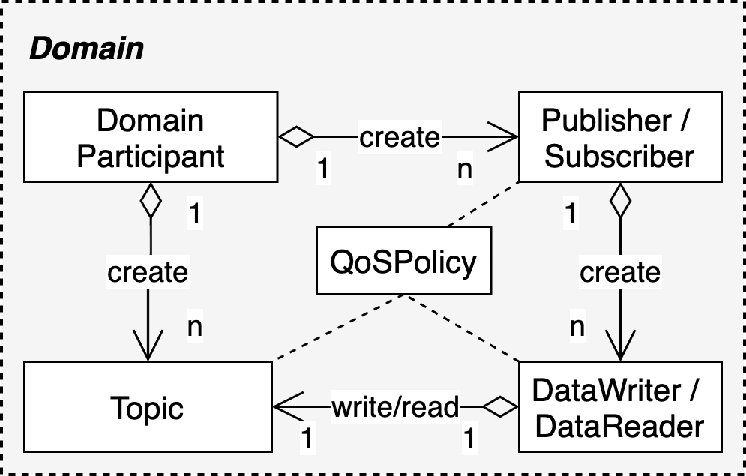
Technical Background (2/8)
DDS Architecture

Slide 9
Technical Background (3/8)
Kubernetes CNI (Container Network Interface)
  Plug-in to control networking between containers
  Used in large cluster environments to forward traffic to the correct container
  Implement network layer (L2, L3) between container runtime and orchestrator
  Kubernetes Built-in CNI Plug-in : kubenet
    Issue: Specific network policies, load balancing, and network security impossible to implement
CNI plug-in used for performance evaluation
  Flannel (L2,L3), WeaveNet (L2), Kube-Router(L3)

Slide 10
Technical Background (4/8)
Host Mode
  Default networking options that do not require installation (≠ kubenet)
  pad shares the host's network
  Port conflicts must be handled when running multiple containers on one host
  Vulnerable to security when used alone,
  but can leverage DDS Security to resolve security issues
  Use as a performance evaluation basis because of the least overhead

Slide 11
Technical Background (5/8)
Flannel
  Simple and stable CNI
  Using Overlay Networking Technology to Configure Virtual Networks
  Configured with other backend VXLANs (L2), Host-gw (L3)
Flannel-VXLAN (Virtual Extensible LAN)
  Tunneling technology that provides scalability and isolation
    Tunneling: technology that wraps and transmits
    as part of other protocol packets
  Include Ethernet frames
  in the payload of packets with VXLAN headers
veth0
vethx
cni0
flannel.1
flanneld
eth0
< Flannel–VXLAN >

Slide 12
Technical Background (6/8)
Flannel–Hostgw (Host gateway)
  Backend to handle routing using gateway for host (node)
  Process pad communication with kernel-level packet routing
  Must have an L2 connection when communicating from another host
  Less overhead
veth0
vethx
cni0
flanneld
eth0
< Flannel–Hostgw >

Slide 13
Technical Background (7/8)
WeaveNet
  Emulate the same shape as the L2 network
  Supports two encapsulation modes: Sleep Mode and FastPath Mode
  Sleeve Mode
    Perform UDP encapsulation in user space
    before forwarding packets to the virtual router
  Fastpath Mode
    Wrap packets into VXLAN headers in kernel space
    and forward packets to virtual routers
    (relatively better performance)
veth0
vethx
weave
vethwe-bridge
vethwe-datapath
Open vSwitch
datapath
vxlan-6784
eth0
< WeaveNet >

Slide 14
Technical Background (8/8)
Kube-Router
  CNI designed to simplify network structure
  Deploy agents on each node to implement an L3 virtual network
  Data encryption is not supported, requiring security on T·L or A·L
veth0
vethx
kube-bridge
eth0
< Kube-Router >

Slide 15
Performance Evaluation

Slide 16
Benchmark Framework (1/4)
Hardware
  Master Node
    count : 1
    quad-core Intel i7-2600 3.40 GHz processors
    4GB RAM
  Worker Node
    count : 10
    Raspberry Pi 3 Model B board
      4 x ARMv71 1.20 GHz processors
      1GB RAM
    100 Mbps LAN
    default MTU size(1500bytes)

Slide 17
Benchmark Framework (2/4)
Software
  OS
    Ubuntu 20.04 LTS (64bit)
    Raspbian 9 (32bit)
  Kubernetes
    Docker 19.04
    Kubernetes 1.19
    KubeAdmin
  CNI Plugins
    Flannel 0.11.0
    WaveNet 2.6.5
    Kube-Router 0.3.0
  DDS
    RTI Connext DDS v6.0.1
    PerfTest v.3.1

Slide 18
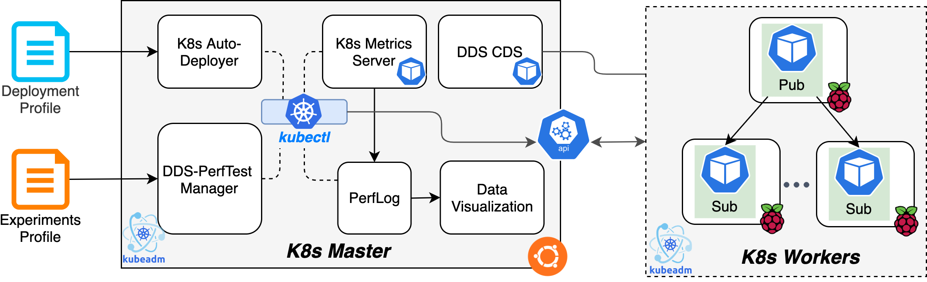
Benchmark Framework (3/4)
Automated Benchmark Framework
  Initialize the K8s cluster
  Install CNI plugins
  Deploy Perftest Pods, DDS-CDS Deployment, Resource Metrics Monitor Deployment
    Perftest Pod : containerized Perftest benchmark application compiled with Connext DDS
    CDS : Cloud Discovery Service. External DDS service used for discovery when multicast is not supported by the network infrastructure
    Resource Metrics Monitor : K8s built-in metrics server for collecting container CPU/memory usage information

Slide 19
Benchmark Framework (4/4)
DDS performance measurements
  PerfTest (Performance Test)
    benchmarking tool provided by RTI Connext DDS
    allows two operation modes
      Throughput Test
      Latency Test
  single pub/sub tests
    PerfTest container deployed on each Raspberry Pi board without any resource constraints
  multi-subscriber tests
    PerfTest containers deployed on Raspberry Pi board with single core limitations

Slide 20
PerfTest (1/2)
Throughput Test
  Calculates round-trip time of the Echo Sample.
  Not so accurate latency will be displayed as well.
Perftest Publisher
Perftest Subscriber
Publisher
Throughput Sample
Echo Sample
Echo Sample
Subscriber
DW (Throughput)
DR (Throughput)
Throughput Topic
Subscriber
Echo Sample
Echo Sample
Publisher
DR (Throughput)
DW (Throughput)
Echo Topic

Slide 21
PerfTest (2/2)
Latency Test
  Uses "stop-and-wait" mode or "ping-pong" mode.
  Calculates one-way latency from the measured round-trip time.
Perftest Publisher
Perftest Subscriber
Publisher
Echo Sample
Echo Sample
Subscriber
DW (Latency)
DR (Latency)
Echo Topic
Subscriber
Echo Sample
Echo Sample
Publisher
DR (Latency)
DW (Latency)
Echo Topic

Slide 22
Experimental Results ToC
Virtualization Overhead
  Throughput
  Latency
CNI-based Network
  *same as 1. Virtualization Overhead
BestEffort QoS
  Latency
Multicast vs. Unicast
  *same as 1. Virtualization Overhead
Evaluating Security Support
  1pub/1sub
  1pub/4sub
CNIs \ Attr | Networking | Performance
Flannel-VXLAN, WeaveNet | L2 CNIs | Bad
Flannel-Hostgw, Kube-Router | L3 CNIs | Good

Slide 23
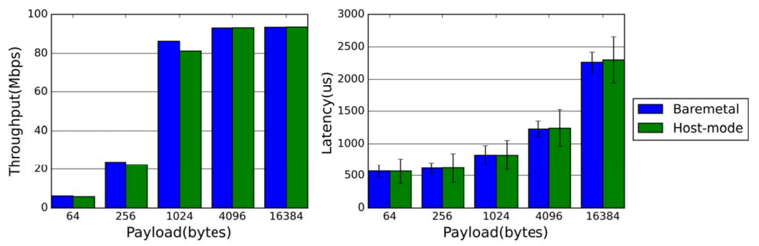
Experimental Results (1/16)
1. Virtualization Overhead
  a. Throughput
    Containerized DDS’s Throughput is 6% lower where payloads are <1KB compared to *BM
    For payloads >1KB impact of container virtualization is negligible.
  b. Latency
    For Latency results performance degradation is <1.5% over 5 payload lengths.
Conclusion
  The impact of container virtualization is not detrimental to *RT property of DDS.
*BM = BareMetal
*RT = Real-Time
Notes:
Previous studies [11], [12] indicate that container virtualization can lead to slight computation overhead for CPU-intensive applications, which is the case when writing small messages at unlimited rate.
Communication Pattern: 1pub-1sub. Publication rate: unlimited for throughput test and ping-pong mode for latency test. Reliability : enabled, Batching: disabled. Test period: 120 seconds.

Slide 24
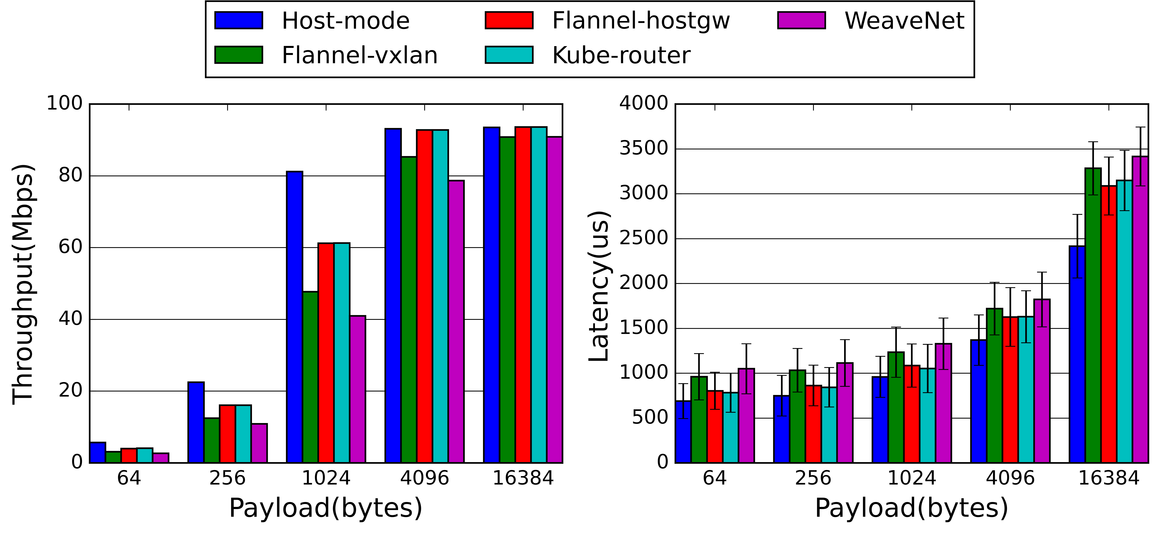
Experimental Results (2/16)
2. CNI-based Network Virtualization Overhead (a. Throughput)
  CNI relying on VXLAN tunneling (L2 CNIs)
    Flannel-VXLAN, WeaveNet
    WeaveNet’s Throughput is lower then Flannel-VXLAN
    OVS VXLAN encapsulation yields more overhead then native VXLAN implementation.
Notes:
Due to the drawbacks of Host-mode (security, portability, and resource isolation), CNI-based network solutions are recommended for most K8s use cases.

Slide 25
Experimental Results (3/16)
2. CNI-based Network Virtualization Overhead (a. Throughput)
  Direct routing approaches (L3 CNIs)
    Flannel-Hostgw, Kube-Router
    Performance gap gradually narrows with the increase in payload size.
    Performance of L3 CNIs is on par with the Host-mode when the bandwidth is saturated.
Notes:
Due to the drawbacks of Host-mode (security, portability, and resource isolation), CNI-based network solutions are recommended for most K8s use cases.

Slide 26
Experimental Results (4/16)
2. CNI-based Network Virtualization Overhead (a. Throughput)
  Conclusion
    Performance degradation depends on the CNI used, payload size, network load condition.
Notes:
Due to the drawbacks of Host-mode (security, portability, and resource isolation), CNI-based network solutions are recommended for most K8s use cases.

Slide 27
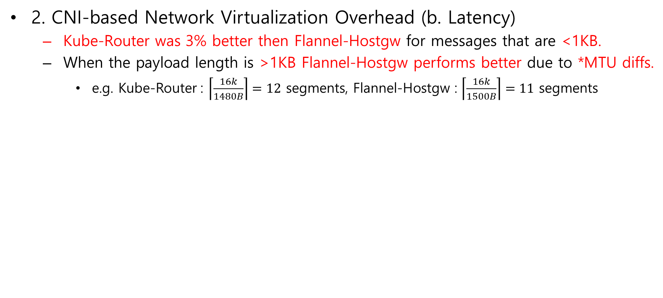
Experimental Results (5/16)
2. CNI-based Network Virtualization Overhead (b. Latency)
  Kube-Router was 3% better then Flannel-Hostgw for messages that are <1KB.
  When the payload length is >1KB Flannel-Hostgw performs better due to *MTU diffs.
    e.g. Kube-Router : $\left\lceil \frac{16k}{1480B}\right\rceil =12$ segments, Flannel-Hostgw : $\left\lceil \frac{16k}{1500B}\right\rceil =11$ segments
CNI | *MTU(B)
Flannel-VXLAN | 1450
Flannel-Hostgw | 1500
Kube-Router | 1480
WeaveNet | 1438
*MTU = Maximum Transmission Unit
Notes:
Due to the drawbacks of Host-mode (security, portability, and resource isolation), CNI-based network solutions are recommended for most K8s use cases.

Slide 28
Experimental Results (6/16)
2. CNI-based Network Virtualization Overhead (b. Latency)
  WeaveNet is slower than Flannel-VXLAN by 4.3%~12.9% over five payload lengths.
  Which further testifies WeaveNet’s OVS VXLAN encapsulation yields more overhead.
Notes:
Due to the drawbacks of Host-mode (security, portability, and resource isolation), CNI-based network solutions are recommended for most K8s use cases.

Slide 29
Experimental Results (7/16)
3. BestEffort QoS
  Reliable
    DataWriter will block until an ACK signal from the sub has been delivered successfully.
    Then the confirmed sample is deleted from the queue.
    Recovering DataWriter to the writeable state.
  BestEffort
    Every sample is written immediately and disseminated at most once.
    No extra resources are consumed for maintaining reliable connection between pubs/subs.
    May aggravate congrestion if network is overwhelmed.
      Therefore, it is unreliable to observe the maximum throughput with BestEffort.

Slide 30
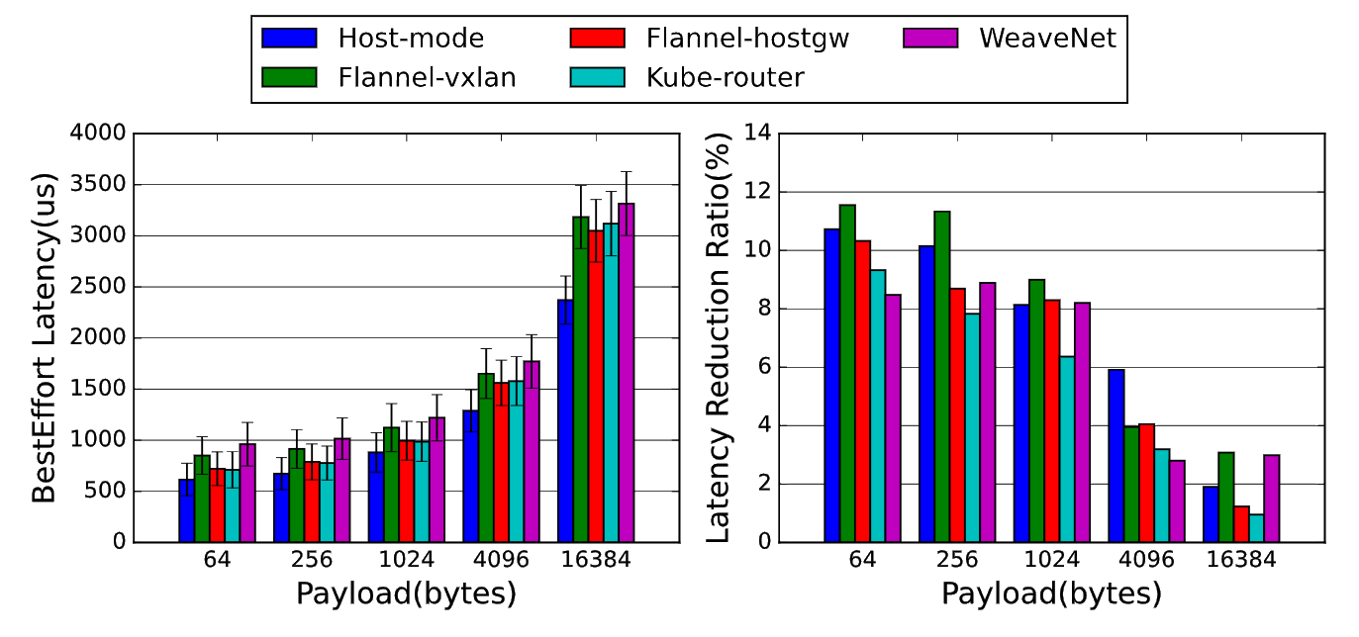
Experimental Results (8/16)
3. BestEffort QoS (a. Latency)
  L2 CNIs have higher latency than L3 CNIs.
  However, their latency dramatically reduces in the BestEffort mode.

Slide 31
Experimental Results (9/16)
4. Multicast vs. Unicast
  DDS supports middleware-level multicast with both underlying unicast and multicast.
  In general, multicast is better when the same data needs to be sent to multiple subs.
  Only WeaveNet fully emulates layer-2 network supporting multicast.
  According to previous expriments, Kube-Router and Flannel-Hostgw are preferred.
  Can WeaveNet make up for the overhead yield from OVS VXLAN encapsulation?

Slide 32
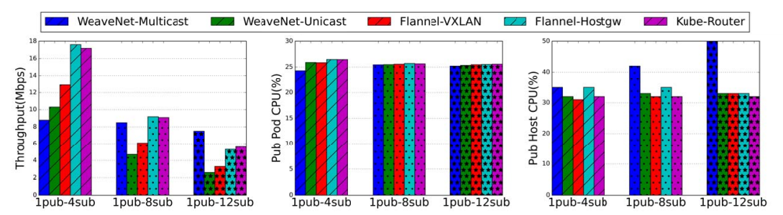
Experimental Results (10/16)
4. Multicast vs. Unicast (a. Throughput)
  WeaveNet-Multicast exceeds other methods in 1pub/8sub or 1pub/12sub use case.
  Since pub rate is unlimited, DataWriter is blocked once the writing buffer overflows.
    CPU usage of perftest process and pub host are restricted to around 25% and 32%.
  WaveNet-Multicast, wraps samples to individual subs in Weave container.
    Leading to incrementally increasing CPU utilization on the host.

Slide 33
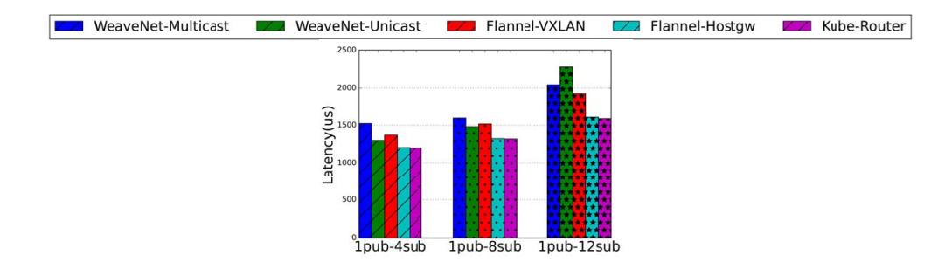
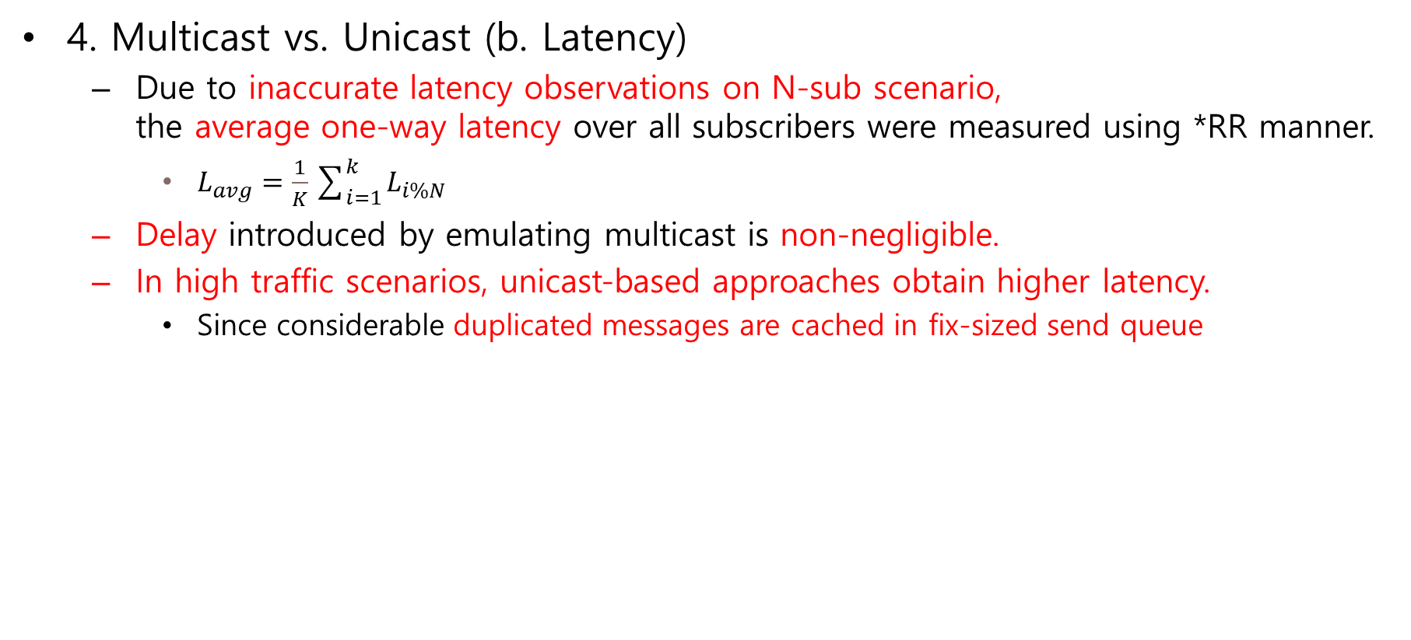
Experimental Results (11/16)
4. Multicast vs. Unicast (b. Latency)
  Due to inaccurate latency observations on N-sub scenario,
  the average one-way latency over all subscribers were measured using *RR manner.
    $L_{avg}=\frac{1}{K}\sum_{i=1}^{k}{L_{i\%N}}$
  Delay introduced by emulating multicast is non-negligible.
  In high traffic scenarios, unicast-based approaches obtain higher latency.
    Since considerable duplicated messages are cached in fix-sized send queue
*RR = Round-Robin
Notes:
where Li%N is the one-way latency of the (i%N)-th subscriber and K is the total number of samples emitted by publisher during the test.

Slide 34
Experimental Results (12/16)
4. Multicast vs. Unicast (Conclusion)
  For small-scale systems where a pub has lower data frequency.
    unicast-based CNIs are recommended.
  Otherwise (large-scale systems where a pub has higher data frequency)
    WeaveNet-Multicast is more scalable and therefore better option.

Slide 35
Experimental Results (13/16)
5. Evaluating Security Support
  DDS protection layers
    middleware layer (DDS Security extension)
    transport layer (DTLS)
    IP layer (IPSec)
  Previous study indicate that DDS Security plugin is more suitable than DTLS.
  Comparison of DDS Security extension and IPSec approaches in K8s deployment.
CNI | Auth & Integrity | Encrypt
DDS Security plugin | AES-128-GMAC | AES-128-GCM
Flannel-IPSec | AES-128-GMAC | AES-128-GCM
WeaveNet-Encrypt | AES-128-GMAC | AES-256-GCM
Notes:
every algorithm is the fastest in each CNIs

Slide 36
Experimental Results (14/16)
5. Evaluating Security Support
  DDS Security extension
    Defines three data protection kinds
      i.e. SIGN, ENCRYPT, WITH_ORIGIN_AUTHENTICATION
    Using all three provides comparable data protection level.
      i.e. SignWithOrigAuthRTPSEncryptSM
  For DDS Security plugin(OpenSSL v1.1.1d) Kube-Router is used.
    Due to standing out performance in reliable unicast scenario.
CNI | Auth & Integrity | Encrypt
DDS Security plugin | AES-128-GMAC | AES-128-GCM
Flannel-IPSec | AES-128-GMAC | AES-128-GCM
WeaveNet-Encrypt | AES-128-GMAC | AES-256-GCM
Notes:
every algorithm is the fastest in each CNIs
RealTimePubSub
SubMessage

Slide 37
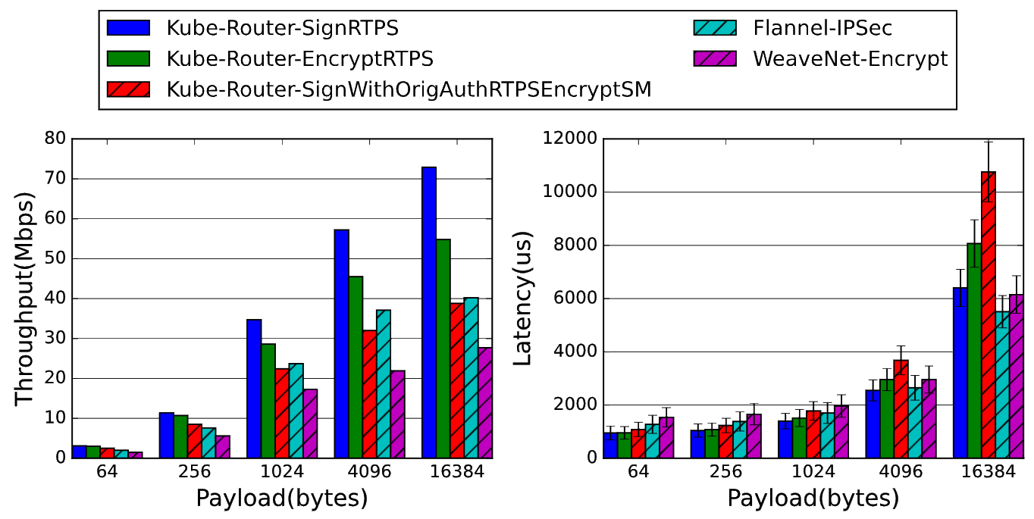
Experimental Results (15/16)
5. Evaluating Security Support (a. 1pub/1sub)
  Kube-Router with DDS Security performs better than Flannel when *msgs are <1KB.
  But earns lower throughput and higher latency for lager ones.
  ESP transport mode of WeaveNet IPSec’s lower encapsulation overhead
  cannot overcome the impact of VXLAN encapsulation performance.
    i.e. 34bytes for WeaveNet ESP overhead, 57 bytes for Flannel ESP overhead.
*msgs = messages
Notes:
i.e. 34bytes for WeaveNet ESP overhead, 57 bytes for Flannel ESP overhead.

Slide 38
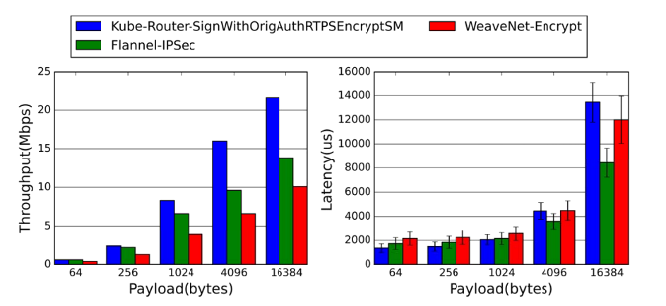
Experimental Results (16/16)
5. Evaluating Security Support (b. 1pub/4-sub)
  DDS Security provides better throughput performance for multi-subscriber use cases.
  DDS Security plugin enable security options for a specific domain or topic.
    avoids performance overhead induced by unnecessary security operations.
*msgs = messages

Slide 39
Conclusions

Slide 40
Conclusions
There is no one-size-fits-all CNI recommendation.
  For performance only, K8s Host-mode achieves the best performance.
  Containerized DDS performance on a hybrid-platform (ARM+AMD).
  Compared to Reliable mode, BestEffort QoS reduces latency.
  WeaveNet’s L2 multicast outperforms in large-scale multi-sub use cases.
  In 1pub/1sub DDS Security only outperforms ESP when payload is <MTU.
  In N-sub DDS Security is the best practice for performance and scalability.

Slide 41
Future Work

Slide 42
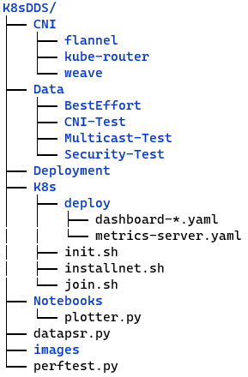
Source Code Architecture
CNI : manifest files of CNI plugins
Data : log files of test results
Deployment : initialize the K8s cluster or *CDS
K8s : scripts for managing K8s bootstrapper
Notebooks : Jupiter notebooks for
some additional experiments
datapsr.py : parse given datasets, used in notebooks
images : image of K8s cluster architecture
perftest.py : run pub/sub and log the results
*CDS = Cloud Discovery Service

Slide 43
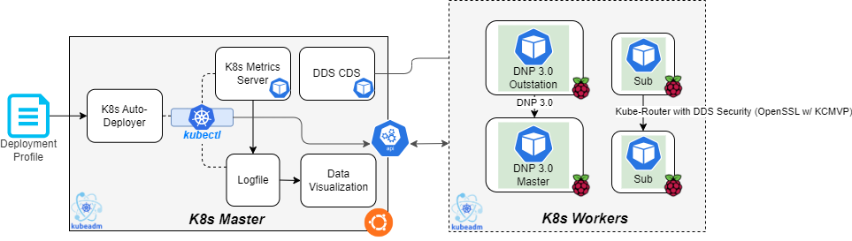
Future Work
Use scripts for Auto-Deploying K8s cluster
DNP over various CNIs
DDS over various OpenSSL versions (with/without KCMVP)

