Slide 1
WebGL / Graphics 스터디
Day 3
WebGL with Three.js

Slide 2
1. What is Three.js?
Threejs is an easy to use, lightweight, cross-browser, general purpose 3D library.
Threejs dramatically simplifies WebGL pipeline

Slide 3
Possible applications & Use cases
3D product displays, landing pages, video games or game engines, music videos, 3D or CAD software, journalistic visualizations
Examples
https://threejs.org/
https://www.awwwards.com/websites/three-js/

Slide 4
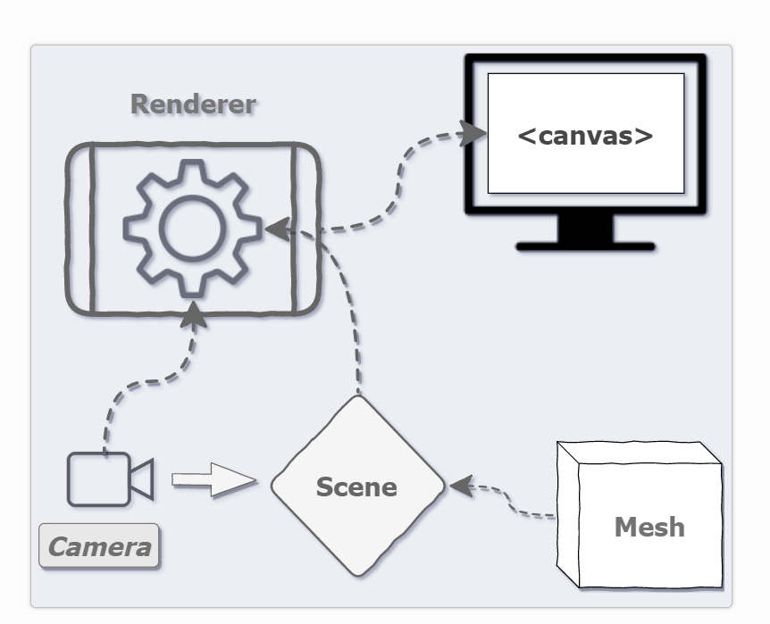
Generic Pipeline, in three.js
Conatiner (Canvas)
Renderer (Attached to conatiner)
Scene, Camera (Attached to Rend
erer)
Meshes (Scene graph)

Slide 5
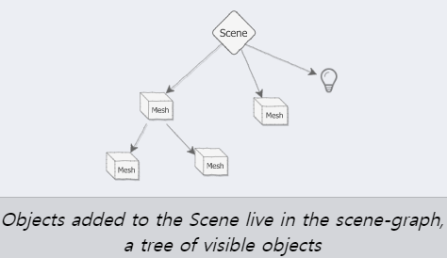
Scene Graph

Slide 6
Simplest Three.js Code
const container = document.querySelector('#scene-container’);
// create a Scene
const scene = new Scene();
// Set the background color
scene.background = new Color('skyblue');
// Create a camera
const fov = 35; // AKA Field of View
const aspect = container.clientWidth / container.clientHeight;
const near = 0.1; // the near clipping plane
const far = 100; // the far clipping plane const camera = new PerspectiveCamera(fov, aspect, near, far); // every object is initially created at ( 0, 0, 0 )
// move the camera back so we can view the scene
camera.position.set(0, 0, 10);

Slide 7
Define Your first Mesh!
// create a geometry
const geometry = new BoxBufferGeometry(2, 2, 2);
// create a default (white) Basic material
const material = new MeshBasicMaterial();
// create a Mesh containing the geometry and material
const cube = new Mesh(geometry, material);
// add the mesh to the scene
scene.add(cube);

Slide 8
Define Your first Renderer!
const renderer = new WebGLRenderer();
// next, set the renderer to the same size as our container element
renderer.setSize(container.clientWidth, container.clientHeight);
// finally, set the pixel ratio so that our scene will look good on HiDPI displays
renderer.setPixelRatio(window.devicePixelRatio);
// add the automatically created <canvas> element to the page
container.append(renderer.domElement);
// render, or 'create a still image', of the scene
renderer.render(scene, camera);

Slide 9
See in action!

Slide 10
2. Refactored
Code structure is way too messy to work with.
In general, you want to have OOP structure in your code.
Checkout 2.js and World folder.
https://discoverthreejs.com/book/first-steps/world-app/

Slide 11
3. Coordinates & Transformation
Scene Defines a “world-space” with “world-coordinate”
Camera is positioned in world-space.
But!
Every Object has a Coordinate System

Slide 12
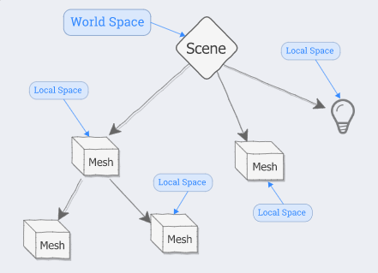

Slide 13
Let’s See in Action!

Slide 14
Note : Rotation
Rotation is… very difficult to understand
Understand:
Euler Rotation
Quaternion Rotation

Slide 15
Before that… is rotation… “Commutative?”
No!
…Why?
SO_3 is not Commutative.
https://en.wikipedia.org/wiki/3D_rotation_group

Slide 16
Euler Rotation
Euler rotation is simple to understand.
Rotate X, Rotate Y, Rotate Z.

Slide 17
Quarternions
Not doing this today! But these have very nice property.
➔ They don’t suffer from Gimbal Lock!

Slide 18
Animations

Slide 19
Ref

