Slide 1
WebGL / Graphics 스터디
류시모

Slide 2
스터디 소개
이런걸 만들기 위해 필요한 지식을 배울거에요.
https://phage-lab.com/
https://www.corca.ai
https://www.lyst.co.uk/fashion-dna

Slide 3


Slide 4


Slide 5
Introduction
류시모
사국 경영 19학번 (4학년 2학기)
(fresh info : 기계과 진학 예정!)
코르카에서 ML 엔지니어로 근무중
고양이 좋아함

Slide 6
What you can expect
Learning basics of graphics pipeline and shaders
Bits of popular WebGL frameworks (p5js, PixiJS, ThreeJS)
Basics of GLSL
Integrating graphics frameworks with popular web frameworks (React)
Toy Projects and Tasks!

Slide 7
What you shouldn’t expect
Detailed math behind graphics (vector calculus, geometry, shape analysis) etc..
Creating 3d models, vector graphics (i.e., graphical assets)
Details of none-web graphics tools (OpenGL, Vulkan, Unreal, Unity etc..)
현업의 짬? 등 숙련된 개발자의 경험
Portfolio that gets you into major company immediately
We are interested in low-level engineering, theories and principles, but more on high-level applications!

Slide 8
금요일 8시 ~ 9시 (인원 6 ~ 8명?)
1주차
OT
Typical Graphics pipeline
2 주차
p5js
GLSL
3 주차
ThreeJS 1
4 주차
ThreeJS 2
5 주차
ThreeJS with React / glTF
6 주차
PixiJS / Toy Project
7 주차
Toy Project

Slide 9
What is computer graphics?
Conversion from “3D Scene” to “2D image”
What makes “3D Scene”…
3D geometry and transformations
Lights
material properties
Made out of
Vertices
Triangles

Slide 10
Graphics Pipeline
And why you should care

Slide 11

Conceptually…
How do we transform “3D scene” to “Image”?
Application : Executed by main processor ➔ changes made to scene
Collision detection, animation, morphing, ...

Slide 12

Geometry

Slide 13
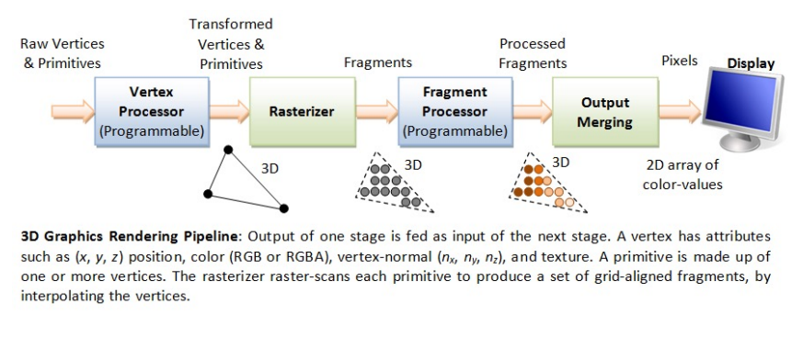
“Typical Graphics Pipeline”

Slide 14
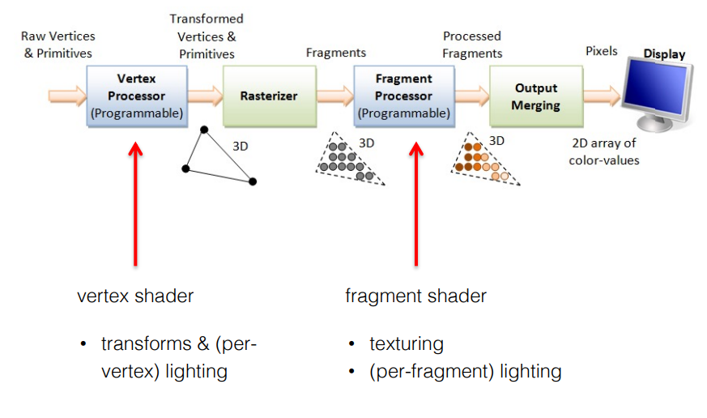

Slide 15
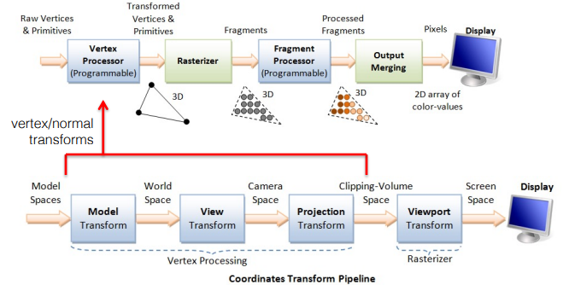
Vertex Transforms

Slide 16
Vertex Transforms
1. Arrange the objects (or models, or avatar) in
the world (Model Transform).
2. Position and orientation the camera (View
transform).
3. Select a camera lens (wide angle, normal or
telescopic), adjust the focus length and zoom
factor to set the camera's field of view
(Projection transform).

Slide 17
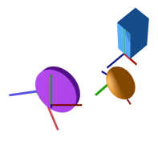
Model Transform

Slide 18
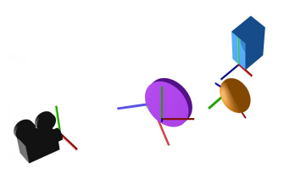
View Transform

Slide 19
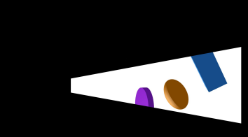
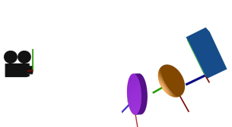
Projection Transform

Slide 20
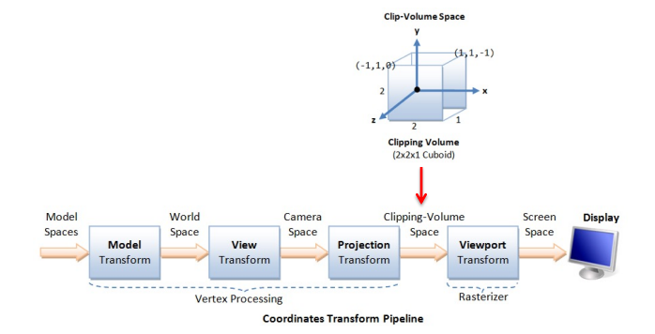
Clip Space, Viewport Transform

Slide 21
Rasterization
1. determine which fragments
are inside the triangles
2. interpolate vertex attributes
(e.g. color) to all fragments

Slide 22
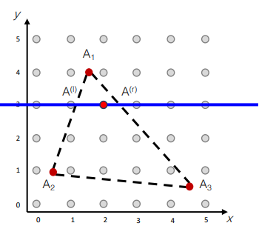
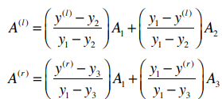

Scanline Interpolation
Attributes interpolation
First determine Al, Ar:
Next, for target A:

Slide 23
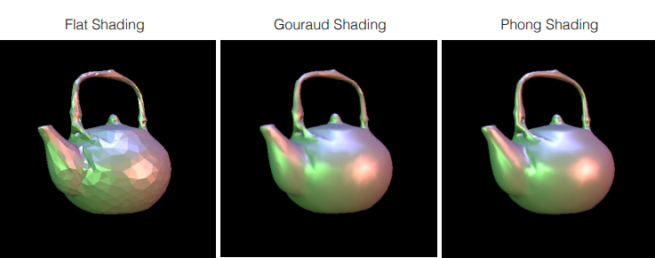
Lighting, Shading, Texture mapping, Depth test,
By the Vertex Processing & Rasterizing, we know what attributes each fragments have.
Use these attributes to perform stuff on each fragments (pixels)!

Slide 24
Shaders
We’ve seen Vertex shaders and Fragment shaders.
Why Do We Need Shaders?
massively parallel computing
• single instruction multiple data (SIMD) paradigm à GPUs are
designed to be parallel processors
• vertex shaders are independently executed for each vertex on
GPU (in parallel)
• fragment shaders are independently executed for each
fragment on GPU (in parallel)

Slide 25
Shading Languages
GLSL (for OpenGL)
HLSL
OSL
Cg
DirectX Shader Assembly Language
We will use GLSL for WebGL

Slide 26
Vertex Shader
Input:
input variables are either uniform (passed in from JavaScript, e.g. matrices) or attribute (values associated with each vertex, e.g. position, normal, uv, …)
Output : vec4 gl_Position
(vertex position in clip coordinates)

Slide 27
Fragment Shader
Input:
input variables are either uniform (passed in from JavaScript) or varying (passed in from vertex shader through rasterizer)
Output:
vec4 gl_FragColor
float gl_FragDepth

Slide 28
Fun Example
Later, we will use Fragment shader to perform beautiful fluid-simulation very fast
… with Pixijs, NextJS

Slide 29
In action with WebGL!
WebGL only cares about 2 things: clip space coordinates and colors.

Slide 30
Note!
OpenGL is basically a state machine
We always need to “not-functionally” change gl’s state.

Slide 31
Basic OpenGL…
To let “shader code” use “some values”
Create Code ➔ Create Shader ➔ Create Program
Define data ➔ Define Buffer ➔ Bind Buffer
bindBuffer : we’ll work on X
bufferData : Put ~~ on X
createShader, shaderSource, compileShader, attachShader, linkProgram, useProgram

Slide 32
Setting Attribute
getAttributeLocation
vertexAttributePointer
enableVertexAttributeArray

Slide 33
Example Code

Slide 34
All that… Just for a simple triangle;
Clearly we need simpler, OOP / functional (i.e., reasonable) frameworks…
Various Frameworks, engines and libraries help us with just that.

Slide 35
References
https://stanford.edu/class/ee267/lectures/lecture2.pdf
https://stanford.edu/class/ee267/lectures/lecture3.pdf
https://stanford.edu/class/ee267/lectures/lecture4.pdf
https://webglfundamentals.org/webgl/lessons/webgl-shadersand-glsl.htm
https://www.tutorialspoint.com/webgl/webgl_drawing_a_triangle.htm
https://www.youtube.com/playlist?list=PLlrATfBNZ98foTJPJ_Ev03o2oq3-GGOS2

