Slide 1
Places of origin and destination
Unit 4-Class 2
Recognize the diverse ways that the countries of origin and destiny are affected of by the migratory processes

Slide 2
KEY TERMS
REMITTANCES: The sending of money to someone at a distance
XENOPHOBIA: person that is affraid of people from different countries or cultures.
OUTFLOW: Something that flows out
OUTKAST: feeling of being left out

Slide 3
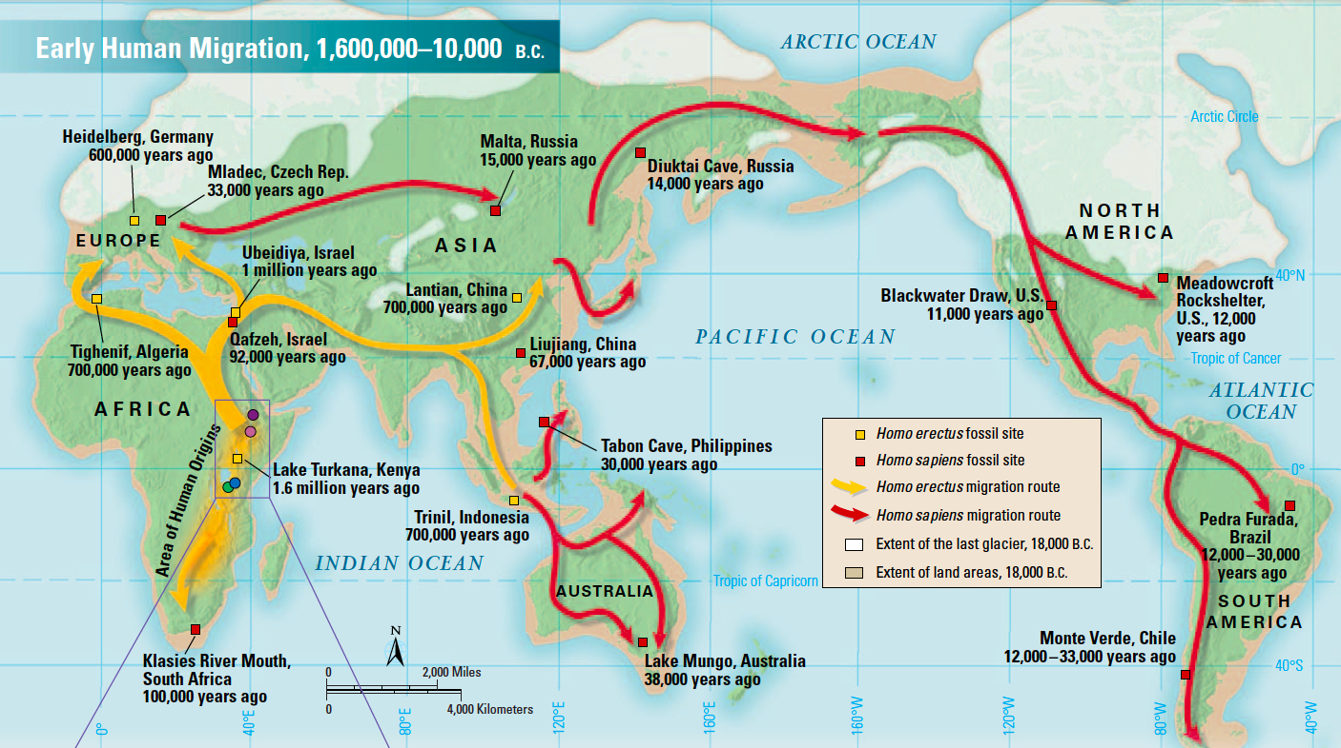
LET´S ANALYZE
How important were nomads and sedentaries for the development of society through migration?

Slide 4
origin
destiny
Country of destination
MIGRATION POLES
ORIGIN: is the country of origin that people want to get out of. Migrants take the name of emigrants.
DESTINY: is the country that people want to arrive to. Migrants take the name of immigrants
Country of destiny: Place where immigrants choose to settle

Slide 5
COUNTRIES OF ORIGIN AND ITS IMMIGRANTS
Studies show that South American people of the middle class, are the ones that migrate to other countries
CHARACTERISTICS OF THE COUNTRIES PEOPLE MIGRATE FROM
Lack of economic opportunities
Absence of economic development
Unemployment
Presence of spirit of struggle

Slide 6
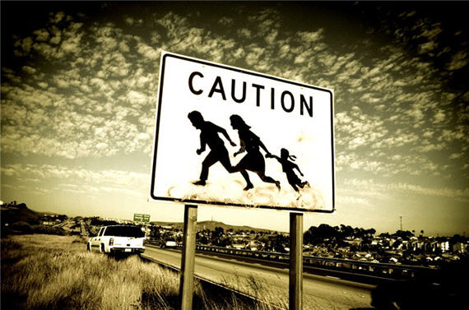
Integration of immigrants in the country of destination
Some immigrants have integrated with no problem, however there are others that have suffered from xenophobia.
PROBLEMS
REJECTION
POVERTY
LOW SALARIES
UNVALUED
OUTKAST
FEAR OF EXPRESSION

Slide 7
Costs of migration to countries of origin
Human outflow
Ecuador´s investments go with people
Loss of people of great value
optimistic, self-determined and valuable people
Promoting the consumption of luxury
Luxury can be afforded through remittances

Slide 8
Benefits of the countries of destination
Required and cheap labor
People with fightig spirit
Save money by not paying what immigrants deserve
BENEFITS
Educated people Gov. didn´t invest on
Development of economic wealth
Young people to contribute retirements

Slide 9

What are the cons of migration in countries of destination?
Unemployment, NO Social Security and Crime
Discrimination
Fear of lost of culture

Slide 10
Immigrants in Spain work on?
Europe
-Finantial sector
-Commerce
-Apply university studies
Latin America
-Hotels
-Domestic service

Slide 11
Immigrants in Spain work on?
Morocco
-Agriculture
East Europe
-Construction

