Slide 1
PREPOSITIONS
Miss Nina Quiroga

Slide 2
Prepositions
a word or group of words that combines with a noun or pronoun to form a phrase that usually acts as an adverb, adjective, or noun “With” in “the house with the red door” is a preposition.

Slide 3
Examples of preposition in a sentence:
'The dog jumped over the wall', the word 'over' is a preposition.
The preposition “on” in “The keys are on the table” shows location.
The preposition “in” in “The movie starts in one hour” shows time.

Slide 4
Types of Prepositions
There are three types of prepositions, including:
a. Prepositions of place, position and direction. b. Prepositions of time. c. Prepositions for other relationships
Each type of preposition is important.

Slide 5
Prepositional Phrases
Here are some examples of prepositional phrases:
'under' the desk 'during' the lecture 'across' the yard 'after' lunch 'behind' the tree

Slide 6
Rule: They are always followed by a "noun", never followed by a verb. By "noun" we include: Noun (dog, money, love)
Proper Noun (name) (London, Mary)
Pronoun (you, him, us)
Noun Group (my first car)
Gerund (swimming) If we want to follow with a verb, we must use the "-ing" form which is really a gerund or verb in noun form.
Subject + Verb | Preposition | "noun"
The pen is | on | the table.
He lives | in | England.
Henry is looking | for | you.
The newspaper is | under | your green book.
Pascal is used | to | English people.
She isn't used | to | working.
We ate | before | coming.

Slide 7
At for a PRECISE TIME
In for MONTHS, YEARS, CENTURIES and LONG PERIODS
On for DAYS and Dates
At | In | On
At 4:30 pm | in March | on Monday
At 3 o'clock | In Winter | On 6 March
At noon | In the summer | On 22 Dec.2012
At dinnertime | In 1990 | On Christmas Day
At bedtime | In the next century | On your birthday
At the moment | In the future | On New Year's Eve

Slide 8
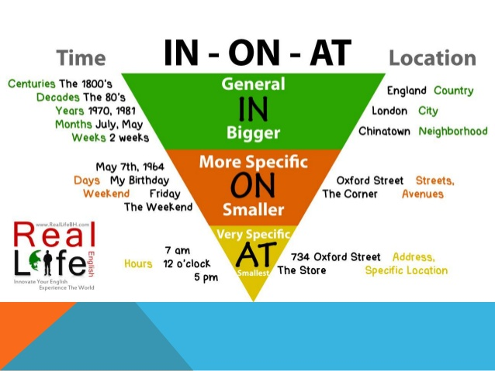

Slide 9
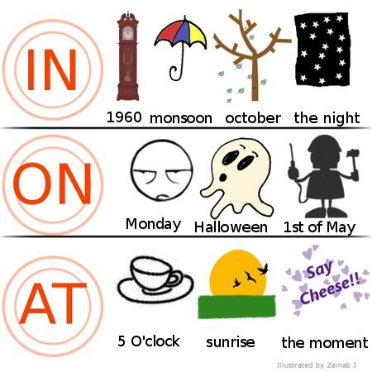

Slide 10
Materias de clase
Lectura
Escritura
Matemática
Ciencia y tecnología
Ciencias sociales
Música y arte

Slide 11
Lectura
Breve lista con los temas de lectura y las actividades
Agregar una lista de libros

Slide 12
Escritura
Breve lista con los temas de escritura y las actividades

Slide 13
Matemática
Breve lista con los temas de matemáticas y las actividades

Slide 14
Ciencia y tecnología
Breve lista con los temas de ciencia y tecnología y las actividades

Slide 15
Ciencias sociales
Breve lista con los temas y las actividades
Lista de proyectos especiales

Slide 16
Música y arte
Breve lista con los temas y las actividades

Slide 17
Deberes
45 minutos de tareas en casa todas las noches
Entregas los viernes por la mañana
¿Necesitas más tiempo? Durante el descanso, puedes asistir al club de tareas.

Slide 18
Excursiones
Asistir a dos representaciones de teatro infantil (unidades de Lectura)
Tomar muestras de agua en el parque Maple Grove (unidad de Ciencias)
Visitar una panadería (unidad de Ciencias sociales)

Slide 19
Retrasos
El centro abre a las 8:15 a.m.
¿Llegas tarde? Comunícalo a la oficina del centro antes de venir a clase.
Si te retrasas en cuatro ocasiones, el centro se pondrá en contacto con tus padres.

Slide 20
Suministros
Debes traer todos los días:
No debes traer:
Lápiz del número 2
Dispositivos electrónicos

Slide 21
Recursos
Biblioteca
Sala de informática
Ayuda del profesor
Padres voluntarios

Slide 22
¿Alguna pregunta?

Slide 23
¡Este año va a ser genial!

