Slide 1
PT Lion Wings
IT Application Roadmap 2024

Slide 2
2023 Objective Key :
Non – SAP Applications :
Ticketing Apps (2023)
Move Foxpro to PHP / SAP (2023)
Revamp PHP Apps using latest PHP Technology (2024)
Lion Portal Apps (2024)
SSO Lion Wings Apps by NIK (2024)
Knowledge Base Documentation (2024)
Why need to upgrade Foxpro to PHP or SAP ?
The official support of VFP ended in 2015
SAP Applications :
Rollout Plant Gresik (Q2-2023)
Knowledge Base Documentation (2024)
Digitalization for manual process to SAP (Z Tcode) (Continuous Improvement), example :
Form PIB
Manual Proforma Invoice
Mapping Customer Material Wings Surya & Lion
Mapping Customer Material Lion Group
Applications Policy :
Development standardization (Q1-2023)
Change Request standardization (Q1-2023)
Technology standardization (Q1-2023)

Slide 3
2023 Objective Key Progress :
Non – SAP Applications :
Ticketing Apps (2023) => Q4 For Phase 1 (Internal IT Used)
Move Foxpro to PHP / SAP (2023) => 35.29 % (6/17 items)
Revamp PHP Apps using latest PHP Technology (2024) => 8.33 % (1/12 items)
Lion Portal Apps (2024) => 10% (3/30 items estimated)
SSO Lion Wings Apps by NIK (2024) => All web apps will be merged to Lion Portal using one database user login by NIK
Knowledge Base Documentation (2024) => Documenting source code changes on GitHub
Ruang Meeting => Q4 (New)
Perkas Gresik => Q4 (New)
Print Kwitansi => Q4 (New)
Employee Self Attendance => Q4 (New)
SAP Applications :
Rollout Plant Gresik (Q2-2023) => Q3
Knowledge Base Documentation (2024) => Documenting Functional Specification on google sheet
Digitalization for manual process to SAP (Z Tcode) (Continuous Improvement), example :
Form PIB
Manual Proforma Invoice
Mapping Customer Material Wings Surya & Lion
Mapping Customer Material Lion Group
Applications Policy :
Development standardization (Q1-2023) => Q3
Change Request standardization (Q1-2023) => Q3
Technology standardization (Q1-2023) => Q3

Slide 4
2024 Objective Key :
Non – SAP Applications :
Cont. Move Foxpro to PHP / SAP (2025)
Cont. Helpdesk IT Ticketing Phase 2 : Deploy to all users (2024)
Cont. Revamp PHP Apps using latest PHP Technology (2025)
Move Payroll Cakung (Old PERKAS) to New PERKAS (2025)
Revamp JS Native to React JS (2024)
Lion Portal Go Public (2024)
Need to prepare for Password Protection ( forgot password, change password, reset password), will using MD52 Hashing
Need to prepare for SQL Injection (URL Masking)
Need to prepare for Spamming (Google Captcha), will implement google captcha v4
Have 2 options :
Build other DMZ for Lion Portal, separate network
Use Dewa web to route to our public ip (firewall)
Host to Dewa Web

Slide 5
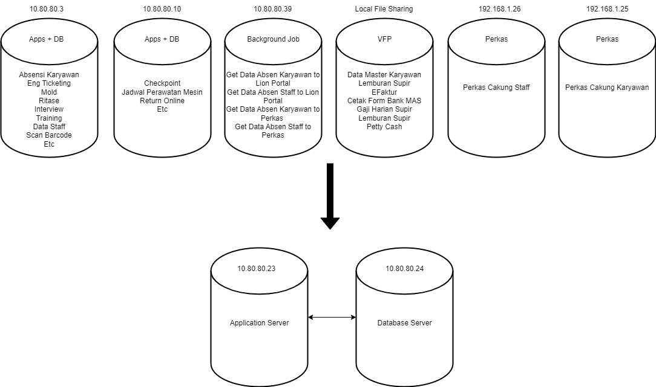
Application Architecture
Migrate existing architecture from multi server standalone to centralized server (2024), benefit :
Easy to manage & maintain (Backup & Recovery, DRC Plan, Performance & Scalability, Replication, Load Balancing, etc)
Reduce the VMs

Slide 6
End – Thank You
Content here

