Slide 1
Heart Disease prediction system using Machine Learning(Classification) for HealthCare
UNDER THE SUPERVISION
OF:
DR. RACHNA JAIN
( CSE DEPARTMENT)
PRESENTED BY:
AKANSH GUPTA-00451203117
LOKESH KUMAR-01451203117
(IT-DEPARTMENT)-(EVE)
B.TECH

Slide 2
First Step: Data Collection
Age - age in years
Sex - sex (1 = male; 0 = female)
CP - chest pain type (1 = typical angina; 2 = atypical angina; 3 = non-anginal pain; 4 = asymptomatic)
Restbps - resting blood pressure (in mm Hg on admission to the hospital)
Cholesterol - serum cholestoral in mg/dl
FBS - fasting blood sugar > 120 mg/dl (1 = true; 0 = false)
RestEcg - resting electrocardiographic results (0 = normal; 1 = having ST-T; 2 = hypertrophy)
MaxHR - maximum heart rate achieved
Exang - exercise induced angina (1 = yes; 0 = no)
Oldpeak - ST depression induced by exercise relative to rest
Slope - the slope of the peak exercise ST segment (1 = upsloping; 2 = flat; 3 = downsloping)
Nmajvess - number of major vessels (0-3) colored by flourosopy
Thal - 3 = normal; 6 = fixed defect; 7 = reversable defect
ADS - the predicted attribute - diagnosis of heart disease (angiographic disease status) (Value 0 = < 50% diameter narrowing; Value 1 = > 50% diameter narrowing)

Slide 3
Second Step: Data pre-processing & Exploration of dataset
Box plot
Count Plot
Bar Graphs

Slide 4
Observations:
• age (54-67) - higher chances
• asymptotic type of chest pain - disease.
• no exercise induced chest pain- less chances
• Males - higher chances

Slide 5
Third Step :Building Model
Applying various machine learning algorithm.
The model will built by using 75% of data for training and 25% of data for testing.

Slide 6
Algorithms Used:
• Logistic Regression
• K-Nearest Neighbours
• Support Vector Machine
• Naïve Bayes
• Decision Tree
• Random Forest

Slide 7
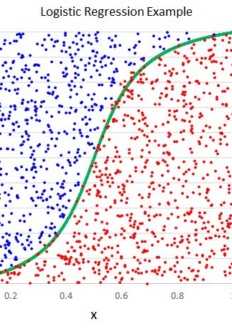
Logistic Regression
• Classification algorithm
• Uses Sigmoid Function.

Slide 8
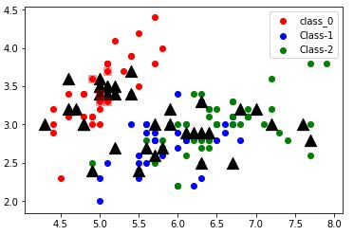
K-Nearest Neighbours
• Supervised classification algorithm
• Looks at the nearest neighbour.

Slide 9
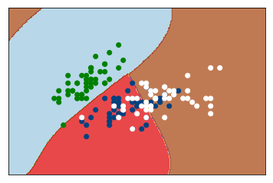
A Support Vector Mechanism (SVM)
• Used for both classification or regression challenges.
• However, it is mostly used in classification problems.

Slide 10
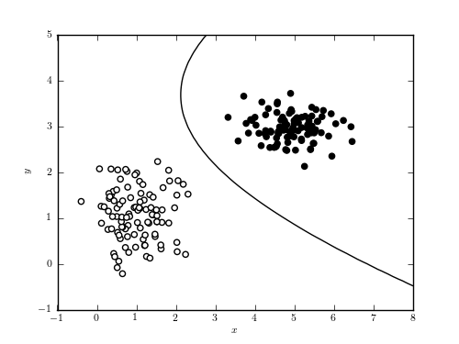
Naïve Bayes:
• combination of multiple classifiers.
• all working on the basic Naïve Bayes principle of independent features.

Slide 11
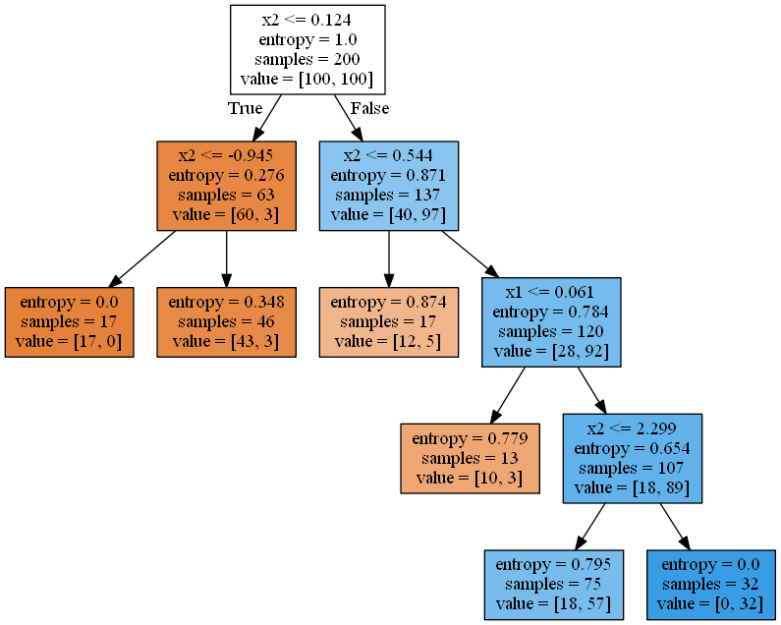
Decision Tree
• categorical as well as numerical value.
• Represents data instances with their label
• A set of rules can be deduced from the tree which can be used to classify the unknown data record to its output value

Slide 12
Random Forest Classifier
•Random Forest algorithm does not overfit the set like 'Decision Tree’.
• It first considers many decision trees before giving an output. It works well with the bigger dataset

Slide 13
Fourth step : Evaluation
• accuracy
• recall, precision ,F-Score

Slide 14
Accuracies Obtained:
• Logistic Regression-85.53%
• K-Nearest Neighbours-88.16%
• Support Vector Machine-88.16%
• Naïve Bayes -84.21%
• Decision Tree-82.89%
•Random Forest-86.84%

Slide 15
Optimisation of the model results.
•Feature Extraction:
→Correlation Method
→Backward Elimination
→Embedded Method
Naïve Bayes final accuracy obtained-88.16%
with 8 major attributes

Slide 16
Tentative Outcomes
• Naïve Bayes model performed best, with 88.16% accuracy over test set, after the features were extracted.
• Thalassemia , Number of major vessels , Old Peak, Slope ,Max Heart rate achieved, Chest Pain Type, Exercise induced angina , Sex :(8/14) had come out to be major predictors. Only Max Heart Rate among them is indirectly proportional to ADS.

Slide 17
THANK YOU.

