Slide 1
Big Data Processing
kNN-IS An Iterative Spark-based design of the k-Nearest Neighbours classifier for big data

Slide 2
Objective and Motivation
The k-Nearest Neighbours classifier is a very popular method in data mining as it is easy to implement and still provides good results. But application of this model in big data is not feasible as it takes a huge amount of memory and long runtime.
We implemented a novel Spark-based method for performing an accurate k-nearest neighbour classification. The k-nearest neighbours in various training data splits are calculated during the map phase. Subsequently, the list acquired in the map phase is processed by reducers to determine the definitive neighbours.

Slide 3
Learning Outcomes
kNN-IS is an exact parallel approach and obtains the same accuracy and very good achievements on runtimes.
Despite producing more transfer from the map to reduce, the number of neighbors ( k ) does not drastically affect to the total runtime.
When datasets are enormous and it exceed the memory capacity of the cluster, kNN-IS calculates the solution with more than one iteration by splitting the test set. Therefore, it has allowed us to apply the kNN algorithm in large-scale problems.

Slide 4
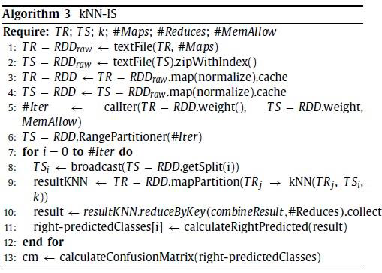
Algorithm
https://colab.research.google.com/drive/1SvKYMxoi-mohpyACknpGe_8fQcb5eAs3?usp=sharing

Slide 5
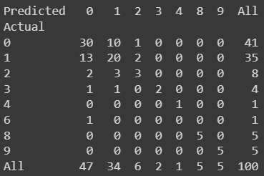
Result
We used to Poker-hand dataset given in the UCI Machine Learning repository to test the code.
Finally confusion matrix is printed as a output. Eg: Training data - 25010 instances
Test data - 100 instances

Slide 6
Future suggestions
As future work, we can tackle big datasets that contain missing values by using kNN-IS to impute them, and datasets with a very large number of features by using multi-view approaches.
We can extend the use of kNN-IS to instance selection techniques for big data , where it reports good results.

Slide 7
References
Maillo, Jesus, et al. "kNN-IS: An Iterative Spark-based design of the k-Nearest Neighbors classifier for big data." Knowledge-Based Systems 117 (2017): 3-15.
M. Lichman , UCI Machine Learning Repository, 2013
https://archive.ics.uci.edu/
https://github.com/JMailloH/kNN _ IS

Slide 8
Group Members:
202001039 - Vishrut Shah
202001040 - Dev Malkan
202001087 - Siddharth Makhija
Thank you!

