Slide 1
Disposable Jenkins
Mandy Hubbard

Slide 2
Disposable Jenkins
Mandy Hubbard
@DevMandy

Slide 3



Company Info

Slide 4
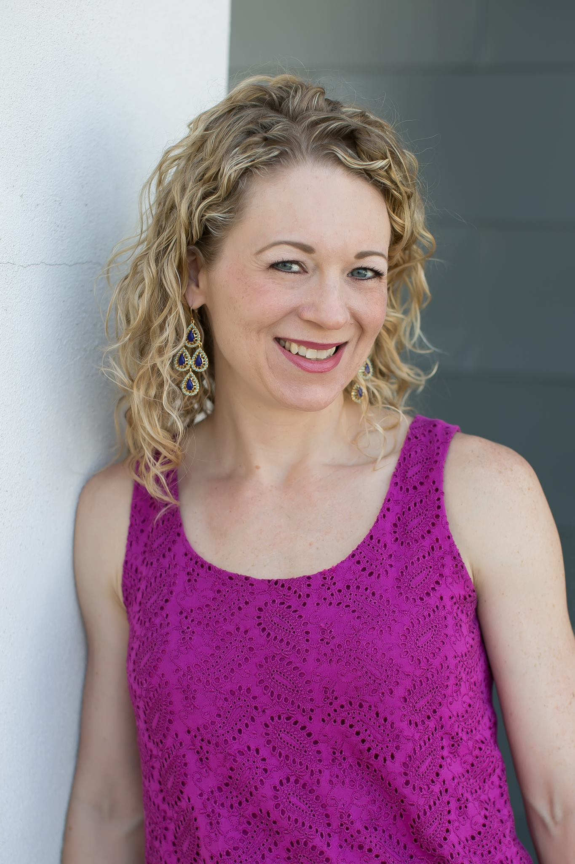
About Me
Mandy Hubbard
@DevMandy
QA Architect, Care.com HomePay

Slide 5
What is Quality?
“Quality is not an act, it is a habit.”
— Aristotle

Slide 6
Analogy time
Q: Why do cars have brakes?
A: So they can go fast!

Slide 7


Steps to Quality Software
Dev
Dev
Upstream Master
(Pull Requests)
(Trigger)
Dev
Auto
build and
test
Dev
Dev

Slide 8
GitHub Process
2
GitHub
Mandy
local
Origin
1
Clone
Fork
3
Upstream
PR
Push
Mandy’s account
4
Patrick
local
Origin
Fork
Clone
PR
DevMandy account
Push
Patrick’s account

Slide 9
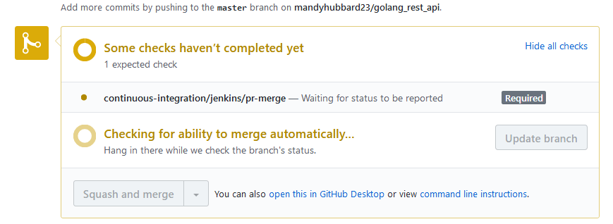
Continuous Integration
5
Mandy’s
Fork
4
Upstream
Webhook Event
PR
Build/Test
Build Status
6

Slide 10
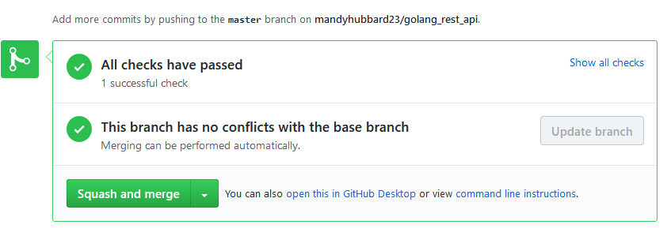
Continuous Delivery
7
push
Build/Test
9
Upstream
Webhook Event
Release
8
10

Slide 11
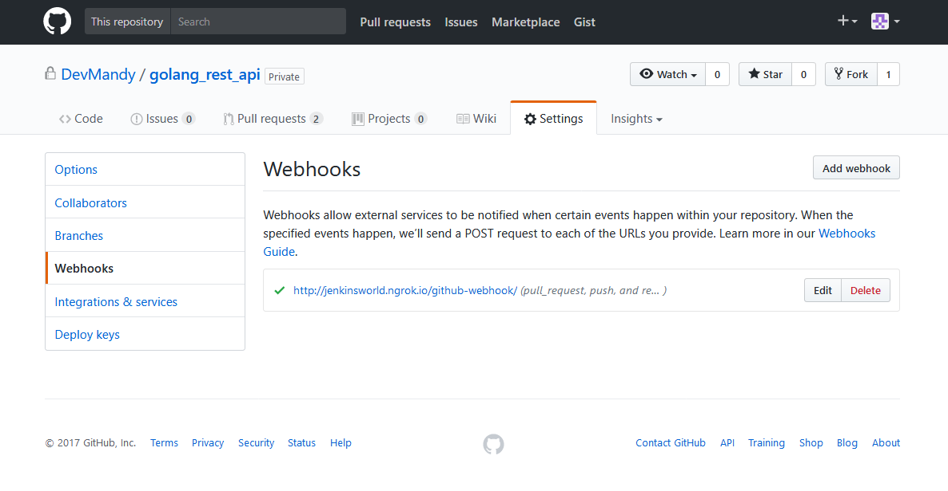
GitHub Webhook Configuration

Slide 12
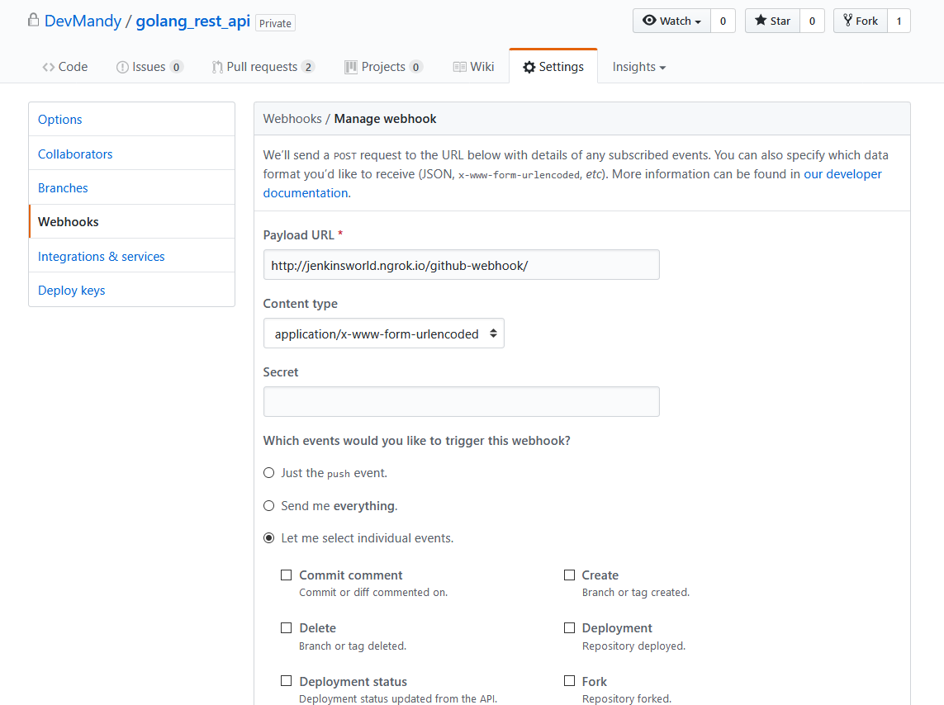
GitHub Webhook Configuration

Slide 13
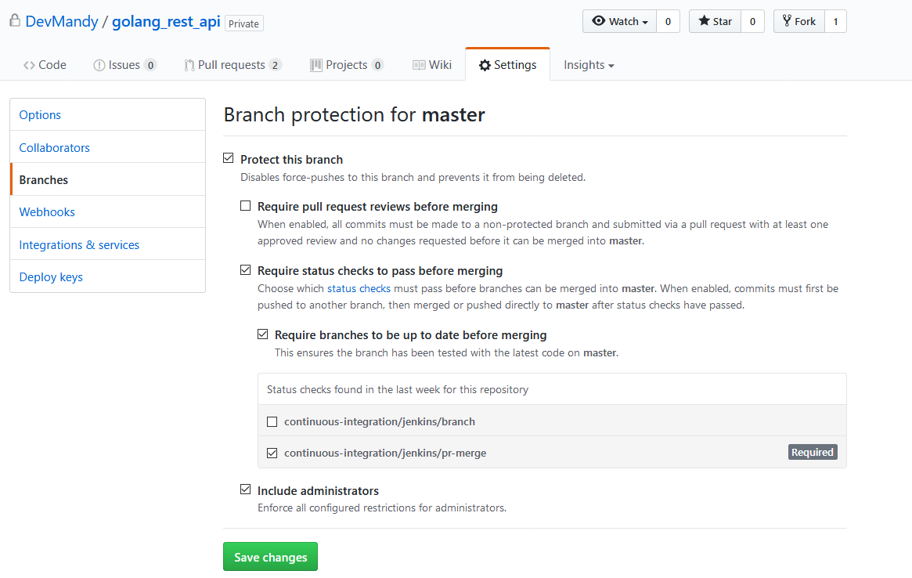
Protected Branch

Slide 14

Demo Time
Graphic design by Vo Maria https://www.teepublic.com/user/vo_maria

Slide 15
Technology Stack
Docker
ContainerPilot
Consul
Docker Compose

Slide 16

Architecture
preStart
Jenkins
Health
Health
Task
Task
ContainerPilot
Consul

Slide 17
Docker Compose
version: '3' services: jenkins: image: devmandy/auto-jenkins:0.0.1-master-2017-08-22T185233Z.c355274 restart: always env_file: _env
ports: - "8080:80" - "2222:22" volumes: - /var/run/docker.sock:/var/run/docker.sock
dns: - 8.8.8.8 - 127.0.0.1 environment: - CONSUL=consul links: - consul:consul command: > containerpilot /usr/local/bin/jenkins.sh
env_file: _env
command: > containerpilot /usr/local/bin/jenkins.sh

Slide 18
Anatomy of a Plugin
<plugin="docker-plugin@0.16.1-SNAPSHOT">
<scope>GLOBAL</scope>
<id>unique-id</id>
<description>Triton Certificates</description>
<path>/var/jenkins_home/.sdc/docker/jenkins</path>
</com.nirima.jenkins.plugins.docker.utils.DockerDirectoryCredentials>
Read / Write
Jenkins UI
config.xml

Slide 19
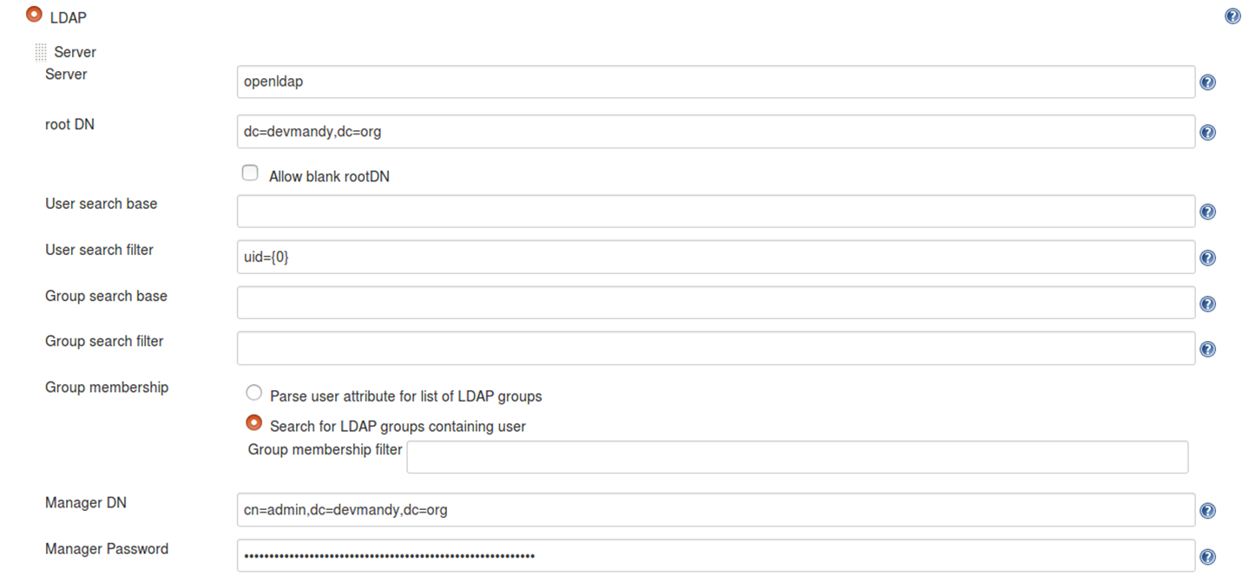
LDAP Plugin UI

Slide 20
Configuration File
<securityRealm class="hudson.security.LDAPSecurityRealm" plugin="ldap@1.16"> <jenkins.security.plugins.ldap.LDAPConfiguration> <server>ldap-server</server> <rootDN>root-dn</rootDN> <inhibitInferRootDN>false</inhibitInferRootDN> <userSearchBase></userSearchBase> <userSearch>uid={0}</userSearch> <groupMembershipStrategy class="jenkins.security.plugins.ldap.FromGroupSearchLDAPGroupMembershipStrategy"> <filter></filter> </groupMembershipStrategy> <managerDN>manager-dn</managerDN> <managerPasswordSecret>password</managerPasswordSecret> <displayNameAttributeName>givenName</displayNameAttributeName> <mailAddressAttributeName>mail</mailAddressAttributeName> </jenkins.security.plugins.ldap.LDAPConfiguration> </securityRealm>
<server>ldap-server</server> <rootDN>root-dn</rootDN>
<managerDN>manager-dn</managerDN> <managerPasswordSecret>password</managerPasswordSecret

Slide 21
Docker Compose Environment File
LDAP_SERVER=openldap
LDAP_ROOT_DN=dc=devmandy,dc=org
LDAP_MANAGER_DN=cn=admin,dc=devmandy,dc=org
LDAP_MANAGER_PASSWORD_SECRET=password
LDAP_USERNAME=mandy
LDAP_PASSWORD=password
GITHUB_TOKEN=305fa17c9af90d1351541357528a5c49592d4260
GITHUB_USERNAME=devmandy
GITHUB_ORGANIZATION=DevMandy
GITHUB_CREDENTIALS_ID=github
DOCKERHUB_ORGANIZATION=devmandy
DOCKERHUB_USERNAME=devmandy
DOCKERHUB_PASSWORD=password
DOCKER_REGISTRY=https://index.docker.io/v1/
DOCKERHUB_CREDENTIALS_ID=dockerhub
DOCKER_HOST=tcp://10.0.2.15:2375
…
LDAP_SERVER=openldap
LDAP_ROOT_DN=dc=devmandy,dc=org
LDAP_MANAGER_DN=cn=admin,dc=devmandy,dc=org
LDAP_MANAGER_PASSWORD_SECRET=password

Slide 22
Jenkins Environment Variables
jenkins@b10065bda8f4:/$ printenv | grep LDAP
LDAP_ROOT_DN=dc=devmandy,dc=org
LDAP_MANAGER_PASSWORD_SECRET=password
LDAP_SERVER=openldap
LDAP_MANAGER_DN=cn=admin,dc=devmandy,dc=org

Slide 23
first-run.sh
'//jenkins.security.plugins.ldap.LDAPConfiguration/server' \ -v ${LDAP_SERVER} \ -u '//jenkins.security.plugins.ldap.LDAPConfiguration/rootDN' \ -v ${LDAP_ROOT_DN} \ -u '//jenkins.security.plugins.ldap.LDAPConfiguration/managerDN' \ -v ${LDAP_MANAGER_DN} \ -u '//jenkins.security.plugins.ldap.LDAPConfiguration/managerPasswordSecret' \ -v ${LDAP_MANAGER_PASSWORD_SECRET} \ ${JENKINS_HOME}/config.xml

Slide 24
ContainerPilot Config
{ "consul": "http://localhost:8500", "preStart": "/usr/local/bin/first-run.sh", "stopTimeout": 5,
. . . }

Slide 25
Summary: Do Try This at Home
Quality makes the business go fast
Jenkins automates our pipeline so we can go fast
Jenkins is critical
Software-define your Jenkins!

Slide 26
Q&A
Thanks for attending!
Contact:
Mandy.Hubbard@yahoo.com @DevMandy
Ask me questions
Meet me after this presentation, Expo Hall near the Social Media booth

Slide 27
Additional Resources
https://github.com/autopilotpattern/jenkins
https://jenkins.io/blog/2017/07/17/speaker-blog-care/
https://www.joyent.com/containerpilot

