Slide 1

AI Diet Assistant
Hack and Welness 2
Team Members:
Anas Osama
Ahmed Tarek
Amr Atif
Esmail Mosaad
Omar Elshherif

Slide 2
Inspiration
Feeling bored and lonely so we can’t keep up our diet
Helping people to enjoy the journey of their fitness plan
Light up the fire on a competition and scoreboard
Going public with our fitness progress

Slide 3
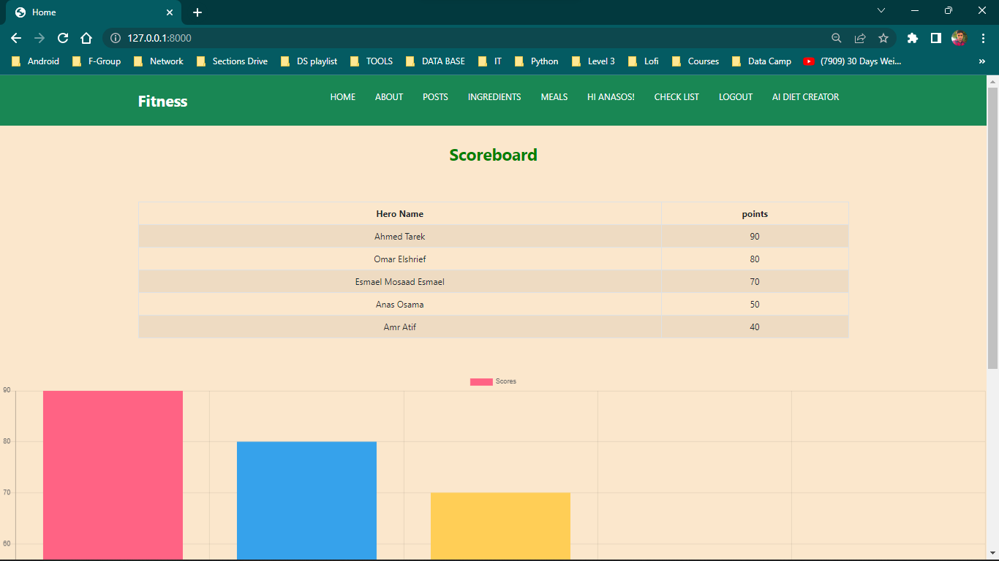

Slide 4
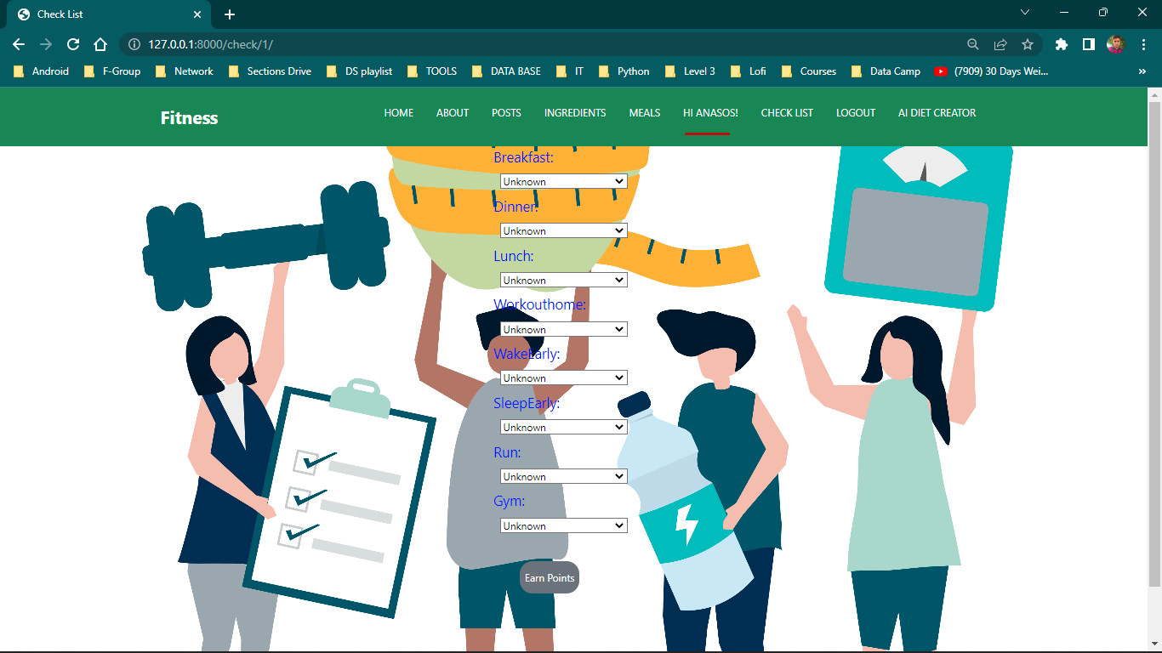

Slide 5
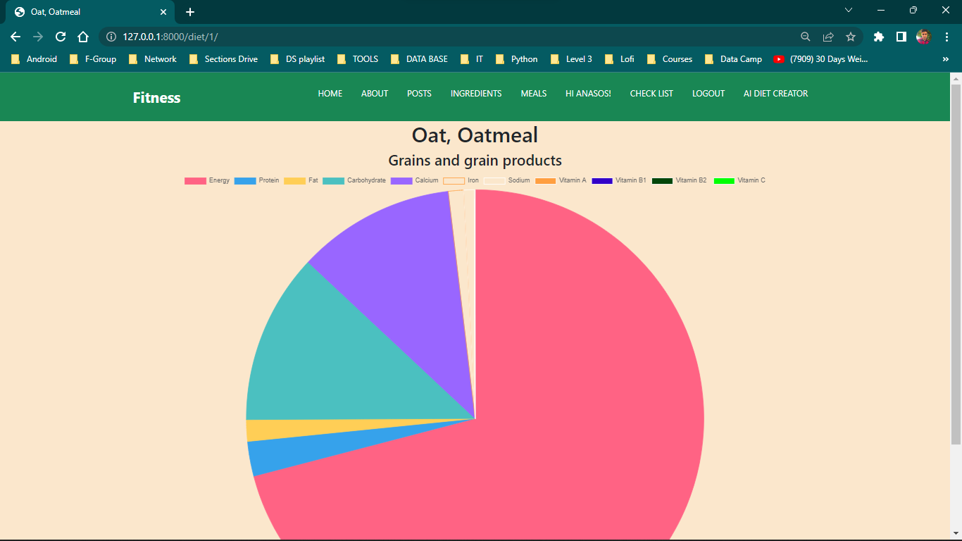

Slide 6
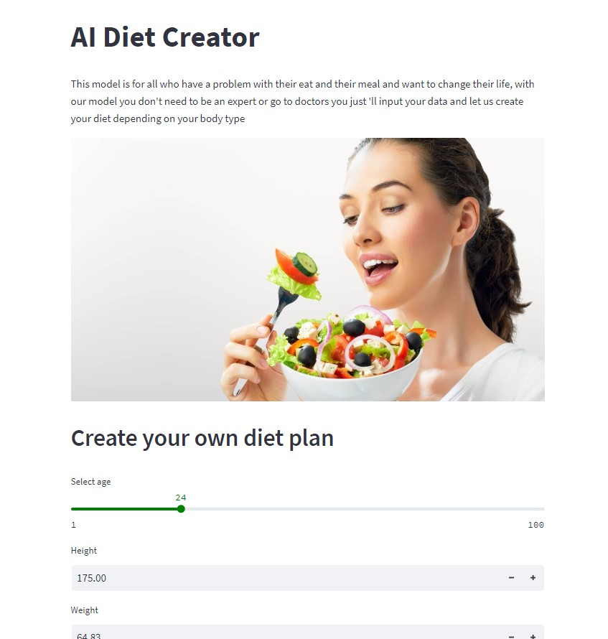

Slide 7
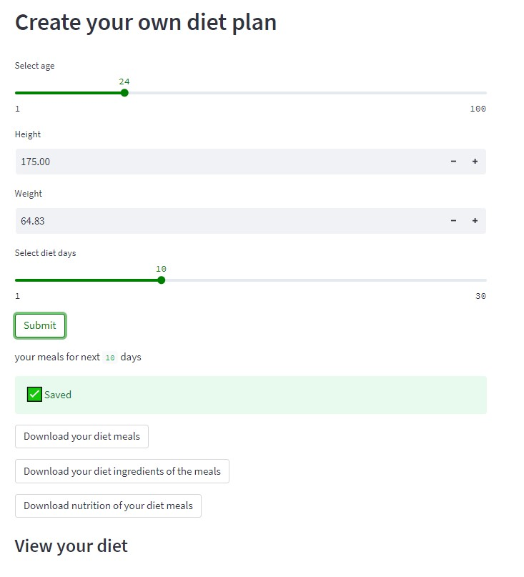

Slide 8
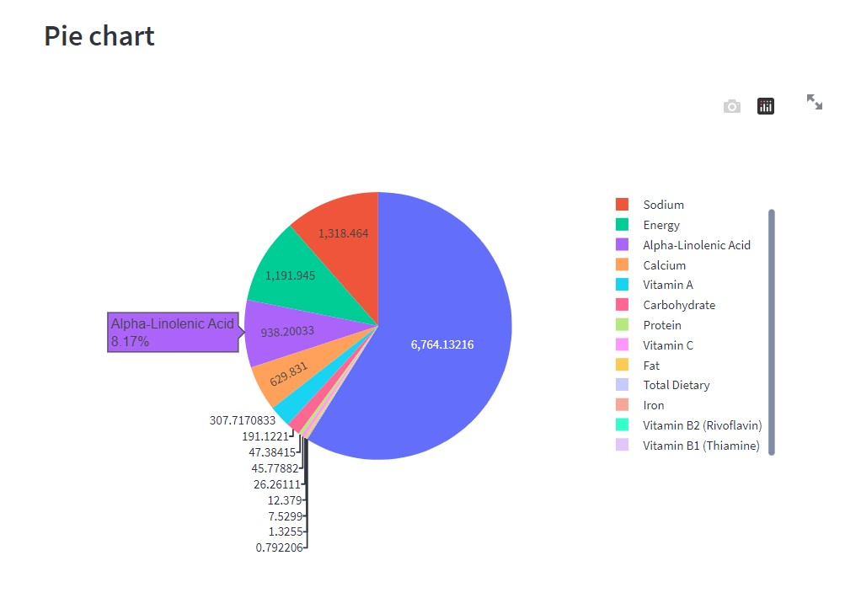

Slide 9
What AI Diet Assistant Does?
Get data from user to generate a diet that fit him
Allow fitness hackers to compete with each other through sharing their progress and ranking on the leaderboard
Everyone can explore the popular ingredients with their nutrition values to customize their favorite meals.

Slide 10
MLH Sponsor Prizes
1- Get Outside Hack
2- Best Medical Hack

Slide 11







Tech Stack

Slide 12
Project Demo

