Slide 1

Inferences from the Coffee Dataset
DATA ANALYSIS PROJECT
Thirty years of world coffee production and trade, 1990-2019
By Mercy Olaosebikan

Slide 2

CONTENTS
What this deck covers
01
Historical background
How coffee became a global commodity
02
Producers
Who grows the world's coffee
03
Importers
Who drinks it, and who passes it on
04
Model and verdict
Which markets look strongest
05
Call to action
How a new coffee company should start

Slide 3

Historical background
01
From an Ethiopian shrub to one of the world's most traded crops

Slide 4
How coffee became a global commodity
FIVE CENTURIES OF COFFEE
1400s
1727
1840s
1962
1989
Ethiopia and Yemen
Coffee grows wild in Ethiopia's highlands and is cultivated in Yemen, traded through the port of Mocha.
Coffee reaches Brazil
Seedlings arrive in Brazil, the country that will dominate world supply.
Brazil becomes #1
Brazil becomes the world's largest producer, a position it still holds in every year of this dataset.
Quotas begin
The International Coffee Agreement sets export quotas to manage supply and prices.
Quotas collapse
The quota system ends in July 1989. This dataset begins in 1990, the first year of the free market.

Slide 5
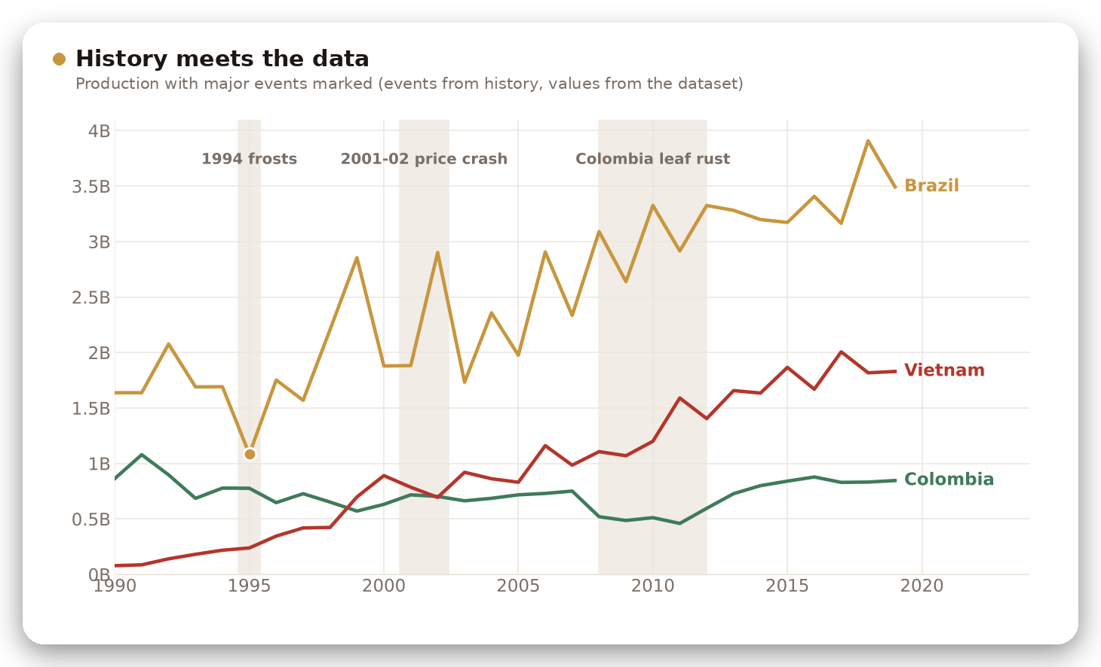
Three events you can see in the data
1990-2019 IN CONTEXT
1994 frosts in Brazil
Brazil's 1995 crop is its lowest in the dataset: 1,084M, down 36% on the year before.
2001-02 price crash
Fast growth in Vietnam and Brazil left the market oversupplied, and prices fell to their lowest in decades.
Colombia's leaf rust
Colombia's output fell from 751M (2007) to 459M (2011), then recovered to 846M by 2019.

Slide 6

THE QUESTION
Where should a coffee company build?
A new coffee company needs to choose where to sell and where to buy. Every number in this deck comes from the dataset.
55
35
producing countries
importing countries
30
5
years, 1990-2019
measures

Slide 7
Five things the data shows
AT A GLANCE
13x
61% to 74%
63%
31%
-12%
Vietnam's production growth, from #17 producer to #2
share of world output made by the top 5 producers
of import growth since 1990 was re-exported, not drunk
of importer consumption is the USA's (2019)
Germany's consumption change, while Russia's rose 168%

Slide 8
Producers
02
Production in 55 countries, 1990-2019

Slide 9
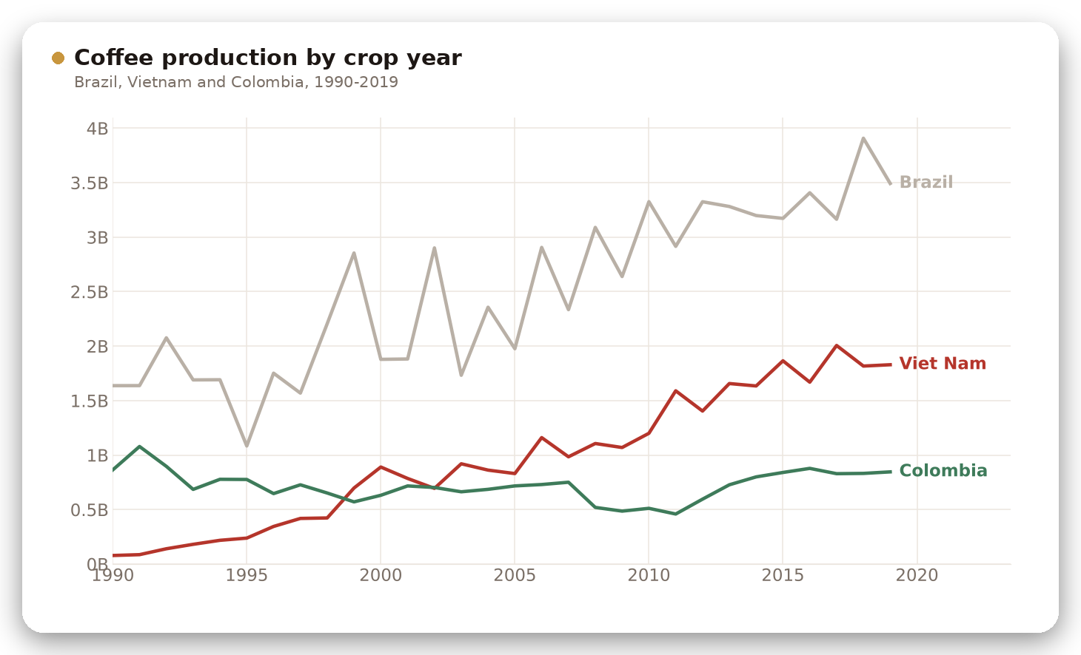
Vietnam went from a small producer to the world's #2
PRODUCERS
13x
Vietnam's growth, 1990-94 to 2015-19
Average output rose from 141M to 1,837M a year.
Its world share went from 1.4% to 18.5%.
Colombia stayed near 850M a year, so its share fell from 15.4% to 8.5%.

Slide 10
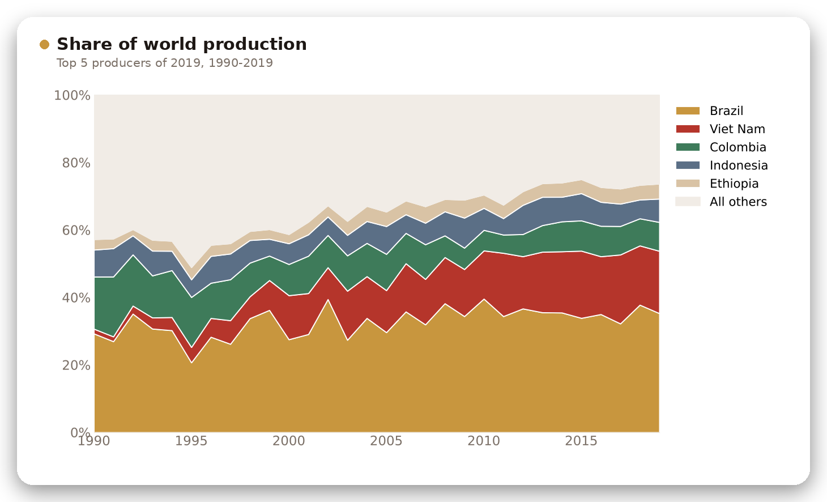
Production is concentrating in fewer countries
PRODUCERS
74%
of 2019 output came from the top 5
The top 5 made 61% in 1990.
Brazil alone makes 35% and is #1 in every year.
Mexico and Guatemala left the top 5; Vietnam and Ethiopia joined.

Slide 11
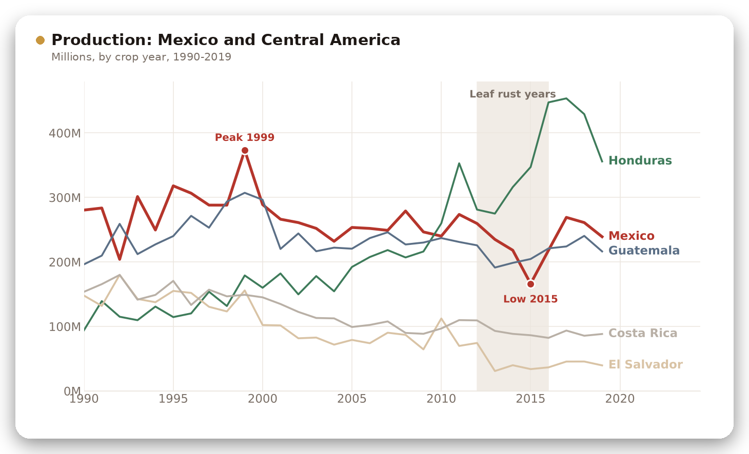
Mexico shrank while Honduras more than tripled
PRODUCERS
-55%
Mexico's fall from its 1999 peak (373M) to its 2015 low (166M)
1989: Mexico's coffee institute closed and export quotas ended, leaving growers without price support.
From 2012: leaf rust hit its mostly smallholder Arabica farms, matching the 2015 low.
Output recovered to 239M by 2019.
Notes:
Sources for the Mexico context: Sucafina, Mexico origin profile (INMECAFE dismantled in 1989; 70% of producers farm under 10 hectares; 2012 leaf rust cut output by almost half). Perfect Daily Grind, 2017 (production fell from 4.5M to 2.2M bags by 2015/16 amid leaf rust). Naatik Mexico, History of coffee in Mexico.

Slide 12
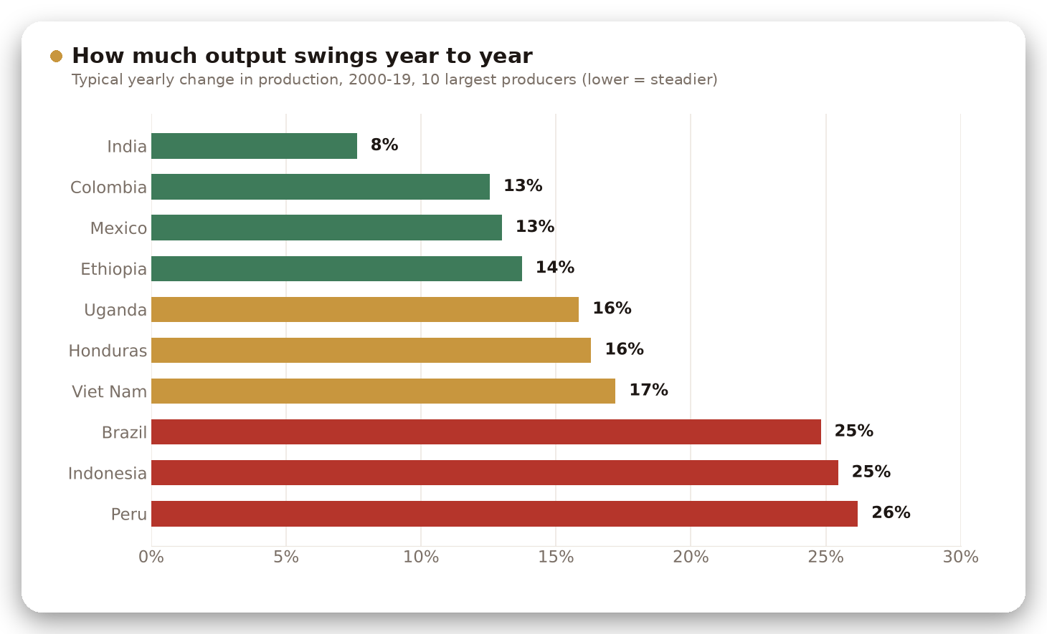
India and Colombia are the steadiest big suppliers
PRODUCERS
25%
Brazil's typical yearly change in output
India changes only about 8% a year, Colombia and Mexico about 13%.
Brazil, Indonesia and Peru swing 25-26% a year.
A buyer relying on one origin should expect large year-to-year gaps.

Slide 13
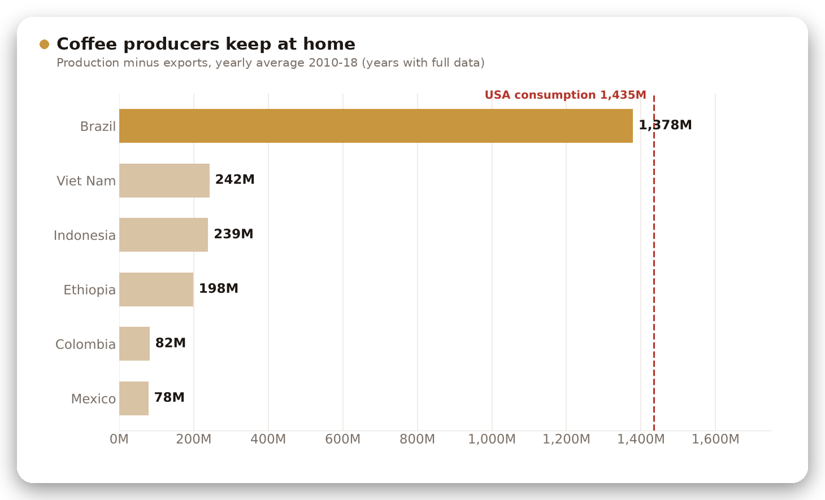
Brazil keeps almost as much coffee as the USA drinks
PRODUCERS
1,378M
kept in Brazil each year (production minus exports)
That is 41% of Brazil's output, close to USA consumption of 1,435M.
Ethiopia keeps 51% of its coffee and Indonesia 38%.
Producing countries are large markets too.

Slide 14

Importers
03
Imports, consumption and re-exports in 35 countries

Slide 15
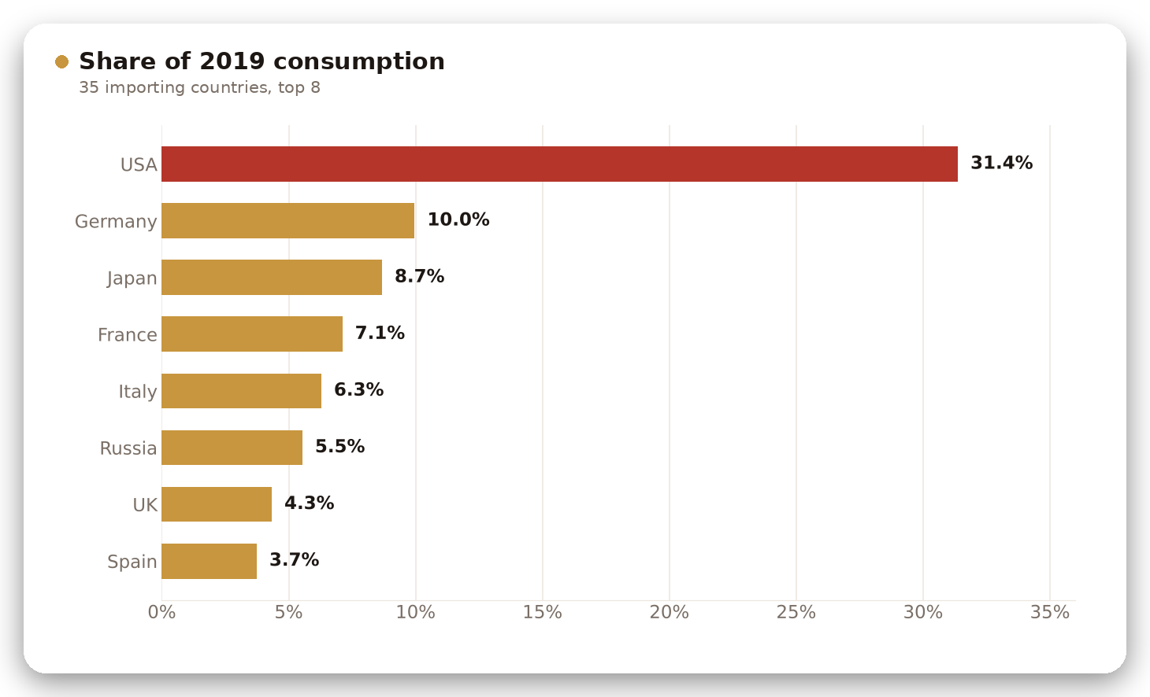
The USA drinks about a third of the importers' coffee
IMPORTERS
31.4%
of 2019 consumption is in the USA
Three times Germany's 10%.
Japan, France and Italy follow.
Russia has no data before 1992 and now ranks sixth at 5.5%.

Slide 16
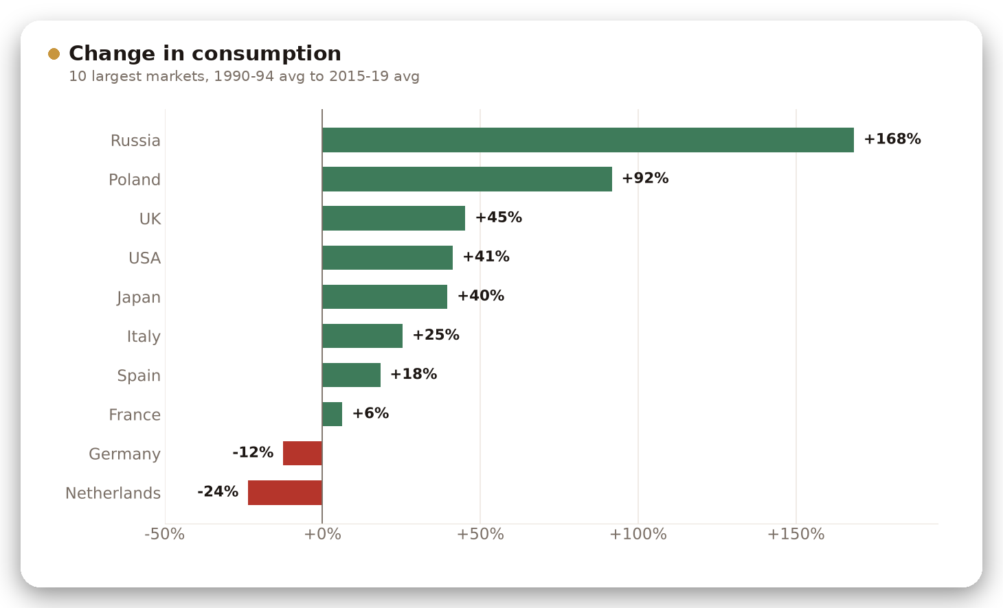
Germany and the Netherlands shrank; Russia grew most
IMPORTERS
+168%
Russia's consumption growth
Poland grew 92%, the UK 45%, the USA 41%.
Germany fell 12% and the Netherlands 24%.
Denmark, Hungary and Austria also fell.

Slide 17
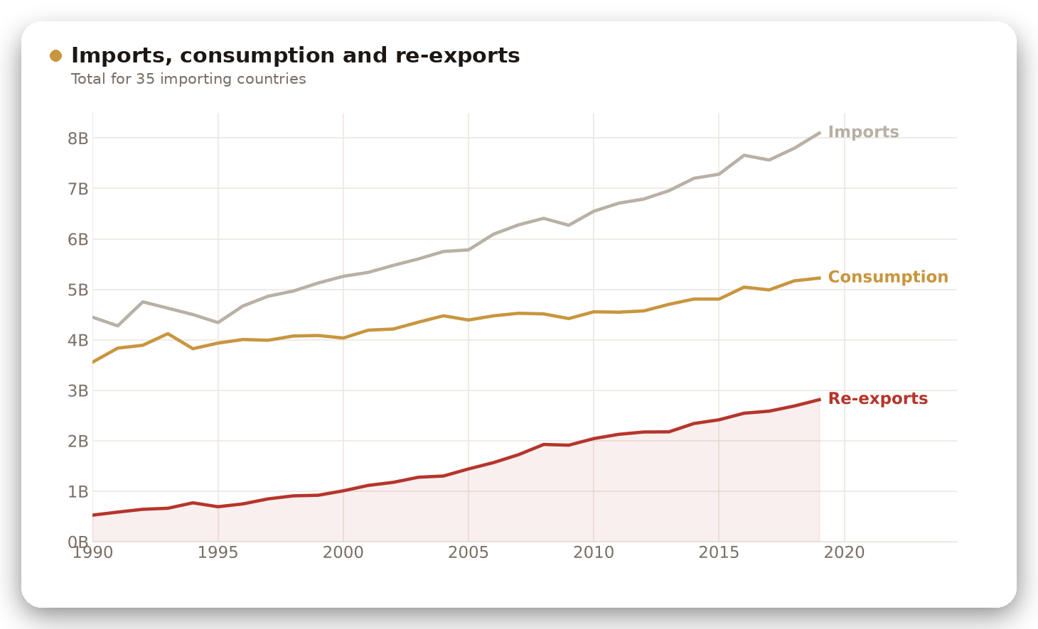
Most import growth is coffee passing through
IMPORTERS
63%
of import growth since 1990 was re-exported
Imports grew by 3.65B from 1990 to 2019.
Re-exports grew by 2.29B of that.
Consumption grew by only 1.66B.

Slide 18
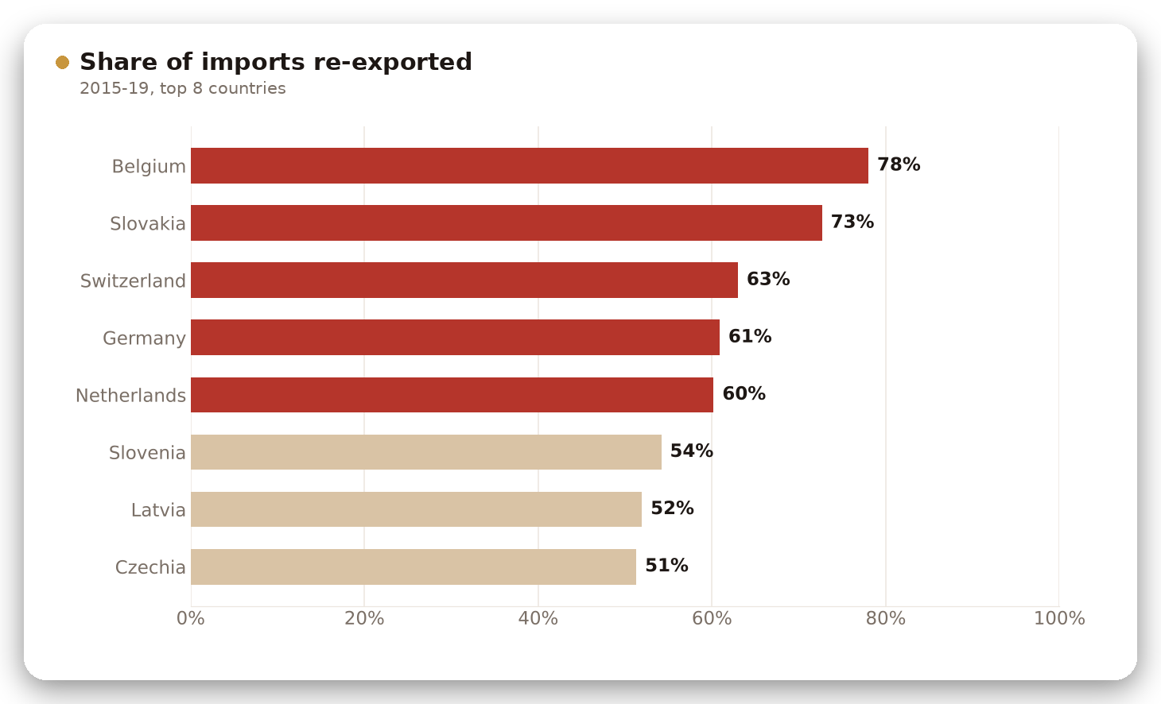
Belgium sends on 78% of the coffee it imports
IMPORTERS
78%
of Belgium's imports are re-exported
Germany, the Netherlands and Switzerland re-export about 60% or more.
For these hubs, imports overstate the home market.
Consumption is the better measure of demand.

Slide 19
Model and verdict
04
What predicts imports, and which markets look strongest

Slide 20
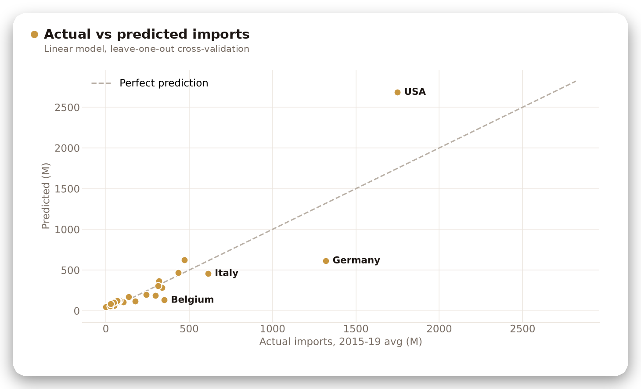
Consumption predicts imports, except for the hubs
MODEL
R² 0.66
linear model, leave-one-out test on 34 countries
Points on the dashed line are predicted perfectly.
Germany imports 1,320M but its consumption predicts 616M.
The gap is its re-exports.

Slide 21
Market scorecard: the USA, Japan and Italy rank highest
VERDICT
Rank | Country | Consumption 2015-19 | Growth since 1990-94 | Year-to-year variation | Score
1 | USA | 1,556M | +41% | 2.2% | 6.3
2 | Japan | 464M | +40% | 2.5% | 7.7
3 | Italy | 344M | +25% | 3.9% | 9.3
4 | Romania | 65M | +151% | 5.6% | 10.0
5 | United Kingdom | 216M | +45% | 8.2% | 11.7
6 | Croatia | 22M | +159% | 3.6% | 11.7
How the score works
Each market is ranked on size, growth and stability, and the three ranks are averaged. Lower is better.
Year-to-year variation is the typical yearly change in consumption, 2000-19. Russia and Poland grow fastest but swing 16-17% a year.

Slide 22
Call to action
05
A data-backed entry plan for a new coffee company

Slide 23
Four moves for a company starting out
CALL TO ACTION
1
Launch in a large, steady market
The USA, Japan or Italy. All are top-5 markets, grew 25-41%, and change only 2-4% a year.
2
Add a growth market next
Russia (+168%) or Poland (+92%). Faster growth, but demand swings 16-17% a year.
Scorecard ranks 1 to 3
Yearly swing 16-17% vs 2-4%
3
Source from two regions, not one
Brazil and Vietnam make 54% of all coffee, and Brazil's crop swings about 25% a year. Add a steady or rising origin: Ethiopia, Colombia or Honduras.
4
Distribute through a European hub
Belgium, the Netherlands and Germany already re-export 60-78% of their imports, so the routes to the rest of Europe exist.
Ethiopia +168%, swing 14% a year
Re-export share, 2015-19

Slide 24
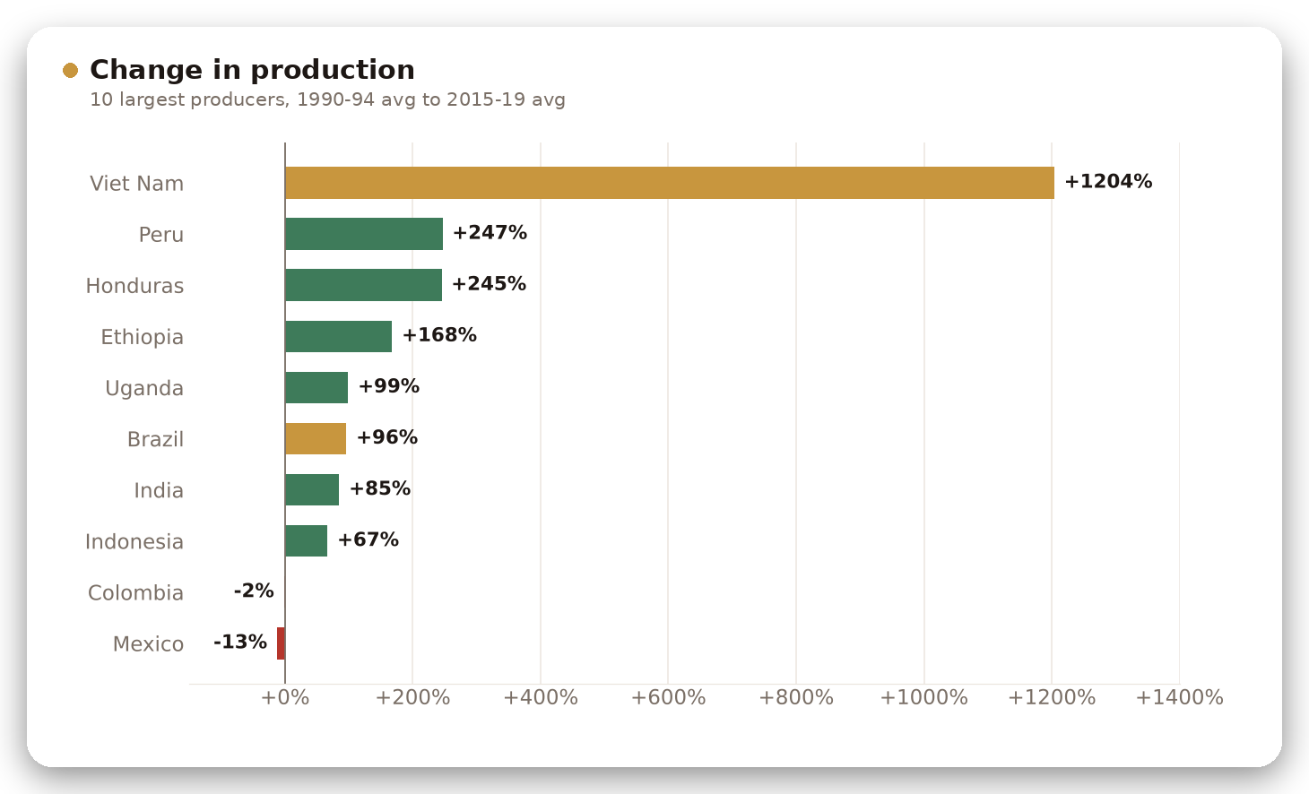
Rising origins can back up Brazil and Vietnam
SOURCING
54%
of 2019 output came from Brazil and Vietnam
Peru and Honduras more than tripled their output.
Ethiopia grew 168% and is now the #5 producer.
Colombia and Mexico did not grow.

Slide 25

CONCLUSION
What the data says
Supply Brazil and Vietnam now make over half the world's coffee.
Demand The USA is the biggest and steadiest market; Japan and Italy follow.
Growth Greece, Russia, Romania and Poland grew fastest among markets above 50M.
Supply risk Brazil's crop swings about 25% a year; India, Colombia, Mexico and Ethiopia are the steadiest big origins.

