Slide 1
Practical Quantitative Research & Algorithmic Trading
How modern trading firms use data, statistics and algorithms
Introduction to quantitative research
Understanding markets scientifically

Slide 2
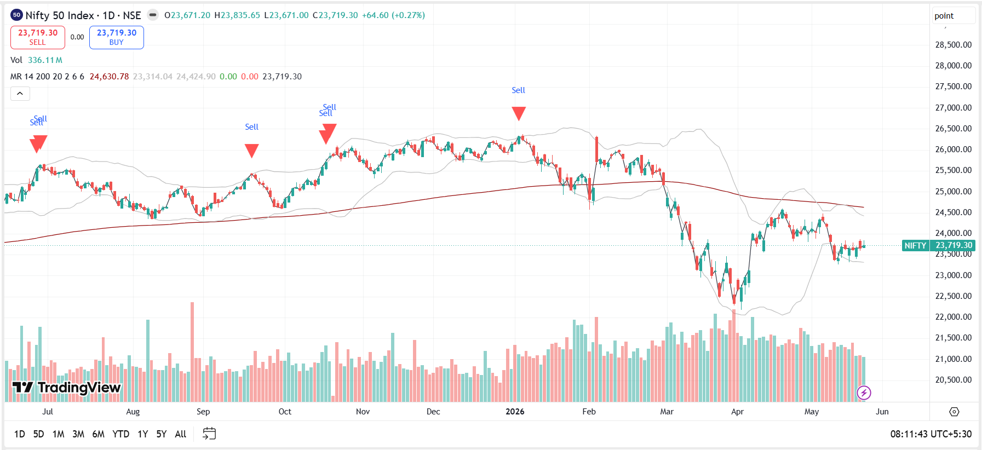
What is Quantitative Trading?
Using data to make trading decisions
Building algorithms from market patterns
Replacing emotions with systematic research

Slide 3
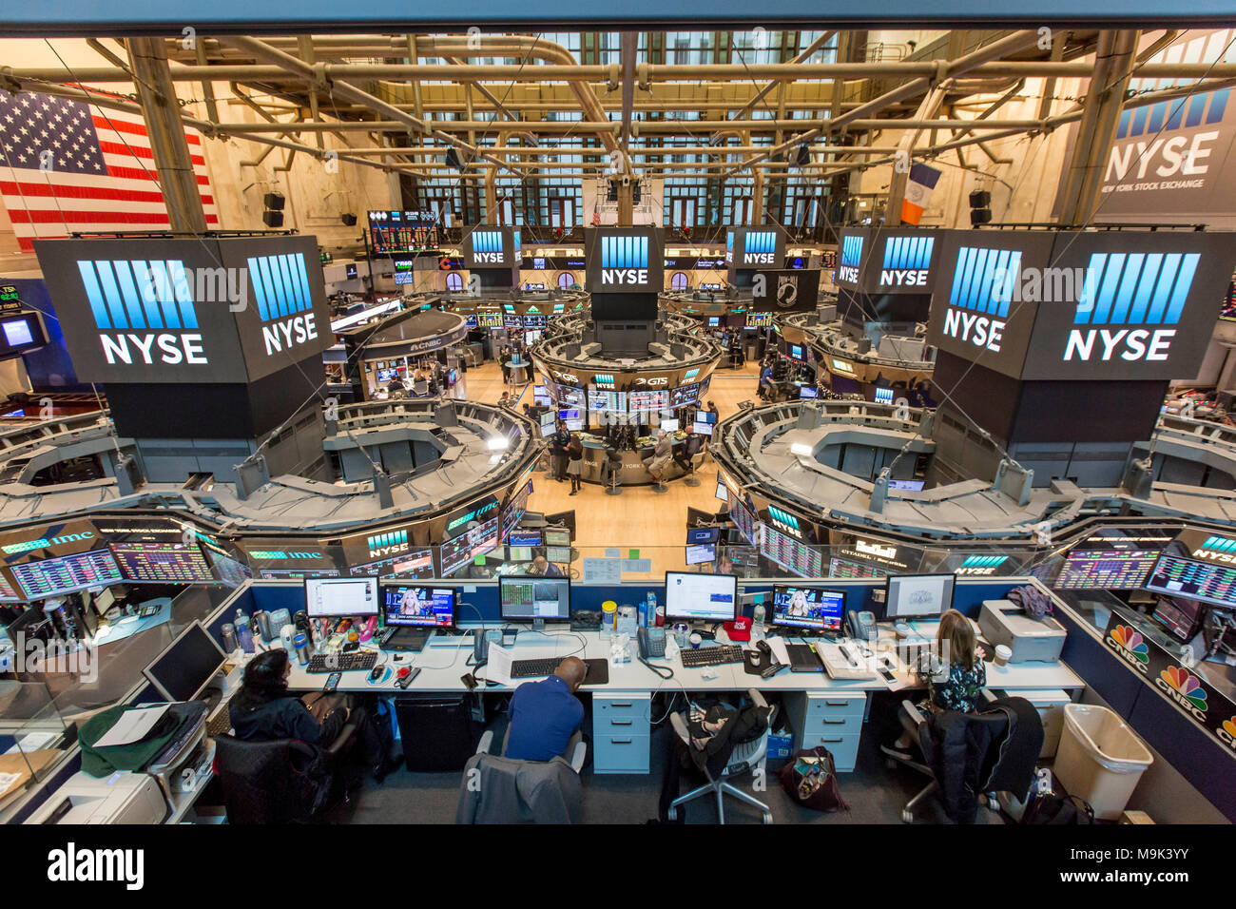
Traditional Trading vs Quant Trading
Traditional trading relies heavily on intuition and news
Quant trading relies on data, probabilities and testing
Modern firms increasingly automate trading decisions

Slide 4
Where Do We Use Prediction Systems?
Netflix recommendations
YouTube recommendations
Google Maps traffic prediction
Trading systems use similar data-driven logic

Slide 5
Why Financial Markets Exist
Investing for future growth
Speculating on prices
Managing and hedging risk
Providing liquidity to markets

Slide 6



Who Uses Quantitative Trading?
Jane Street
Citadel
Two Sigma
Jump Trading
WorldQuant

Slide 7
What Does a Quant Researcher Do?
Collect market data
Study statistical patterns
Build trading signals
Backtest strategies
Monitor performance and improve systems

Slide 8
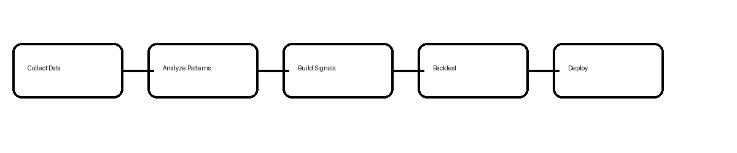
Quant Research Workflow
Collect Data
Analyze Patterns
Build Signals
Backtest
Deploy Systems

Slide 9
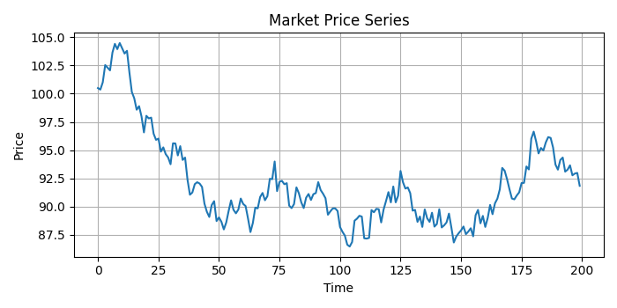
What is Alpha?
Alpha means a statistical edge
No signal works 100% of the time
Quant trading is probabilistic

Slide 10
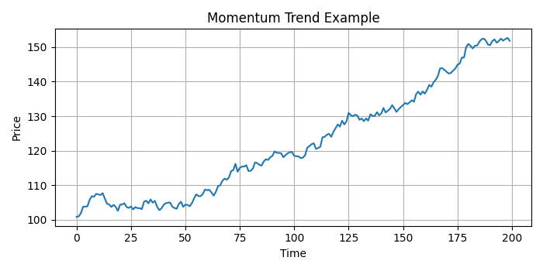
Momentum Example
Assets rising strongly may continue rising
Trends attract attention and buying pressure
Momentum is one of the most common trading signals

Slide 11
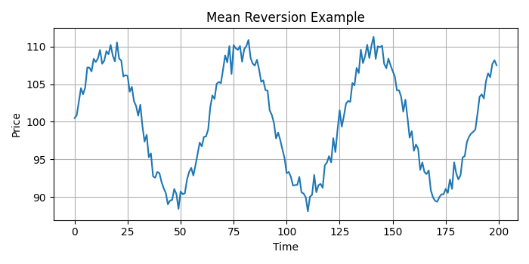
Mean Reversion Example
Markets sometimes overreact
Prices may move back toward normal levels
Human emotions create temporary inefficiencies

Slide 12
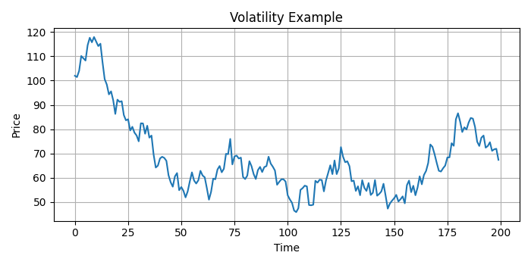
Why Quant Trading is Difficult
Markets constantly evolve
Competition is intense
Strategies decay over time
Transaction costs reduce profitability

Slide 13
What You Will Learn in This Course
Market data analysis
Alpha signals
Backtesting systems
Portfolio construction
Machine learning for trading
Quant infrastructure and KDB+/q

Slide 14
Key Takeaways
Quant Trading = Data + Research + Probability + Discipline
Good quant researchers think scientifically
The goal is systematic decision making

