Slide 1
Lecture 3 — Financial Time Series for Traders
Understanding market behavior using data

Slide 2
What is a Financial Time Series?
Data recorded over time
Markets generate continuous time-series data

Slide 3
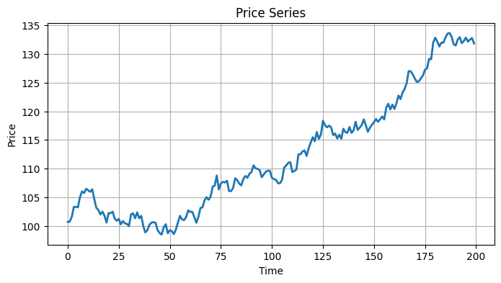
Prices vs Returns
Returns normalize movement
Returns allow fair comparison

Slide 4
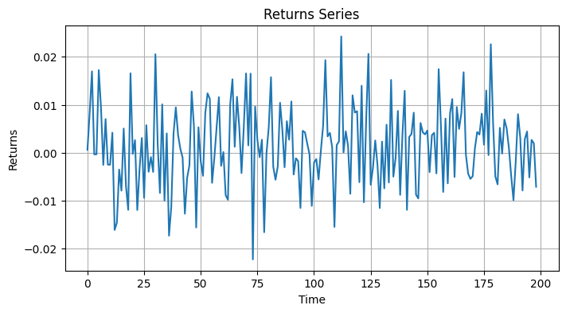
Return Formula
(New Price - Old Price) / Old Price

Slide 5
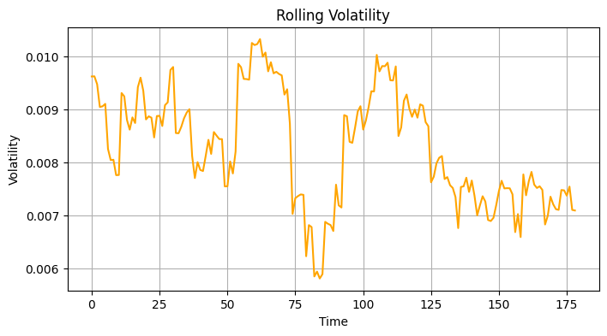
Understanding Volatility
Volatility measures fluctuation
Higher volatility means higher uncertainty

Slide 6
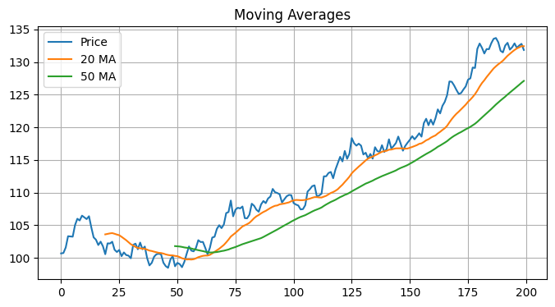
Moving Averages
Smooth noisy prices
20-day vs 50-day moving averages

Slide 7
Trend Following
Momentum strategies follow trends
Strong trends may continue

Slide 8
Mean Reversion
Markets sometimes overreact
Prices may return toward normal levels

Slide 9
Randomness & Noise
Not every movement has meaning
Researchers distinguish signal from noise

Slide 10
Quick Quiz
What are returns?
What is volatility?
Why use moving averages?

Slide 11
Lab Session
Compute returns
Estimate volatility
Build moving averages

Slide 12
Assignment
Build financial market dashboard

Slide 13
Mini Project
Simple trend-following system

