Slide 1
Lecture 4: Alpha Signals & Quant Research
What is Alpha?
Signal Types
Signal Evaluation
Research Workflow
Lab Walkthrough

Slide 2
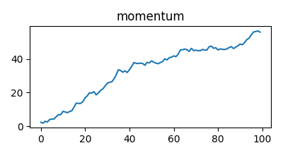
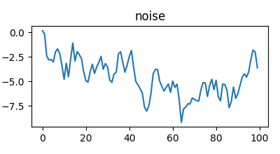
What is Alpha?
Alpha = predictive edge beyond benchmark returns
Goal: generate excess returns

Slide 3
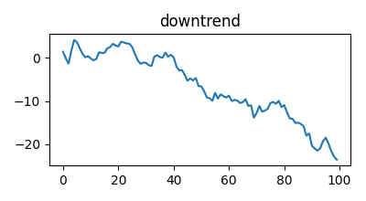
Why Might Alpha Exist?
Humans, institutions and liquidity create patterns
Information spreads gradually

Slide 4
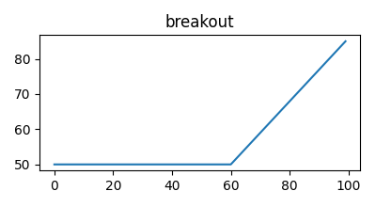
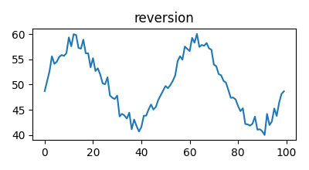
Examples of Alpha Signals
Momentum
Mean Reversion
Relative Strength
Breakout

Slide 5
Momentum Signals
Trend-following behavior
Moving average crossover
Breakout continuation

Slide 6
Momentum Strategy Example
BUY when short MA > long MA
SELL otherwise

Slide 7
Mean Reversion Signals
Extreme moves may reverse
Oversold bounce

Slide 8
Why Signals Fail
Overfitting
Changing markets
Transaction costs

Slide 9
Signal vs Noise
Markets contain random movement
Not every pattern is real

Slide 10
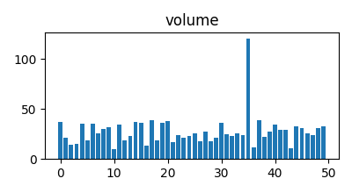
Major Signal Categories
Momentum
Reversion
Breakout
Volume
Cross-Sectional

Slide 11
Breakout Signals
Price breaks resistance
Volume confirmation

Slide 12
Volume Signals
Volume spikes may indicate institutional activity

Slide 13
Cross-Sectional Signals
Rank strongest vs weakest assets

Slide 14
Feature Engineering
Convert raw data into features
Returns, volatility, volume

Slide 15
Combining Signals
Combine weak signals to improve robustness

Slide 16
Signal Decay
Signals weaken as markets adapt

Slide 17
No Perfect Signal
All strategies have drawdowns

Slide 18
The Biggest Problem
Is the signal real or random?

Slide 19
What is Backtesting?
Testing strategies on historical data

Slide 20
Why Backtests Mislead
Overfitting
Look-ahead bias

Slide 21
Overfitting
Fitting noise instead of true signal

Slide 22
Hit Rate
Percentage of profitable trades

Slide 23
Average Return Per Trade
Measure average profitability

Slide 24
Signal Stability
Strategies behave differently across regimes

Slide 25
Signal Decay (Evaluation)
Alpha may disappear over time

Slide 26
Information Coefficient
Measures predictive relationship

Slide 27
Transaction Costs
Spread
Commissions
Slippage

Slide 28
Good Quant Research Mindset
Skeptical
Experimental
Data-driven

Slide 29
Quant Research Pipeline
Idea → Data → Features → Signals → Backtest

Slide 30
Idea Generation
Research begins with observations

Slide 31
Hypothesis Formation
Create testable market assumptions

Slide 32
Data Collection
OHLCV
Volume
Macro Data

Slide 33
Feature Engineering Workflow
Transform raw data into predictive inputs

Slide 34
Signal Construction
Convert features into BUY/SELL logic

Slide 35
Backtesting Workflow
Apply strategy rules on historical data

Slide 36
Validation
Test robustness across market conditions

Slide 37
Research Iteration
Improve and retest strategies

Slide 38
Why Most Ideas Fail
No predictive power
Crowding

Slide 39
What Makes a Good Quant Researcher?
Curious
Disciplined
Patient

Slide 40
Key Takeaways
Alpha is probabilistic
Research is iterative

Slide 41
Lab: Building Alpha Signals
Load data
Compute returns
Generate signals

Slide 42
Momentum Strategy Lab
Moving averages
Signal generation

Slide 43
Mean Reversion Strategy Lab
Rolling mean
Deviation threshold

Slide 44
Strategy Comparison
Compare cumulative returns

Slide 45
Lab Summary
Built and evaluated alpha signals

Slide 46
Thank You
Questions & Discussion

